Slide 1



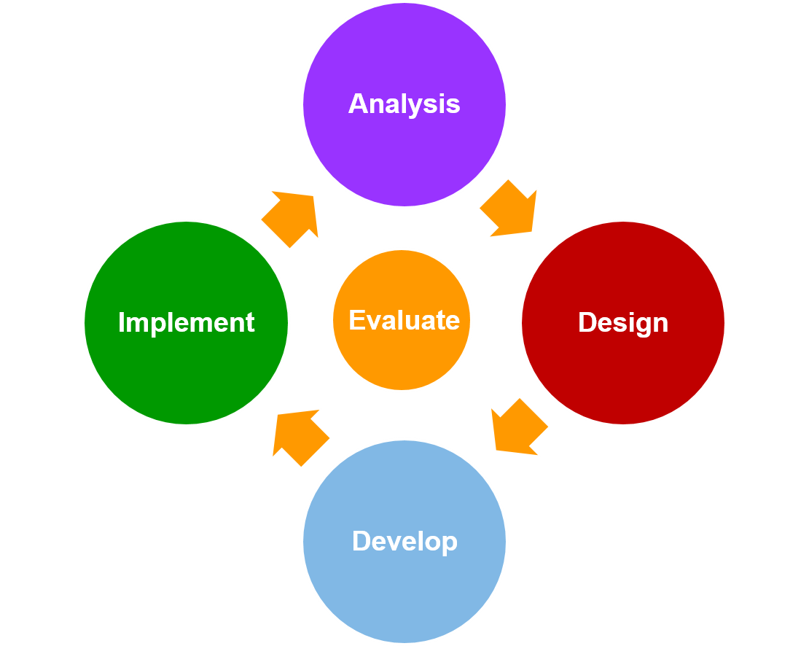
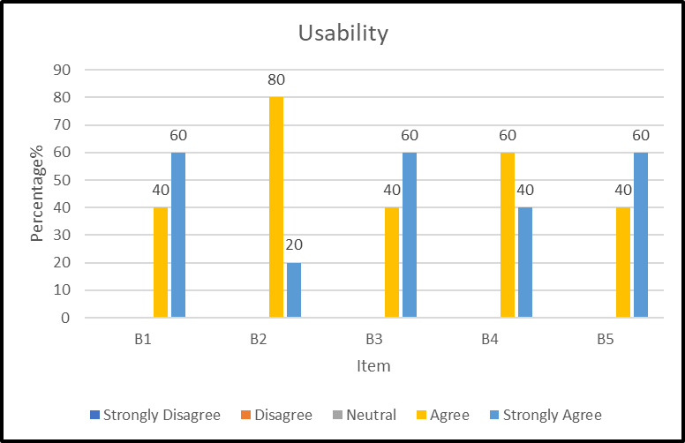

PENGURUSAN JENAZAH COURSEWARE
ADAM BIN ZULKIFLI
INSTITUTION
ABSTRACT
This study aims to develop and evaluate a computer assisted teaching and learning courseware CD-ROM based on tutorial approach entitled Pengurusan Jenazah Courseware. This courseware is provided based on the course syllabus of standard 5 “Ibadat” subject at Sekolah Agama Seri Pantai Mersing Johor. The courseware is developed based on the ADDIE instructional design model. This courseware has also adopted the concept of teaching and learning. e courseware is developed based on the ADDIE instructional design model The courseware is developed based on the ADDIE instructional design model
PROBLEM STATEMENT
OBJECTIVE
The level of understanding quite low among students for the topic of pengurusan jenazah.
Students to become less interested and quick to get bored.
Lack of teaching aids and tools to assist teachers in informing the topic .
To identify the current problem and requirements in learning Islamic funeral management for standard 5 students.
To develop and design learning Pengurusan Jenazah Courseware for standard 5 students.
To evaluate the functionality and usability of the courseware.
FINDINGS & RESULT
METHODOLOG1Y
FINDINGS & RESULT
Student
Can learn do exercise easily and can learn in detail every step related to how to manage Islamic remains
Teachers
Can give more attention to the student through teaching method like this
BENEFITS
NOVELTY
BENEFITS
Using the ADDIE model, it can clarify the process step-by-step to complete the software that includes the analysis phase, design phase, development phase, implementation phase and the final one is evaluation phase. With the use of this model to produce Pengurusan Jenazah Courseware for Standard 5 Students, it ensures the effectiveness of the courseware developed.
COMMERCIALIZATIO
COMMERCIALIZATION
CONCLUSION
Allow student to learn about pengurusan jenazah anytime using PC guided by the teacher.
Notes and some simple video making it easy for students to learn.
Pengurusan Jenazah Courseware can give the students and their teachers benefits. The learning process is interactive using this courseware. In addition, this courseware has a several aspects need to improve and repair for future enhancement. For improvements, it takes a long period to produce a better structure and extra features.

