Slide 1



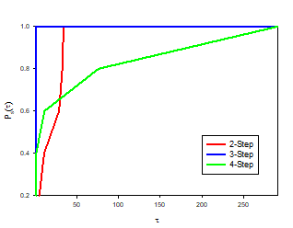
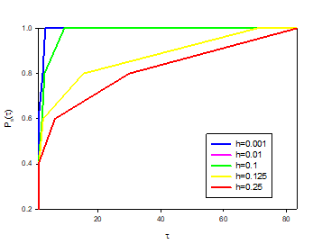
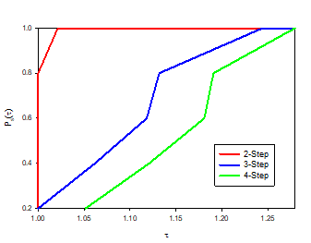
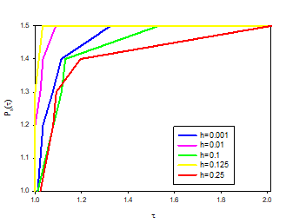

SOLVING FIRST ORDER ORDINARY DIFFERENTIAL EQUATION USING IMPLICIT MULTISEP ADAMS-MOULTON METHOD
SITI NUR AISYAH BINTI ISA
UiTM Kuala Terengganu
Adams-Moulton method is a numerical method to approximate the solution of differential equations. This method is also known as a multistep method that requires the use of another numerical method at the first few steps depending on its step. In this research, the Adams-Moulton method in the form of 2-Step, 3-Step, and 4-Step together with the Fourth Order Runge-Kutta method and Adams-Bashforth method are used to estimate the solution of the first-order ordinary differential equation. This research aim is to compare the efficiency between different versions of the Adams-Moulton multistep method in terms of the central processing unit (CPU) time and error analysis.
ABSTRACT
PROBLEM STATMENT
OBJECTIVE
The main problem is to find the correct formula to be used and blend which is the Runge-Kutta and Adams-Moulton method. It is still unknown which version of the Adams-Moulton multistep method is the best to approximate the solution of ODE numerically. Hence, this study tries to compare the accuracy and performance of a different version of the Adams-Moulton method.
To solve the first-order ODE using theoretical methods.
To solve the first-order ODE numerically using the Adams-Moulton method.
To analysis the efficiency of the Adams-Moulton version to solve the first-order ODE.
To determine the best Adams-Moulton multistep method for solving first order ODE.
METHODOLOG1Y
FINDING&RESULT
Firstly, the selected for the first order ODE problems comes from different functions such as trigonometric, polynomial, exponential, logarithm, and rational function. The purpose of different first-order ODE problems that combine all these functions is to observe the behavior of the Adams-Moulton method. Then, the software used in this study is Maple 17. This software is known to give higher efficiency results, and it may help to gain a deeper insight.
However, the programming code constructed is tested. If there is an error that appeared in the codes, further correction is needed until the approximate solution is obtained. After that, two ways to solve the first-order ODE problems. The first is through the theoretical method and the second is through the numerical method.
Later on, all the results are analyzed based on the percentage of relative error for each version of the Adams-Moulton method and also compared based on CPU time.
The conclusion is also made to see whether the objective of this research is achieved based on errors and CPU time analysis for each Adams-Moulton method.
The result concluded that Adams-Moulton 3-Step method is the best solver based on error analysis and that the best step-size to be used is 0.001. Besides that, this Adams-Moulton 2-Step complies with the best performance profile rules as it is the upper curve on the left which means that it has the fastest CPU time in solving ODE problems and the best step-size for CPU time is to be used in 0.125.
CONCLUSION
In conclusion, several ODE problems have been solved using the theoretical method. All these ODE problems had been solved successfully. Therefore, the first objective of this research is achieved. Later on, the programming code of the Adams-Moulton method is coded using Maple17 software. All the coding problem has been run successfully. All the numerical results based on the approximate solution and CPU time are recorded. Therefore, the second objective of this study which is to solve ODE problems numerically has been fulfilled. The recorded CPU time is also analyzed to determine the fastest way to get a close solution. Performance profiles based on error and CPU time analysis have been successfully compiled. Thus, the three objectives were fulfilled.
BENEFITS
Based on the multistep Adams-Moulton results, it will help researchers to give conclusions on which methods are good to apply in other areas of research. It is also useful for researchers because the solution uses less time where the results can be obtained immediately. This project is expected to benefit other researchers to use the best Adams-Moulton method in terms of and can be used for further research.

