Slide 1


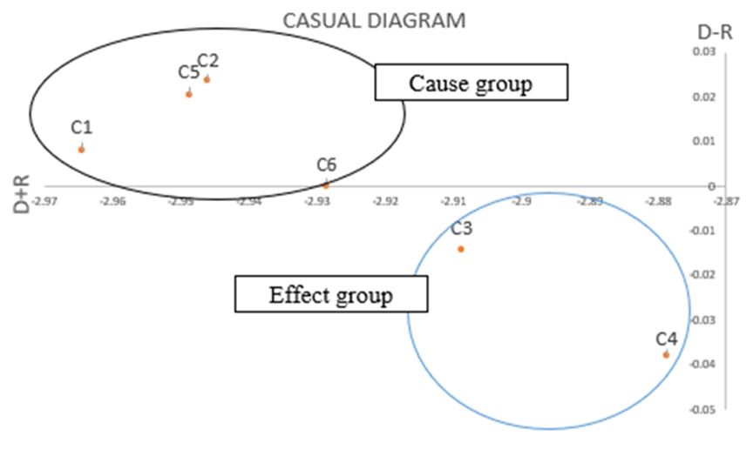

AN APPLICATION OF FUZZY DEMATEL ON FINANCIAL MISMANAGEMENT AMONG STUDENTS
AMIRUL SHAFIQ BIN MOKTHAR
UNIVERSITI TEKNOLOGI MARA KAMPUS KUALA TERENGGANU
ABSTRACT
Most university students in Malaysia facing problems managing their own money. In this research , fuzzy DEMATEL was applied to study cause and effect of financial mismanagement among students. The directed influential degrees between pairwise criteria are indicate in triangular fuzzy numbers is used in the DEMATEL method. Six criteria were discussed in this research.
PROBLEM STATEMENT
OBJECTIVE
The increase in the cost of living require students to manage their financial well.
This problem affect students’ learning process.
High percentages of students who fail to manage their finances.
To apply a fuzzy DEMATEL METHOD on the financial mismanagement
To identify the cause group and the effect group in the Causal Diagram.
To determine the ranking of each criterion that contributed to the financial mismanagement among students.
METHODOLOGY
START
STEP 1 : Determination of criteria and linguistic value
STEP 2 : Design questionnaire
STEP 3 : Compile students’ evaluation & construct average direct relation matrix
STEP 4 : Defuzzification with CFCS method
END
STEP 8 : Build up a Casual Diagram
STEP 7 : Determination of fuzzy weight of the criteria
STEP 6 : Calculating Fuzzy Affecting and Effected Factor
STEP 5 : Creating Fuzzy Total Relation Matrix
FINDINGS & RESULT
Rank | Criteria | Symbol
1 | Spending Behaviour | C1
2 | Financial Independence | C5
3 | Financial Behaviour | C2
Rank | Criteria | Symbol
4 | Financial Status and Psychology | C6
5 | Lack of Financial Literacy | C3
6 | Financial Distress | C4
BENEFITS
CONCLUSION
This research may be beneficial to students who want to manage their finance well. They will know the criteria that were causing and effecting the financial mismanagement. They also can improve their financial status with the guidance from ranking criteria. This research may help a lot to those who struggling with financial since students need a lot of money to survive in university’s life.
The fuzzy DEMATEL is great tool to analyse correlation among factors. Result from this research shows that there were four criteria in the cause group and two criteria were in the effect group. Meanwhile for ranking, spending behaviour was ranked at the first. This result may help students who struggling with financial problem to plan their financial wisely.

