Slide 1


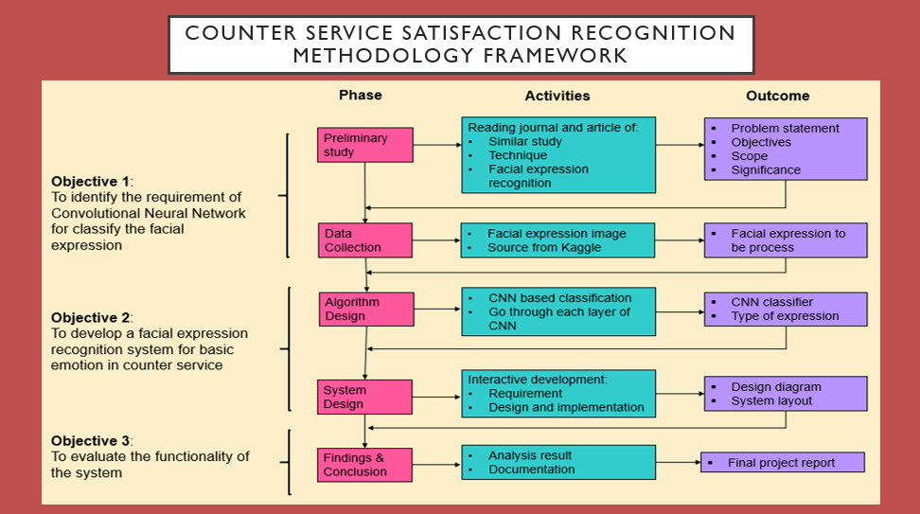
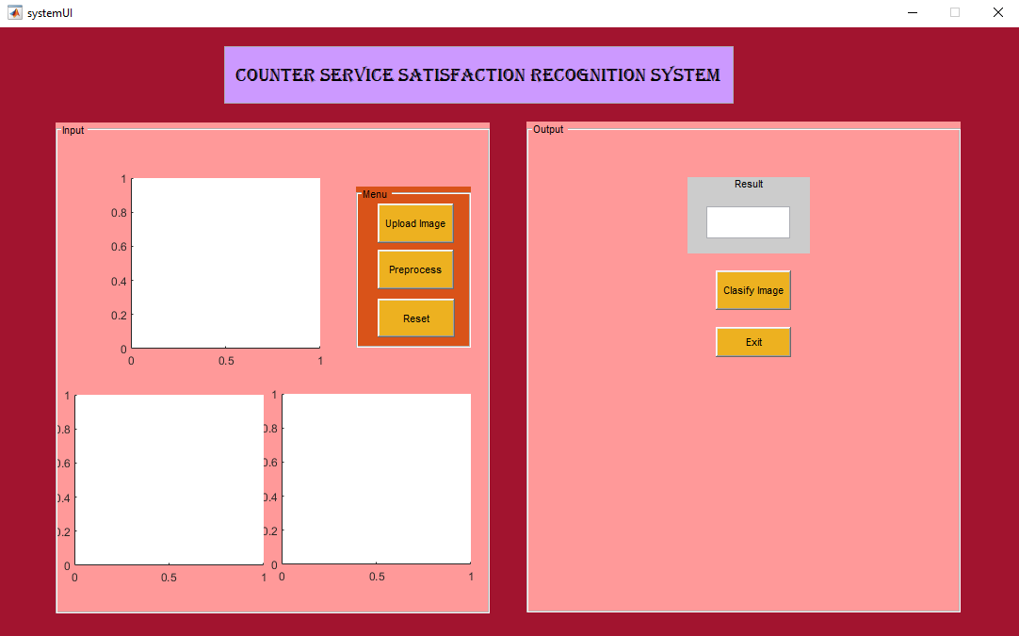
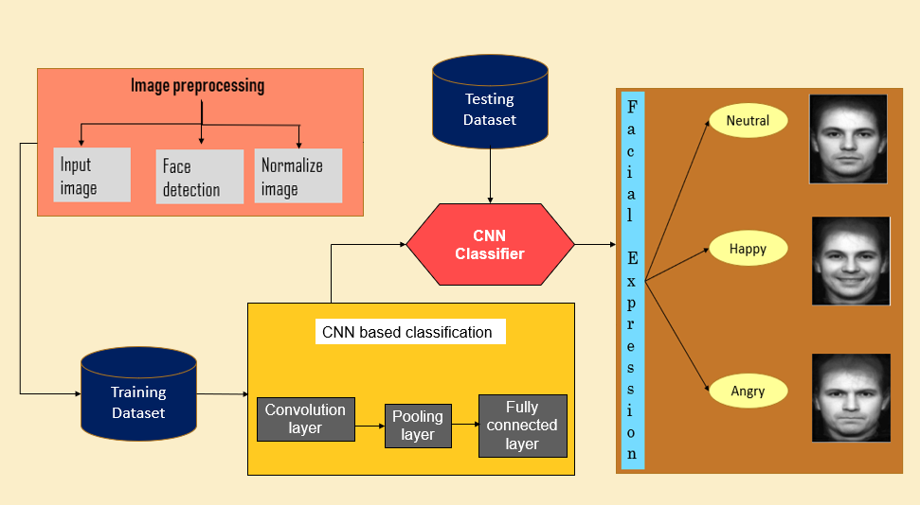

COUNTER SERVICE
SATISFACTION RECOGNITION USING
CONVOLUTIONAL NEURAL NETWORK (CNN)
RAHIL AMIERA BT MUSTAFA BAKRIM
HAMIDAH BT JANTAN
Introduction
Facial Expression Recognition (FER) is the latest technology using human’s expression. This FER is classified as biometric software that capture human’s facial feature as an input to the future learning. In this deep learning era, FER is widely used in many fields including in recognizing the satisfaction of people towards the services at any counter services. By implement the Convolutional Neural Network (CNN) as an algorithm, it will provide the best result for the classification of the facial expression. For that reason, in this study, Counter Service Satisfaction Recognition using Convolutional Neural Network (CNN) has been proposed to recognize the expression so that it can assist the staff at the counter to gain the correct feedback’s result about their services.
Objectives
Experiment Setup
To identify the requirement of CNN for classify the facial expression.
To develop facial expression recognition system for basic emotion in counter service.
To evaluate the functionalities of the proposed system.
The experiment has been done to find the best classifier. For the result, the experiment conducted shows that the set of 80:20 spilt produced the highest accuracy.
Methodology
Training data | 150
Data spilt | 80:20
Number of layers | 3
Max epoch | 10
Mini batch size | 64
Learning rate | 0.0001
Accuracy rate | 0.7778
There are a few phases in this project methodology framework that helps to achieve the three main objectives in this project.
Prototype System
A proposed prototype system is user-friendly system for Counter Service Satisfaction Recognition and easy to use by the user.
Results and Findings
Conceptual Framework
The proposed CNN architecture for Counter Service Satisfaction Recognition System for classification of human expression into happy, neutral, and angry.
Conclusion
In conclusion, the objectives discussed has been achieved in guiding on the development of this project. On the other hands, the limitations have been detected together with its recommendation for the future improvement of the upcoming system.
RAHIL AMIERA BT MUSTAFA BAKRIM
FACULTY OF COMPUTER AND MATHEMATICAL SCIENCES
UNIVERSITI TEKNOLOGI MARA (TERENGGANU)
HAMIDAH BT JANTAN
FACULTY OF COMPUTER AND MATHEMATICAL SCIENCES
UNIVERSITI TEKNOLOGI MARA (TERENGGANU)

