Slide 1



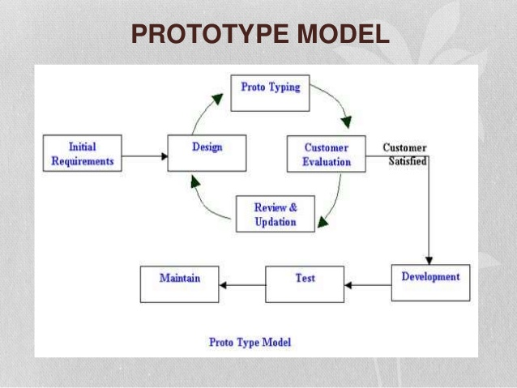
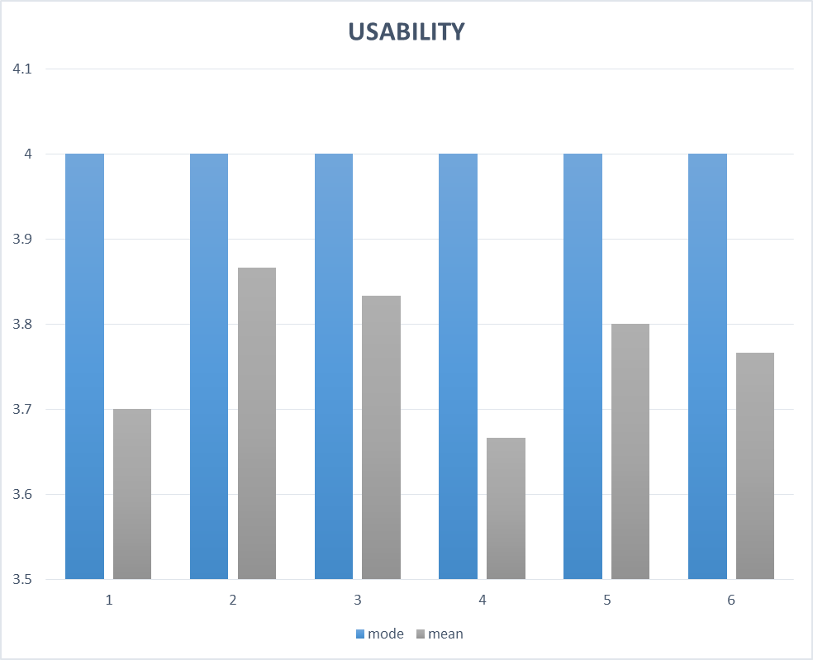
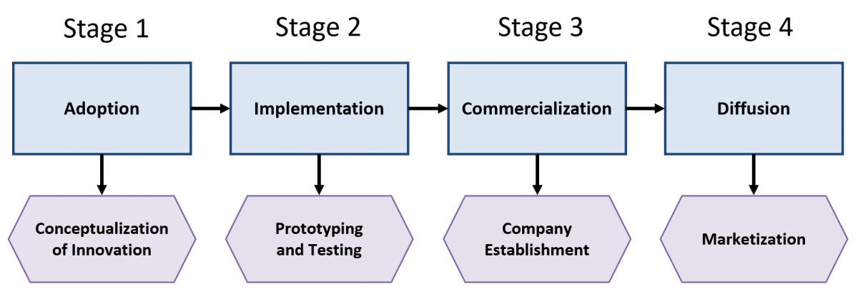

FAWANI ONLINE PARTY BOOKING SYSTEM (FOPABS)
FARAH HANUM BINTI ISMAIL, DR HASIAH BINTI MOHAMED@OMAR
Faculty of Computer and Mathematical Sciences
Universiti Teknologi MARA (UiTM)
ABSTRACT
Fawani Online Party Booking System (FOPABS) is a system for booking process for Fawani Florist Sdn Bhd. This system is to ease the process for manage all booking for event planner, customer and runner. Currently, the users are booking event or party manually. Prototype Model is used as a guidance to build this system. In Prototype Model, there have several processes which starting with requirement gathering and analysis, quick design, build prototype, user evaluation, refining prototype and engineer product. The objectives of this project to identify the current practice, problems and requirement in making booking process, to design and develop a system to assist booking process in company and to evaluate functionality and usability of the system.
The system has been tested by two (2) expert users and thirty (30) respondents. There are eighteen (18) female respondents and twelve (12) male respondents participated in answering this survey that had distributed through Google Form. A total of 30, female and male between 24 and above years of age randomly selected to be the respondents of the study. In conclusion, some recommendations have been included in the final part of the report to enhance the quality of this project and also for future research.
PROBLEM STATEMENT
OBJECTIVE
Record all data manually in log book.
Take 10 to 15 minutes to identify and update available time and date to customer.
Sometime take 45 minutes to 1 hour to get respond from event planner and did not get many information about package.
To identify current practise, problems and requirements in making booking process.
To design and develop a system to assist booking process in company.
To evaluate the functionality and usability of the proposed system.
METHODOLOG1Y
FINDINGS & RESULT
FINDINGS & RESULT
BENEFITS
NOVELTY
BENEFITS
Easier and faster to book event or party
Meet the new self-service portals
Work in 24/7
Get smarter insights into business
There are runners who can help the event planner to complete the entire activity.
Can check the availability of time and place without waiting for the owner's response.
COMMERCIALIZATIO
CONCLUSION
COMMERCIALIZATION
As a conclusion, this system was completed as to help owner to manage customer’s booking and runner also can help owner to complete all activity. Using UCD as a chosen theory was the best to complete the system.

