Slide 1



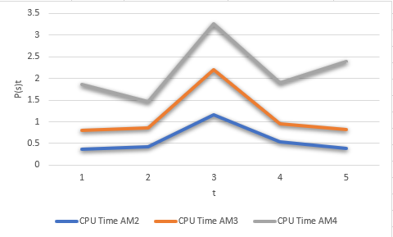

EMBEDDED NUMERICAL METHOD FOR EARLY STEPS OF
ADAMS-MOULTAN METHOD IN SOLVING FIRST ORDER ORDINARY DIFFERENTIAL EQUATION
NUR ALIFAH ILYANA BINTI RASIDI
UNIVERSITI TEKNOLOGI MARA KUALA TERENGGANU
ABSTRACT
Adams Moulton method is a numerical method to approximate the solution of differential equation and known as multistep method that requires the use of other numerical methods at the first few steps depending on its step. Different types of Adams Moulton method with Fourth Order Runge-Kutta method are used to estimate the solution of first order ODE.
PROBLEM STATEMENT
OBJECTIVE
A theoretical method is complicated and has a longer calculation compared to the numerical method.
To find the correct formula to be used and blend together.
To solve the first order ODE theoretically using theoretical methods.
To solve first order ODE numerically using Adams-Moulton methods.
To analyze the efficiency of Adams-Moulton method for solving first order ODE.
To determine the best Adams-Moulton multistep method for solving ODE.
METHODOLOG1Y
FINDINGS & RESULT
This research explained about the fundamental of theoretical and numerical method to solve the first order ODE problem. In this research, Adams Moulton method together with RK4 method has been selected to solve first order ODE problems numerically.
The result concluded that Adams Moulton 2-Step method is the best solver based on CPU time analysis.
By referring to the result, it shows that the step-size of 0.25 is the best solver because it is the lower line.
It is concluded that the best method is Adams Moulton 2-Step with the step size of 0.25.olver based on CPU time analysis.
BENEFITS
BENEFITS
It can be decided which method is better to be used for future research.
It will help researcher to give a conclusion on which method is good to be applied in other area of research.
Useful for the researcher since the solutions used less computation time where the result can be obtained immediately.
COMMERCIALIZATIO
CONCLUSION
Maple16 software has been used to created programming code to find the solution numerically.
The CPU time is analyzed to determine the fastest method to obtain the approximate solution.
Performance profile based on CPU time analysis has been successfully plotted
The best method in terms of accuracy is Adams Moulton 2-Step method with a step size of 0.25

