Slide 1


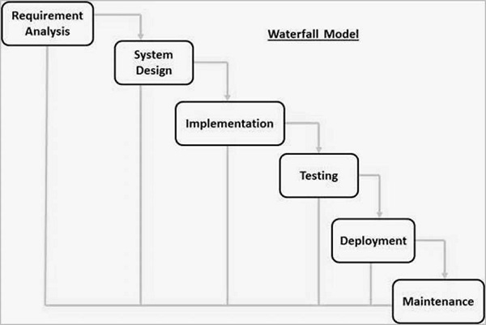

Bangsal Chetak Order Processing System
FAZNUR FARHANAH BT ZAINOL NAHAR
UNIVERSITI TEKNOLOGI MARA KAMPUS KUALA TERENGGANU
ABSTRACT
Bangsal Chetak Order Processing System (BCOPS) is a prototype system that caters sales order system. Allowing the customers to order products and make payment for the purchase. This system also applies the Human Computer Interaction principles as the theory for developing the system. This prototype system is derived from the development process conducted by adapting the Waterfall Model of the SDLC
PROBLEM STATEMENT
OBJECTIVE
The company do not have their own official business website
Order unorganized conducted with paper-based management
The staff unable to know the number of products available
To identify the current business process and the problem arises from the process
To design and develop an order processing system for Bangsal Chetak
To evaluate the functionality and usability of the proposed system
METHODOLOGY
FINDINGS & RESULT
The overall task completion rate is 80% while the minimum rate for a good system is 78%, meanwhile the average time-based efficiency is 0.194 goals/sec showing that the user manage to complete the task within short period of times.
Adapted Waterfall Model
BENEFITS
NOVELTY
BENEFITS
The Order Processing System that is developed for Bangsal Chetak would be the first system that the business will implement for making an online presence to gain larger number of customers thus supporting the business to go for the next step
A platform for the business to make an online presence where they can market their product in an appropriate ways
The system allowing the business to manage their order management in computerized system
Customer can choose various printing based products
COMMERCIALIZATIO
CONCLUSION
COMMERCIALIZATION
Simple web design, and easy to learn. Novice customers also can understand how the system flows.
The order processing system for Bangsal Chetak Company is an order processing website that allows customers to buy from various categories of the products listed by the company. The positive response from the targeted users shows that their satisfy with the system.

