Slide 1
Space facility reservation system for rakan muda larut matang & selama
PREPARED BY :
NOR AZURA HAZLINA BT KAMIS
SUPERVISOR NAME:
MUHAMMAD ATIF BIN RAMLAN

Slide 2
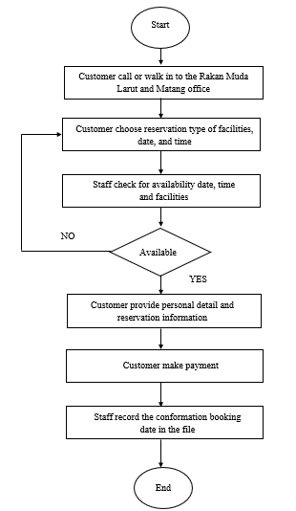
Current Business Process
Background of study
Case Study:
Rakan Muda Larut Matang & Selama Office
Area of Interest:
Management Information System
Domain:
Reservation Management System
Theory:
Shneiderman's Eight Golden Rules

Slide 3
PROBLEM STATEMENT
Problem Statement | Proposed Solution
Take time for the staff to find existing data about reservation that have been made | Develop a system where staff can easily view the reservation information.
Have some potential of misplacing the data since they only use filling system to keep the data. | The system will store the customer and reservation information in a proper database.
Occurs duplicate in reservation | The system will allow the customers to check the availability of the place, date and time before make the reservation.

Slide 4
OBJECTIVES
To identify the problems with the current reservation process for Rakan Muda Larut Matang & Selama office
To design and develop a Space Facility Reservation System for Rakan Muda Larut Matang & Selama office.
To evaluate the functionality and usability of the Space Facility Reservation system.

Slide 5
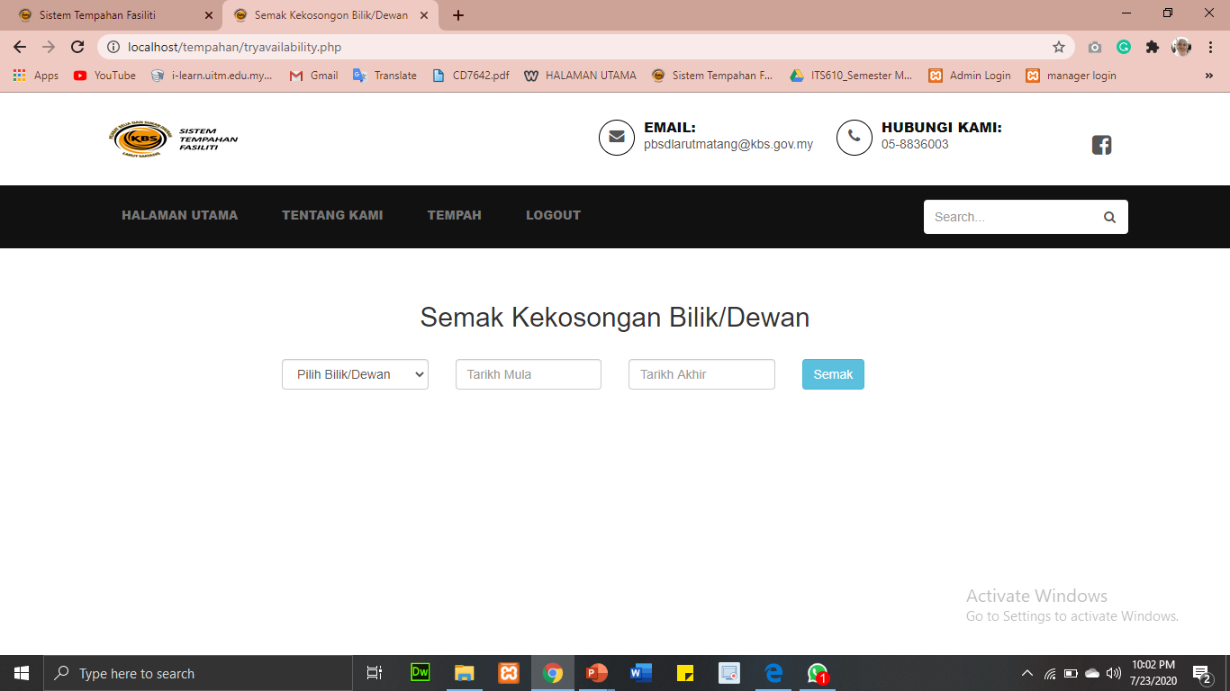
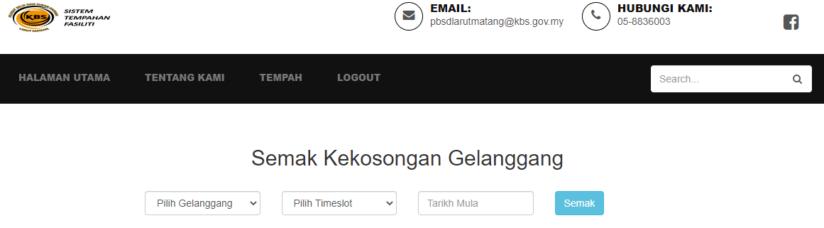
IMPLICATION THEORY IN SPACE FACILITY RESERVATION SYSTEM FOR LARUT MATANG & SELAMA OFFICE
CHARACTERISTTIC | DESCRIPTION
1. Strive for consistency | This mean to achieve or to aim for the consistency of the program interface, how the interface looks and detail of the layout of the program. For example, the banner for all page should be same in term of size or colour to avoid confusion.

Slide 6
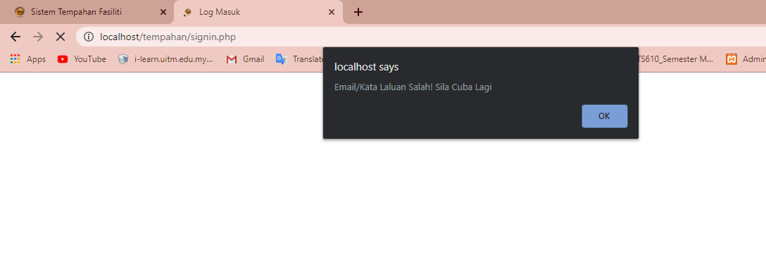
CHARACTERISTTIC | DESCRIPTION
2. Offer simple error handling | Careful design that will prevent users from making mistakes such as by providing extra information about what information is needed when filling the forms. For example, error prevention is happened when the user input the invalid username or password. There will notify the users by displaying the message that user has key in the wrong username and password

Slide 7
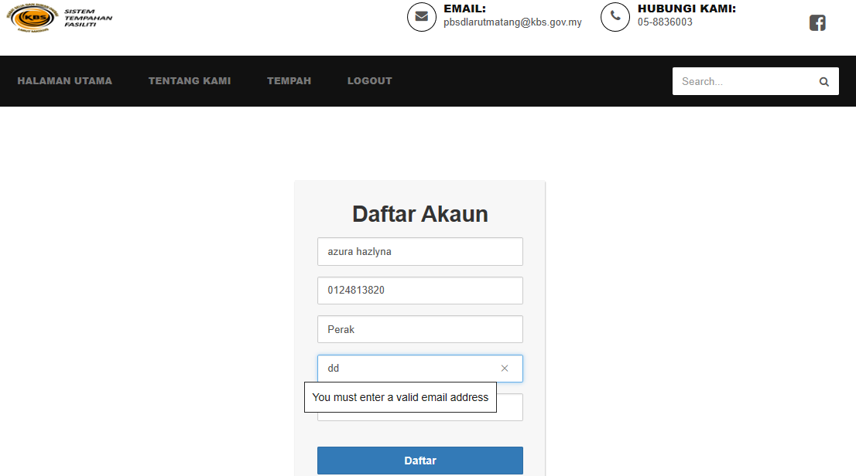
CHARACTERISTTIC | DESCRIPTION
3. Offer informative feedback | Feedback is very important as they will be message box guiding the what to do. When the user did not input the right format, they will be message box guiding them what to do.

Slide 8
THANK YOU !

