Slide 1

STUDENT’S PARCEL TRACKING AND MANAGEMENT SYSTEM FOR KERAWANG’S COLLEGE UiTMKT
Prepared by:
FARAH IZZIATI BT ROSHIDAN
Supervised by:
MUHAMMAD ATIF BIN RAMLAN

Slide 2
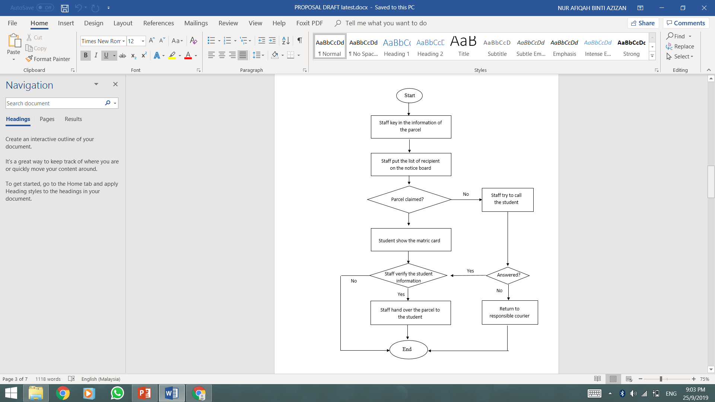
Background of Study
Case Study: Kerawang’s College at UiTMKT
AOI: Management Information System
Domain: Parcel Management System
Theory: Application Programming Interface
(API)
PROBLEM STATEMENT
Objectives
To study the current business process of parcel management at Kerawang’s College office, UiTM Campus Kuala Terengganu.
To design and develop a web-based parcel management system for Kerawang’s College office.
To evaluate the functionality and usability of the proposed system.

Slide 3

PROBLEM STATEMENT
Problem Statement | Proposed Solution
There is no record for recipient information that can be access by the staff. | A web-based system are developed to help the staff to gather all information in a proper database so that it will reducing the potential of misplacing the data or information.
Occur a redundancy of student’s name in the list. | The system allows the staff to check the student’s name more accurately. So that it can reduce the redundancy of the data.
The staff notify the student regarding their parcel through a piece of paper on a Kerawang’s College notice board. | The system will help the student to view their parcel information easily.

Slide 4
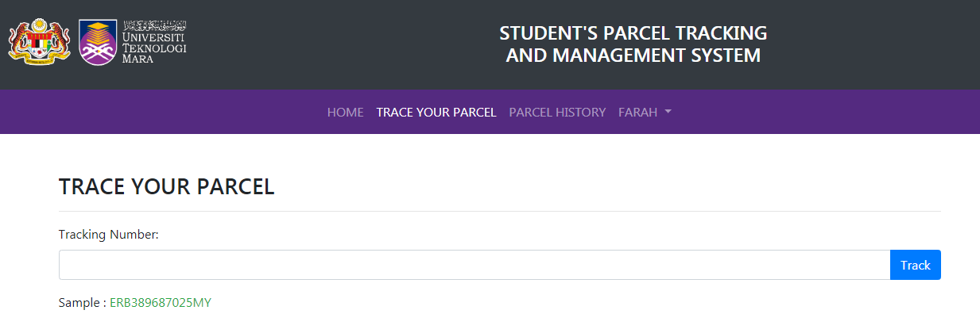
THEORY OF APPLICATION PROGRAMMING INTERFACE (API) AND HOW IT IS IMPLEMENTED IN STUDENT’S PARCEL TRACKING AND MANAGEMENT SYSTEM
Characteristics | Implemented In The System
Tracking API | - This means to gather the tracking information from the courier services. The user can easily check their tracking number without go to the courier company website.

Slide 5

THANK YOU

