Slide 1
THE DEVELOPMENT OF A COURSEWARE ON MALAYSIAN ENDANGERED ANIMALS USING MULTIPLE INTELLIGENCE THEORY
By:
Nur Farhana Binti Azman
Supervisor:
Miss Nor Azila Binti Awang Abu Bakar

Slide 2
Background of Study
Case Study:
Malaysian age 16 years old and above
Area of Interest:
Multimedia Application
Domain:
Education
Theory:
Multiple intelligence theory
Background Study
The haze phenomenon in the southeast Asian region including Malaysia had take the spotlight on the issues about endangered wildlife in Malaysia.
The issues about endangered wildlife in Malaysia is in the critical states.
Lee (2019)- The animal welfare activist says the move was in line with recent developments that saw the hunters’ activities become more and more greedy for robbing nature’s treasures for profit and endangering the protected species.

Slide 3
Problem Statement
Problem | Support statement | Solution
The Malaysian lack of awareness about endangered wildlife | Based on Ahmad Ismail (2019) said the lack of awareness among the authorities and the public had also led to the decline in the numbers. (Sources: www.thestar.com.my) (Date: 09 May 2019) | Give information about the endangered wildlife in Malaysia with the profile of the wildlife.
Lack of interactive awareness application about endangered wildlife | Based on Ahmad Ismail (2018), in addition to visiting the zoo, exhibits in posters or short video presentations can be made for future generations to learn about endangered species and how they can help protect and conserve these endangered animals and support the government’s wildlife conservation program. (Sources: m.utusan.com.my) (Date: 29 Jun 2018) | Develop courseware about endangered wildlife in Malaysia.
The increasing of endangered wildlife in Malaysia | Based on Wildlife director-general Datuk Abdul Kadir Abu Hashim, the number of elephants left is now 1,000 to 1,100 in Peninsular Malaysia, beetles (150 to 200), striped tigers (about 200), Tapir (700 to 800), deer (350 to 400), wild goats (200 to 500) and bald birds (20 to 30). (Sources: hmetro.com.my/mutakhir/2019/04/447325/gajah-tinggal-1000) (Date: 22 April 2019) | Give information about conservation endangered wildlife in Malaysia.

Slide 4
Objectives
1. To identify the requirements of a courseware on endangered wildlife animals in Malaysia.
2. To develop and design an endangered wildlife courseware prototype.
3. To evaluate the functionality and usability of the proposed courseware.
Scope
The target users:
Malaysian range age 16 years old and above: - Target users had the capabilities to contribute in the conservation efforts such as aware and obey the law in Akta Hidupan Liar Tahun 2010 (Akta 716).
The scope of content information:
The information about endangered wildlife in Malaysia.
The ways to help in conservation endangered wildlife in Malaysia.
PERHILITAN information.
The delivering scope:
CD based.

Slide 5
Significance
Increase the interactive awareness application about endangered wildlife in Malaysia.
Furthermore, the proposed courseware of endangered wildlife can give a guideline for Malaysian to conserve the endangered wildlife.

Slide 6
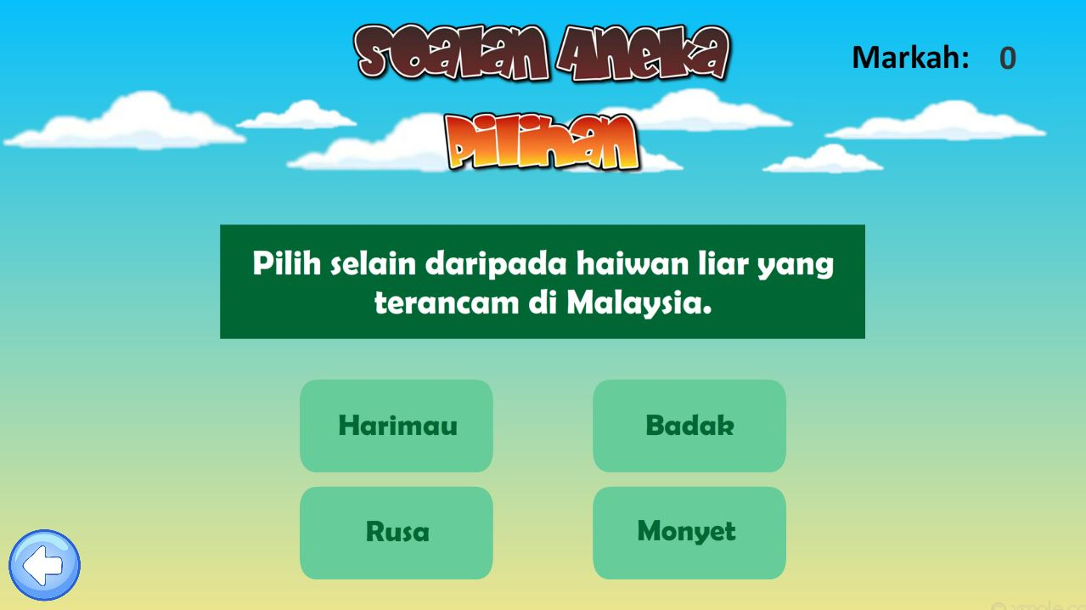
Multiple Intelligence Theory
Intelligence | Description
Logical-Mathematical Intelligence | Ability to use rational to logical deduction.

Slide 7
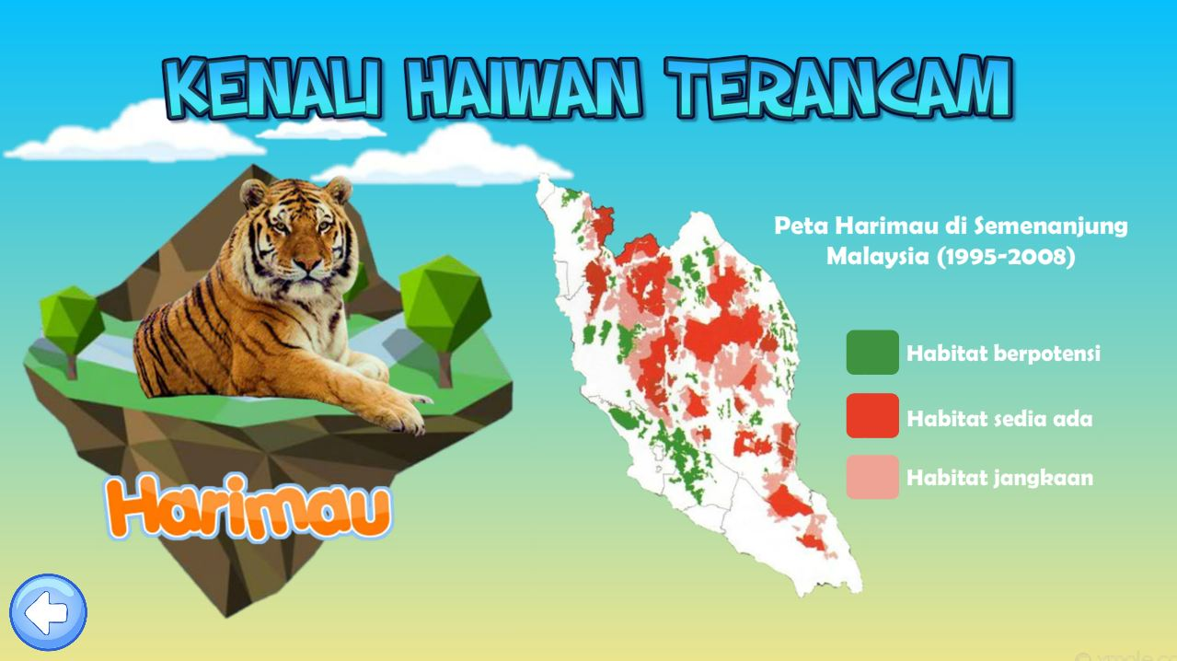
Multiple Intelligence Theory
Intelligence | Description
Visual Intelligence | Ability to perceive the visual-spatial world accurately.

Slide 8
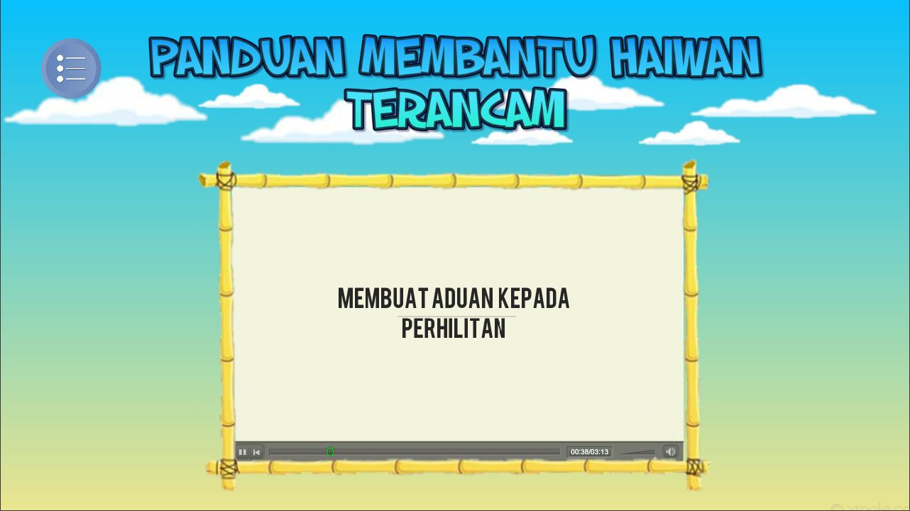
Multiple Intelligence Theory
Intelligence | Description
Intrapersonal Intelligence | Ability to act adaptively based on that knowledge.

Slide 9
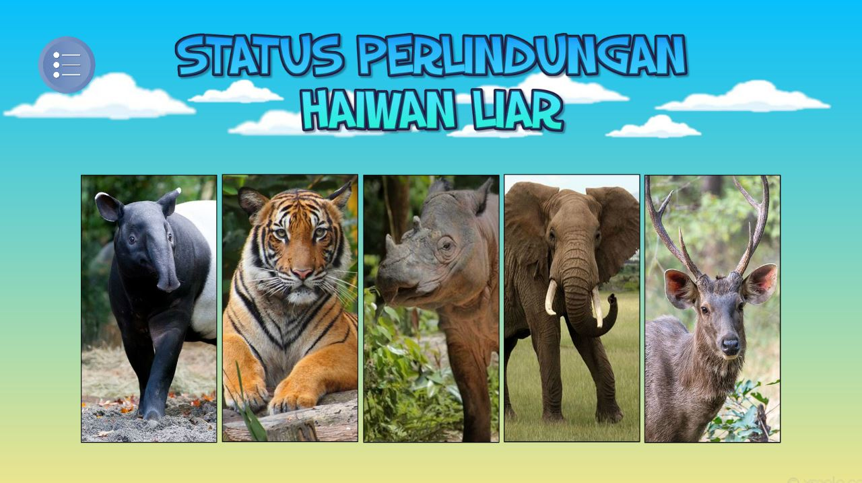
Multiple Intelligence Theory
Intelligence | Description
Natural Intelligence | Ability to recognize and classify of the species of flora and fauna.

