Slide 1
FOOD DELIVERY ORDERING SYSTEM (FDOS)
By:
NUR SHAFIKA IZANI BINTI MOHAMAD ASERI
SUPERVISOR’S NAME:
MADAM SITI NURUL HAYATIE BINTI ISHAK

Slide 2
Problem Statement
1. Merchants are not registered with UiTM
- It can be fraud issue between students and merchant.
Merchants do not comply with established rules by HEP UiTM (food poisoning case is under university responsibility).
2. WhatsApp Group as a platform for ordering.
- Difficult to manage order
- Lack of merchants information
3. Lacks the physical copy of menu items, lack visual confirmation that the order was placed correctly.
Background of Study
Case Study: Trend of using food delivery service among UiTMCTKKT students.
Area of Interest: e-marketplace
Domain: Restaurant
Theory: On Demand Delivery Service(ODDS)

Slide 3
Objectives
1. To identify the current business process and requirements for ordering system.
2. To design and develop the food delivery ordering system.
3. To evaluate the functionality and usability of food ordering system to target users.

Slide 4
Current Business Process
Retail food delivery is a courier service in which a restaurant, store or independent food delivery company delivers food to a customer.
Recently, this new trend become popular among students when they have moved on from ordering offline to ordering online. An order is typically made either through a restaurant’s website or phone, or through a food ordering company.
Some students joined a WhatsApp group to make an order which this group act as a platform for students and merchants to perform transaction.
Most students prefer using this service because it is easy, convenient and faster in just one click away.

Slide 5
Proposed Solution
Problem Statement | Proposed Solution
Merchants are not registered with UiTM It can be fraud issue between students and merchant. Merchants do not comply with established rules by HEP UiTM (food poisoning case is under university responsibility). | Using this system, merchant need to register and get approval of membership by the JPK. Student will get many selection of restaurants based on their preferences under one e-marketplace.

Slide 6
Problem Statement | Proposed Solution
WhatsApp Group as a platform for ordering. Difficult to manage order Lack of merchants information | By develop the system, the merchants easy to manage the order or make the promotion. Then students will easy to know the merchants information and easy to make order.
Lacks the physical copy of menu items, lack visual confirmation that the order was placed correctly. | By develop the system, students will easy to select, view the menu and can compare the price between another restaurants.

Slide 7
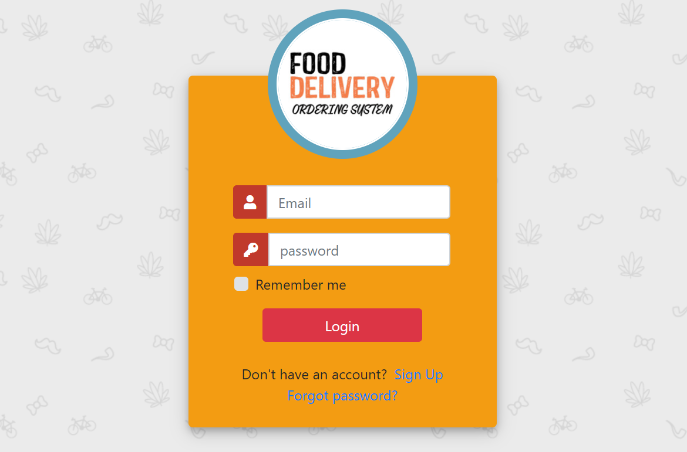
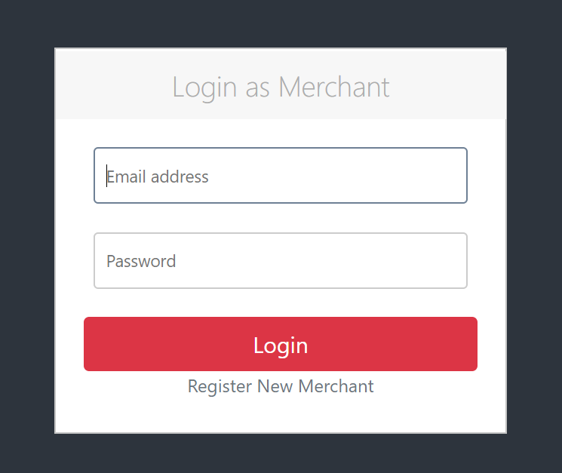
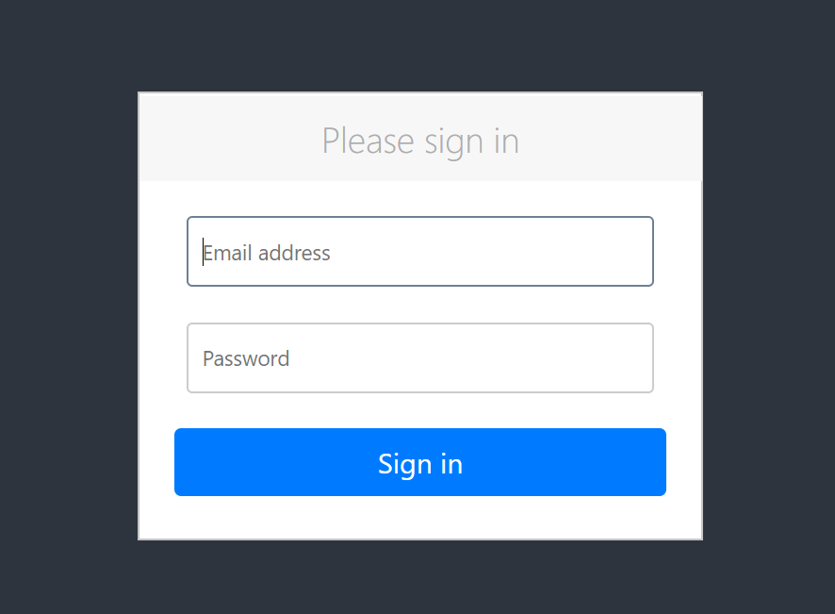
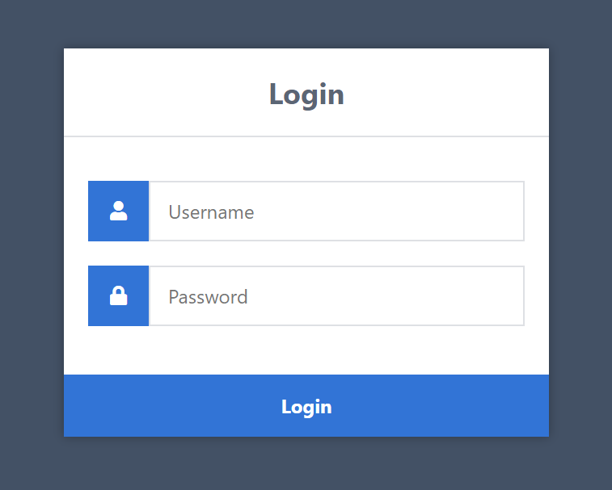
On Demand Delivery Service Theory
Characteristics | How it is implemented
Authentication is the key
It needs to be taken up by keeping the customers at the forefront so that users can register or login by entering details.

Slide 8
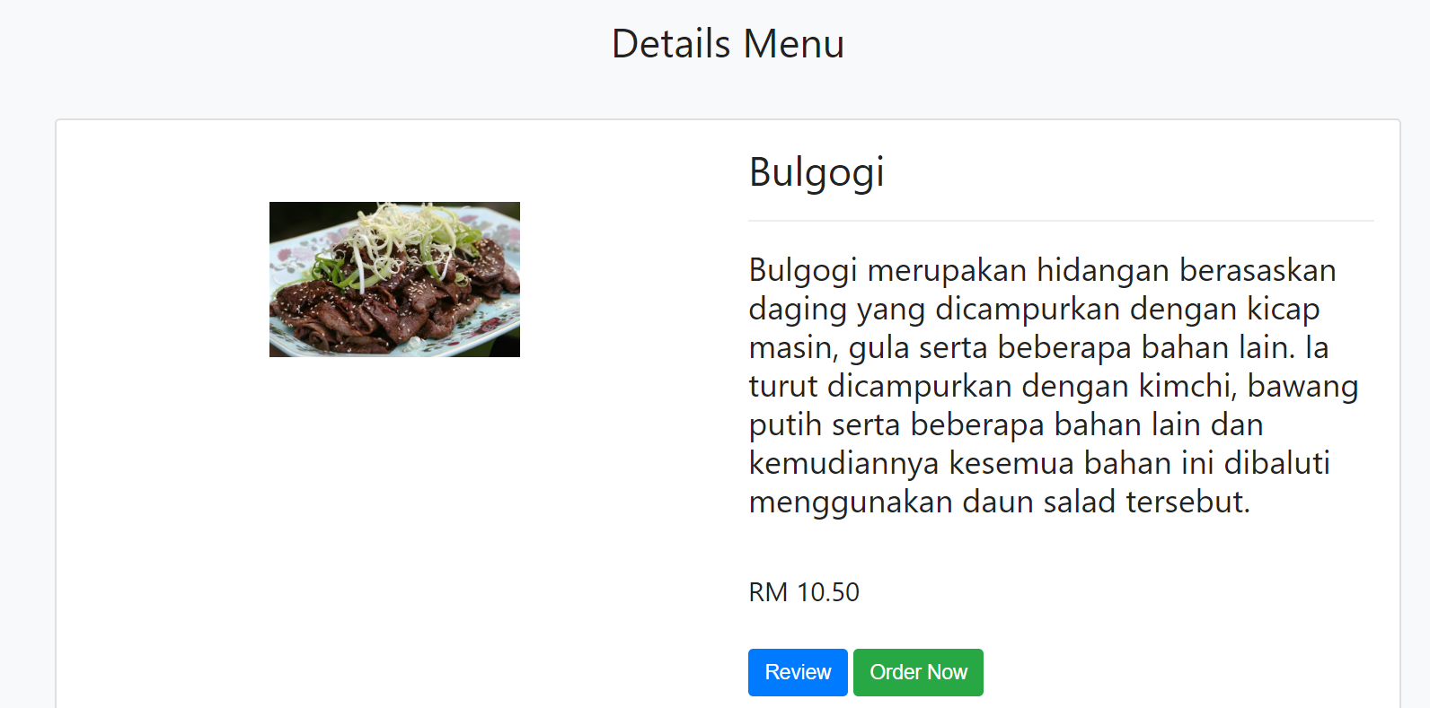
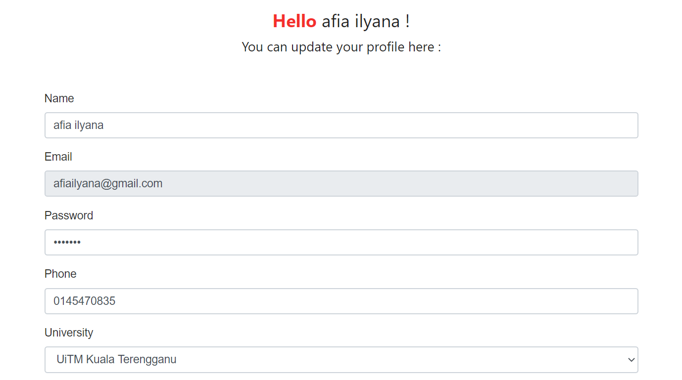
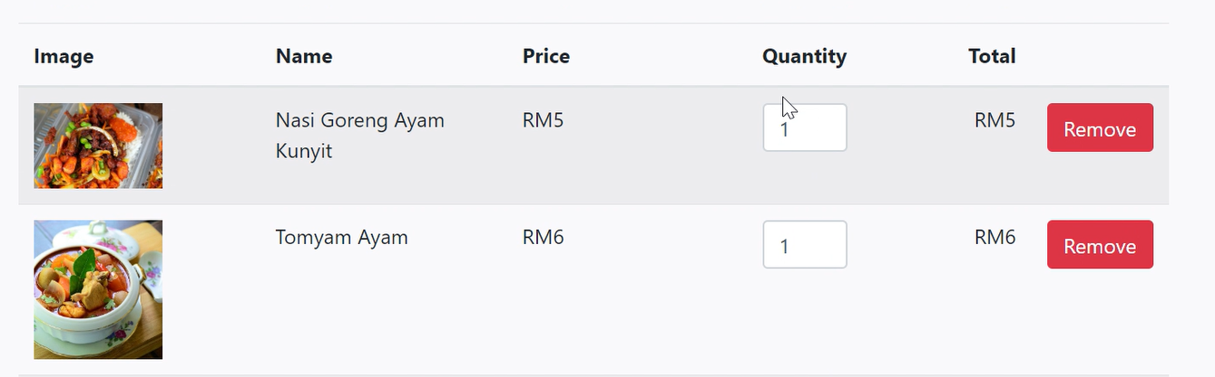
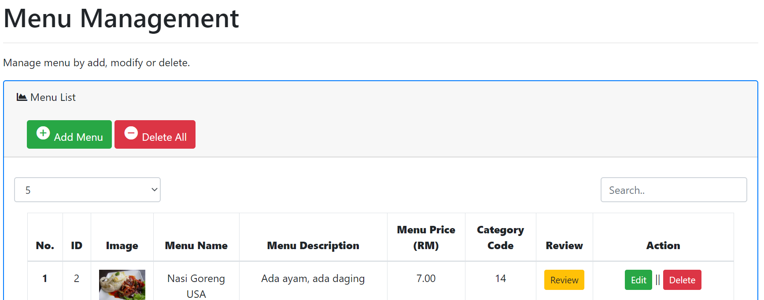
Characteristics | How it is implemented
Visually informative
It allows manual placement of orders by filling in basic information in the form of addresses, preferred delivery time, price, product info, and customer’s info.

Slide 9
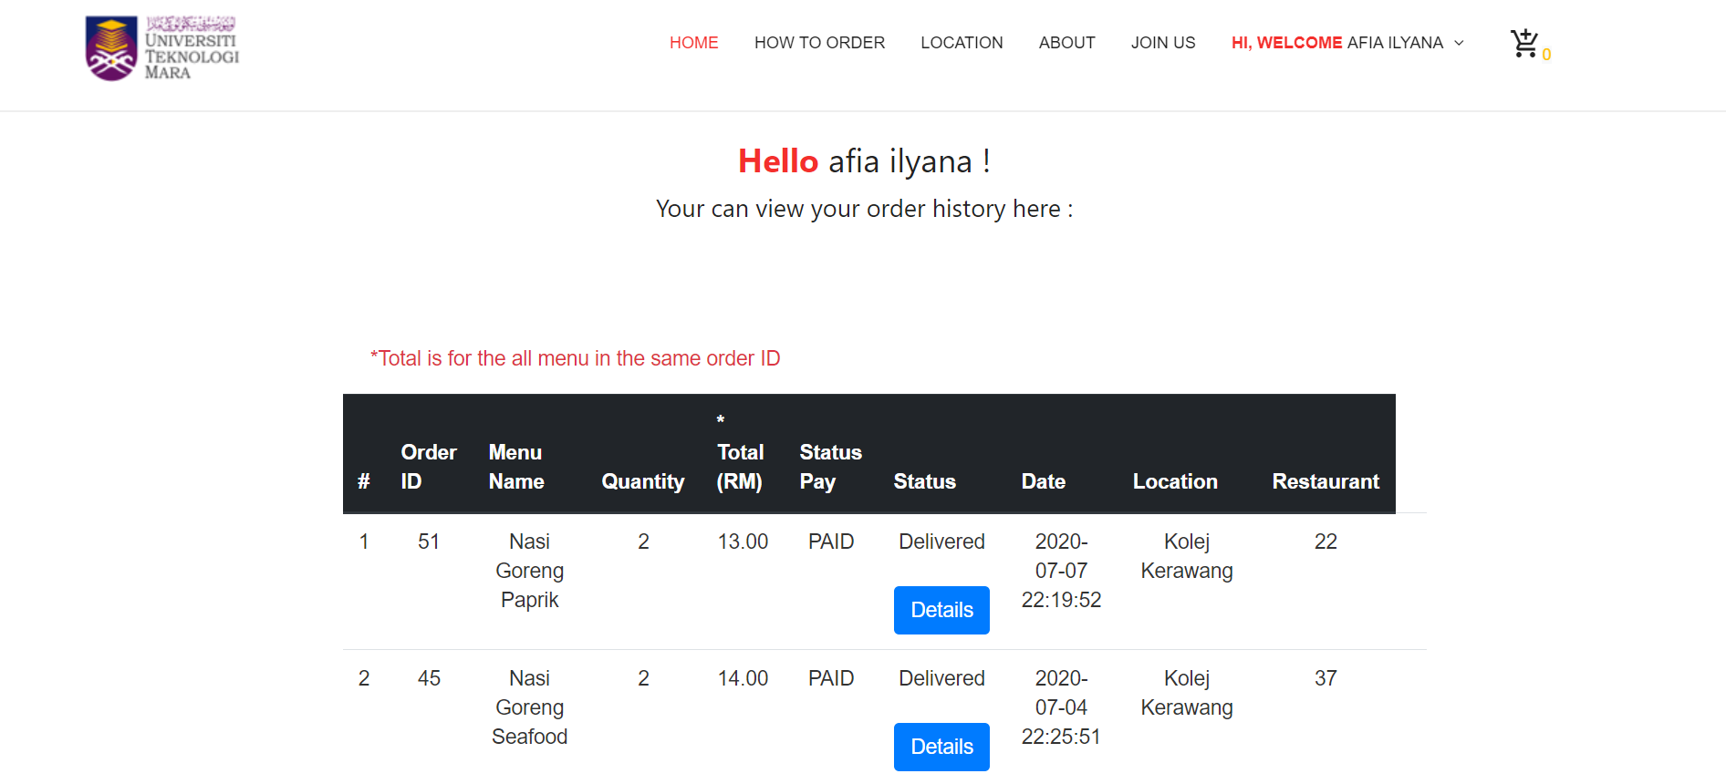
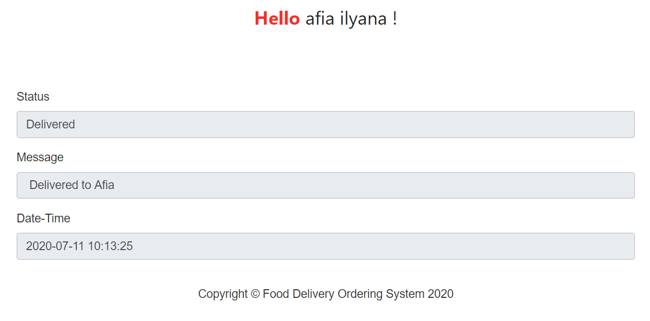
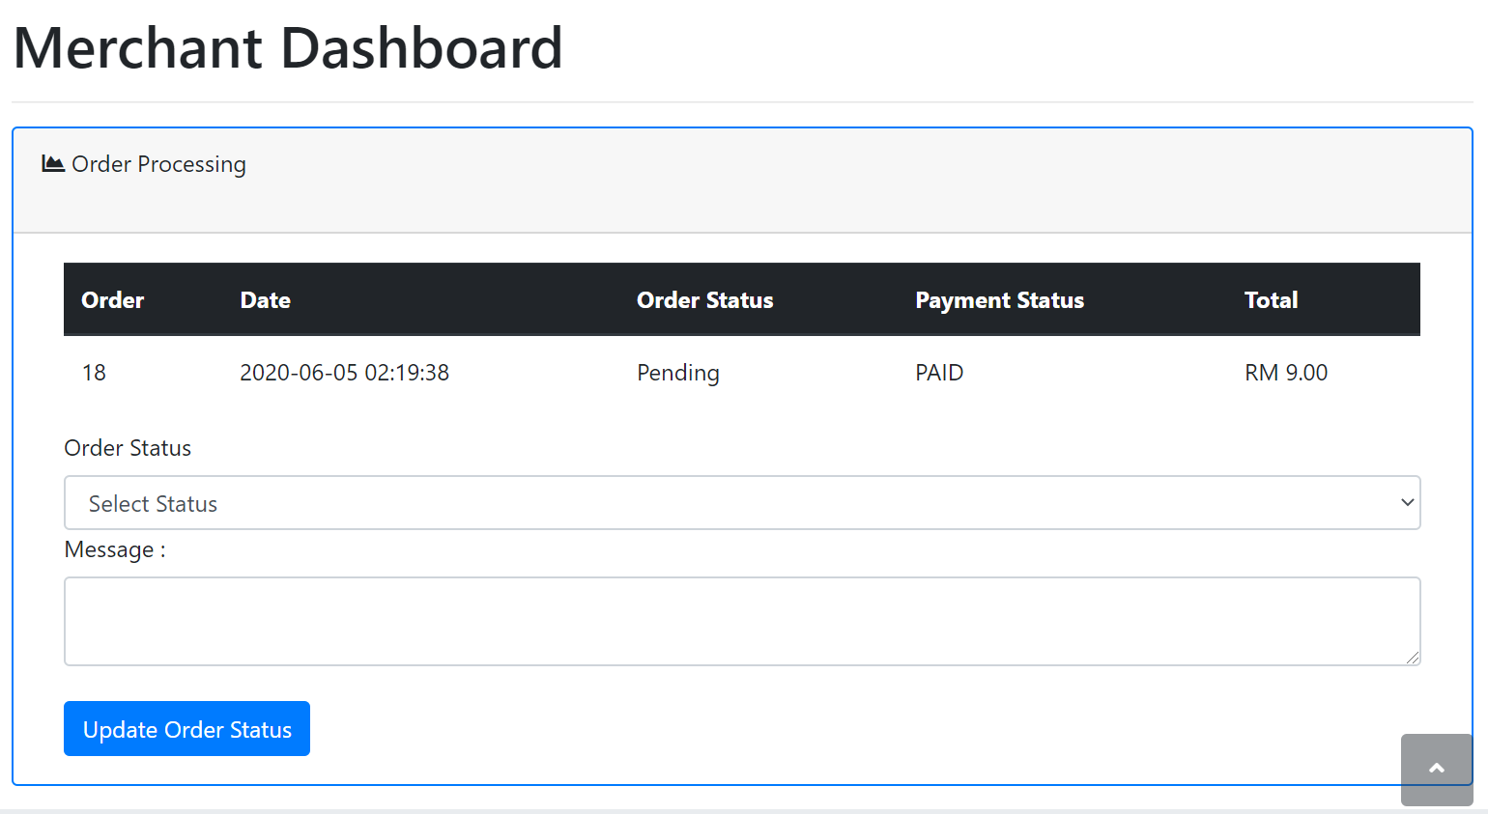
Characteristics | How it is implemented
Live GPS tracking
Customer can track their product, order management.
- Unable to implement GPS tracking but providing with order tracking.

Slide 10
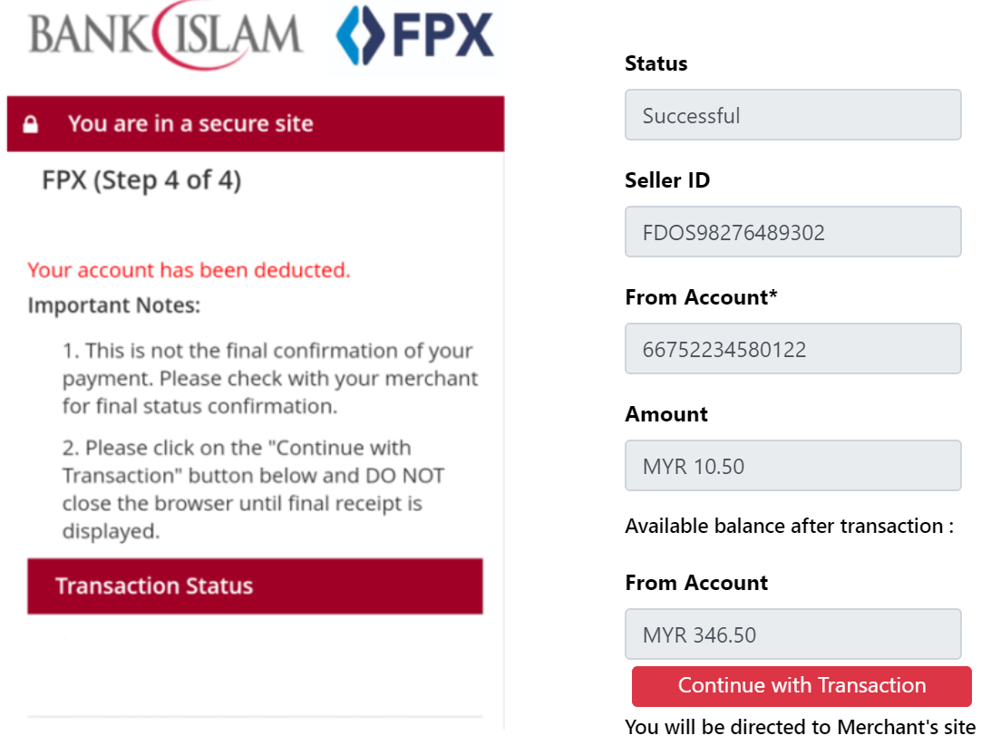
Characteristics | How it is implemented
Payment gateway integration
Customer can make payment.

Slide 11
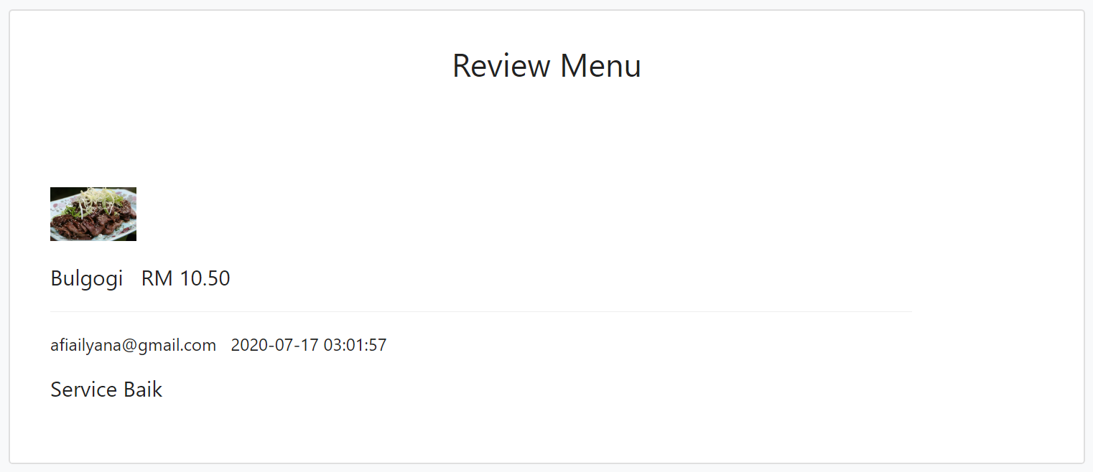
Characteristics | How it is implemented
Review and rating system
A platform for users to share their experience, ratings and reviews

Slide 12
Result and Finding
The highest mean value is on online food ordering and restaurant perception.

Slide 13
THANK YOU

