Slide 1

Car Rental Hub
Prepared for : Madam Ummu Fatihah Binti Mohd Bahrin
Prepared by : Muhammad Shahreen Aqiff Bin Mat Ayob
Supervised by : Miss Nor Azila Binti Awang Abu Bakar

Slide 2
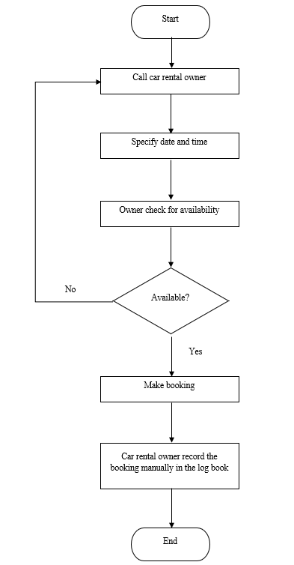
Current Business Process
Background of Study
Case Study: Car renting process among UiTM KT students.
Area of Interest: E-commerce
Domain: Online car rental service
Theory: E-marketplace

Slide 3
Problem Statement
Problem | Proposed Solution
Hassle booking process | Develop a car rental hub that allow students to rent car easily without having to check with every car rental owners.
The process cause a waste of time and money because they have to call multiple car rental owners before they can make a booking. | The students that want to rent a car just have to choose the available car from the Car Rental Hub and they do not need to call multiple car rental owners anymore.
Double booking | No double booking problem as the rental process will now take place in the system and cars that have been rented will be unavailable to be rented.

Slide 4
Objectives
1. To identify current car renting process and the problem arises from the process.
2. To design and develop Car Rental Hub for UiTM KT students.
3. To evaluate the functionality and usability of Car Rental Hub.

Slide 5
Theory
E-MARKETPLACE

Slide 6
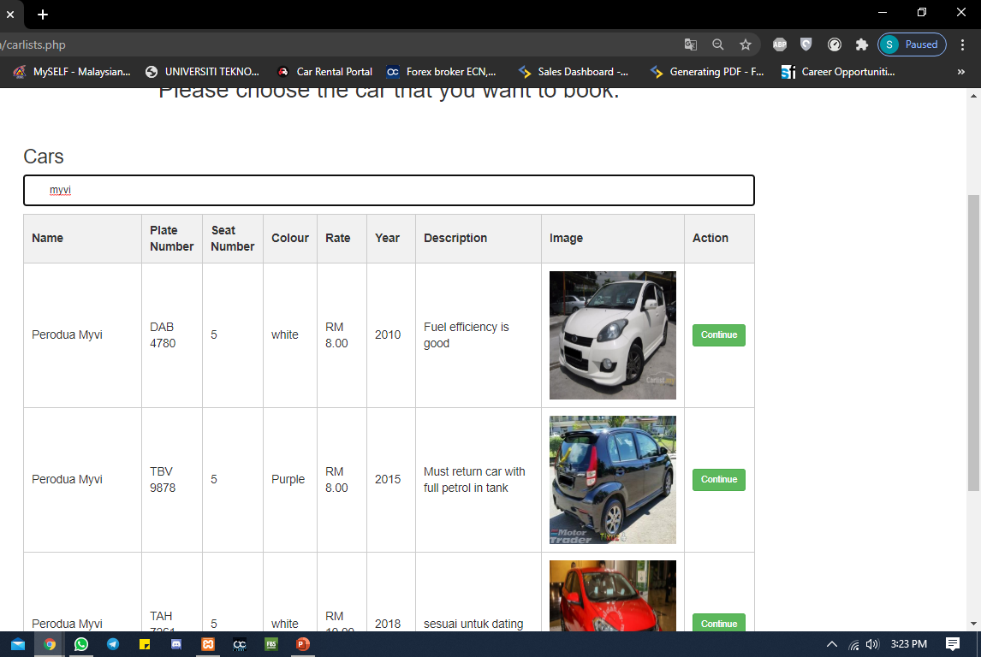
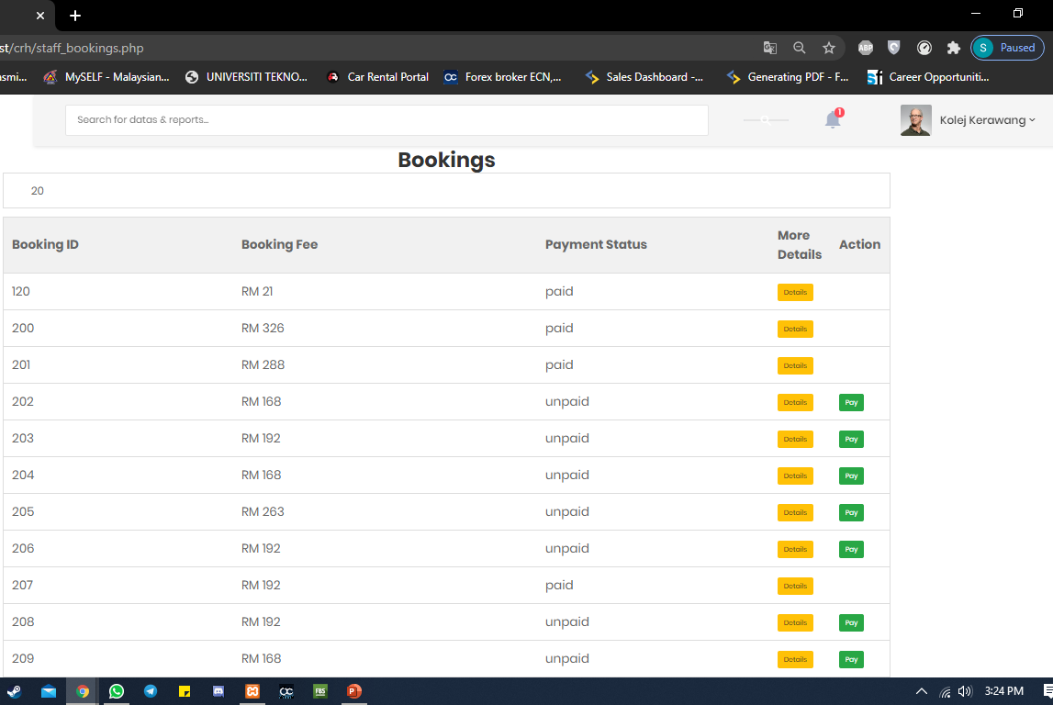
Feature – Search Function
Search function to search for cars (Student side)
Search function to search for booking ID (Staff side)

Slide 7
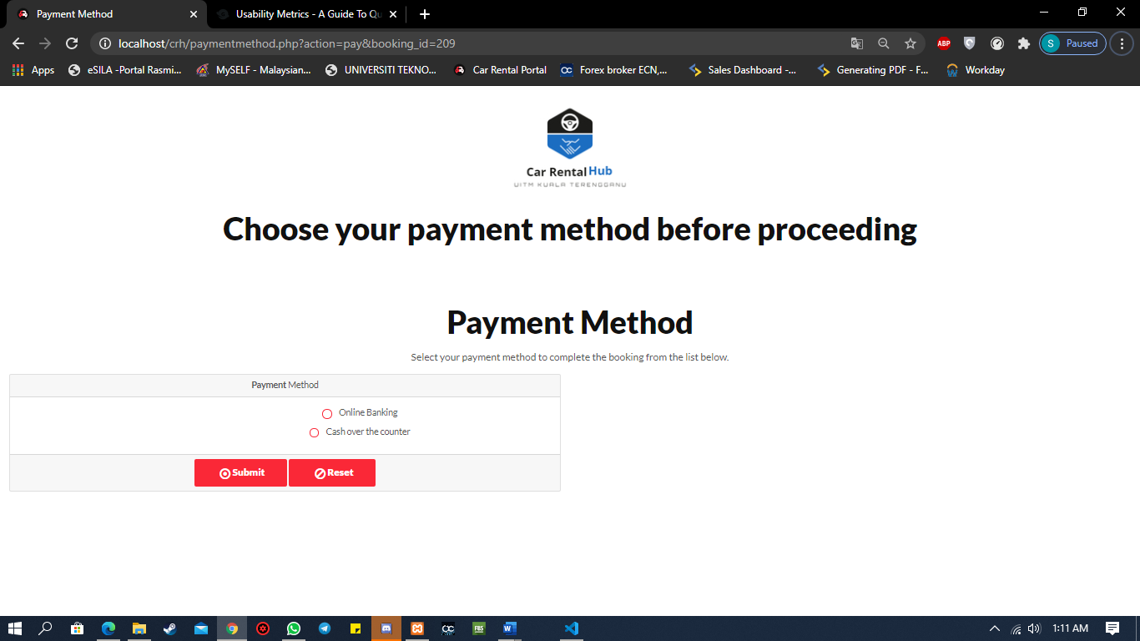
Feature – Payment Option
Student can choose whether to pay by cash or via online banking

Slide 8
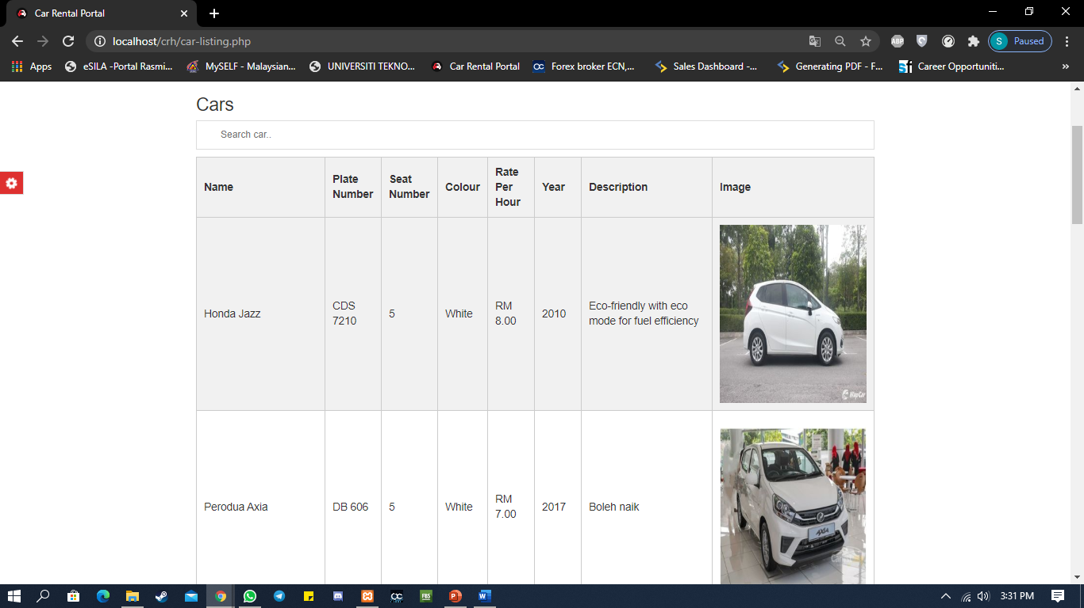
Feature – Product Catalogue
Students can view list of cars that are listed in Car Rental Hub

Slide 9

Feature – Product Information

Slide 10
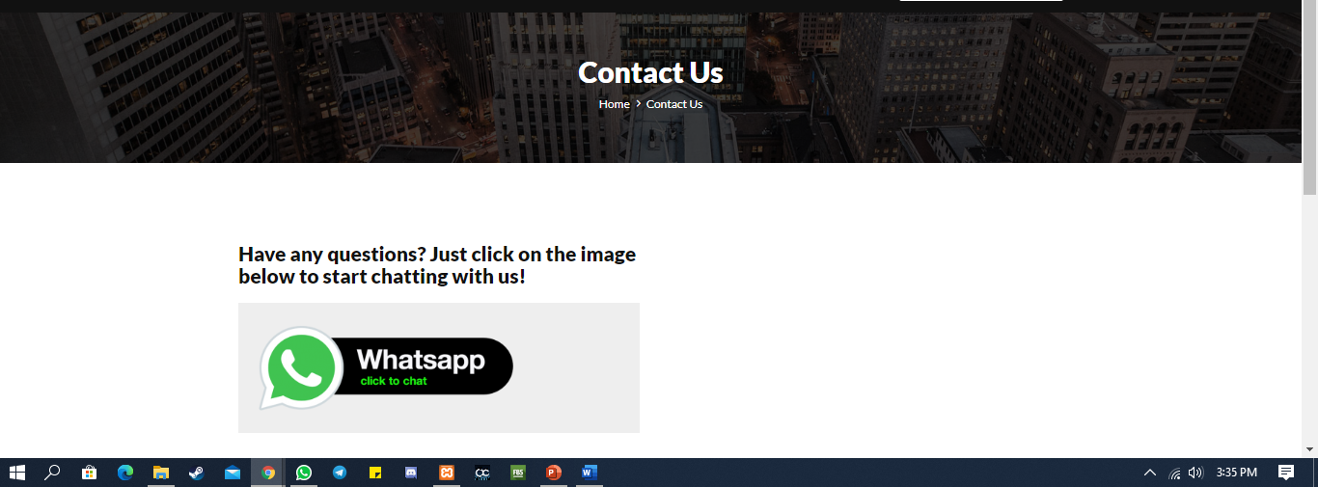
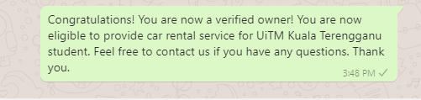
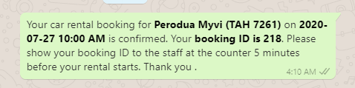
Feature – Customer Service
Link to Whatsapp for inquiries
Notify students for their rental
Notify owners once they are verified

Slide 11
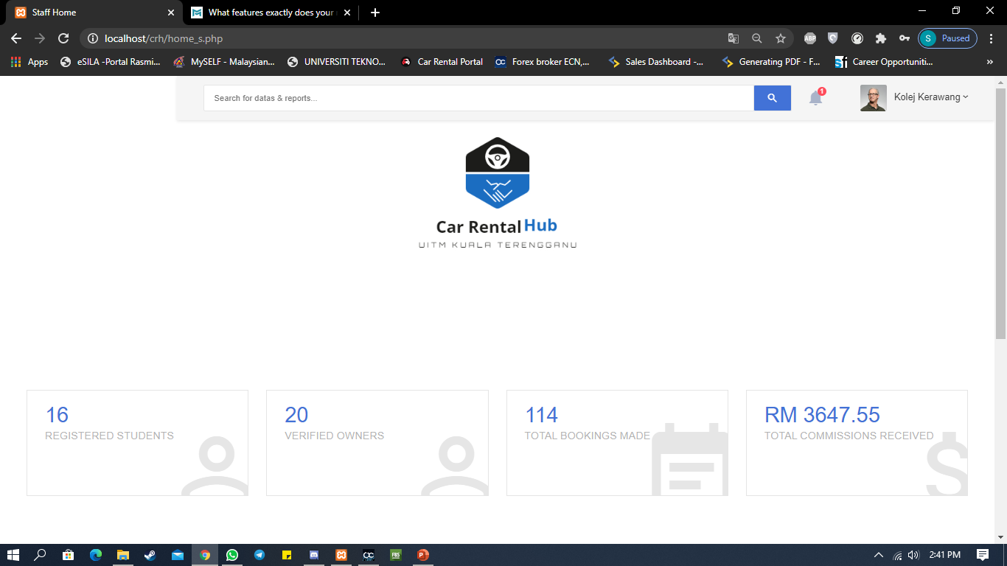
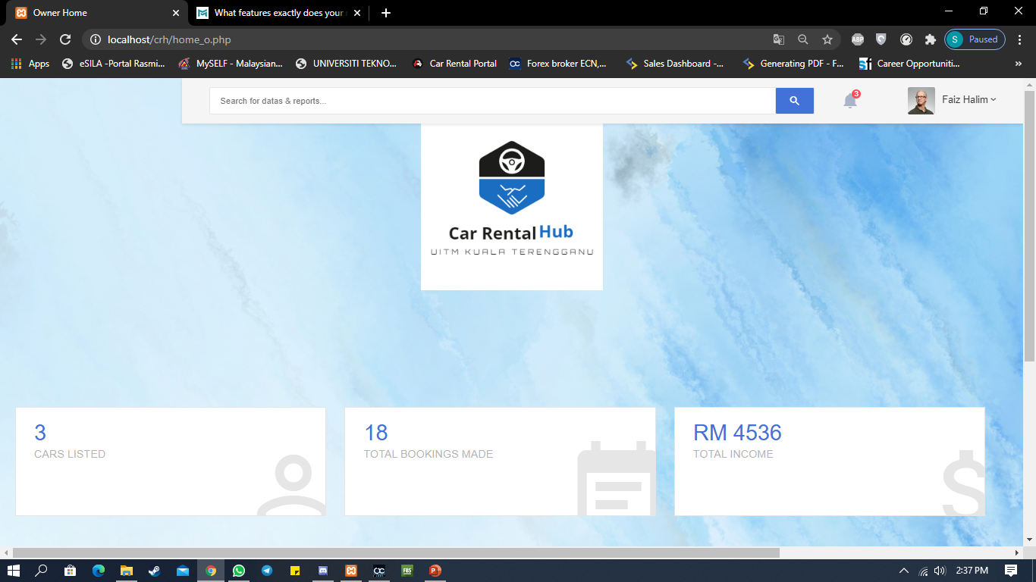
Feature – Dashboard for staff and owners
Dashboard for Staff
Dashboard for Owner

Slide 12

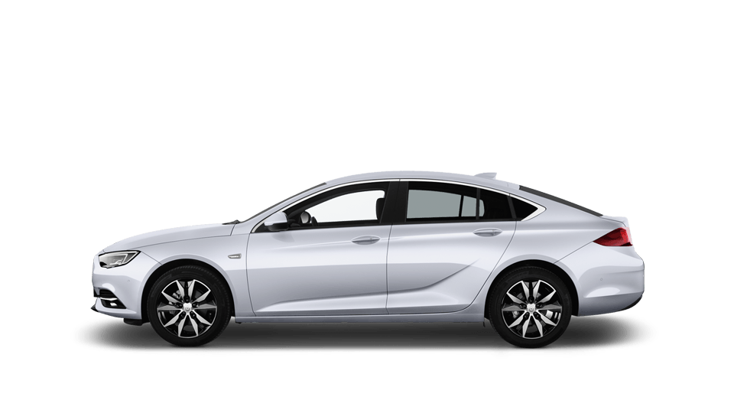

THANK YOU

