Slide 1
E-Marketplace For Muslim Food Products
BY:
MUHAMAD ZARUL ASYRAF BIN AHMAD SUHAIMI
(2017669254)

Slide 2
Background of study
Case Study: Muslim Product
Area of Interest: Electronic Marketplace
Domain: Business
Theory: Theory of E-Marketplace
Problem Statement
1. Do not have centralized market for Muslim products (Food industry)
2. Products quantity (buy in bulk)
3. Lack of information about Muslim Products
Objectives
To identify current process and problem face by the buyer and seller
To design and develop e-marketplace for Muslim products
To evaluate the functionality and the usability of e-marketplace of Muslim products

Slide 3
Proposed solution
Problem Statement | Propose Solution
Do not have centralized market for Muslim products (Food industry) | Develop e-marketplace for Muslim products
Products quantity (buy in bulk) | Give freedom for the customer to buy in large or small quantity
Lack of information about Muslim Products | Propose e-catalogue for Muslim products

Slide 4
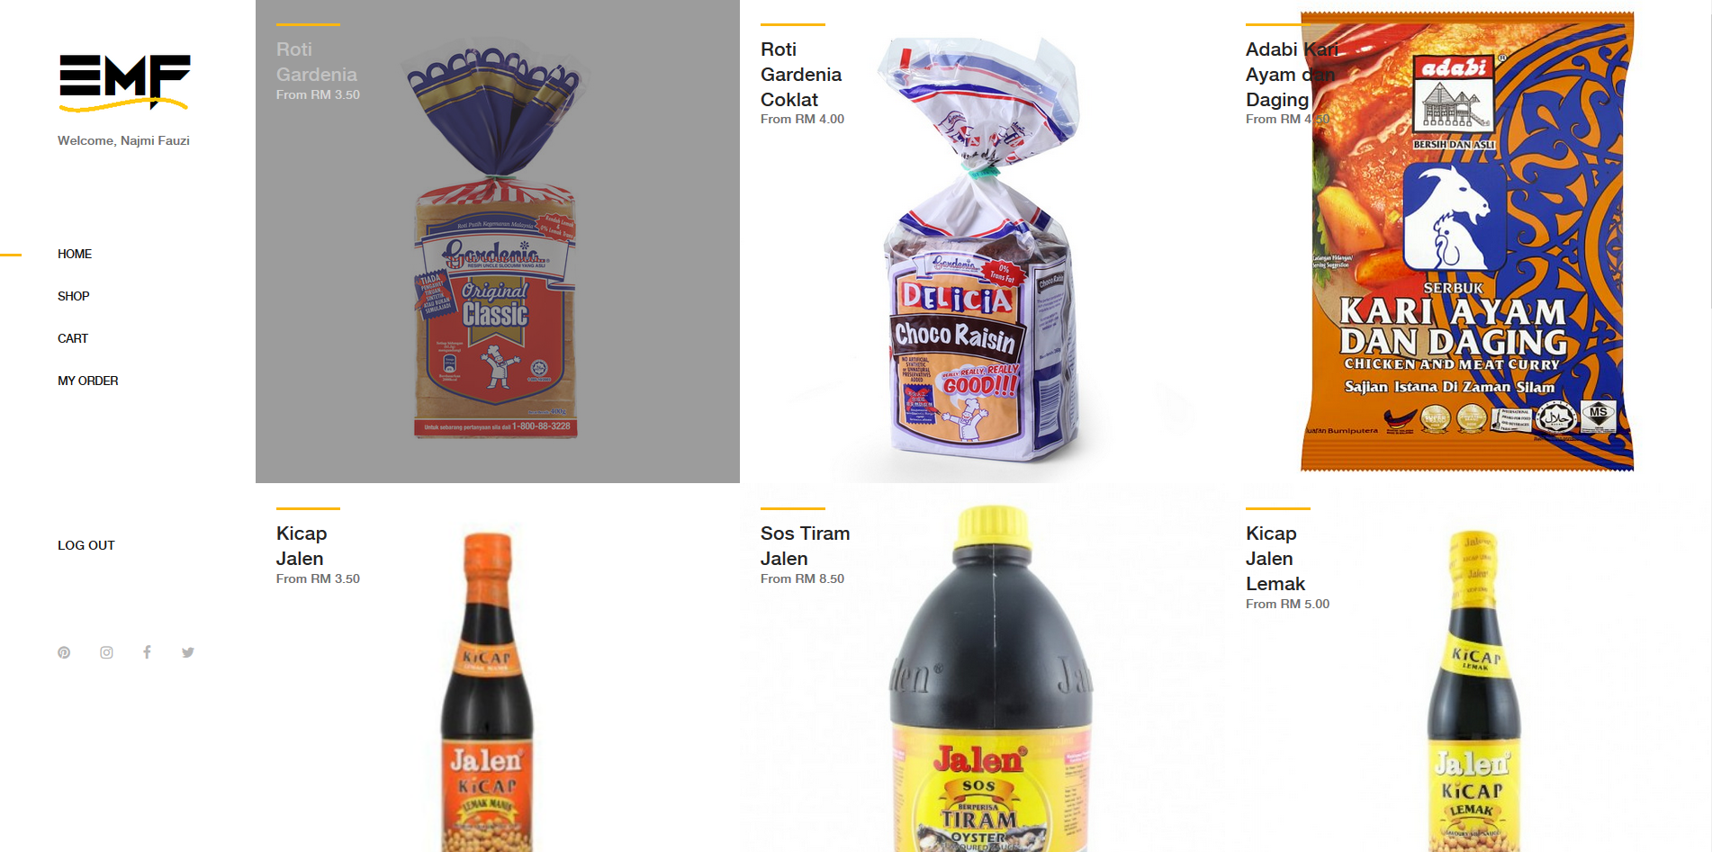
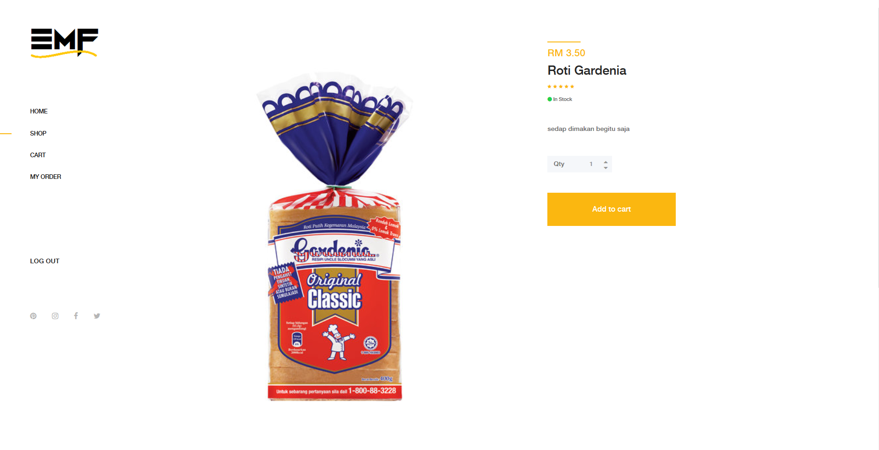
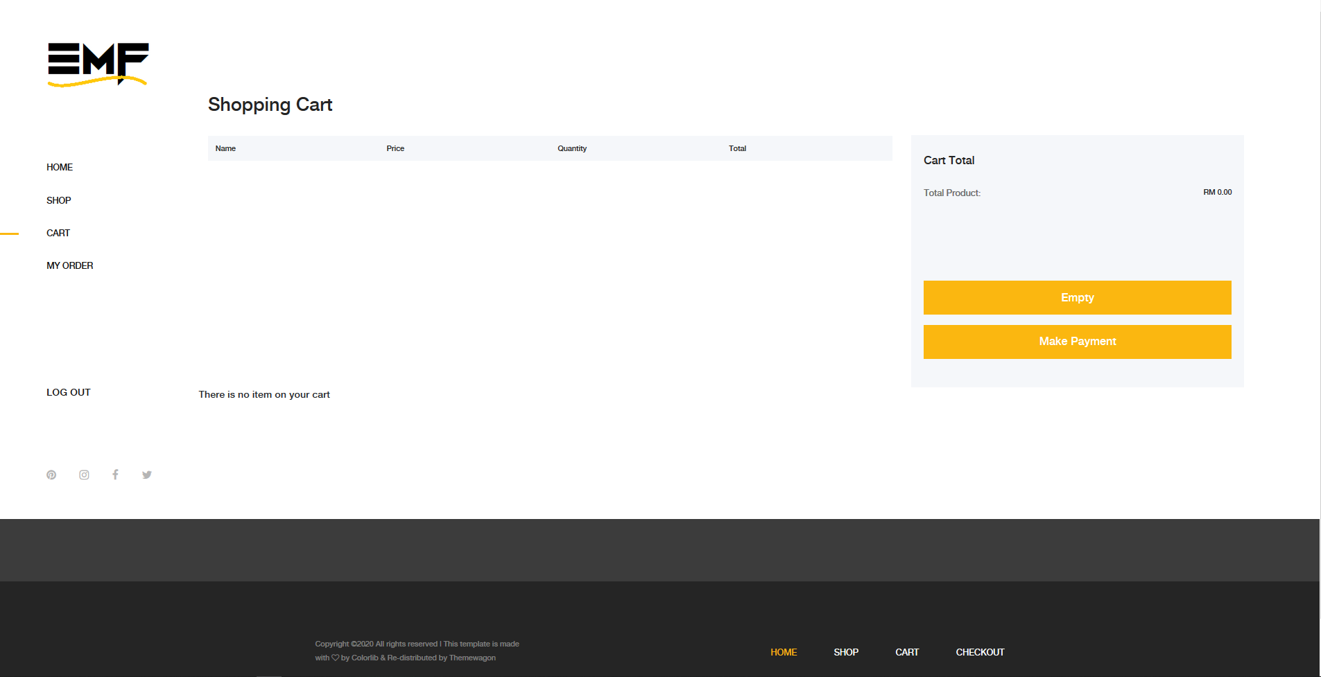
1. Product Catalogue
2. Product information
3. Shopping cart

Slide 5
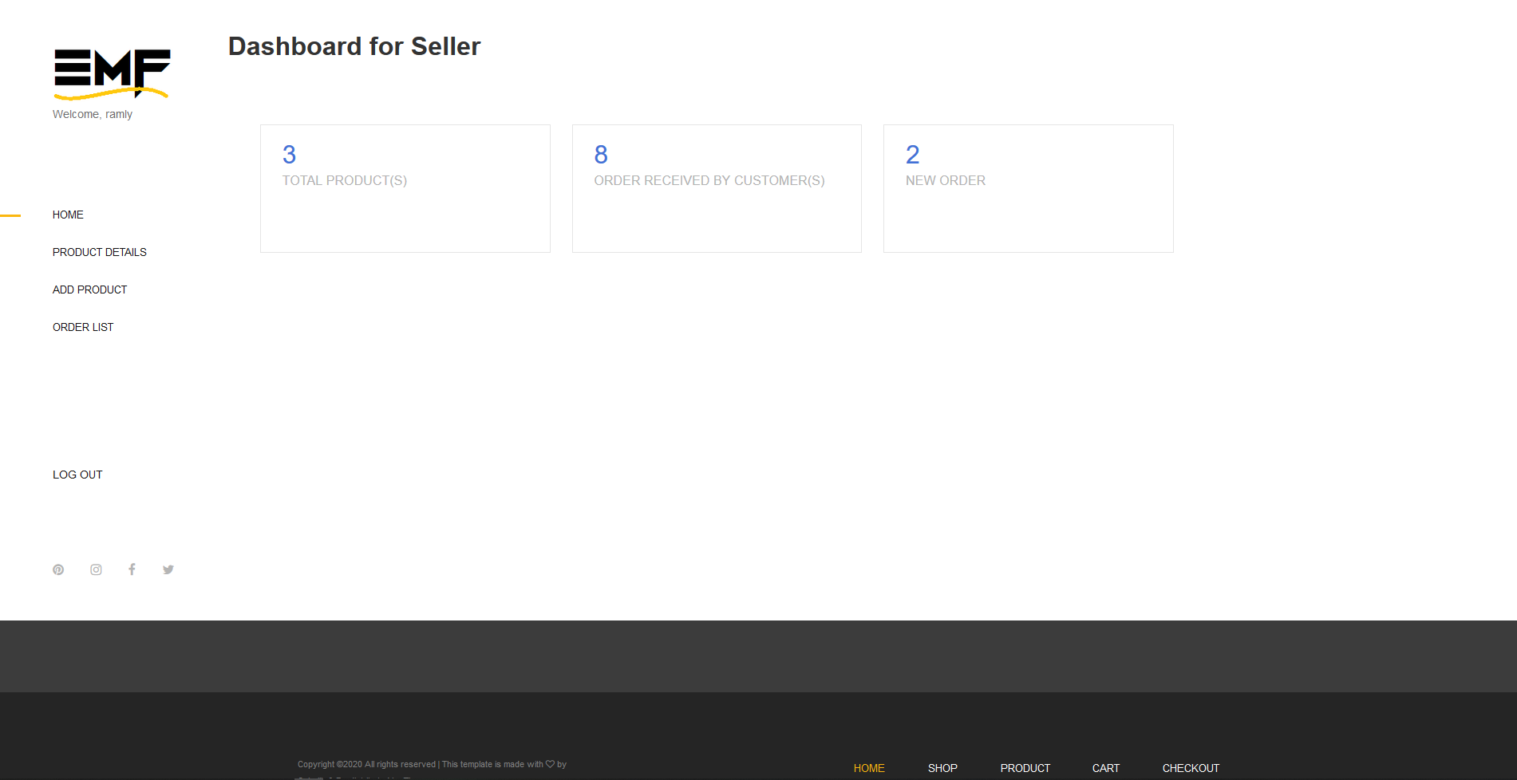
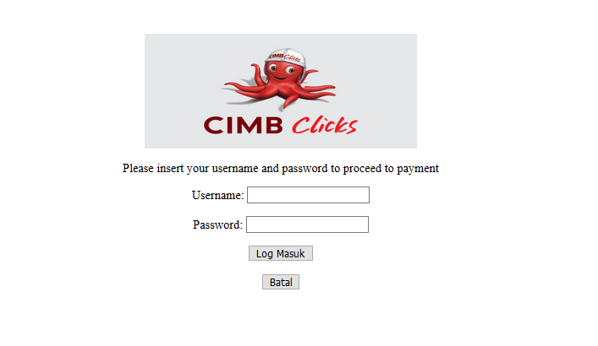
4.1 Buyer microsite
4.2 Seller microsite
5. Payment option

Slide 6
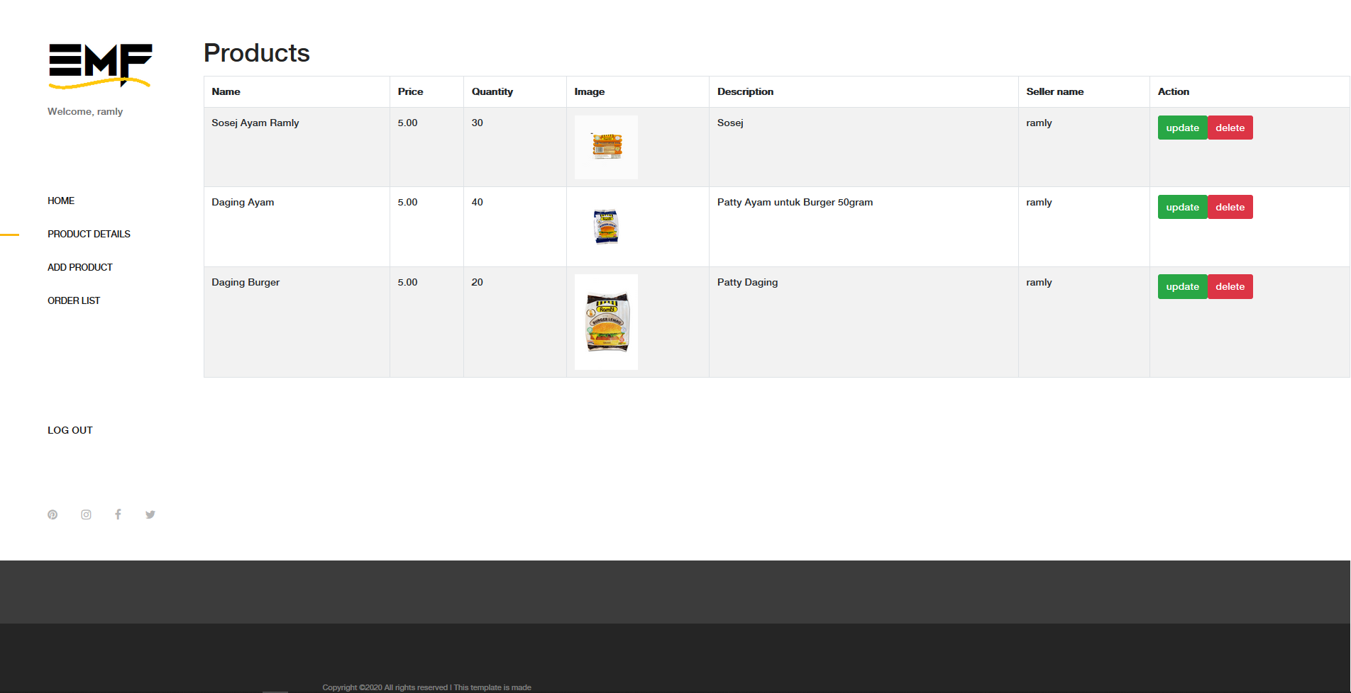
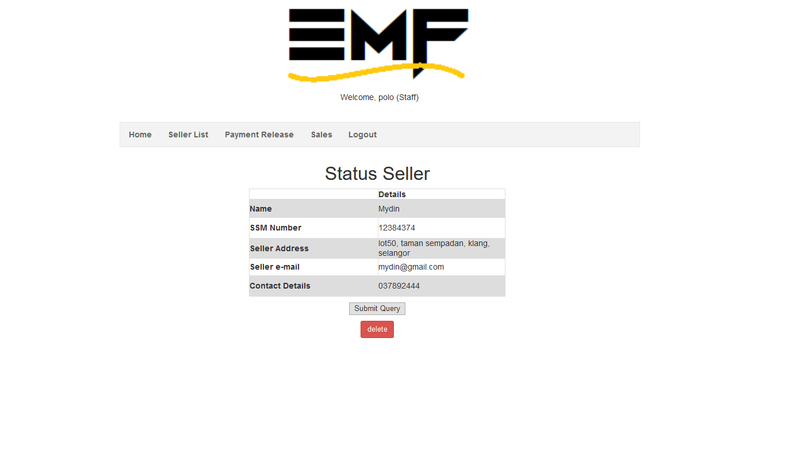
6. Seller Catalogue Management
7. Vendor verification document

Slide 7
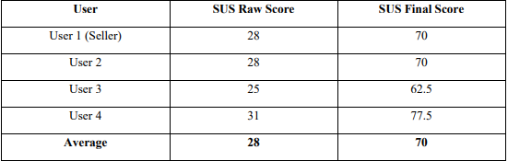
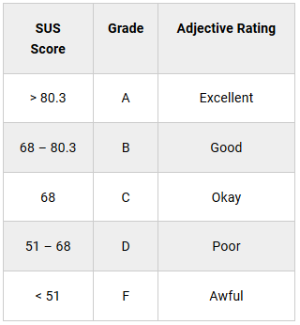
Result and Finding
The user evaluation was using the SUS questionnaire where the user testing will answer the questionnaire after using the system
The result show in the table
70 means the system is in good condition and have grade B.

Slide 8
THANK YOU

