Slide 1
Science Learning Courseware for Preschoolers Using Assistive Approach
Supervised by : Madam Siti Salbiah Binti Hamzah
Examiner: Dr Hasiah Mohamad
Lecturer : Miss Nik Marsyahariani Binti Nik Daud
Prepared by : Muhamad Syawal Azali Bin Mohd Rozlan

Slide 2
Background of Study
Case Study: Kindergarden’s Students Little Caliphs Kuala Lumpur.
Area of Interest: Courseware
Domain: Education
Theory: Assistive approach

Slide 3
Current Business Process
The traditional method of preschool education focuses on a curriculum developed by preschool itself.
Teachers are trained to ensure that the children learn how to count, read and write. They also have structured lessons based on storytelling, art and crafts.
They only refer on textbooks and some exercise materials which is from the book to teach the children.
They do not have suitable materials for example courseware in learning. With courseware for their learning it helps them to interact with multimedia and give more attention to courseware because some of exciting elements inside courseware for example, animation. Nowadays we know that children tend to like animation, cartoon because all of that is the elements to catch their attention more rather than referring a book.

Slide 4
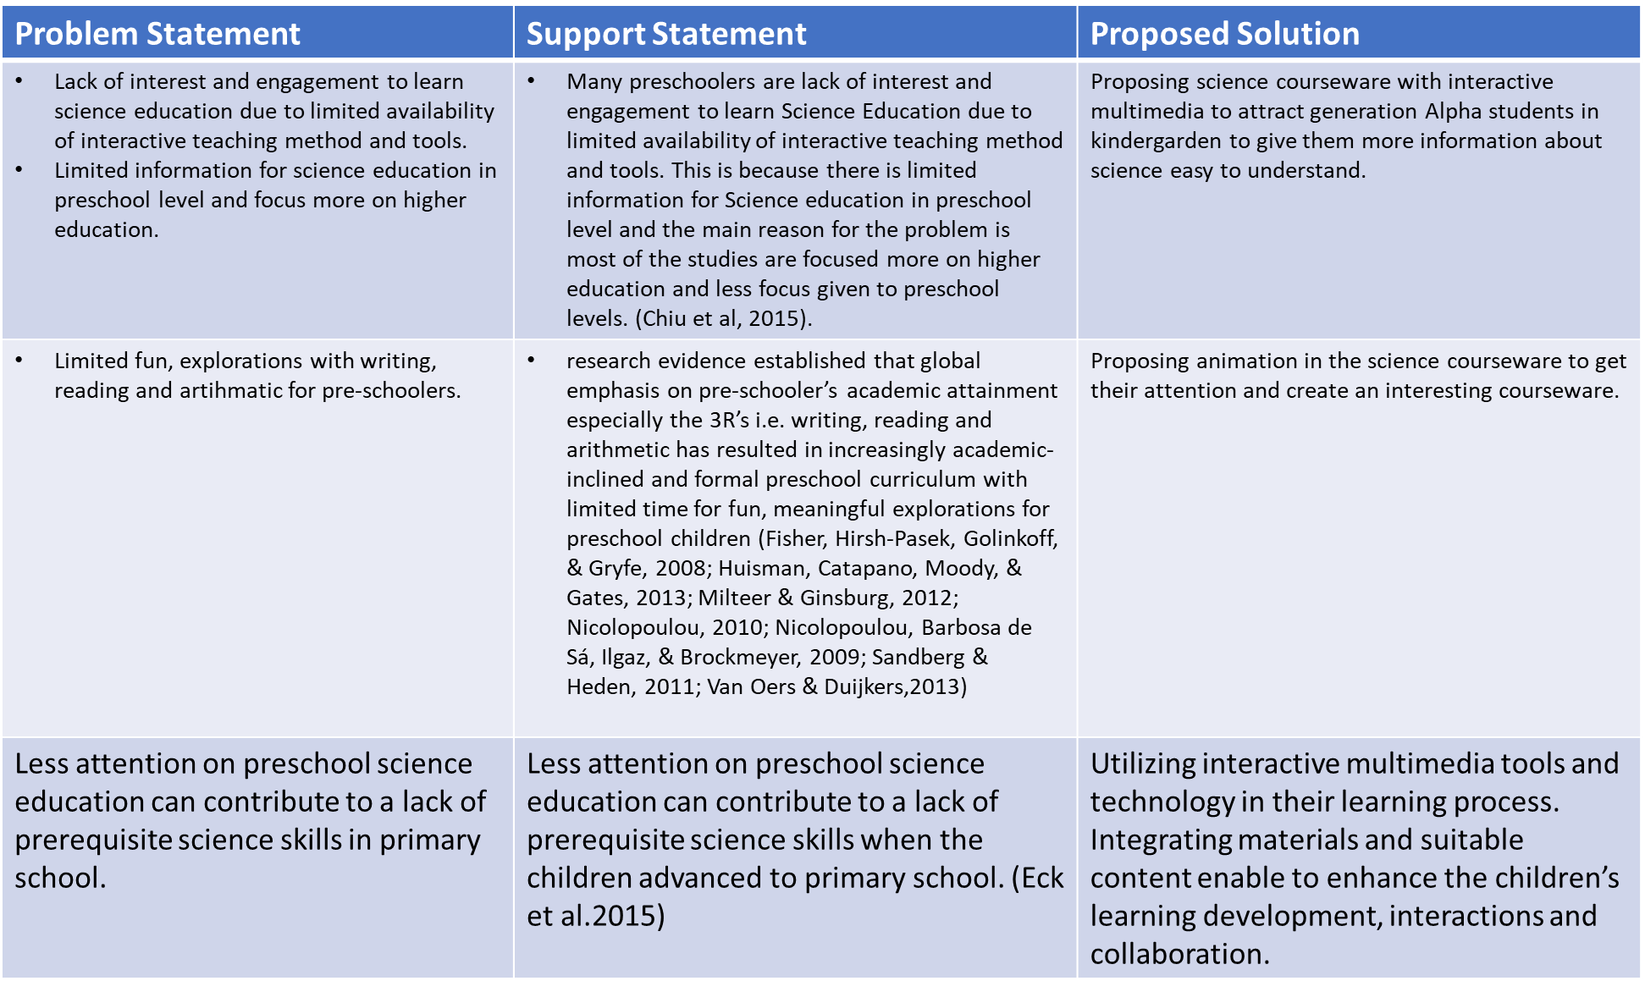

Slide 5
Objectives
1. To identify the current problem and requirement in learning science for kindergarden’s student age 5 and 6.
2. To design and develop learning science courseware to attract kindergarden’s students to learn about science.
3. To evaluate the functionality and usability of the courseware.
Scope
Students of little caliphs Kuala Lumpur (age 5 and age 6)
Teachers
Plants Growth, Magnet, Light

Slide 6
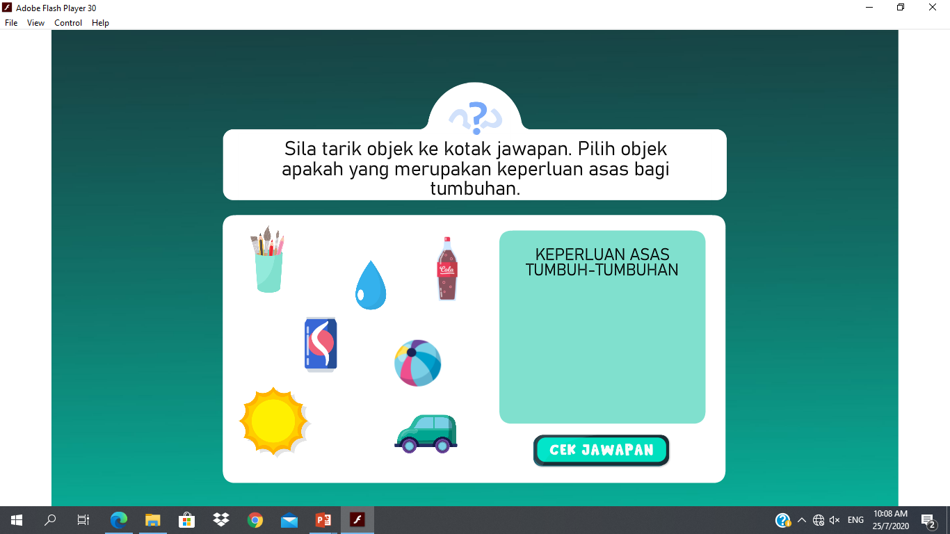
Theory
Theory (e.g. ASSISTIVE APPROACH) | How it is implemented
Characteristics | Implementation in the system
1. Interactive

Slide 7
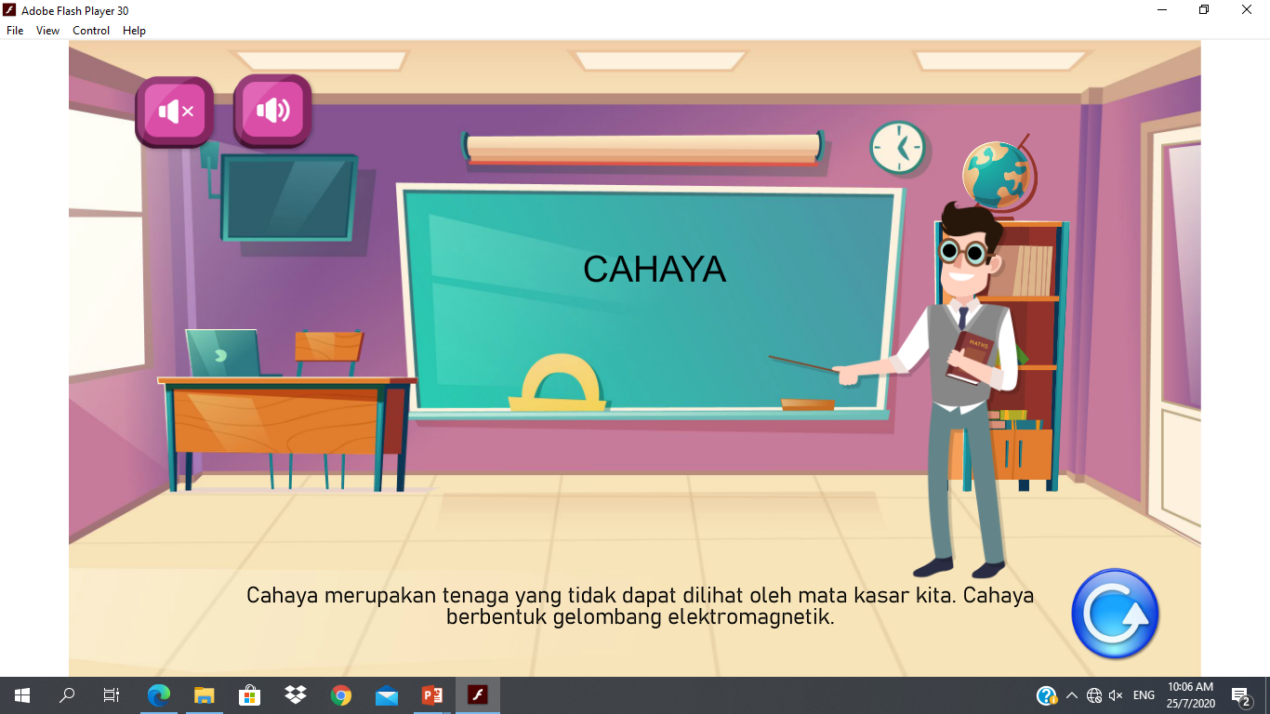
Theory (e.g. ASSISTIVE APPROACH) | How it is implemented
Characteristics | Implementation in the system
2.Communication

Slide 8
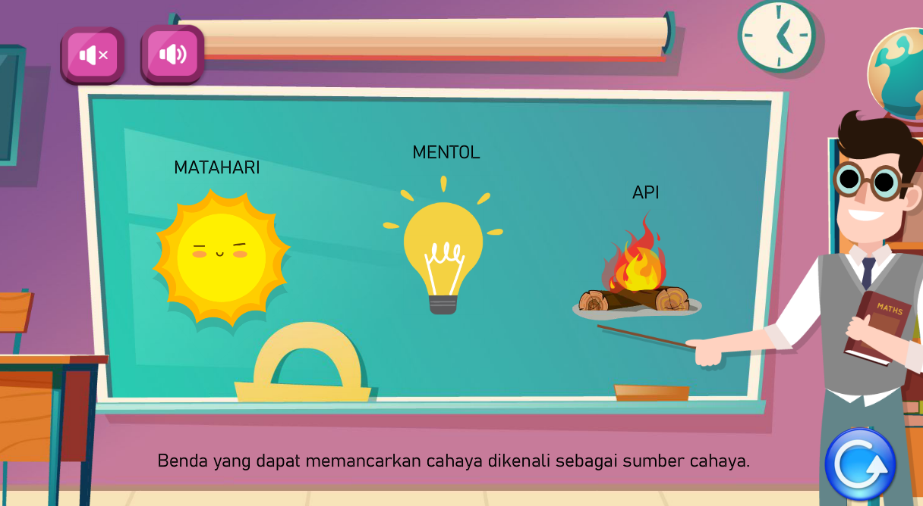
Theory (e.g. ASSISTIVE APPROACH) | How it is implemented
Characteristics | Implementation in the system
3. Visual supports

Slide 9
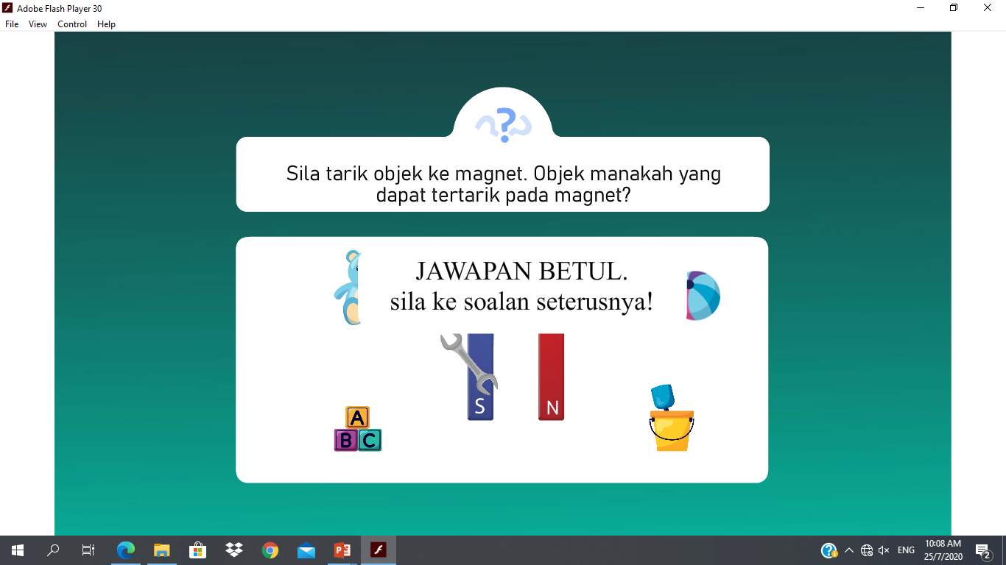
Theory (e.g. ASSISTIVE APPROACH) | How it is implemented
Characteristics | Implementation in the system
4. Independence

Slide 10
Thank you ☺

