Slide 1


E-commerce and delivery management system for pilah store melang (EPSM)
MUNDZIR BIN ROSDI
2017669228
SUPERVISOR: MR MUHAMMAD ATIF RAMLAN

Slide 2

BACKGROUND STUDY
Case study
  Pilah Store Melang
Area of interest
  E-commerce
Domain
  Business
Theory
  On demand delivery service

Slide 3
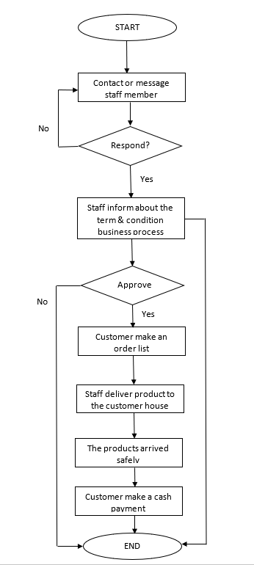
CURRENT
BUSINESS
PROCESS
1
2

Slide 4
PROBLEM STATEMENT
Problem Statement | Proposed Solution
Customer need to wait respond by the staff | With e-commerce, customer can buy directly and staff no need to respond the message.
Customer did not know the availability of the product and there are times when the product is out of stock | With e-commerce, customer can view and check the availability of the product on the catalogue.
Customer need to specify details of the product manually such as brand name and quantities. Sometimes, customer give a wrong details of product | E-commerce help customer give specific details of product and they can see the description of the product so they can buy a right product
Delivery schedule not well manage by the Delivery Man | With the proposed system Delivery Man can view the time and date for the delivery that has been choose by the customer

Slide 5
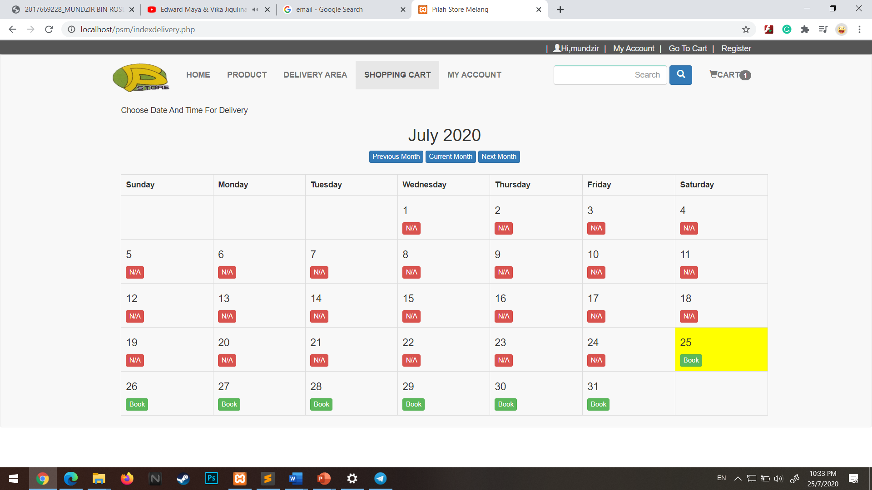
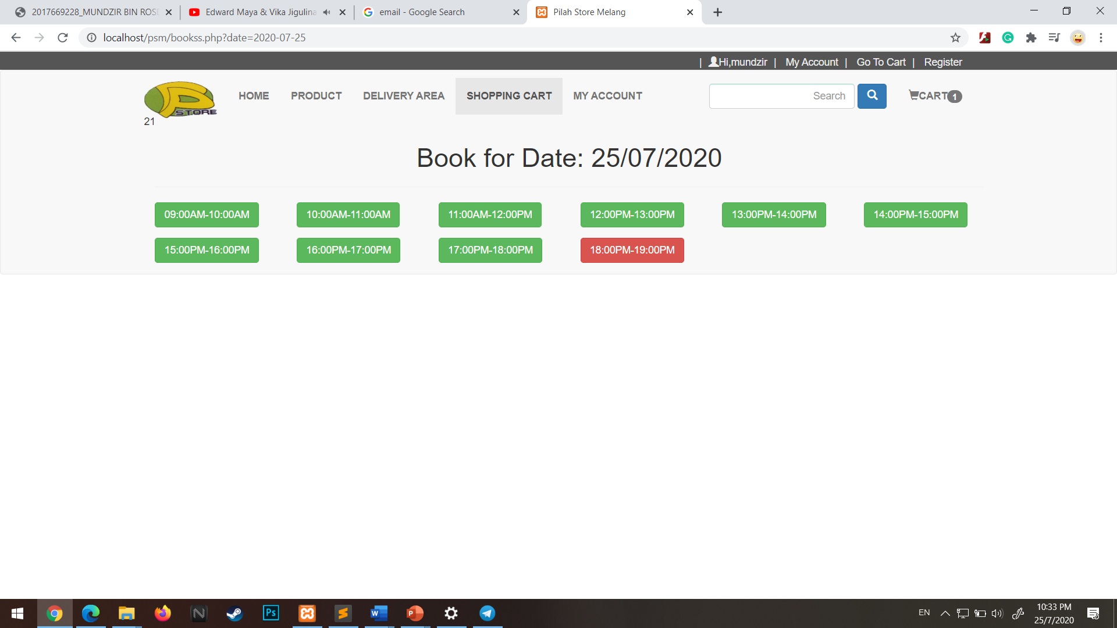
Theory of on demand delivery services and how it implemented in epsm
Characteristic | Implemented In The System
Booking date and time for delivery | Customer can choose date and time for the delivery on the available delivery slot.

Slide 6
Thank you

