Slide 1

Pengurusan Jenazah Courseware
UNIVERSITI TEKNOLOGI MARA
CAWANGAN TERENGGANU
KAMPUS KUALA TERENGGANU
Presenter: Adam Bin Zulkifli
Supervisor: Madam Zeti Darleena Binti Eri
Lecturer: Miss Nik Marsyahariani Binti Nik Daud
EXAMINER: Madam Siti Salbiah Binti Hamzah

Slide 2
Background of Study
Case Study: Sekolah Agama Rakyat Seri Pantai Mersing Johor
Area of Interest: Courseware
Domain: Education
Theory: Cognitive Learning Theory
Current Business Process
Proposed Solution
Both teaching and learning process at Sekolah Agama Rakyat Seri Pantai Mersing Johor is done traditionally where the teachers teach in class and the students taking notes and still using teaching aids like textbooks, whiteboard and marker pen in teaching sessions.
The Johor State Religious School is the only religious and systematic and non-existent religious education in another state where it is an Islamic education school run directly by the state government through the Islamic Education Division of the State Islamic Religious Department of Johor.
Problem | Proposed Solution
1. The level of understanding quite low among students for the topic of pengurusan jenazah. | By using multimedia interaction methods, teachers can focus on the parts that are frequently asked in the examination
2. Students to become less interested and quick to get bored. | There is a sound element that will help students in the process of understanding the situation or topic they are presenting.
3. Lack of teaching aids and tools to assist teachers in informing the topic | The video will be included in order to interest the students in learning and make it easier for the students to see detailed in pengurusan jenazah.
Problem Statement
The level of understanding quite low among students for the topic of pengurusan jenazah.
Students to become less interested and quick to get bored.
Lack of teaching aids and tools to assist teachers in informing the topic
Objectives
To identify the current problem and requirements in learning “pengurusan jenazah” for standard 5 students.
To design and develop learning Pengurusan Jenazah courseware for 5th year students.
To evaluate the functionality and usability of the courseware.

Slide 3
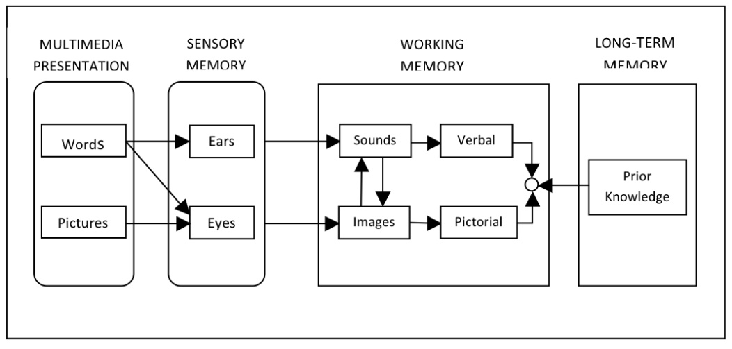
Theory
Theory (Cognitive Learning Theory) | How it is implemented
Characteristics | Implementation in the system
1. Generative processing - cognitive processes that are required for making sense of the presented material (selecting, organizing and integrating words and images) | Photo stacking or puzzle activities related to the position of the funeral.
2. Extraneous processing - cognitive processes that are not required for making sense of the presented material. But occur due to the design of the learning task. | The simple design and arrangement of the buttons are arranged especially on the main menu, indirectly easy for students and teachers in the teaching and learning process.
3. Essential processing - cognitive processes that allow a mental representation to be held in working memory for a period (also termed representational holding) | Each topic will be accompanied by a simulation video to further explain the topics studied and a simple quiz.

