Slide 1
UiTM Industrial Training System
Prepared By: Muhammad Khairulizham Bin Muhammad Isha (201766974)

Slide 2
Background of Study
Problem Statement
Case study: UiTM Industrial Training Management
Area of interest: Management information system
Domain: Industrial training
  Industrial training candidates are difficult to send their log book in given as they are too far from their campus and supervisor.
  The supervisor hard to monitor their industrial training candidates.
  Industrial training candidates are difficult to interact with both of their supervisor at the company and campus in a short time.
Objectives
To identify current gym booking process and requirements for online gym booking system.
To design and develop an online gym booking system for Workout Fitness Gym.
To evaluate the functionality and usability of the proposed system.

Slide 3
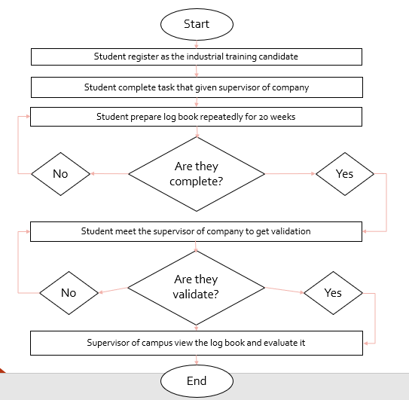
Current Business Process
Approved?

Slide 4
Proposed Solution
Problem Statement | Solution
Industrial training candidates are difficult to send their log book in given as they are too far from their campus and supervisor. | The development of the system enable them to update their log book through it hence their supervisor can get know their activity in time given.
The supervisor hard to monitor their industrial training candidates. | Supervisor can monitor their candidates through the system without going to the company.
Industrial training candidates are difficult to interact with both of their supervisor at the company and campus in a short time. | The system enable to have an effective interaction between them.

Slide 5
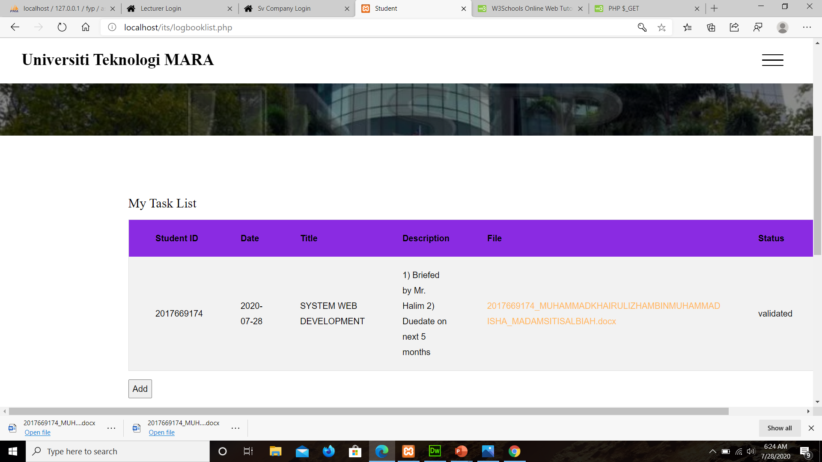
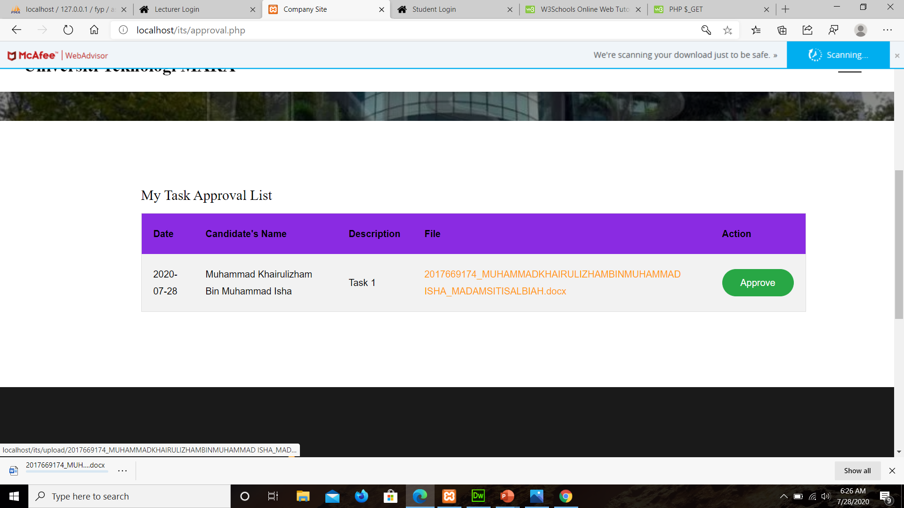
Theory (UiTM Indusrial Training System) | How it is implemented
Characteristic | Implementation in the system
1) Uploading Logbook Task
2) Downloading File

Slide 6
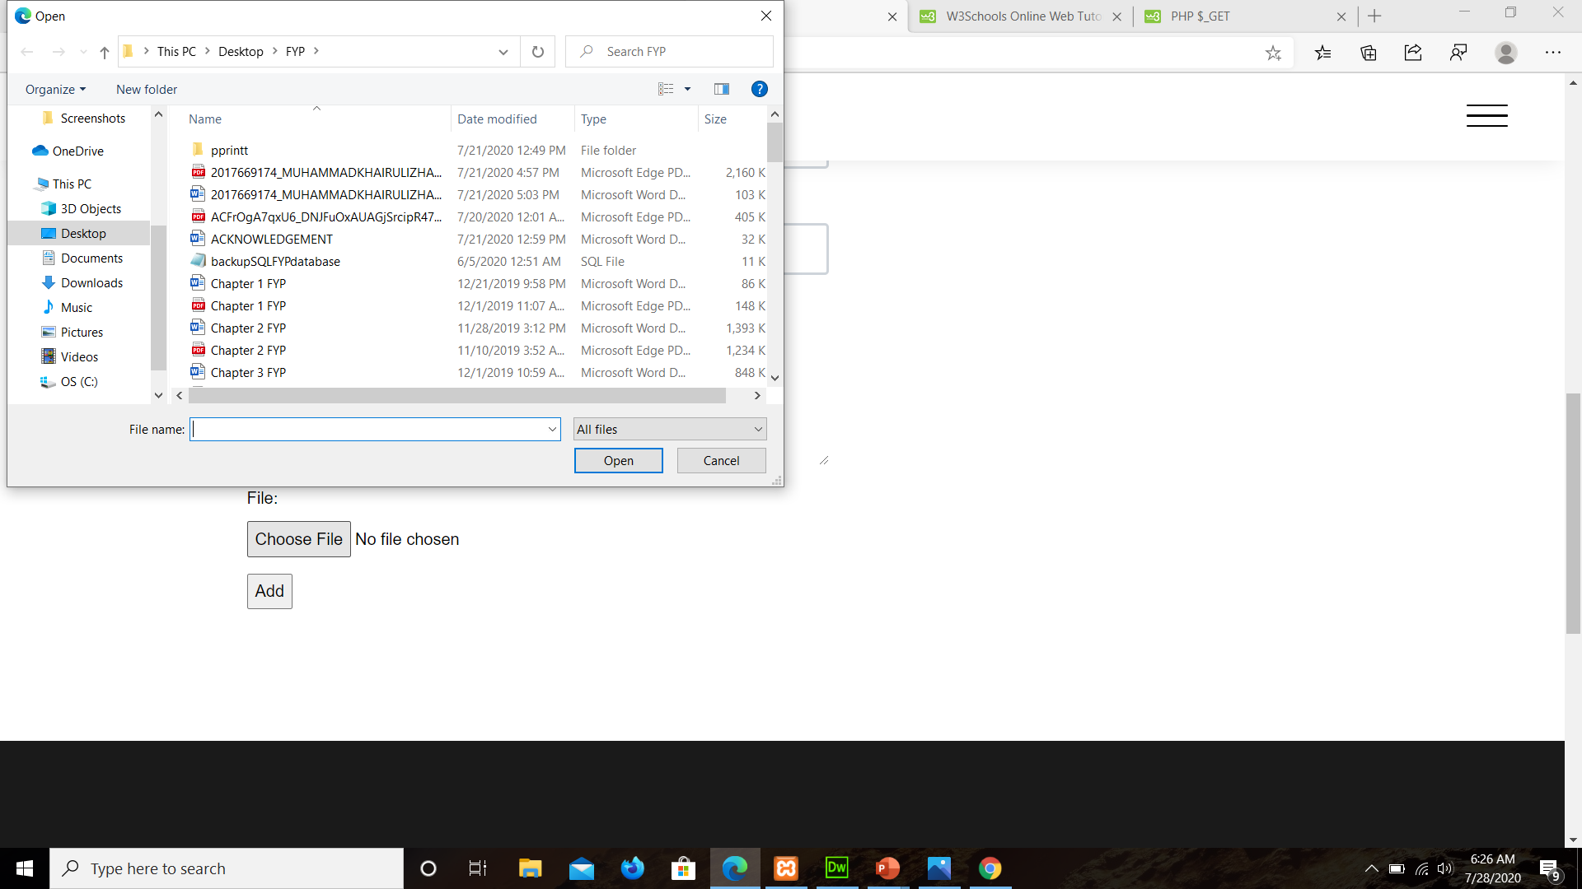
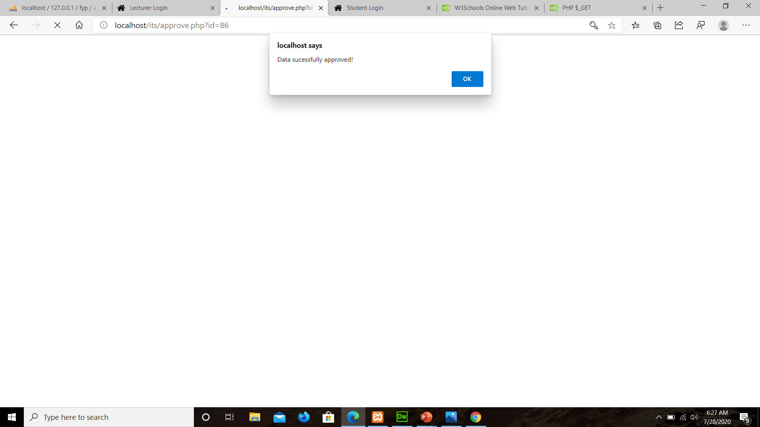
Theory (UiTM Indusrial Training System) | How it is implemented
Characteristic | Implementation in the system
3) Uploading File
4) Approval Logbook Task

Slide 7
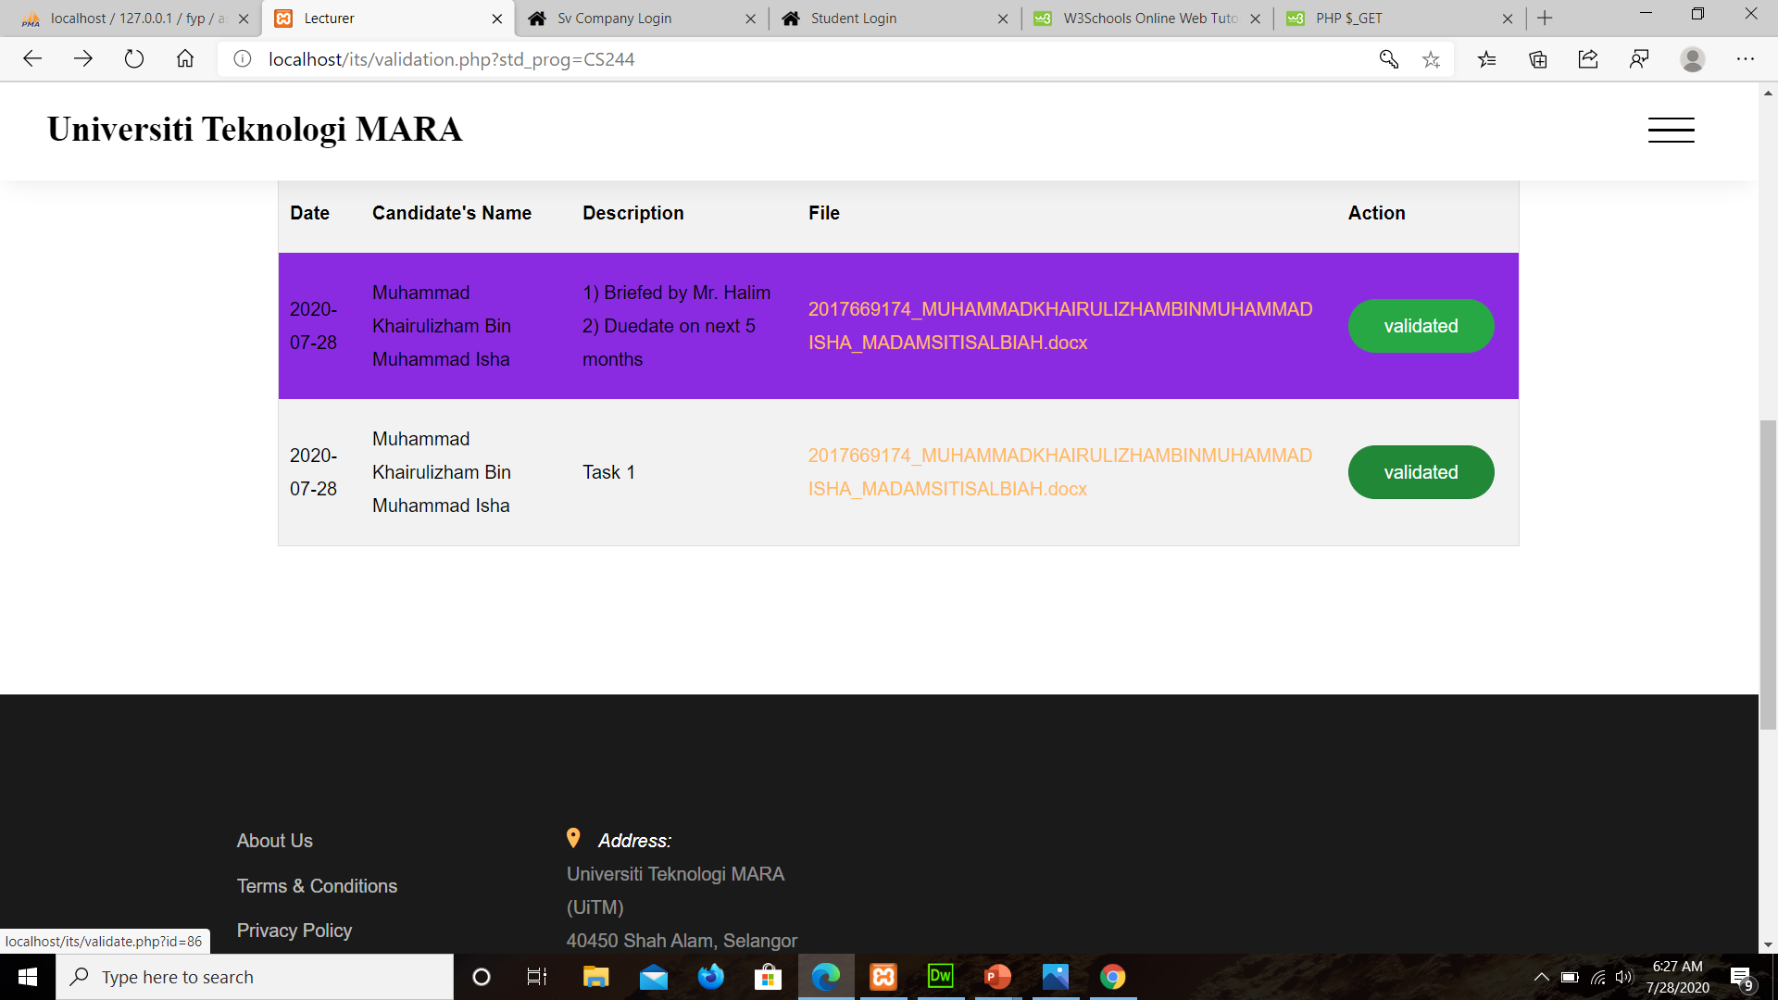
Theory (UiTM Indusrial Training System) | How it is implemented
Characteristic | Implementation in the system
5) Validate Logbook Task

