Slide 1
Plant Nursery Electronic Commerce System
By:
Wan Zarif Haziq Bin Wan Mizan
2017669264

Slide 2
Background of Study
Case Study: Plant Nursery System
AOI: E-commerce
Domain: Business
Theory: Human Computer Interaction
Current Purchasing Process
Proposed Solution
Start
Customer go to the store to buy products
Problem Statement | Proposed Solution
The company does not have their own website | Develop E -commerce online system
The company provides less customer services such as feedback from customer | Develop feedback platform for customer
The company only accept cash money and customer cannot pay online. | Develop online payment
Customer choose the desired products
Problem Statement
1. The company does not have their own website
2. The company provides less customer services such as feedback from customer
3. The company only accept cash money and customer cannot pay online.
Product Obtained
Payment
Objectives
To identify the current business process and requirement of Plant Nursery.
To design and develop a system Plant Nursery E-Commerce system (e-Nursery).
To evaluate the functionality and usability of system for Plant Nursery E-Commerce system (e-Nursery).
End

Slide 3
HCI & EC system
HCI is more than user interfaces and more than ``screen-deep''. In the first 10 to 15 years of its history, HCI focus on interfaces and design criteria for graphical user interface (GUIs) using windows, icons and menus to create an effective system.
Plant Nursery system use Jakob Nielsen’s 10 Usability Heuristic.

Slide 4
HCI priciples implemented: -
Consistency and standards
Recognition rather than recall
Error prevention
Flexibility and efficiency of use

Slide 5
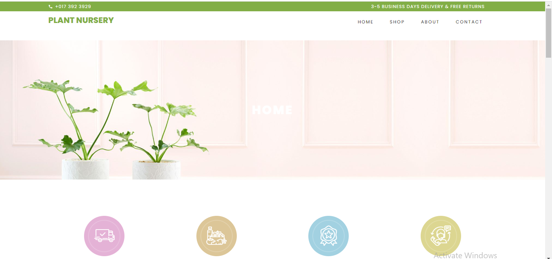
Home page for Bangsal Chetak Website

Slide 6



Merging Human Computer Interaction (UI) concept with EC system
Human Computer Interaction | How it is implemented
Design patterns | Implementation in the system
1. Navigation
2. Message Error
3. Button
4. Icon

