Slide 1


KOSISWA E-MARKETPLACE MOBILE APPLICATIONS
(KEMMA)
BY:
MOHD. AIMAN DANIAL BIN BAKARI
2017669184
SUPERVISOR:
MISS NIK MARSYAHARIANI BINTI NIK DAUD
EXAMINER:
SIR MUHAMMAD ATIF BIN RAMLAN

Slide 2
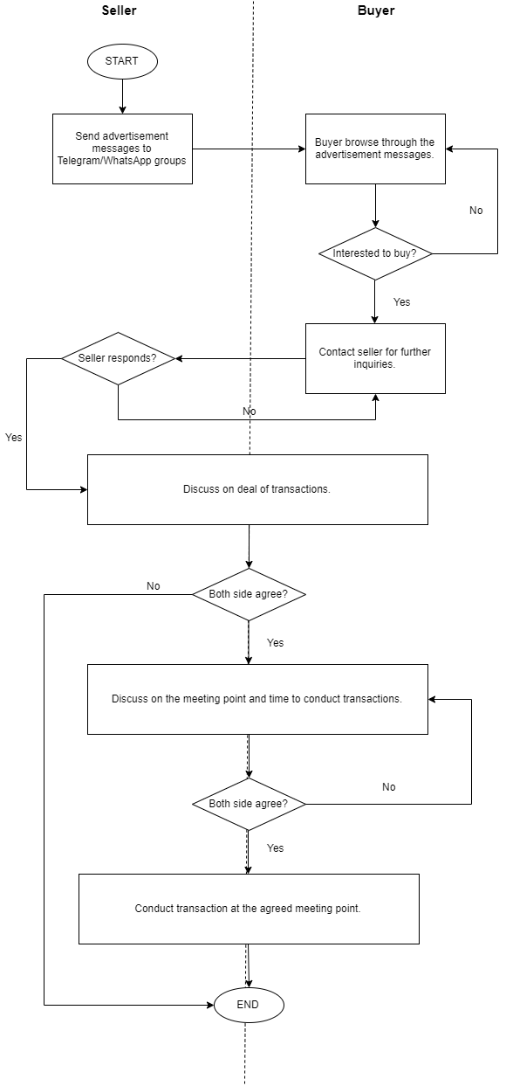
Background of Study
Case Study: KOSISWA E-Marketplace Mobile Application(KEMMA)
AOI: E-marketplace, mobile apps
Domain: E-commerce
Theory: E-marketplace
Current Booking Process
Proposed Solution
Problem | Proposed Solution
1. There are no suitable platform for sellers to conduct business transactions. | Develop an application that can be used as a platform to cater buying and selling transactions among students.
2. Lack of certain information provided by seller to their buyer before buyer can make their decision on the transactions. | Product Catalog with complete product details.
3.Business activities (buying and selling transactions) among students cannot be controlled by the management. | Develop an application that can be used by management to control or regulate buying and selling transactions among students.
Problem Statement
There are no suitable platform for sellers to conduct business transactions.
Lack of certain information provided by seller to their buyer before buyer can make their decision on the transactions.
Business activities (buying and selling transactions) among students cannot be controlled by the management.
Objectives
The development of KEMMA is to meet these three main objectives:
To identify the current business process, problems and requirements of business transactions between students of this campus.
To design and develop an e-marketplace mobile application specialize for business transactions between students of this campus.
To evaluate usability and functionality of proposed e-marketplace mobile application.

Slide 3
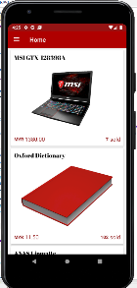
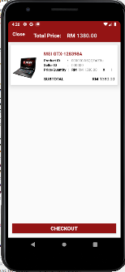
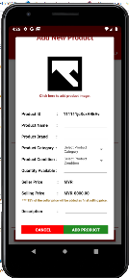
Theory
E-Marketplace | How it is implemented
Characteristics | Implementation in the system
1. Product Catalog
2. Shopping Cart
3. Commision per transaction

