Slide 1
Student Luggage Storage System
(SLSS)
Prepared by :
Sofea Aida binti Sallehan
(2017669176)

Slide 2
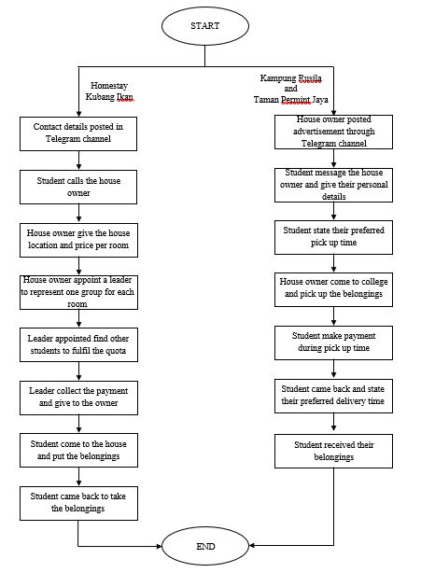
Background of Study
Case Study: UiTM Terengganu Kampus Kuala Terengganu
AOI: Rental Management System
Domain: Educational Institution
Theory: 10 Usability Heuristic by Jakob Nielsen
Problem Statement
1. Time consuming to obtain details of room
2. Risk of losing students information
3. Losing of personal belongings
Current Booking Process
Objectives
1. To identify current process and problems with the current system.
2. To design and develop a system for both user requirements and system requirements.
3. To evaluate the functionality and usability of the system.

Slide 3
Proposed Solution
Problem Statement | Proposed Solution
Too much time consumption in obtaining the details of the room. | Online room booking system.
Manual paper-based system may risk into losing of student and booking information. | Each data of the students will be recorded in a proper database.
Students tend to lost their belonging when they came back to receive their personal belongings. | Booking details is a proof that booking is made by a student.

Slide 4
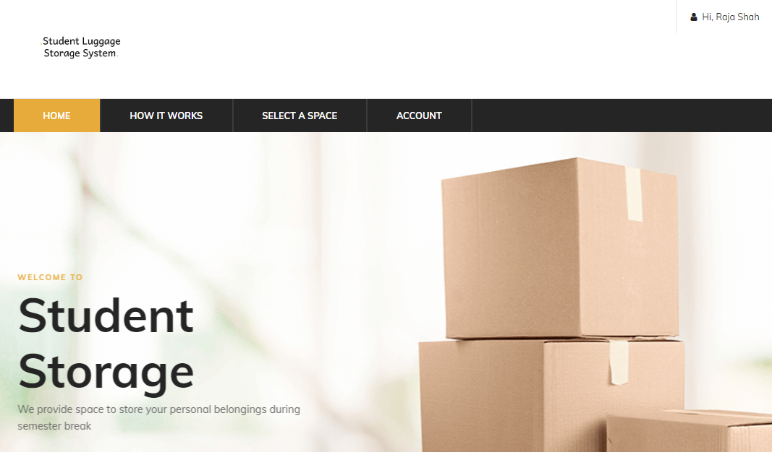
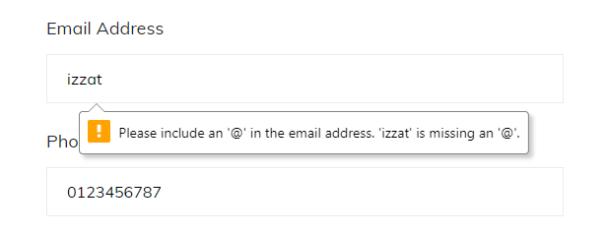
Theory (10 Usability Heuristic for User Interface Design)
Theory (10 Usability Heuristics by Jakob Nielsen) | Implementation in the system
Aesthetic and minimalist design
Help users recognize, diagnose and recover from errors

Slide 5
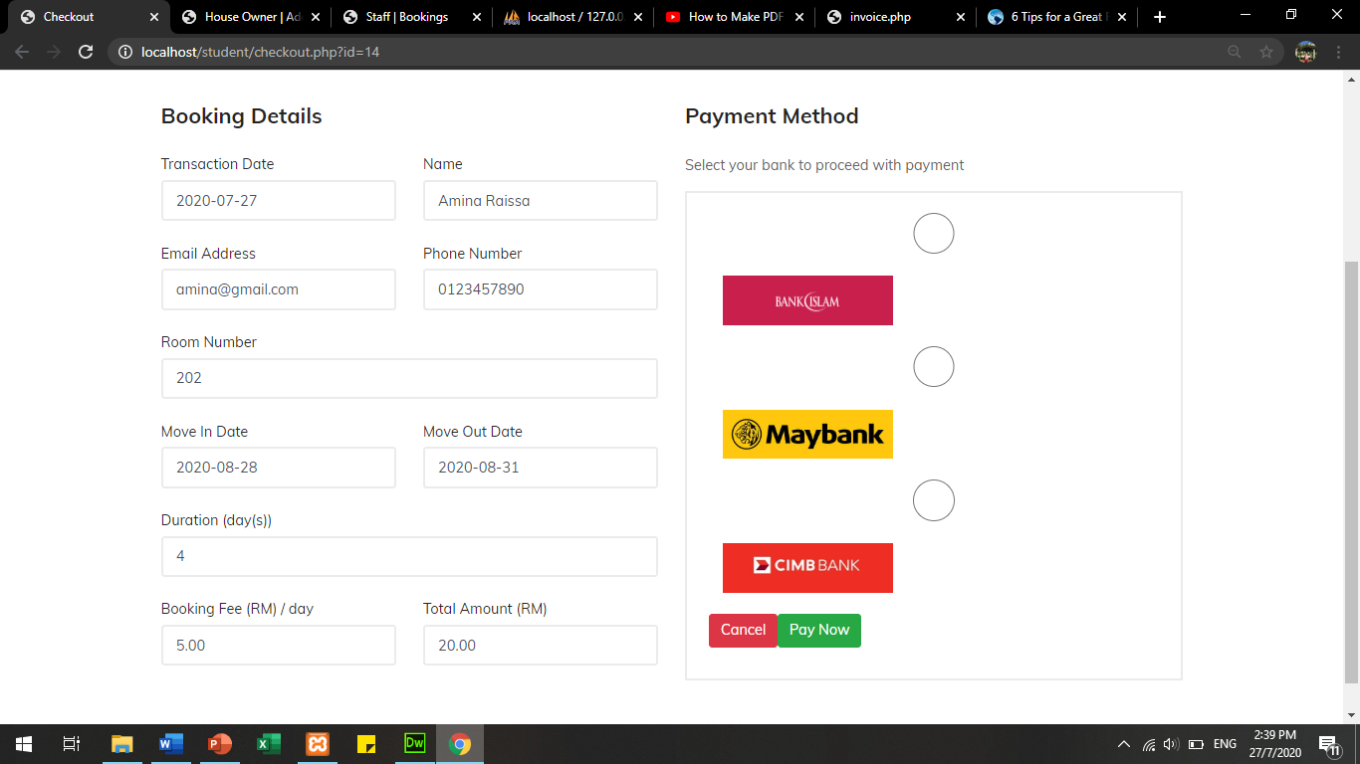
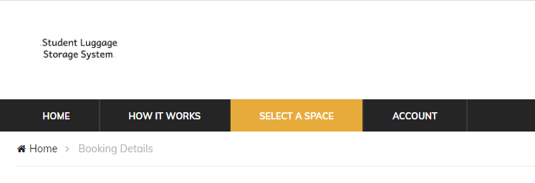
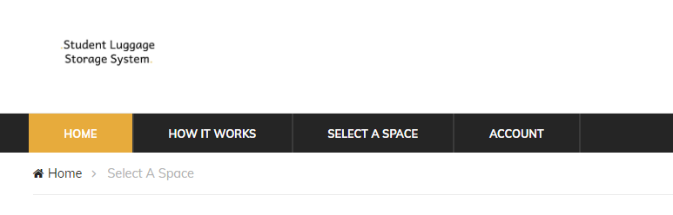
Theory (10 Usability Heuristic for User Interface Design)
Theory (10 Usability Heuristics by Jakob Nielsen) | Implementation in the system
User control and freedom
Consistency and standards

Slide 6
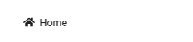
Theory (10 Usability Heuristic for User Interface Design)
Theory (10 Usability Heuristics by Jakob Nielsen) | Implementation in the system
Match between system and real world
Error prevention
Primary action
Secondary action

Slide 7
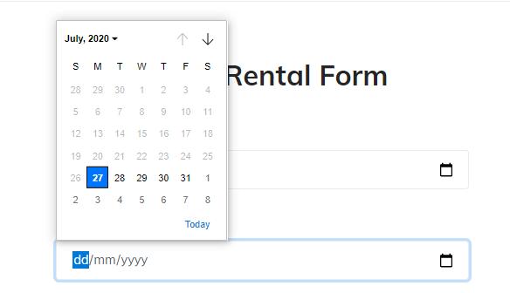
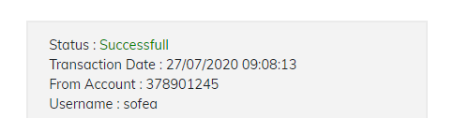
Theory (10 Usability Heuristic for User Interface Design)
Theory (10 Usability Heuristics by Jakob Nielsen) | Implementation in the system
Recognition rather than recall
Visibility of system status

