Slide 1

CANDIDATE’S NAME:
Ahmad Taufik Choo bin Rahmat Choo (2017663652)
PROJECT TITLE:
Classification of ‘Buy Muslim First’ Messages on Twitter Using Deep Convolutional Neural Network
PROGRAM:
CS230 – Bachelor of Computer Science (Hons.)
SUPERVISOR’S NAME:
Norulhidayah binti Isa

Slide 2
Problem Statement
The BMF initiative is gaining popularity in our country but there exists little to no way of identifying the market opinion regarding it.
Muslim markets does not have enough source to collect the required intelligence to plan business strategies.
Manual predictions take too much time and effort while machine learning can perform with relative ease.

Slide 3
Objectives
To identify the steps involved in data preparation.
To develop a prototype classifier using DCNN.
To evaluate the performance of the classifier in term of accuracy.

Slide 4

Scope
Twitter data is obtainable by integrating Java application with the Twitter service by using Twitter4J library.
All data is collected directly from Twitter.
2526 instances of Twitter data were collected.

Slide 5
Other Researches on Twitter Messages
Research Title | Aim | Algorithm
Classification of sentiment reviews using n-gram machine learning approach (Tripathy, Agrawal, & Rath, 2016) | To evaluate the accuracy of four different approaches of sentiment analysis | Naïve Bayes
Sentiment Classification Using Convolutional Neural Network (Kim & Jeong, 2019) | To develop new approach using consecutive convolutional layers for longer texts | Convolutional Neural Networks
Machine Learning-Based Sentiment Analysis for Twitter Accounts (Hasan, Moin, Karim, & Shamshirband, 2018) | To develop a hybrid approach for sentiment analysis | Support vector machines

Slide 6
Other Researches using DCNN
Field | Research Title | Aim
Granularity analysis in image classification | Rock Images Classification by using Deep Convolution Neural Network (Cheng & Guo, 2017) | To improve efficiency and accuracy of manual granularity analysis
Sentiment analysis | UNITN: Training Deep Convolutional Neural Network for Twitter Sentiment Classification (Severyn & Moschitti, 2015) | To develop a process to initialize CNN parameter weights
Breast cancer histology image analysis | Deep Convolutional Neural Network for Breast Cancer Histology Image Analysis (Rakhlin, Shvets, Iglovikov, & Kalinin, 2018) | To develop computational approach for breast cancer histology image classification
Image classification | Deep Convolutional Neural Networks for Image Classification (Rawat & Wang, 2017) | To identify the importance of DCNN in image classification

Slide 7
Similar Systems
Research Title | Aim
UNITN: Training Deep Convolutional Neural Network for Twitter Sentiment Classification (Severyn & Moschitti, 2015) | To develop a process to initialize CNN parameter weights
A Study of Sentiment Analysis Techniques of Twitter Data (Alsaeedi & Khan, 2019) | To explore the various methods for sentiment analysis applied to Twitter data
Twitter Sentiment Classification using Distant Supervision (Go, Bhayani, & Huang, 2009) | To develop a method for sentiment analysis using machine learning algorithms

Slide 8


Project Conceptual Framework
Java | Python
Data Collection | Data Preprocessing |  | Training | Model Development
Java source code Twitter API Excel files Notepad files | Tokenization Remove punctuation Lowercasing Remove stop words | Splitting (90:10) | Testing | Embedding layer Convolution layer Max pooling layer

Slide 9
Project Methodology Framework
PHASE | ACTIVITIES |  | OUTPUT
Preliminary Study | Literature Review | Read articles on: Twitter sentiment analysis DCNN classifier Twitter API | Background of Study Problem Statement Objectives Scope
Data Collection | Twitter API | Extract data from Twitter | 2526 instances of raw data
Data Preprocessing | Tokenize Remove punctuation Lowercasing Remove stop words |  | Cleaned documents
Algorithm Design | Develop the model Fit the model on training data Test the model |  | BMF data model
Findings and Results | Model accuracy analysis Documentation |  | Final Project Report

Slide 10
Data Analysis

Slide 11
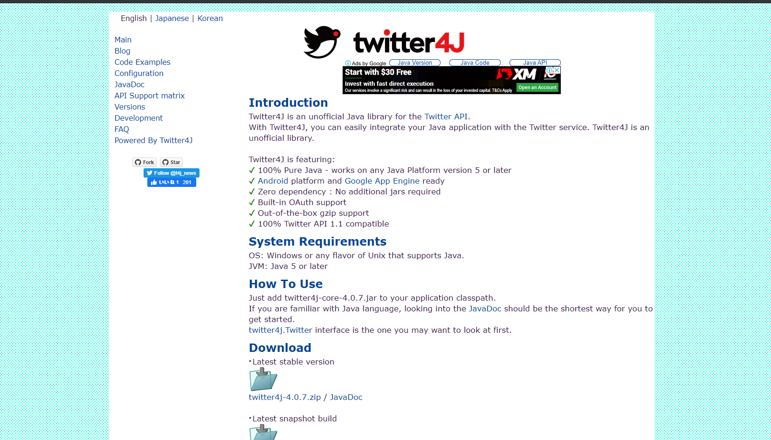
twitter4j.org/en/

Slide 12
import java.util.*;
import twitter4j.Status;
import twitter4j.Paging;
import twitter4j.ResponseList;
import twitter4j.Twitter;
import twitter4j.TwitterFactory;
import twitter4j.auth.AccessToken;
import twitter4j.conf.ConfigurationBuilder;
import twitter4j.TwitterException;
public class secondBMF
{
public static void main (String args[]) throws TwitterException
{
ConfigurationBuilder cb = new ConfigurationBuilder();
cb.setDebugEnabled(true)
.setOAuthConsumerKey("BU4Sa8c6U3k0kbhNRQjRf2Vpy")
.setOAuthConsumerSecret("6sft9tThD6lvBYKvmQv6bfNZ4LUm6w1Xv7YeWzcjqPyUHE1xnJ")
.setOAuthAccessToken("257897939-p9uCqPMyCuWT4apLCyBdGZJ4m0RpTGLwpN2xSJ5y")
.setOAuthAccessTokenSecret("OeneTmtsvVh8R8lSTvMfEjkphGxji1hCzohSdZkKAheOF");
TwitterFactory tf = new TwitterFactory(cb.build());
twitter4j.Twitter twitter = tf.getInstance();
List<Status> status = twitter.getHomeTimeline();
for (Status st : status)
{
System.out.println("=================\n>>>"+st.getUser().getName()+
"<<<\n"+st.getText()+"\n=================\n\n\n");
}
}
}

Slide 13
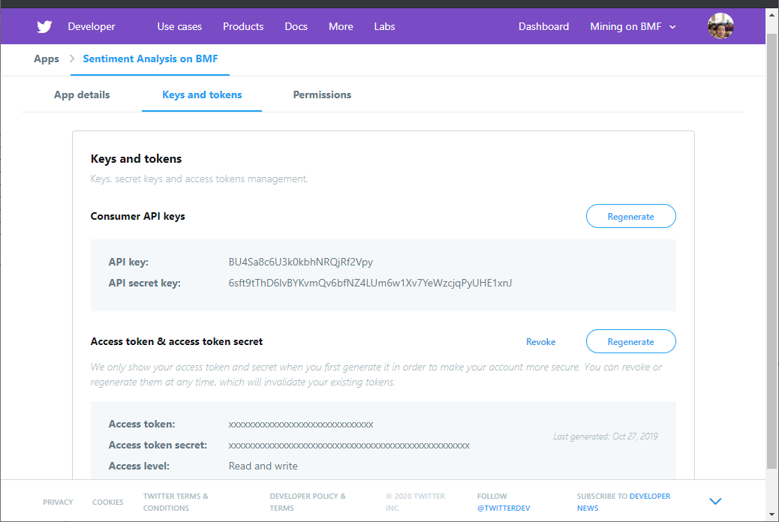
developer.twitter.com

Slide 14
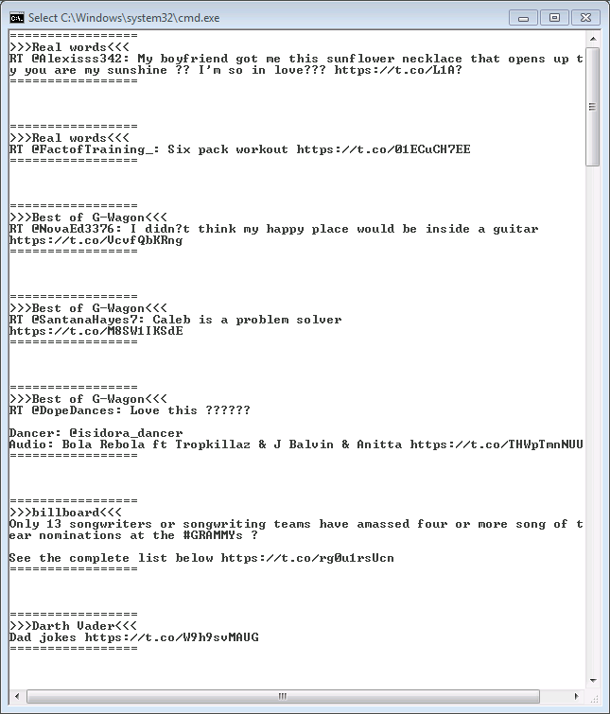
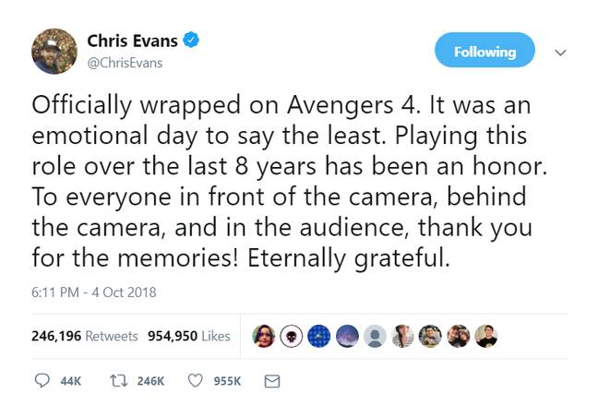
ASPECT | DETAIL
Source | Twitter
Data | Tweets related to BMF
Data type | String
Amount | 2526
Data mining technique | Classification

Slide 15
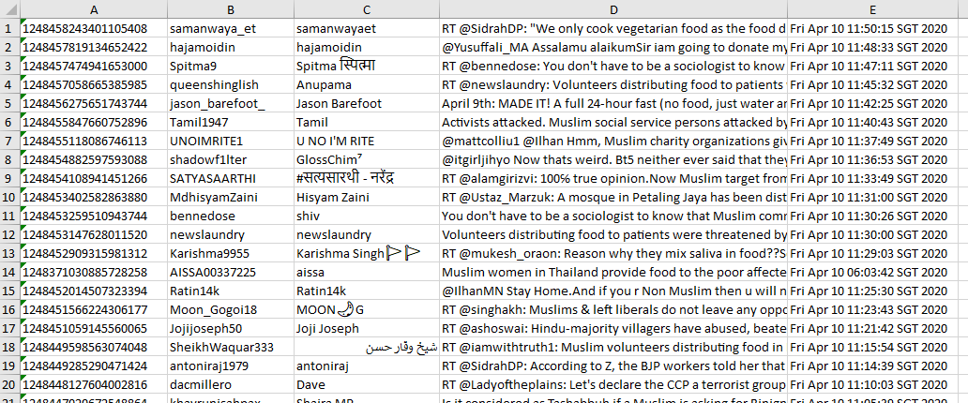
Tweet ID
User ID
Username
Tweet text
Timestamp

Slide 16
Preprocessing
Input | Have you tried Muslim products before? You must try them! I always support BMF because I like how Muslims make clean and halal products. Did you know that 85% of high quality carpets are made by Muslims?
Tokenize | ['Have', 'you', 'tried', 'Muslim', 'products', 'before?', 'You', 'must', 'try', 'them!', 'I', 'always', 'support', 'BMF', 'because', 'I', 'like', 'how', 'Muslims', 'make', 'clean', 'and', 'halal', 'products.', 'Did', 'you', 'know', 'that', '85%', 'of', 'high', 'quality', 'carpets', 'are', 'made', 'by', 'Muslims?’]
Remove punctuation | Have you tried Muslim products before You must try them I always support BMF because I like how Muslims make clean and halal products Did you know that 85 of high quality carpets are made by Muslims
Lowercasing | have you tried muslim products before you must try them i always support bmf because i like how muslims make clean and halal products did you know that 85 of high quality carpets are made by muslims
Remove stop words | tried muslim products must try always support bmf like muslims make clean halal products know 85 high quality carpets made muslims

Slide 17
BMF Classification Process Flowchart
Start | Clean the sentence |  |  |  | Load into the model for prediction |  | End
 | Tokenize | Remove punctuation | Lowercasing | Remove stop words
Input the sentence |  |  |  | Convert into sequences |  | Predicted polarity of the sentiment

Slide 18
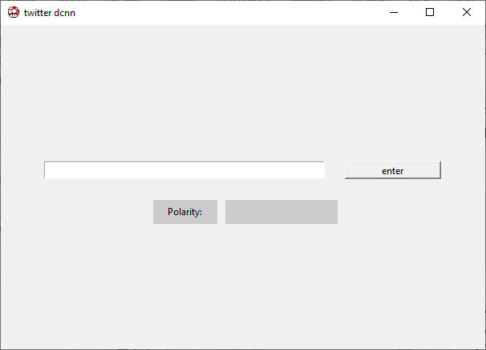
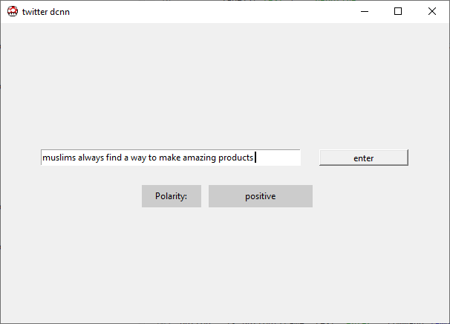

Slide 19

Pseudocode (Implementation)
input=entry.get()
if len(input)==0: output=‘’ #blank
else:
token=clean(input)
document.append(token)
encoded=tokenizer.texts_to_sequences(document)
padded=pad_sequences(encoded, maxlen=ML, padding=‘post’)
output=loaded_model.predict_clasess(padded)
label[‘text’]=output

Slide 20

Experiment Setup (python)
Sample input (raw data):
After seeing the viral video of a Muslim being caught spitting on the food of his customer before he served it, I have decided that I will no longer support the Muslim market, and anything related to Muslim products.
To conduct the experiments, data must be cleaned (first step).
Next step, the padded sequences must be loaded to the model for prediction of the polarity.
Tokenize | ['After', 'seeing', 'the', 'viral', 'video', 'of', 'a', 'Muslim', 'being', 'caught', 'spitting', 'on', 'the', 'food', 'of', 'his', 'customer', 'before', 'he', 'served', 'it,', 'I', 'have', 'decided', 'that', 'I', 'will', 'no', 'longer', 'support', 'the', 'Muslim', 'market', 'and', 'anything', 'related', 'to', 'Muslim', 'products.']
Remove punctuation | After seeing the viral video of a Muslim being caught spitting on the food of his customer before he served it I have decided that I will no longer support the Muslim market and anything related to Muslim products
Lowercasing | after seeing the viral video of a muslim being caught spitting on the food of his customer before he served it i have decided that i will no longer support the muslim market and anything related to muslim products
Remove stop words | seeing viral video muslim caught spitting food customer served decided longer support muslim market anything related muslim products
Convert to sequences | [2, 3, 4, 1, 5, 6, 7, 8, 9, 10, 11, 12, 1, 13, 14, 15, 1, 16]
Padding (post) | [ 2 3 4 1 5 6 7 8 9 10 11 12 1 13 14 15 1 16 0 0 0 0 0]

Slide 21
Result Analysis
Filter Size | Kernel Size | Dropout | Accuracy (%)
32 | 5 | 0.2 | 45.78
 |  | 0.1 | 53.88
 | 8 | 0.2 | 47.27
 |  | 0.1 | 51.90
128 | 5 | 0.2 | 43.67
 |  | 0.1 | 55.46
 | 8 | 0.2 | 51.39
 |  | 0.1 | 52.02

Slide 22
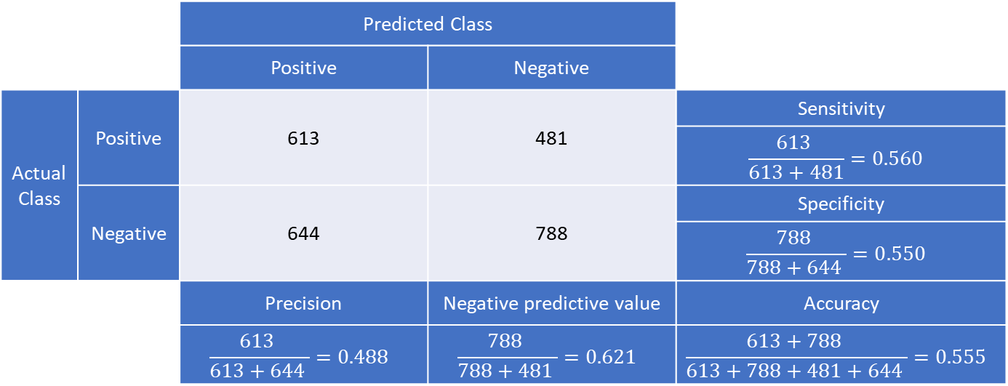
Result Analysis
Based on the results, the classifier is working but with low performance.
Analysis suggests that the issue may have been caused by a problem in model training.
The highest accuracy was 55.46% gained from the following specs:
Filter size = 128
Kernel size = 5
Dropout = 0.1
 |  | Predicted Class
 |  | Positive | Negative
Actual Class | Positive | 613 | 481 | Sensitivity
 |  |  |  | $$\frac{613 }{613+481}=0.560$$
 | Negative | 644 | 788 | Specificity
 |  |  |  | $$\frac{788 }{788+644 }=0.550$$
 |  | Precision | Negative predictive value | Accuracy
 |  | $$\frac{613 }{613+644 }=0.488$$ | $$\frac{788 }{788+481 }=0.621$$ | $$\frac{613+788 }{613+788+481+644 }=0.555$$

Slide 23
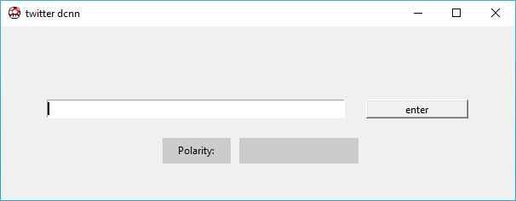
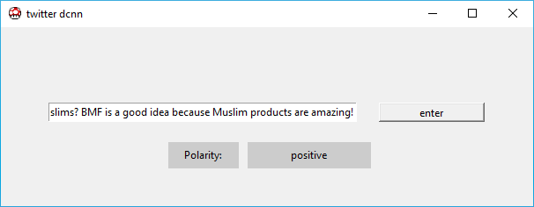
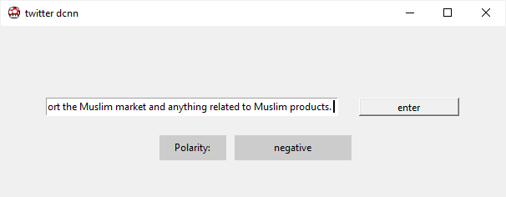

Slide 24
Conclusion
Accuracy has room for improvements.
All objectives are achieved.
Future works must use better dataset.

Slide 25
References
Alsaeedi, A., & Khan, M. Z. (2019). A Study on Sentiment Analysis Techniques of Twitter Data. 10(2), 361–374.
Attia, M., Samih, Y., Elkahky, A., & Kallmeyer, L. (2016). Multilingual Multi-class Sentiment Classification Using Convolutional Neural Networks. 635–640.
Bommerson, B. (2015). Machine learning to classify bullying messages on Twitter Research questions. 2005, 1–14.
Cheng, G., & Guo, W. (2017). Rock Images Classification by using Deep Convolution Neural Network.
Deriu, J., & Cieliebak, M. (2016). Sentiment Analysis using Convolutional Neural Networks with Multi-Task Training and Distant Supervision on Italian Tweets.

Slide 26
References
Go, A., Bhayani, R., & Huang, L. (n.d.). Twitter Sentiment Classification using Distant Supervision.
Gupta, B., Negi, M., Vishwakarma, K., Badhani, P., & Rawat, G. (2017). Study of Twitter Sentiment Analysis using Machine Learning Algorithms on Python. 165(9), 29–34.
Hosseinmardi, H., Mattson, S. A., Rafiq, R. I., Han, R., Lv, Q., & Mishra, S. (2014). Detection of Cyberbullying Incidents on the Instagram Social Network.
Ismail, I., Azlina, N., Abdullah, N., Ahmad, Z., & Sidek, N. L. (2011). Halal Principles and Halal Purchase Intention Among Muslim Consumers.
Jianqiang, Z., Xiaolin, G. U. I., & Xuejun, Z. (2018). Deep Convolution Neural Networks for Twitter Sentiment Analysis. IEEE Access, 6, 23253–23260. https://doi.org/10.1109/ACCESS.2017.2776930

Slide 27
References
Karim, J. A., Rahman, S. A., & Ariffin, Z. Z. (2011). Do Muslims Purchase Muslim Products ? Muslim Centric Ness : An Exploratory Study. 25, 60–65.
Kharde, V. A. (2016). Sentiment Analysis of Twitter Data : A Survey of Techniques. 139(11), 5–15.
Kim, H., & Jeong, Y. (2019). applied sciences Sentiment Classification Using Convolutional Neural Networks. 1–14. https://doi.org/10.3390/app9112347
Kumar, A., & Sebastian, T. M. (2012). Sentiment Analysis on Twitter. 9(4), 372–378.
Molchanov, P., Yang, X., Gupta, S., Kim, K., Tyree, S., & Kautz, J. (n.d.). Online Detection and Classification of Dynamic Hand Gestures with Recurrent 3D Convolutional Neural Networks.

Slide 28
References
Passonneau, R., Agrawal, A., Xie, B., Vovsha, I., & Rambow, O. (2011). Sentiment Analysis of Twitter Data.
Puteh, M., Abu Bakar, A., Hamdan, A. R., & Omar, K. (2008). Classifying Heterogeneous Data With Artificial Immune System. 4–8.
Rakhlin, A., Shvets, A., Iglovikov, V., & Kalinin, A. A. (n.d.). Deep Convolutional Neural Networks for Breast Cancer Histology Image Analysis.
Rawat, W., & Wang, Z. (2017). Deep Convolutional Neural Networks for Image Classification : A Comprehensive Review Deep Convolutional Neural Networks for Image Classification : A Comprehensive Review. October. https://doi.org/10.1162/NECO
Severyn, A., & Moschitti, A. (2015). UNITN : Training Deep Convolutional Neural Network for Twitter Sentiment Classification. SemEval, 464–469.

Slide 29
References
Spencer, J., & Uchyigit, G. (n.d.). Sentimentor : Sentiment Analysis of Twitter Data. 56–66.
Tang, D., Qin, B., & Liu, T. (2014). Aspect Level Sentiment Classification with Deep Memory Network.
Tripathy, A., Agrawal, A., & Rath, S. K. (2016). Classification of sentiment reviews using n-gram machine learning approach. Expert Systems With Applications, 57, 117–126. https://doi.org/10.1016/j.eswa.2016.03.028
Wehrmann, J., Becker, W. E., & Barros, R. C. (2018). A Multi-Task Neural Network for Multilingual Sentiment Classification and Language Detection on Twitter.
Wikipedia. (2016). Giant Hypermarket. https://en.wikipedia.org/w/index.php?%0Atitle=Giant_Hypermarket&oldid=916901328

