Slide 1

UNSTEADY MHD BOUNDARY LAYER FLOW OVER A STRETCHING SURFACE EMBEDDED IN POROUS MEDIUM WITH RADIATION EFFECT
BY: NUR SYIFFAHANI BINTI ABU SAMAH
PROGRAM: BACHELOR OF SCIENCE (HONS.) COMPUTER MATHEMATICS
SUPERVISOR: PUAN ZANARIAH BINTI MOHD YUSOF
FACULTY OF COMPUTER AND MATHEMATICAL SCIENCES UITM KUALA TERENGGANU

Slide 2
Introduction
Magnetohydrodynamic
(MHD)
Radiation
Known as the magnetic field.
Emitted in all directions to the hemisphere above the surface by every point of the plain surface.
Permeability
Heat transfer
Boundary layer
Permeability relates to how the pore spaces are linked to each other.
Categorised into different mechanisms such as thermal conduction, thermal convection, thermal radiation.
The thin region of flow adjacent to surface.

Slide 3
PROBLEM STATEMENT
The magnetic field and thermal radiation significantly influence the thickness of the velocity and thermal boundary surface. This may impact parameter and temperature distribution in the equation of the boundary layer problem. The quality of the final product depends on parameters with the rate of heat transfer at the stretching surface during the manufacturing processes.

Slide 4
OBJECTIVE OF THE RESEARCH
To transform the partial differential equation to the ordinary differential equation in boundary layer equation via a similarity transformation.
To solve the ordinary linear equation numerically by using Runge-Kutta-Fehlberg method with shooting technique.
To analyse the effect of the permeability parameter, unsteadiness parameter, radiation parameter, magnetic parameter and Prandtl number parameter on the thermal boundary layer together with heat of transfer characteristics.

Slide 5
Our Services
Significance of The Study
The measured and studied effect of internal and external forces can be advantageous to the industrial manufacturing process in the creation of the boundary layer.
It is possible to control the end product of any industrial manufacturing process and the necessary value as the demands of consumers can be achieved by the heat transfer occurring on the surface.

Slide 6
Literature Review
Ibrahim and Tulu (2019) found that the pressure gradient, permeability, and magnetic parameters increase with the decrease in thickness of the velocity boundary layer.
Mabood et al.(2017) found that the temperature and thermal boundary layer thickness decrease with increasing values of the diffusivity ratio.
2019
Mabood et al. (2016) stated that increasing nanoparticular values and the velocity profiles decrease. The increase in the volume fraction of the nanoparticles increases the temperature distribution of both nanofluids.
Alao et al.(2019) stated that the increase in heat radiation would increase concentration profile and decrease in velocity and temperature of the fluid.

Slide 7
METHODOLOGY
01
Topic selection
02
Understanding the related governing and boundary condition
03
Introducing new parameter
04
Transformations of Partial Differential Equations (PDE) and
Ordinary Differential Equations (ODE)
05
Numerical method
06
Plotting the graph
07
Analyse the result

Slide 8
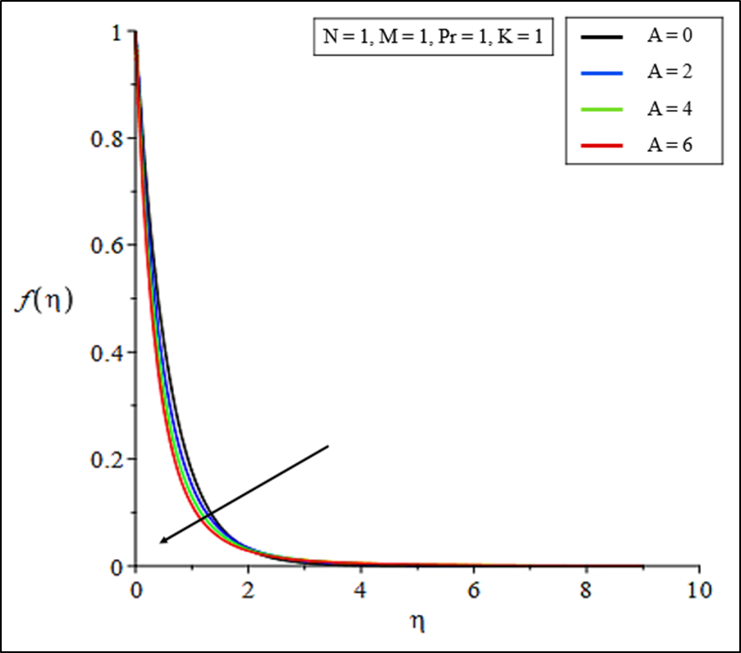
Result and Discussion
N Unsteadiness
A Radiation
K Permeability
M Magnetic
Pr Prandtl number
The velocity profile thickness decreases as A increases with velocity profile gradient. The skin friction coefficient increases.
Figure 1: Velocity profiles for the various value of A

Slide 9
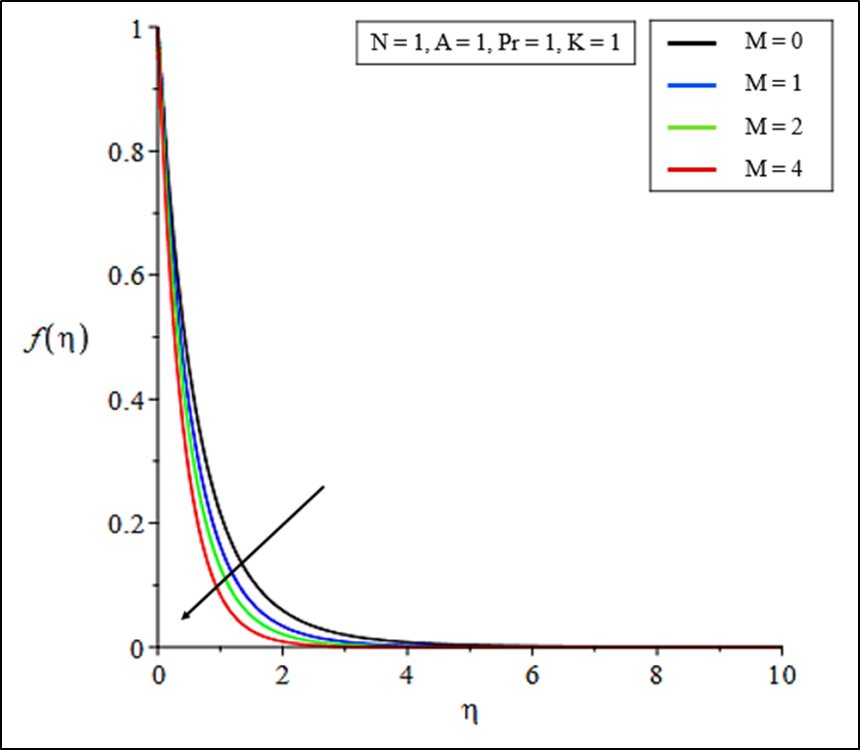
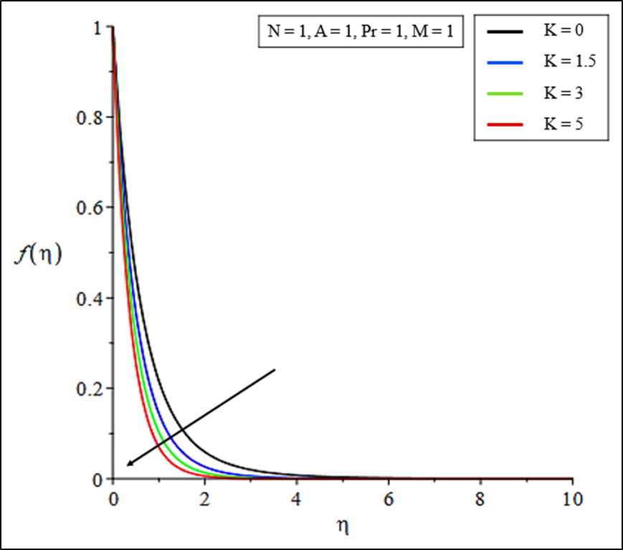
Figure 2: Velocity profiles for the various value of M
Figure 3: Velocity profiles for the various value of K
Both figure show the velocity profile thickness decreases as M or K increases with increasing velocity profile gradient and skin friction coefficient increases.

Slide 10
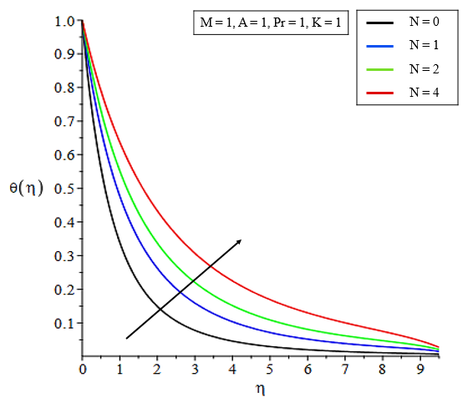
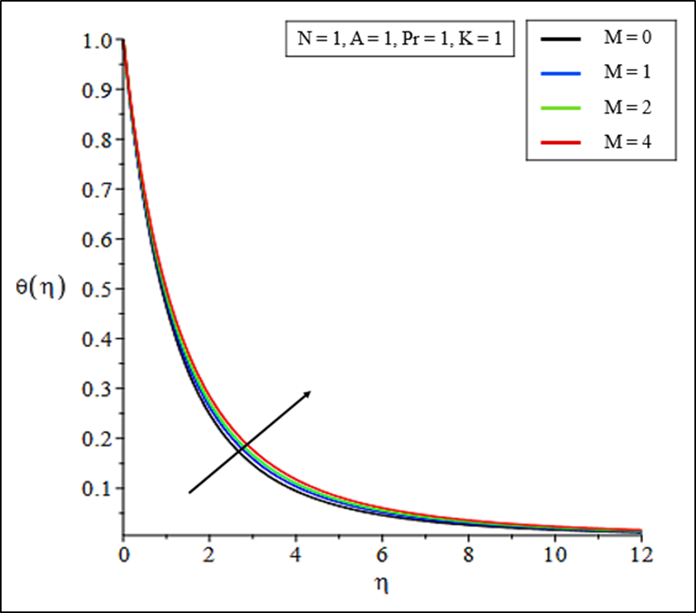
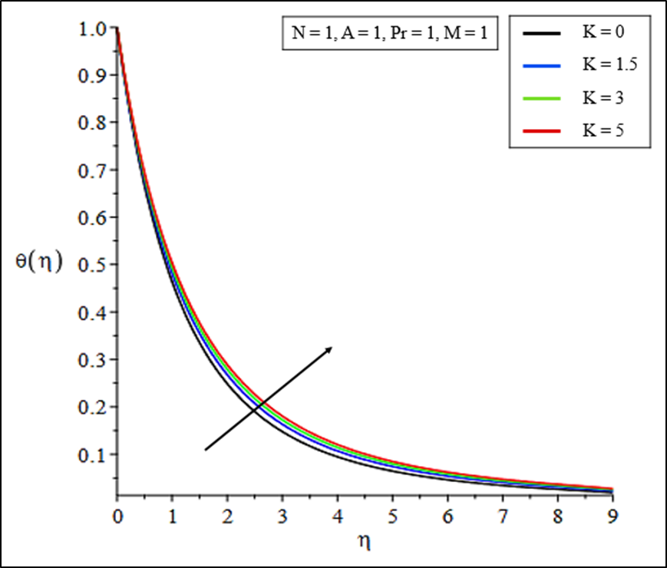
All three figure show that the temperature profile thickness increases with N or M or K and temperature profile gradient decrease. Thus, heat transfer rate decreases.
Figure 4: Temperature profiles for the various value of N
Figure 5: Temperature profiles for the various value of M
Figure 6: Temperature profiles for the various value of K

Slide 11
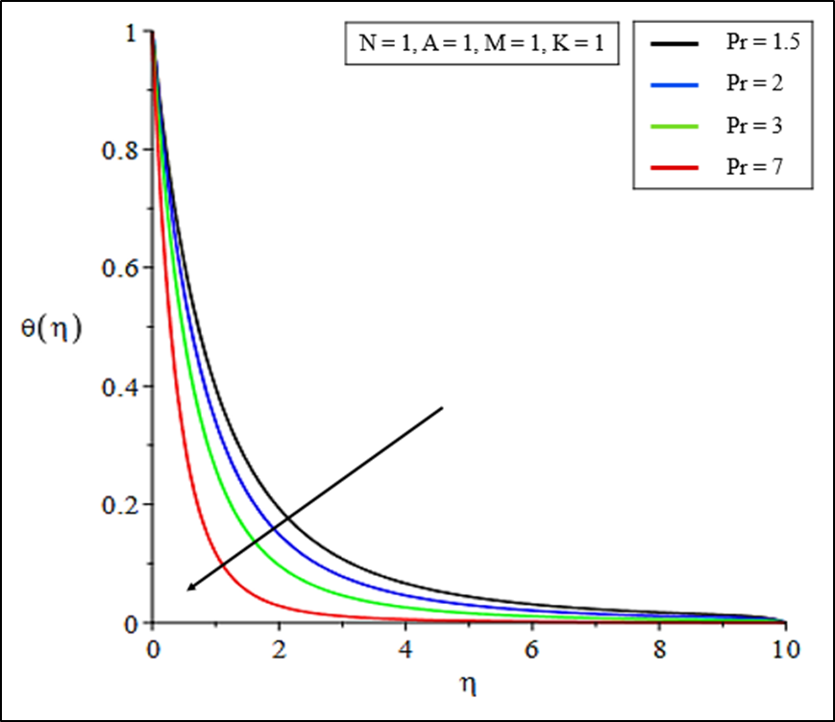
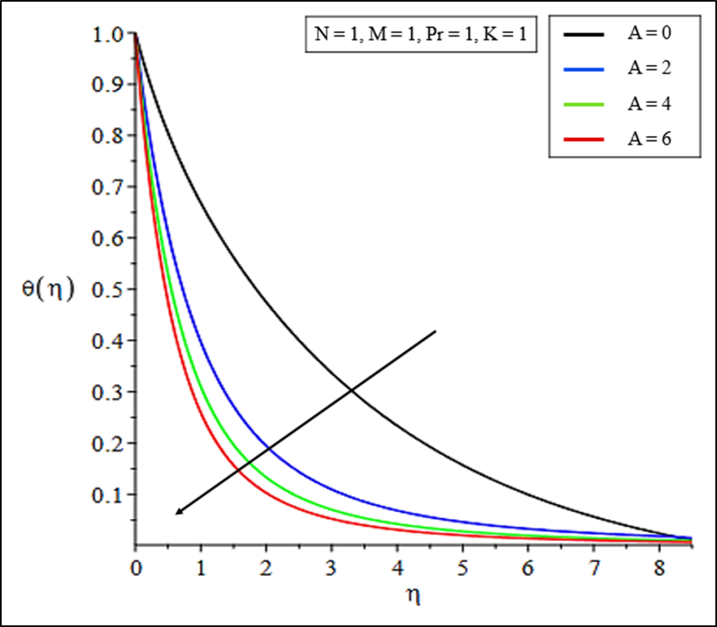
Figure 7: Temperature profiles for the various value of Pr
Figure 8: Temperature profiles for the various value of A
Both figure show that the temperature profile thickness decreases with Pr or A and temperature profile gradient increase. Thus, heat transfer rate increases.

Slide 12
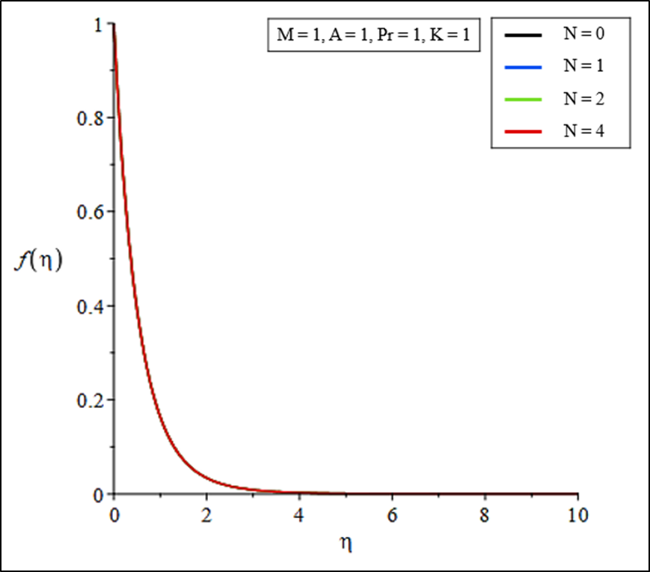
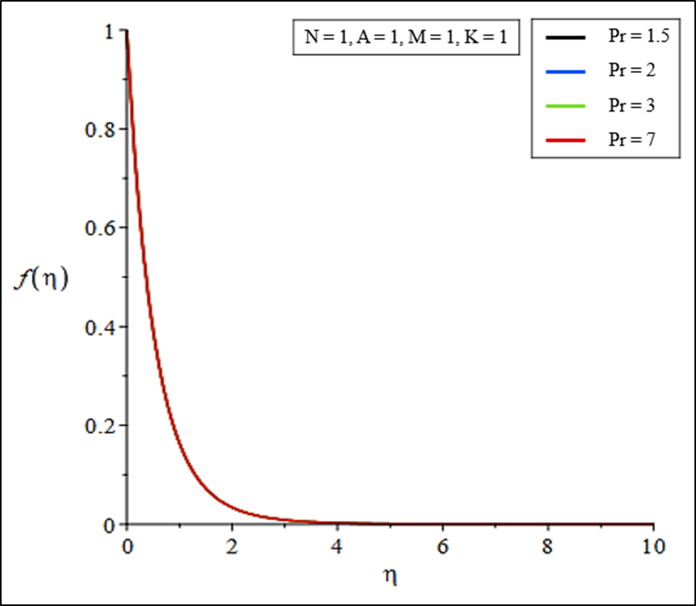
Figure 9: Velocity profiles for the various value of N
Figure 10: Velocity profiles for the various value of Pr
Both figure show no effect of N or Pr on velocity profile.
This phenomenon caused by uncoupled boundary layer equation.
There is no existence of N or Pr in momentum equation.

Slide 13
A | M | N | K | Pr | Ishak (2010) | Yusof et al. (2012) | Present result
0 | 0 | 0 | 0 | 0.72 | 0.8089 | 0.808631 | 0.808834
 |  |  |  | 1 | 1.0000 | 1.000000 | 1.000008
 |  |  |  | 3 | 1.9237 | 1.923683 | 1.923679
 |  |  |  | 6.7 | 3.0003 | 3.000272 | 3.000269
0 | 1 | 0 | 0 | 0.7 | 0.6897 | 0.689712 | 0.691539
 |  |  |  | 1 | 0.8921 | 0.892147 | 0.892418
 |  |  |  | 10 | 3.617 | 3.616992 | 3.616992
1 | 0 | 0 | 0 | 0.7 | 1.0834 | 1.0.083386 | 1.083386
 |  |  |  | 7 | 3.7682 | 3.768235 | 3.768235
1 | 1 | 0 | 0 | 0.7 | 1.0500 | 1.049986 | 1.049986
 |  |  |  | 7 | 3.7164 | 3.716367 | 3.716467
1 | 1 | 1 | 0 | 0.7 |  | 0.708645 | 0.708645
 |  |  |  | 1 |  | 0.867918 | 0.867918
 |  |  |  | 3 |  | 1.608920 | 1.608920
 |  |  |  | 7 |  | 2.561119 | 2.561119
1 | 1 | 1 | 1 | 1.5 |  |  | 1.067581
 |  |  |  | 2 |  |  | 1.256451
 |  |  |  | 3 |  |  | 1.578355
 |  |  |  | 8 |  |  | 2.523820
Table 1: The value of heat transfer for various value of parameter

Slide 14
CONCLUSION & RECOMMENDATION
The accuracy of the results of this
analysis was compatible with the
results published.
For the heat transfer rate, the value of the magnetic parameter, and radiation parameter decrease.
But contrary in unsteadiness parameter and Prandtl number parameter as permeability parameter presence.
In future research, the researcher could add the buoyancy parameter to the unsteady boundary layer problem.
Analyse the effect on the research.
A comparison can then be made with other research to check accuracy and validity.

Slide 15
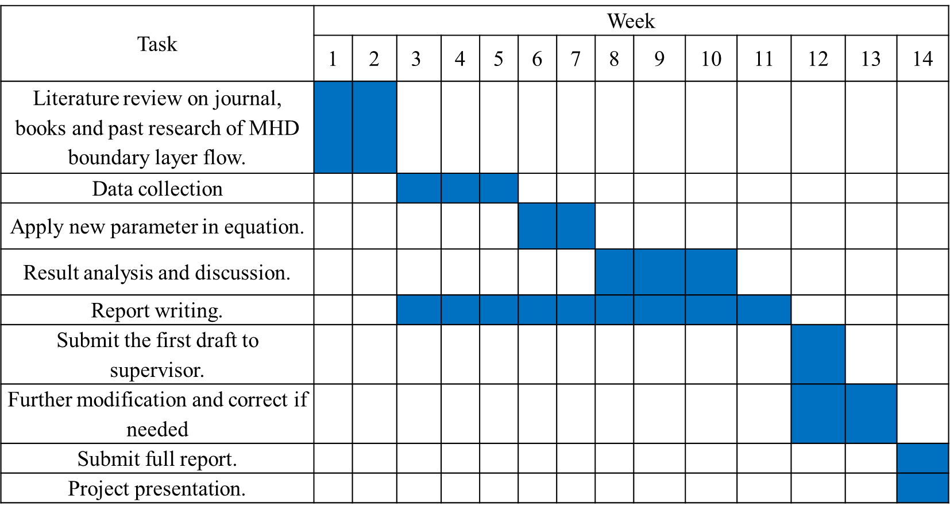
GANTT CHART

Slide 16
REFERENCES

Slide 17

Author biography
Name | : Nur Syiffahani Binti Abu Samah
Matric number | : 2017669332
Programme | : Bachelor Of Science (Hons.) Computational Mathematics
Faculty | : Faculty of Computer and Mathematical Science Universiti Teknologi Mara
Final year project title | : Unsteady MHD Boundary Layer Flow over A Stretching Surface embedded in Porous Medium with Radiation Effect
Supervisor | : Puan Zanariah Binti Mohd Yusof
Email | : nursyiffahani16@gmail.com
Address | : Lot 1435 Jalan Jerantut, Kampung Kelibang Kerdau, 28010 Temerloh Pahang

Slide 18
THANK YOU

