Slide 1
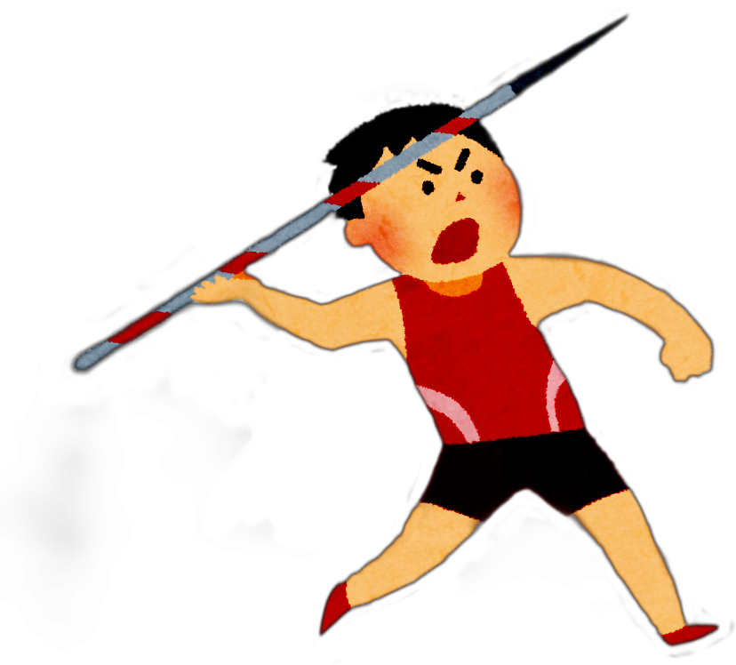


APPLYING PROJECTILE MOTION MODEL
TO DETERMINE THE MAXIMUM DISTANCE
OF JAVELIN THROW
NUR AINA NADZIRAH BINTI AHMAD MIHAFIZUDDIN
BACHELOR OF SCIENCE (HONS.) COMPUTATIONAL MATHEMATICS
SUPERVISOR : PUAN ROHAYATI BINTI MAT RIPIN

Slide 2
Introduction
A track and field event – exist since around the Ancient Games.
Projectile motion method applied.
Most crucial factor – Release height, speed, release angle.
To achieve maximum range, a javelin at release must have the optimal release characteristics.

Slide 3
The javelin thrown from the higher height is going to cover more distance (Clark, 2014).
Release angle and height play important roles in the range of the javelin, but release speed is most crucial factor (Liu et al., 2010).
Other elements that effect the javelin throw result: the correct throwing technique, weather conditions, javelin type and quality and type or level of track and field competition.

Slide 4
Problem Statement
Javelin throw is the combination of basic physics and the human ability.
It easy to calculate the correct way to throw, but it can be much harder to execute (J Clark, 2014).
Correcting technique also hard if you are not sure what you are doing wrong (J Clark, 2014).
Most essential goal in the javelin throw is the throwing record – other factors (weather, time, athlete physical) also could gives some effects
The concern of researchers is how to help the athletes achieves better performance.

Slide 5
This research can be an alternative for the coaches and the athletes to improve their throwing techniques.
Malaysian javelin throw records:
  Mohamed Yazid Imran – 73.34 metre (1995)
  Kho Mei Kwang – 62.90 metre (1999)
  Siti Nur Nadiah Othman – 49.34 metre (2014)
There is no new improvement nor new exceeding record from the Malaysian athletes afterwards.

Slide 6
Objectives
To identify the factors that improve the javelin throw record of the athletes.
To identify the initial velocity, the throwing angle and horizontal distance to attain the best performance of javelin throw.
To identify the relationship between the javelin’s release conditions and the range of the javelin throw.
To apply the projectile motion of javelin throw sport in JAVA application, Graphical User Interface (GUI).

Slide 7
Significance / Benefits of Study
May help the coaches and their athletes to improve their performances for javelin throw competition and to plan strategies.
The result of this project will help the javelin thrower to improve their performances and the throwing techniques.
The javelin athlete can practice their consistency in throwing the spear during training sessions.
The method applied can also be used in other throwing sport ; discus, shot put or hammer throw.

Slide 8
Scope of The Project
Data collected will be applied projectile motion method with different international athletes – Olympics official website
The calculation is based on the height and best personal performance of the athletes.
To enhance the performance of Malaysian athletes by determine the maximum distance of the throwed spear.
The air resistance will be ignored because it only have minor effect to the spear.

Slide 9
Literature Review
Projectile motion is an object launched that travels through the air and can be applied to many types of sports.
The horizontal distance of the javelin throwing reaches the maximum usually in 45 degrees when there is no air resistance (Limin Yan, 2013).
To attain maximum official distance, a released javelin must have the optimal release characteristics for maximum theoretical vacuum or no air resistance projectile motion (Vitasalo, et.al, 2007)

Slide 10
The release height is an important determinant of the distance thrown (Hay, 1985).
The release height parameter is mostly determined by the athlete’s height (Bottchner and Kuhl, 1998).
The heroes in this field are those who do not have special nor extraordinary strengths, but they have achieved a very good record (Dai et. al, 2011).
By considering the records achieved within the javelin throw, a stimulating advancement is seen with the passage of time (Yousel Jalalabad, 2019) :
  record increase is not because of the increase of people strength at the present time – but more precise studies and an engineering view

Slide 11
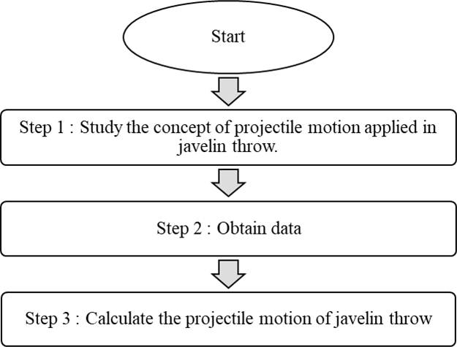
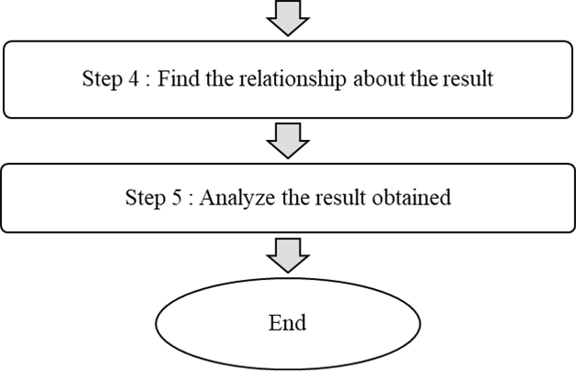
Methodology

Slide 12
Expected Result
Step 1:
NO. | ATHLETE’S NAME | HEIGHT (M) | BEST PERSONAL PERFORMANCE (M)
1. | Thomas Rőhler | 1.91 | 90.30
Step 2:
RANGE OF HORIZONTAL DISTANCE | RELEASE ANGLE | VELOCITY
90.3 M | 20° | 38.2512 m/s
 | 30° | 32.5850 m/s
 | 40° | 30.3771 m/s
 | 50° | 30.2616 m/s
 | 60° | 32.1796 m/s

Slide 13
Expected Result
Step 4:
VELOCITY | RELEASE ANGLE | TIME TAKEN (s)
32.7309 m/s | 20° | 2.44
 | 30° | 3.45
 | 40° | 4.38
 | 50° | 5.19
 | 60° | 5.85
Step 3:
NO | NAME OF THE ATHLETE | AVERAGE OF THE INITIAL VELOCITY
1. | Thomas Rőhler | 32.7309 m/s

Slide 14
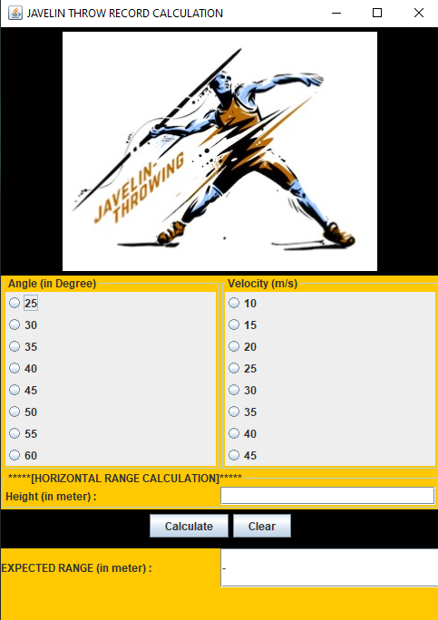
Expected Result
JAVA Application Interface

Slide 15
Gantt - Chart

Slide 16
References
Halliday et al. “Fundamentals of Physics”, 7th Edition. 111 River Street, NJ, 2005, John Wiley & Sons, Inc.
Mohamed, N., Sulaiman, Z., Ismail, A., Suban, R., Rusdi, H., Supaa’t, I., Zainal, N., Salwa U. and Leong, K., 2012. College Physics. Shah Alam: IPTA PUBLICATION SDN BHD, pp.46 - 47
Mohammadi S, Jalalabadi Y, Amiri FN. Analyzing, investigating and calculating the optimum mode of the parameters affecting the record of the javelin throw including the initial velocity, initial angle, and initial height of throw. Turk J Kinesiol, 2019; 5(1): 1- 14.
S.M.Abubshara, J., "Abdul Fattah, O., Ali Adulmajeed Zureigat, A. and Tarawneh, A. (2019). The optimum release height for javelin throwers proportion to their lengths. [online] ResearchGate. Available at: https://www.researchgate.net/publication/328631319_The_optimum_release_
height_for javelin_throwers_proportion_to_their_lengths

Slide 17
References
J, Clark. (2019). Optimal Javelin Flight: Physics and Fixes - Just Fly Sports Performance. [online] Just Fly Sports Performance. Available at: https://www.just-fly-sports.com/optimal-javelin- flight-physics-and-fixes/
Brooker, J. (2019, October 15). Physics of Javelin Throwing. Retrieved from <https://www.sportsrec.com/6929852/physics-of-javelin-throwing>.
Yan, L. (2013). Model Application Research of Javelin Throwing Problem Based on Computer Simulations and Gray Prediction. [online] Tsijournals.com. Available at: <https://www.tsijournals.com/articles/model-application- research-of- javelin-throwing-problem-based-on-computer-simulations- and-gray-prediction.pdf>
Röhler, T. (2019). Javelin throwing technique in detail: speed control | Thomas Röhler - Offizielle Website. [online] Thomas Röhler - Offizielle Website. Available at: <https://www.thomas-roehler.de/en/speerwurf-technik-im- detail-kontrolle-der-geschwindigkeit/>

Slide 18
References
worldathletics.org. 2020. World Athletics | Javelin Throw. [online] Available at: <https://www.worldathletics.org/disciplines/throwing- event/javelin-throw>
Projectile Motion Sports Science Degree Physical Education. (n.d.). Retrieved 11AD, from <https://www.quinticsports.com/projectile- motion/>.
International Olympic Committee. n.d. Rio 2016 Javelin Throw Men – Olympic Athletics. [online] Available at : <https://www.olympic.org/rio-2016/athletics/javelin-throw- men>

