Slide 1
MIXED CONVECTION ON UNSTEADY MAGNETOHYDRODYNAMIC (MHD) FLOW OVER A STRETCHING SURFACE WITH THERMAL RADIATION EFFECT
BY : NUR ATIKAH BINTI ANUAR (2017649722)
PROGRAM : BACHELOR OF SCIENCE (HONS.) COMPUTER MATHEMATICS
SUPERVISOR : PN ZANARIAH BINTI MD YUSOF
FACULTY OF COMPUTER AND MATHEMATICAL SCIENCE UITM KUALA TERENGGANU

Slide 2
The boundary-layer theory developing greatly and applied in nearly all regions of fluid mechanics.
INTRODUCTION
Two types of boundary layers, which are velocity boundary layer and thermal boundary layer.

Slide 3
The magnetic field and radiation have been found significantly influenced by the thickness of the velocity and thermal boundary layers due to their effects on the viscous drag, temperature distribution and the parameters in the equations of boundary layer problems which are not fully employed.
PROBLEM STATEMENT

Slide 4
to transform the governing boundary layer equations from partial differential equation (PDE) into the ordinary differential equation (ODE) by using similarity transformation
2. to solve the transformed boundary layers equations numerically using Runge-Kutta-Fehlberg method scheme with shooting technique in Maple software environment.
OBJECTIVES
3. to determine the effect of various governing parameters such as magnetic field, buoyancy and thermal radiation on the velocity and temperature profiles, and heat transfer characteristics.

Slide 5
SIGNIFANCE OF THE RESEARCH
Hydromagnetic flow and thermal radiation effect significantly influenced the quality of the final product in metallurgical and technological processes.

Slide 6
LITERATURE REVIEW

Slide 7
BOUNDARY LAYER CHARACTERISTICS
The study of boundary layer flow and heat transfer with consideration of stretching surface is important in manufacturing processes (Bachok & Ishak, 2010).

Slide 8
MHD FLOW OVER STRETCHING SURFACE
Based on the research conducted by Ali et al. (2013), it can be observed that the increasing magnetic parameter will decrease the velocity of the fluid and the skin friction at the interface.

Slide 9
THERMAL RADIATION
It is found that the thermal boundary layer thickness increase due to the effect of thermal radiation (Pal and Mondal 2010)

Slide 10
HEAT TRANSFER
It is found that the rate of heat transfer decreases when the magnetic parameter increase, Dakshinamoorthy et al. (2014).

Slide 11
MIXED CONVECTION
Both stretching and buoyancy forces affect the phenomena of flow and heat transfer (Hayat et al., 2015).
Daniel and K. Danial (2015) considered fixed Prandtl number which is 0.71 and the other parameters are zero.

Slide 12
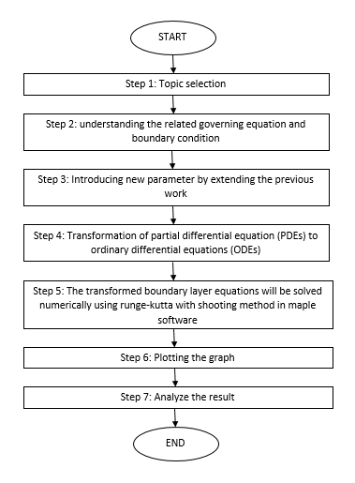
METHODOLOGY

Slide 13
1.TOPIC SELECTION
This research refers to the article Yusof et al. (2012).

Slide 14
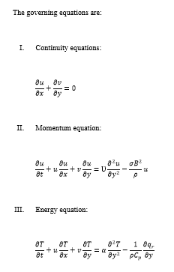
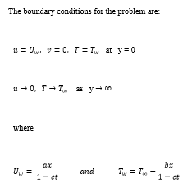
2.UNDERSTANDING RELATED GOVERNING EQUATION & BOUNDARY CONDITION

Slide 15
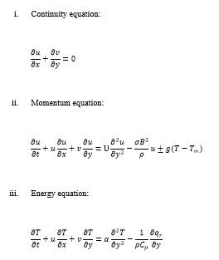

3.INTRODUCING NEW PARAMETER

Slide 16
4.TRANSFORMATION OF PDE
The governing partial differential equations (PDEs) were transformed into the system of the ordinary differential equation (ODEs) by using the similarity transformation method.

Slide 17
5.Numerical method
The Runge-Kutta-Fehlberg method scheme with shooting technique in the Maple software environment will be used to reduce the equation to the solution of the initial value problem.

Slide 18
6.PLOT GRAPH
The graph plot will show the profile of the momentum and thermal boundary layer.

Slide 19
7.ANALYZE RESULT
The numerical solution and graph obtained from the research were analyzed and compared with the result obtained by Yusof et al, (2012).

Slide 20
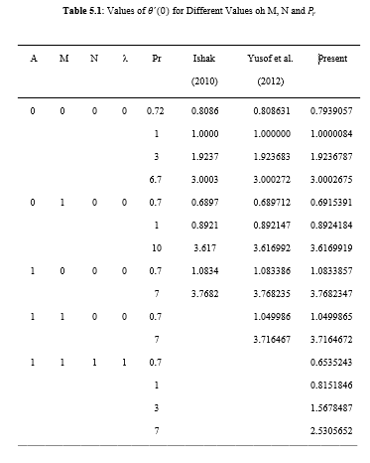
EXPECTED RESULT

Slide 21
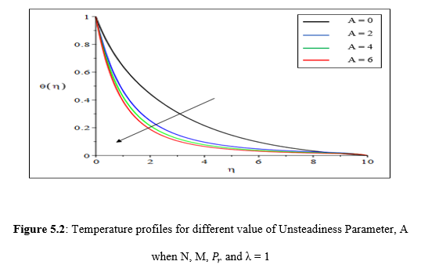
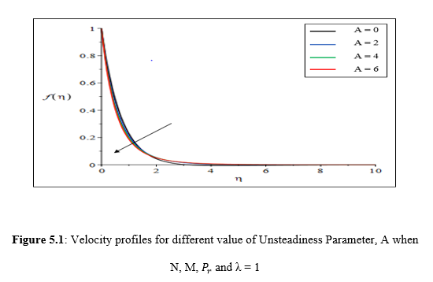
VELOCITY & TEMPERATURE PROFILES
velocity profiles thickness and temperature profiles decreases with increasing the unsteadiness parameter A.

Slide 22
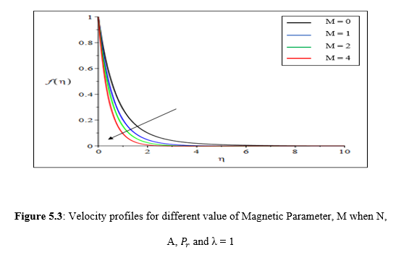
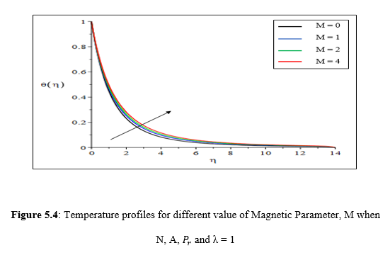
the momentum boundary layer thickness decrease meanwhile the thermal boundary layer thickness increase as the values of M increase.

Slide 23
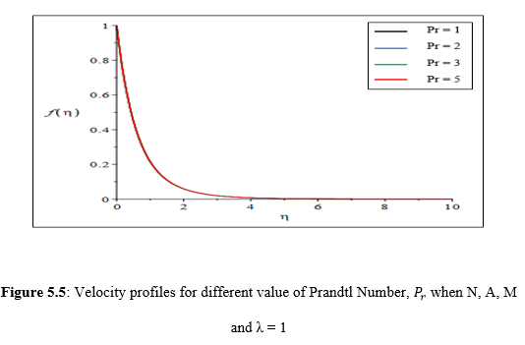
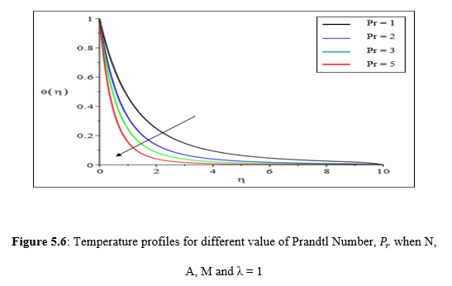
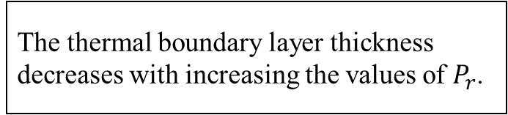
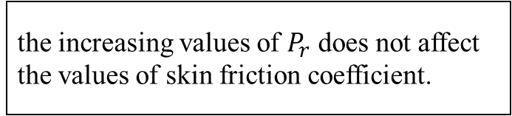
The thermal boundary layer thickness decreases with increasing the values of $P_{r}$.
the increasing values of $P_{r}$ does not affect the values of skin friction coefficient.

Slide 24
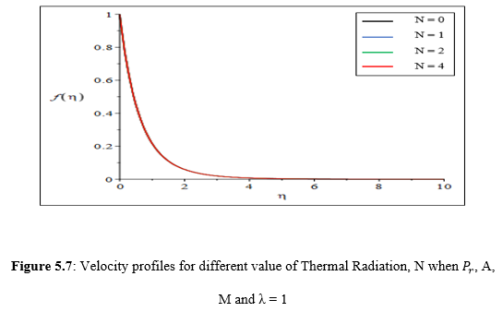
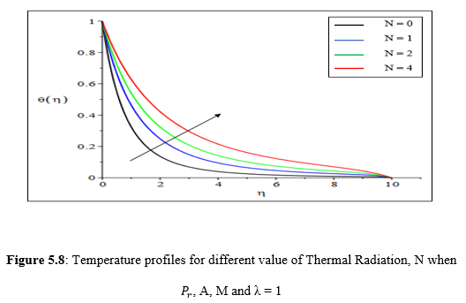
The increasing values of N shows that does not affect the momentum boundary layer thickness
thermal boundary layer thickness increase with the increasing values of N.

Slide 25
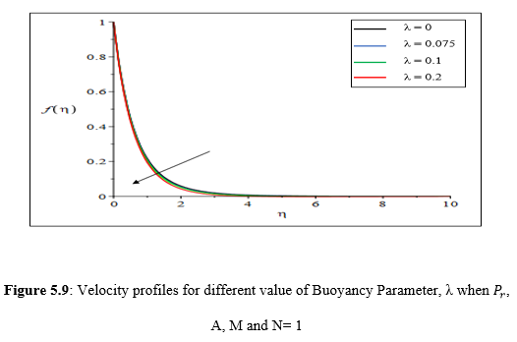
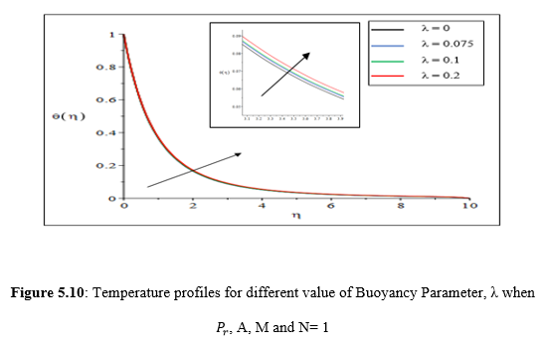
Buoyancy parameter, λ decrease with increasing velocity profile gradient at the surface.
the temperature profiles decreases with increasing the Buoyancy Parameter, λ.

Slide 26
CONCLUSION & RECOMMENDATION
The third objective to determine the effects of various governing parameters on the velocity and temperature profiles has been achieved.
Researchers can add the unsteadiness parameter to the boundary layer flow problem.

Slide 27
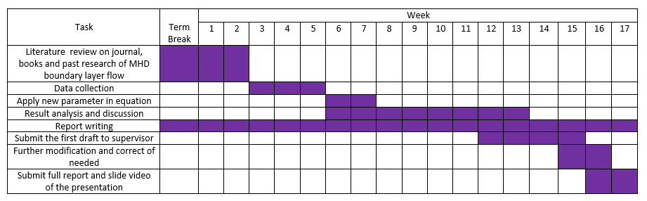
GANTT-CHART

Slide 28
REFERENCES
Ali, M. M., Mamun, A. A., Maleque, M. A., & Azim, N. H. M. A. (2013). Radiation effects on MHD free convection flow along vertical flat plate in presence of Joule heating and heat generation. Procedia Engineering, 56, 503-509.
Bachok, N., & Ishak, A. (2010). Flow and heat transfer over a stretching cylinder with prescribed surface heat flux. Malaysian Journal of Mathematical Sciences, 4(2), 159-169.
Dakshinamoorthy, M., Geeta, P., & Moorthy, M. B. K. (2014). Boundary Layer Flow and Heat Transfer over a Continuous Surface in the Presence of Hydromagnetic Field. International Journal of Mathematical Analysis, 8(38), 1859-1872.

Slide 29
REFERENCES
Daniel, Y.S., & Daniel, S.K. (2015). Effects of buoyancy and thermal radiation on MHD flow over a stretching porous sheet using homotopy analysis method. Alexandria Engineering Journal, 54(3), 705-712.
Hayat, T., Anwar, M. S., Farooq, M., & Alsaedi, A. (2015). Mixed convection flow of viscoelastic fluid by a stretching cylinder with heat transfer. Plos one, 10(3).
Pal, D., & Mondal, H. (2010). Hydromagnetic non-Darcy flow and heat transfer over a stretching sheet in the presence of thermal radiation and Ohmic dissipation. Communications in Nonlinear Science and Numerical Simulation, 15(5), 1197-1209.

Slide 30

AUTHOR BIOGRAPHY
Name : Nur Atikah Binti Anuar
Matric number : 2017649722
Programme : Bachelor Of Science (Hons.) Computational Mathematics
Faculty : Faculty of Computer and Mathematical Science University Teknologi
Mara
Project title : Mixed Convection on Unsteady Magnetohydrodynamic (MHD) Flow
over a Stretching Surface with Thermal Radiation Effect
Supervisor : Puan Zanariah Binti Mohd Yusof
Email : atikah981127@gmail.com
Address : PT 591, Kampung Gong Serapat, Jalan Jelor, 16800 Pasir Puteh,
Kelantan
Phone number : 011-37440658

Slide 31
THANK YOU!!!

