Slide 1


A BISECTION-MODIFIED NEWTON’S HYBRID METHOD FOR SOLVING NONLINEAR EQUATION
PREPARED BY: NOR ZARIFAH BINTI ZULKIFLI (2017696368)
SUPERVISOR: EN. MUHAMMAD FAUZI BIN EMBONG

Slide 2
INTRODUCTION
Numerical analysis is the area of mathematics and computer science that creates, analyses, and implements algorithms for obtaining numerical solutions to problems involving continuous variables.
Bisection method is the simplest among all the numerical schemes to find the roots of nonlinear equation based on the intermediate value theorem for continuous functions.
Newton’s method is a one of the best numerical method used for finding successively better approximations to the zeroes of a real-valued function f(x) = 0.
Modified Newton’s method is the method is relatively simple and is robust, it is more likely to converge to a solution that are either the higher order schemes or Newton’s method itself.
A new hybrid method introduced in this project which is the combination of Bisection method and Modified Newton’s method.

Slide 3
PROBLEM STATEMENT
There are many ways or methods that are used to find the roots for nonlinear equation but some method is not very efficience.
A new Hybrid method that are proposed in this project will be analyse of its efficiency compared to Bisection method, Newton’s method and Modified Newton’s method.
Since there were many methods in finding root for nonlinear equation, the effectiveness of the method will be determining by the number of iteration or the CPU time of the solution.

Slide 4
OBJECTIVE
The objectives of this project are:
To propose a Bisection-Modified Newton’s hybrid method to find roots for nonlinear equation.
To analyse the accuracy of this proposed method based on number of iterations, CPU times and errors.
To compare the performance between new proposed method with Bisection method, Newton’s method and Modified Newton’s method.

Slide 5
LITERATURE REVIEW
According to Tanakan (2013), Bisection method is reliable however it converges slowly, gaining one bit of accuracy with each iteration.
Newton’s method iteratively produces a sequence of approximations that converge quadratically to a simple root.
According to Trevor J.McDougall and Simon J.Wotherspoon (2013), a new computational algorithm of Modified Newton’s method is construct to reduce the number of iterations and numerical errors of nonlinear equations. It has been favored for its simplicity and fast rate of convergence.
A hybrid method is constructed to reduce the number of iteration in solving nonlinear equations. A new hybrid method is the combination of Bisection method and Modified Newton’s method.

Slide 6

METHODOLOGY
Bisection method
Guess an interval (a,b) which f(a) and f(b) has different signs.
Divide the interval into two equal sections, $m=\frac{a+b}{n}$ where n=2 and f(m).
Divide the interval into two equal sections, 𝑚=(𝑎+𝑏)/𝑛 where n=2 and f(m).
Newton’s method
Find an initial number $x_{0}$
Find an initial number 𝑥_0
Compute $f\left(x_{0}\right)$ and $f′(x_{0})$.
Compute 𝑓(𝑥_0 ) and 𝑓′(𝑥_0).
Modified Newton’s method
Find an initial number $x_{0}$
Find an initial number 𝑥_0
Compute $f\left(x_{0}\right),$ $f^{′}\left(x_{0}\right)$ and $f′′(x_{0})$.
Compute 𝑓(𝑥_0 ), 𝑓^′ (𝑥_0 ) and 𝑓′′(𝑥_0).
Hybrid method
Determine if root exists.
Choose the desire interval.
Repeated until desired iteration/ accuracy.
Compute $x_{n}=x_{n−1}−\frac{f(x_{n−1})}{f′(x_{n−1})}$ where n=0,1,…
Compute 𝑥_𝑛=𝑥_(𝑛−1)−(𝑓(𝑥_(𝑛−1)))/(𝑓′(𝑥_(𝑛−1))) where n=0,1,…
Repeated until desired iteration/ accuracy.
Compute
For the interval into $x_{i}=\frac{a+b}{2}$
For the interval into 𝑥_𝑖=(𝑎+𝑏)/2
If $f\left(x_{i}\right)=0$then go to step 7
If 𝑓(𝑥_𝑖 )=0 then go to step 7
If $f\left(a\right). f\left(x_{i}\right)<0$ the $b=x_{i}$else $a=x_{i}$
If 𝑓(𝑎). 𝑓(𝑥_𝑖 )<0 the 𝑏=𝑥_𝑖 else 𝑎=𝑥_𝑖
Then compute into modified newton method formula.
If $f\left(x\right)<δ$ then go to step 7.
If 𝑓(𝑥)<𝛿 then go to step 7.
If $x_{i}=x$ then go to step 4
If 𝑥_𝑖=𝑥 then go to step 4
Stop iteration
Repeated until desired iteration/ accuracy.
$$x_{n}=x_{n−1}−\left(\frac{f\left(x_{n−1}\right). f′(x_{n−1})}{{(f^{′}\left(x_{n−1}\right))}^{2}−f\left(x_{n−1}\right). f′′(x_{n−1})}\right)$$

Slide 7
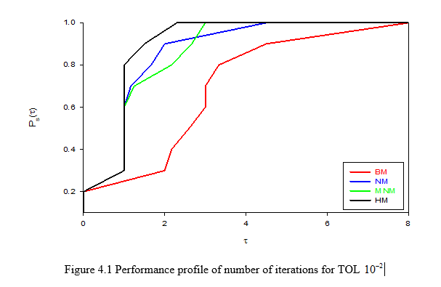
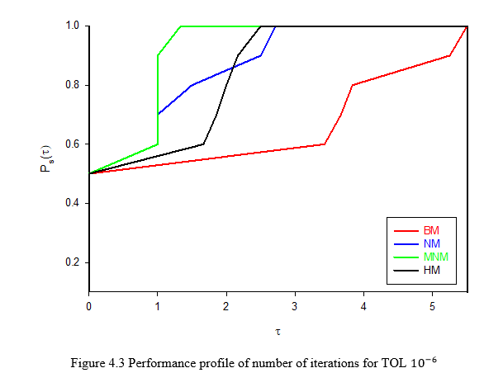
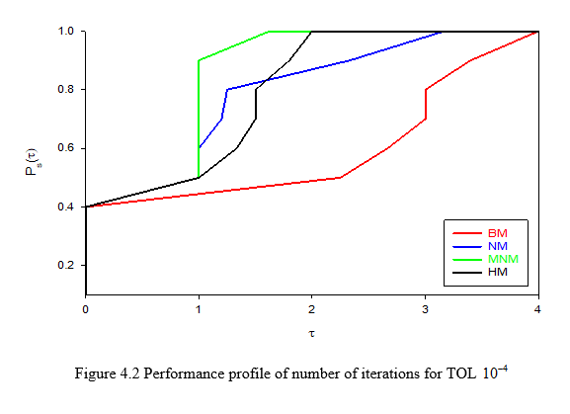
RESULT AND DISCUSSION
Performance profile of number of iteration

Slide 8
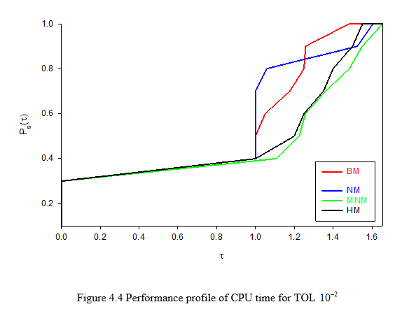
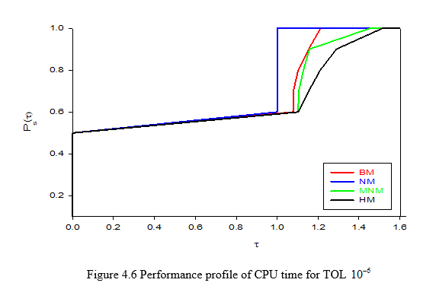
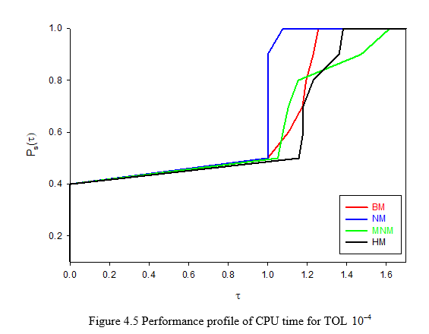
Performance profile of CPU time

Slide 9
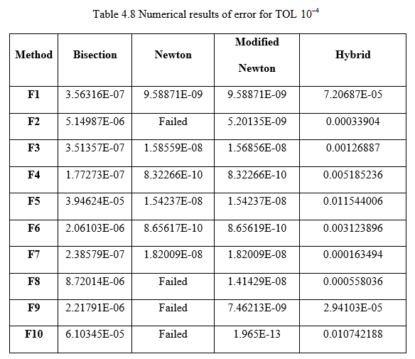
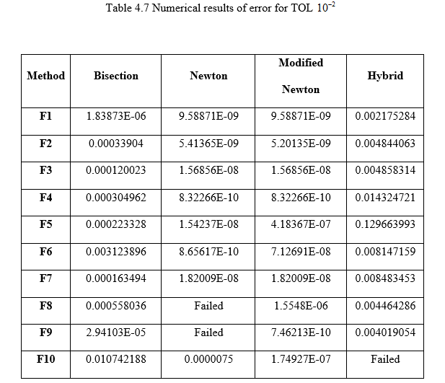
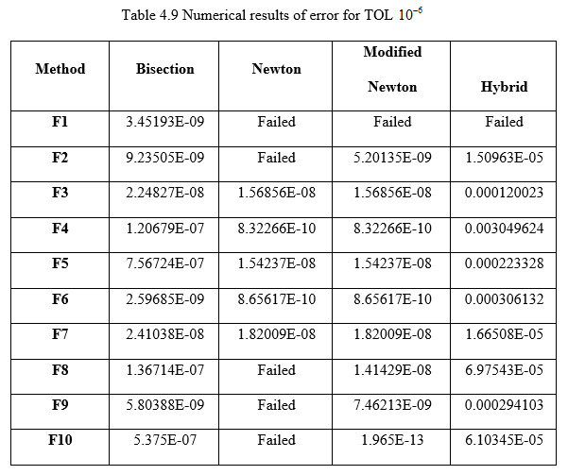
Numerical result of error

Slide 10
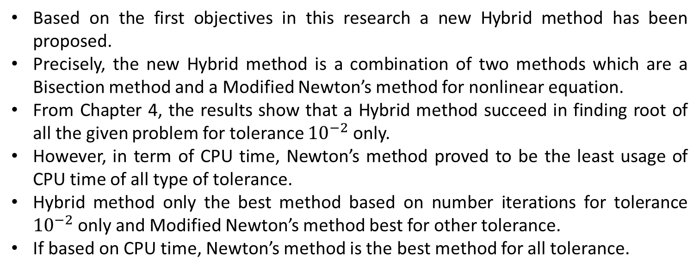
CONCLUSION
Based on the first objectives in this research a new Hybrid method has been proposed.
Precisely, the new Hybrid method is a combination of two methods which are a Bisection method and a Modified Newton’s method for nonlinear equation.
From Chapter 4, the results show that a Hybrid method succeed in finding root of all the given problem for tolerance ${10}^{−2}$ only.
However, in term of CPU time, Newton’s method proved to be the least usage of CPU time of all type of tolerance.
Hybrid method only the best method based on number iterations for tolerance ${10}^{−2}$ only and Modified Newton’s method best for other tolerance.
If based on CPU time, Newton’s method is the best method for all tolerance.

Slide 11
RECOMMENDATION
In the future research, researcher may extend the field in finding the root of other functions such as inverse of trigonometric or higher degree polynomial functions.
Beside that, the next researchers may use other method for this project such as fixed point method, secant method and many other method that can use to find roots for nonlinear equations.

Slide 12
THANK YOU

