Slide 1

ESTIMATION OF TOURIST ARRIVALS IN MALAYSIA BY USING RUNGE-KUTTA METHOD AND LINEAR LEAST SQUARE METHOD BY FITTING TRANSCENDENTAL FUNCTIONS
SITI NURHAZWANI BINTI ZAINUDIN
(2017696304)
Supervisor Name:
PUAN RUHANA BINTI JAAFAR

Slide 2
INTRODUCTION
Tourism is the leading and the largest sector in the world of today. The tourism sector has been recognised as one of the main important service industries in the world (Schumacher, 2007).
Tourism is a mentionable earning industry in Malaysia and this sector is an engine for the growth of nation for developing global competitiveness. The Malaysian economy is affected positively by this industry in increasing foreign exchange earnings and employment opportunities (Bhuiyan, Siwar, Ismail & Islam, 2011).

Slide 3
INTRODUCTION
For solving mathematical problems where it is difficult or even impossible to get exact solutions, numerical methods are commonly used.
There also exist a large number of ordinary differential equations whose solutions cannot be obtained in closed form by using well known analytical methods. Thus, the numerical methods are used to get the approximate solution of a differential equation under the prescribed initial condition (Islam, 2015).

Slide 4
INTRODUCTION
A mathematical model for finding the best fitting curve to a given set of points by minimizing the sum of the squares of the residuals of the points from the curve is called Least Square method.
The simplest form of linear regression is the Linear Least Square method. It provides a solution to the problem of finding the best fitting straight line through a set of points.
For nonlinear Least Square method, Linear Least Square method may be applied iteratively to a linearized form of the function until convergence is achieved. However, it is also possible to linearize a nonlinear function at the outset first and then still use linear method for determining fit parameters without resorting to iterative procedures (Weisstein, n.d.).

Slide 5
PROBLEM STATEMENT
The number of tourist arrivals should be measured and analysed since tourism has become one of the major sectors in this country where it can help in the economic development. If the tourist arrivals increase, it will make the country’s economy become more growing and this show that this country is improving and emphasizing the economic development.
Stakeholder also need to know on how to estimate the number of tourist arrivals as if the tourist arrivals are decreasing, some enhancement can be made to this sector to attract the tourist arrivals again. Stakeholder can learn from the trend of tourist arrivals data to make strategies to attract the tourist arrivals again to this country.
Runge-Kutta method and Linear Least Square method by fitting transcendental functions are used to solve this problem.

Slide 6
OBJECTIVES
To estimate the data by using Runge-Kutta method and Linear Least Square method by fitting transcendental functions.
To determine the best method by comparing errors between the mathematical models.
To predict the number of tourist arrivals in year 2020.

Slide 7
SIGNIFICANT OF PROJECT
This research can facilitate the stakeholder to study on the mathematical models used in analysing the number of tourist arrivals in Malaysia since the number of tourist arrivals is inconsistent for every year and hopefully they can use these mathematical modelling for their own benefits.
Through this research, further insight into the uses of mathematical modelling is gained so as to work out the inconsistency in number of tourist arrivals similarly as evaluating tourist satisfaction. Having chosen to estimate tourist arrivals is enabled us to practically understand its rate of arrivals.

Slide 8
LITERATURE REVIEW
The hypothesis of economic-driven tourism growth in Malaysia for the period 1980-2007 is examined by using the data on annual basis of total tourist arrivals (receipts) to Malaysia, real gross domestic product (GDP), and consumer price index (CPI) (Nanthakumar, Ibrahim & Harun, 2008).
Previous study by Hossain, Miah and Hossain (2017) used a numerical study to predict the evolution of yellow fever diseases using fourth order Runge-Kutta method and according to them, the method was quite efficient and practically well suited for solving initial value problem for ordinary differential equations.

Slide 9
LITERATURE REVIEW
Previous study on the model and errors in data fitting by Ying Chao (2014) showed the linearization of some commonly nonlinear function such as exponential function and power function. The methods used in the study are variable substitution method, least square method and total least squares method to observed curve fitting data after linearized the function. The least square method for curve fitting is most commonly used method as it is more accurate, practical and widely used.

Slide 10
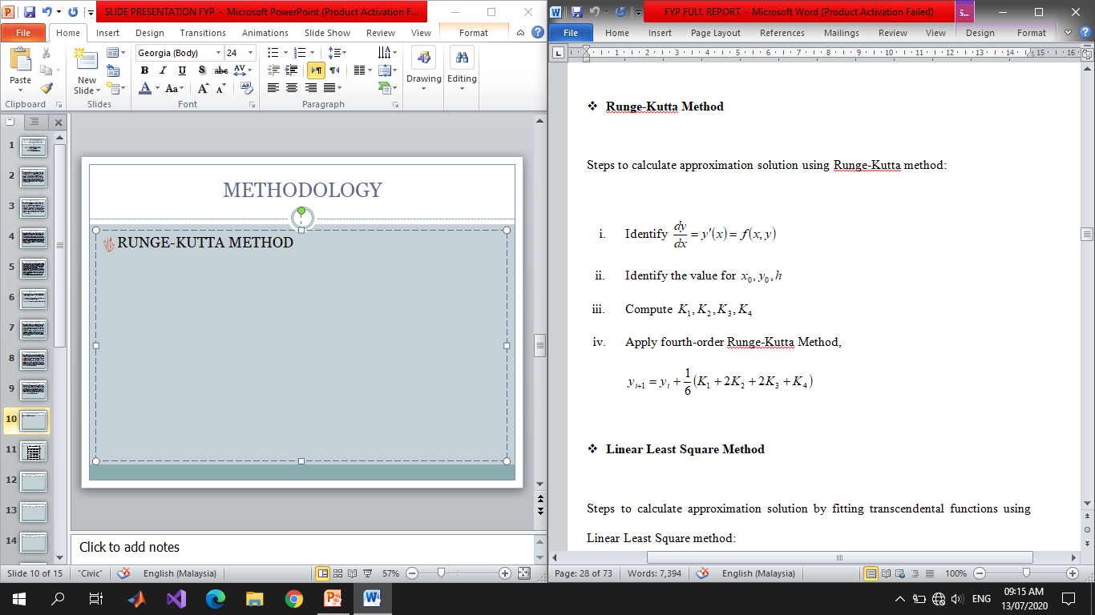
METHODOLOGY
RUNGE-KUTTA METHOD

Slide 11
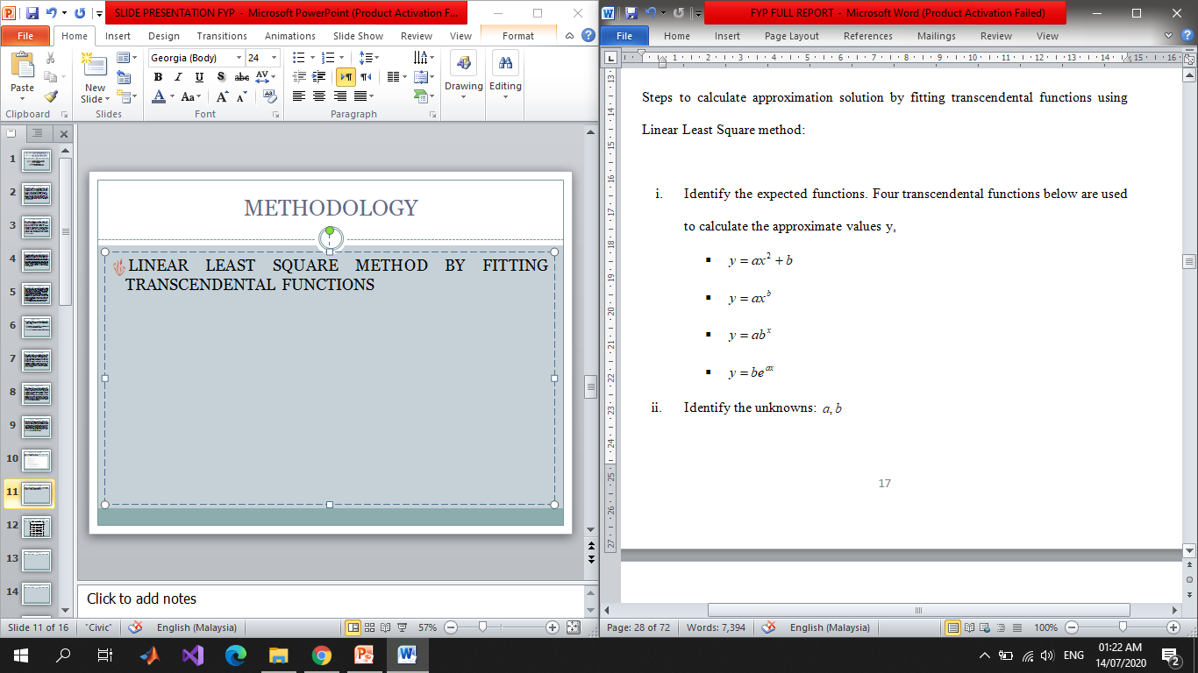
METHODOLOGY
LINEAR LEAST SQUARE METHOD BY FITTING TRANSCENDENTAL FUNCTIONS

Slide 12
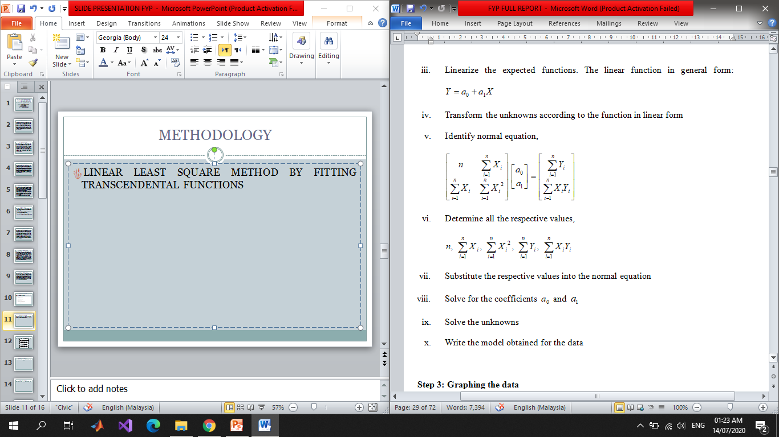
METHODOLOGY

Slide 13
EXPECTED RESULT
ESTIMATION RESULT

Slide 14
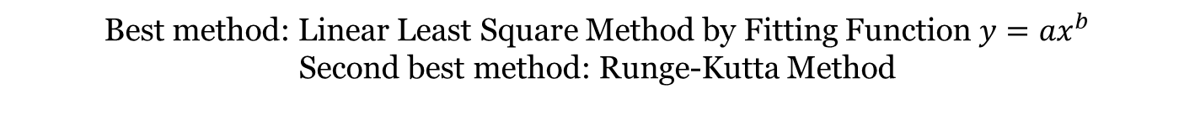
EXPECTED RESULT
ERROR ANALYSIS
Best method: Linear Least Square Method by Fitting Function ${y=ax}^{b}$
Second best method: Runge-Kutta Method

Slide 15
EXPECTED RESULT
PREDICTION
Linear Least Square Method by Fitting Function ${y=ax}^{b}$
Runge-Kutta Method

Slide 16
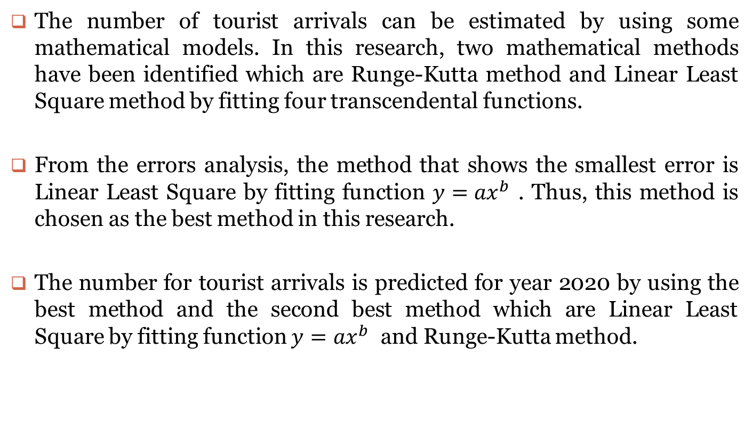
CONCLUSION
The number of tourist arrivals can be estimated by using some mathematical models. In this research, two mathematical methods have been identified which are Runge-Kutta method and Linear Least Square method by fitting four transcendental functions.
From the errors analysis, the method that shows the smallest error is Linear Least Square by fitting function ${y=ax}^{b}$ . Thus, this method is chosen as the best method in this research.
The number for tourist arrivals is predicted for year 2020 by using the best method and the second best method which are Linear Least Square by fitting function ${y=ax}^{b}$ and Runge-Kutta method.

Slide 17
RECOMMENDATION
Besides tourist arrivals, the data about any kind of productions, growths or sales can be used to apply the numerical methods.
For example, the numerical methods used in this research can also be used to make estimation data for rainfall distribution, estimation for dengue cases or prediction for business sales growth.

Slide 18
REFERENCES
Bhuiyan, M. A. H., Siwar, C., Ismail, S. M., & Islam, R. (2011). Potentials of Islamic Tourism: A case Study of Malaysia on East Coast Economic Region. Australian Journal of Basic and Applied Sciences, 5(6), 1333-1340.
Hossain, M. T., Miah, M. M., & Hossain, M. J. (2017). A Numerical Study to Predict the Evolution of Yellow Fever Diseases using fourth order Runge-Kutta Method. International Journal of Scientific & Engineering Research, 8(10), 1040-1046.
Islam, M. A. (2015). Accurate Solutions of Initial Value Problems for Ordinary Differential Equations with the Fourth Order Runge Kutta Method. Journal of Mathematics Research, 7(3), 41-45. doi:10.5539/ijsp.v4n3p41
Nanthakumar, L., Ibrahim, Y., and Harun, M. (2008). Tourism development policy, strategic alliances and impact of consumer price index on tourist arrivals: The case of Malaysia. Tourismos. An International Multidisciplinary Journal of Tourism, 3(1), 83-98.
Schumacher, H. J. (2007, June 15). Let’s Talk Europe: Ecotourism. Business World, p. S1/6.
Weisstein, E. W. (n.d.). Least Squares Fitting. In MathWorld. Retrieved from http://mathworld.wolfram.com/LeastSquaresFitting.html
Ying, C. (2014). Study on the Model and Errors in Data Fitting. International Conference on Informatization in Education, Management and Business, 12-15.

