Slide 1

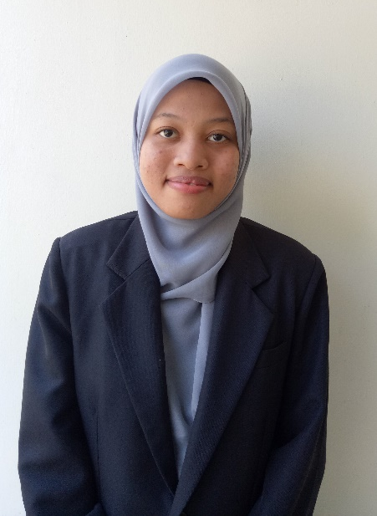
SELECTING THE BEST EMPLOYEE OF THE YEAR USING THE FUZZY AHP WITH NEUTROSOPHIC METHOD
PREPARED BY : NUR AIN NABILA BT MOHD ZAMBRI
SUPERVISOR : PUAN NORAINI AHMAD

Slide 2
INTRODUCTION
01
PROBLEM STATEMENT
02
OBJECTIVES
03
SIFNIFICANCE OF STUDY
04

Slide 3
05
LITERATURE REVIEW
METHODOLOGY
06
07
RESULT
08
REFERENCES
CONCLUSION
09

Slide 4
INTRODUCTION
The employee satisfaction workplace and happiness are very important in order to achieve an effective work process.
To achieve the satisfying and happy workplace is by be promoting awards, offering bonus, promote to higher place in company and holiday.
However finding the right person for this accomplishment are very important.
The employee will be analysis by their work quality,personal quality,knowlegde and skill and external factor
MCDM are applying in this decision making in order to get the most accurate result

Slide 5
PROBLEM STATEMENT
There are few similar requirement that most employers would consider during process of selection. The requirement in 6 key categories which is quality/quantity of work, preparation, commitment, cooperation, communication and factors external.
1
There are several requirement to be considered during the best employee selection process, there is a difficulty with evaluating an employee. The problems could be solve by applying the MCDM and using Fuzzy AHP with Neutrosophic method for more accurate result. The ranking can be proceed using the TOPSIS method
2

Slide 6
OBJECTIVES
To identify the important criteria and sub-criteria in selecting the best employee of the year
To evaluate the criteria and sub-criteria by using Fuzzy AHP with Neutrosophic method
To determine the ranking of the most qualified employee to be selected as the best employee of the year

Slide 7
SIGNIFICANCE OF STUDY
IMPROVE THE EXISTING METHOD THAT HAS BEEN USED IN RESAERCH WHICH IS FUZZY AHP AND TOPSIS METHOD
DETERMINE AND EVALUATE THE LEVEL OF IMPORTANCE FOR CRITERIA AND SUB-CRITERIA FOLLOWED BY RANKING PROCESS IN SELECTION

Slide 8
LITERATURE REVIEW
MCDM become the strategic problem for several organizational decision-makers, is established for the selection process with ordinal requirements and alternatives preferences. A case study is created for MCDM disregarding the weights of the criteria and decision makers
In the selection issue, globalization is an important strategic decision making capacity, the use of AHP considered as an efficient tool to solve. In a case study created a model using AHP method to solve the selection problems
Researcher are proposing an AHP approach for assessing criteria in order to rank and pick the correct suppliers. The application of AHP in MCDM problems can be used to solve quantitative and qualitative problems, to obtain the relevant alternative, criteria and sub-criteria.
In order to solve the AHP method of relying on assumption and unclear data, the complexity of the presence of multiple decision makers, alternative and criteria, a fuzzy multi-criteria analysis model is to analyze the performance of each employee in the company.

Slide 9
METHODOLOGY
Fuzzy
AHP
Method
Start
Step 1: Identify criteria and sub-criteria
Step 2: Determine Triangular Neutrosophic Number (TNN)
Step 3: Constructs a Pair-wise comparison method
Step 4: Define fuzzy geometric mean
Step 5: Calculate the weight of fuzzy of each criterion
Step 6: Perform defuzzification and normalization
End

Slide 10
METHODOLOGY
TOPSIS
Method

Slide 11
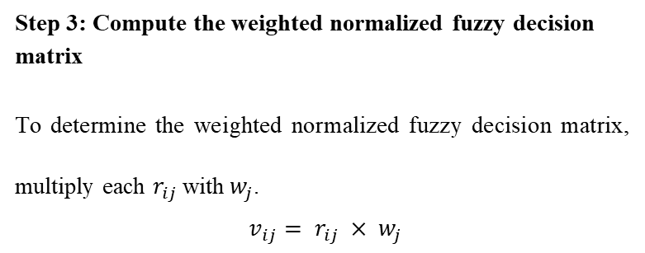
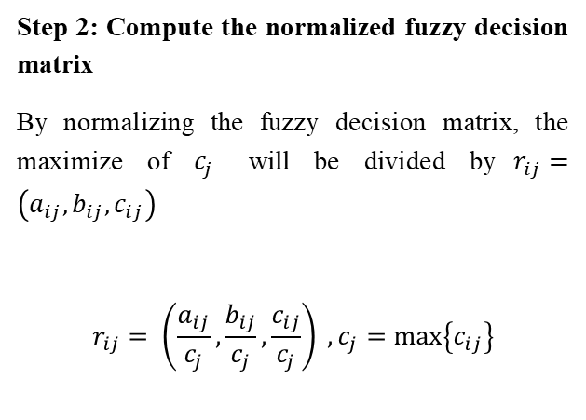
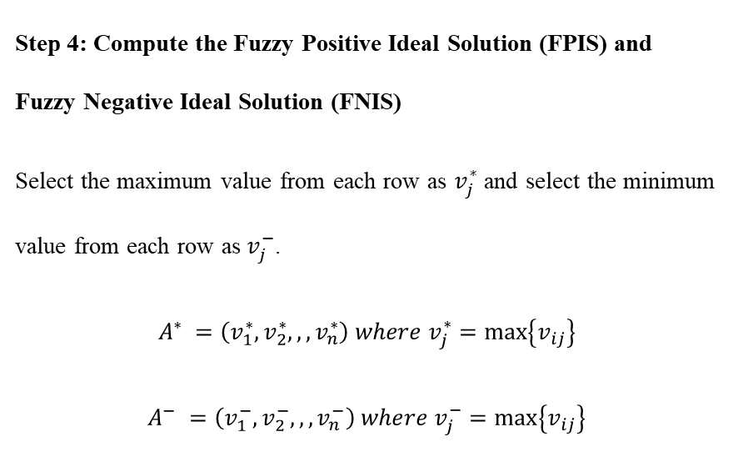
IMPLEMENTATION
Step 3: Compute the weighted normalized fuzzy decision matrix
To determine the weighted normalized fuzzy decision matrix, multiply each $r_{ij}$with$w_{j}$.
$v_{ij}= r_{ij} × w_{j}$
Step 1: Multiplying the weightage of main criteria with each criterion in data of selected employee.
Step 2: Compute the normalized fuzzy decision matrix
By normalizing the fuzzy decision matrix, the maximize of $c_{j}$ will be divided by$r_{ij}=\left(a_{ij},b_{ij},c_{ij}\right)$
$$r_{ij}= \left(\frac{a_{ij}}{c_{j}},\frac{b_{ij}}{c_{j}},\frac{c_{ij}}{c_{j}}\right) , c_{j}=\max\left\{c_{ij}\right\}$$
Step 4: Compute the Fuzzy Positive Ideal Solution (FPIS) and Fuzzy Negative Ideal Solution (FNIS)
Select the maximum value from each row as $v_{j}^{∗}$ and select the minimum value from each row as${ v}_{j}^{−}$.
$$A^{∗} =\left(v_{1}^{∗},v_{2}^{∗},,,v_{n}^{∗}\right) where v_{j}^{∗}=\max\left\{v_{ij}\right\}$$
$$A^{−} =\left(v_{1}^{−},v_{2}^{−},,,v_{n}^{−}\right) where v_{j}^{−}=\max\left\{v_{ij}\right\}$$

Slide 12
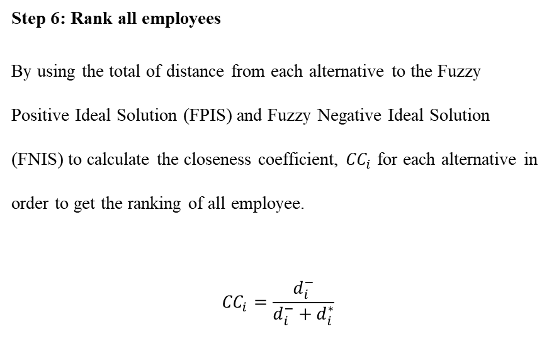
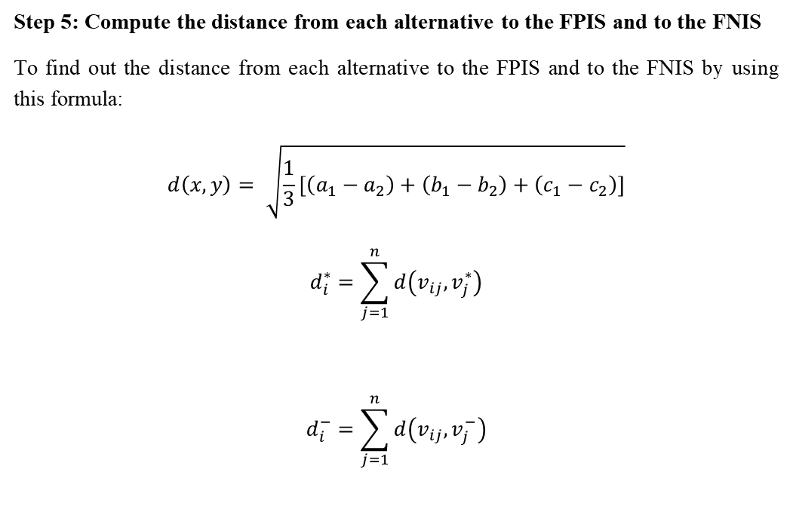
Step 5: Compute the distance from each alternative to the FPIS and to the FNIS
To find out the distance from each alternative to the FPIS and to the FNIS by using this formula:
$$d\left(x,y\right)= \sqrt{\frac{1}{3}\left[\left(a_{1}−a_{2}\right)+\left(b_{1}−b_{2}\right)+\left(c_{1}−c_{2}\right)\right]}$$
$$d_{i}^{∗}=\sum_{j=1}^{n}{d\left(v_{ij},v_{j}^{∗}\right)}$$
$$d_{i}^{−}=\sum_{j=1}^{n}{d\left(v_{ij},v_{j}^{−}\right)}$$
Step 6: Rank all employees
By using the total of distance from each alternative to the Fuzzy Positive Ideal Solution (FPIS) and Fuzzy Negative Ideal Solution (FNIS) to calculate the closeness coefficient, ${CC}_{i}$ for each alternative in order to get the ranking of all employee.
$${CC}_{i}=\frac{d_{i}^{−}}{d_{i}^{−}+d_{i}^{∗}}$$

Slide 13
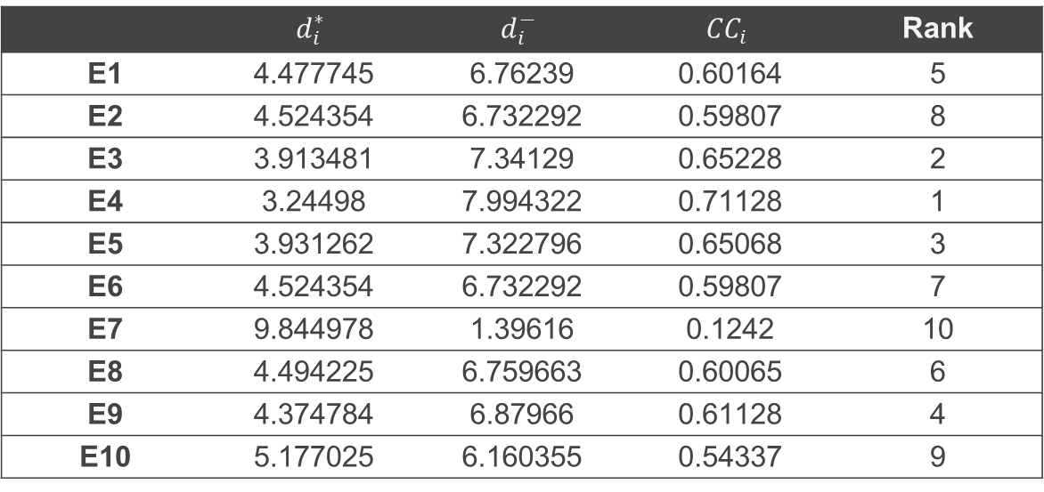
WEIGHTAGE FOR MAIN CRITERIA
Criteria | Weightage
QW | 0.495916
PQ | 0.274204
KS | 0.14414
EF | 0.085741
RESULT FOR FUZZY AHP
RANKING OF ALL EMPLOYEE
 | $$d_{i}^{∗}$$ | $$d_{i}^{−}$$ | $${CC}_{i}$$ | Rank
E1 | 4.477745 | 6.76239 | 0.60164 | 5
E2 | 4.524354 | 6.732292 | 0.59807 | 8
E3 | 3.913481 | 7.34129 | 0.65228 | 2
E4 | 3.24498 | 7.994322 | 0.71128 | 1
E5 | 3.931262 | 7.322796 | 0.65068 | 3
E6 | 4.524354 | 6.732292 | 0.59807 | 7
E7 | 9.844978 | 1.39616 | 0.1242 | 10
E8 | 4.494225 | 6.759663 | 0.60065 | 6
E9 | 4.374784 | 6.87966 | 0.61128 | 4
E10 | 5.177025 | 6.160355 | 0.54337 | 9
RESULT FOR TOPSIS METHOD

Slide 14
CONCLUSION
In conclusion, E4 was the most qualified employee among others employee because of the greatest closeness coefficient which mean that E4 is the best employee of the year of the company. Then for E7 was the lowest qualification among others employee since it had the lowest closeness coefficient. The E2 was the second place with 0.65228 lower than E4 with 0.71128. The employee for E10 get the 9th place with 0.54337 higher than E7 with 0.1242.
Employee | Rank
E4 | 1
E3 | 2
E5 | 3
E9 | 4
E1 | 5
E8 | 6
E2 | 7
E6 | 8
E10 | 9
E7 | 10

Slide 15
RECOMMENDATION
This study has successfully applied Fuzzy AHP, Neutrosophic method and TOPSIS method to accomplish the objectives of this study. This proves Fuzzy AHP with Neutrosophic method is useful and flexible method as it can be combined with other MCDM method to get more accurate results. For instance, Fuzzy AHP can be combined with DEMATEL method. The result obtained from these methods can be compared and determined the accuracy for each of them. In a nutshell, there are many methods that can be used to find the best employee for companies but also for others facilities in various industries.

Slide 16
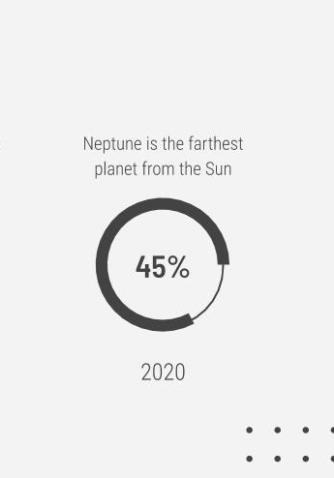
REFERENCES

Slide 17
Nabeeh, Nada A., et al. "Neutrosophic multi-criteria decision making approach for iot-based enterprises." IEEE Access 7 (2019): 59559-59574.
Madi, E. N., Tap, A. O. M., & Osman, A. (2011, July). Fuzzy TOPSIS method in the selection of investment boards by incorporating operational risks. In Proceedings of the world congress on engineering (Vol. 1, No. 1, pp. 291-295).
Saaty, T. L. (2008). Decision making with the analytic hierarchy process. International journal of services sciences, 1(1), 83-98.
Chang, Da-Yong. "Applications of the extent analysis method on fuzzy AHP." European journal of operational research 95, no. 3 (1996): 649-655.
Smarandache, Florentin. "A unifying field in Logics: Neutrosophic Logic." In Philosophy, pp. 1-141. American Research Press, 1999.
Chang, Ching-Hui, Jyh-Jiuan Lin, Jyh-Horng Lin, and Miao-Chen Chiang. "Domestic open-end equity mutual fund performance evaluation using extended TOPSIS method with different distance approaches." Expert systems with applications 37, no. 6 (2010): 4642-4649.
Norddin, Nur Idalisa, Noraini Ahmad, and Zanariah Mohd Yusof. "Selecting best employee of the year using Analytical Hierarchy Process." Journal of Basic and Applied Scientific Research 5, no. 11 (2015): 72-76.
Ahmad, Noraini, Zanariah Mohd Yusof, Ruhana Jaffar, and Nur Najihah Shahrani. "Decision making using fuzzy analytical hierarchy process in choosing postgraduate programs." Journal of Mathematics & Computing Science 4, no. 2 (2018): 1-9.

