Slide 1



SELECTING THE BEST EMPLOYEE OF THE YEAR USING AHP AND PYTHAGOREAN FUZZY NUMBERS
PREPARED BY
WAN NURUL ANIS SHAZIELA BINTI WAN AZILAN
2016289608
SUPERVISOR
PUAN NORAINI BINTI AHMAD

Slide 2
OUTLINE
Introduction
Problem statement
Objectives
Significance of study
Literature Review
Methodology
Results
Conclusion
References

Slide 3
INTRODUCTION
An employee is an individual who was hired by an employer to do a specific job. The employer hires the employee after an application and interview process results in his or her selection as an employee
In a non-union workplace, every employee negotiates on their own; the terms of employment are not universal between all positions.
In the organizational context, an employee is an important asset for organization to achieve their goal and objectives. Employee performance appraisal is an important aspect of human resources management in order to asses each employee’s contribution to the company.
The selection of the best employees is one of the process of evaluating how well the performance of the employees is adjust to the standards set by the company and usually done by top management such as General Manager or Director

Slide 4
It is necessary to build a decision support system that can help facilitate the decision maker in determining the best choice based on standard criteria, faster, and more objective.
A decision support system (DSS) is an information system that supports business or organizational decision-making activities. DSSs serve the management, operations and planning levels of an organization (usually mid and higher management) and help people make decisions about problems that may be rapidly changing and not easily specified in advance.
Therefore, the method that will used in this research is AHP and Pythagorean Fuzzy Set (PFS) in order to fulfil the requirement of this research based on employee evaluation.

Slide 5
PROBLEM STATEMENT
The lack of employee recognition from employer or rewarding programs will lead to decrease the employee morale and is not motivated to perform better in their work
If this happen, the company will having a problem and cannot achieve the goals and target.
It is a very necessary step that the employers need to take for the development and growth of both the company as well as the employees

Slide 6
OBJECTIVES
To identify the important criteria and sub-criteria to select the best employee.
To evaluate criteria and sub-criteria by using Pythagorean Fuzzy Set (PFS) method.
To rank the most qualified employee to being awarded the best employee of the year.

Slide 7
SIGNIFICANCE OF THE STUDY
The outcome of this research will benefit both the company and the employees
The important advantage of this research is it will avoid tendencies for the decision makers or the employers to make unfair selection and mistakes during selection process.
It can help motivates the employee to work harder to achieve company goal and target.
The most important criteria will be references for employers to choose the best employee.

Slide 8
LITERATURE REVIEW
Fuzzy theory introduces the concept of membership function in order to deal with different linguistic variables (Zadeh, 1965, #49). A certain degree of fuzziness exists in terms of people’s thoughts, inference and perception. The theory aims to solve uncertain or fuzzy data in the environment. Unlike traditional Boolean logic which defines whether or not an element belongs to a crisp set (1 or 0), a fuzzy set defines a degree of belonging by a membership function.
The AHP was firstly initiated by Saaty (1980). Instead of using as MCDM tool, AHP can also be used to obtain the weight of criteria. Recently, the crisp AHP is no longer use in determining the weight of criteria because the judgments provided by the DMs are uncertain, imprecise and ill-defined (Torfi et al. (2010)).
Garg H (2017) presented an improved score function for the ranking order of interval-valued Pythagorean fuzzy sets (IVPFSs). Based on it, a Pythagorean fuzzy technique for order of preference by similarity to ideal solution (TOPSIS) method by taking the preferences of the experts in the form of interval-valued Pythagorean fuzzy decision matrices was discuss

Slide 9
Other explorations of the theory of PFSs can be find in Peng X, Yang Y (2015). Pythagorean fuzzy set has attracted great attentions of many researchers, and subsequently, the concept has been apply to many application areas such as decision-making, aggregation operators, and information measures
Yager (2014) developed Pythagorean fuzzy sets (PFSs). These sets are the generalization to the IFSs which in some condition IFSs cannot address the uncertainty. This achievement making PFS is more powerful and flexible tools to solve problems which involving uncertainty.
Regarding this matter, the Pythagorean fuzzy set (Yager (2014), Yager and Abbasov (2013)) is more adequate and practical to deal with vagueness and uncertainty. PFS is a generalization of intuitionistic fuzzy sets (IFSs). Recently, many scholars have used these sets in solving MCDM problems as it provides the liberty to the DMs in expressing their thinking when it comes to the problems that involving imperfect and uncertain.

Slide 10
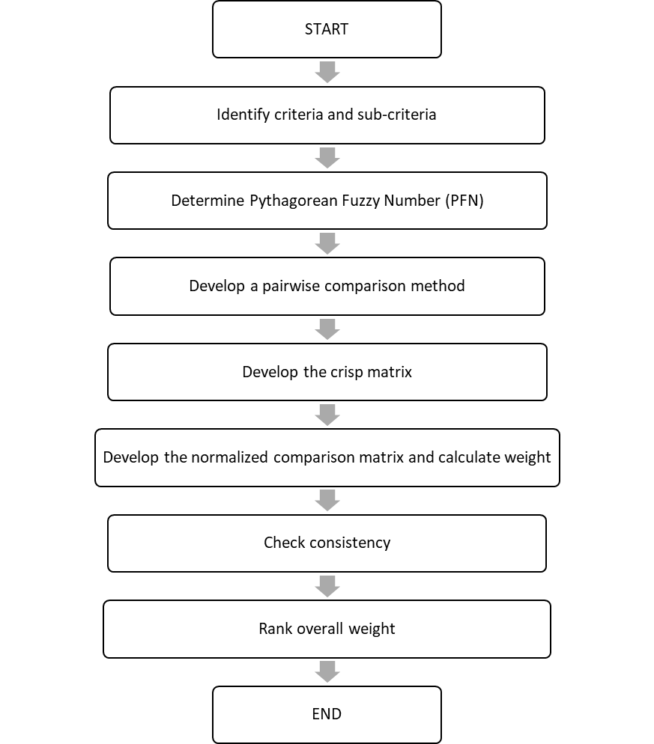
METHODOLOGY

Slide 11

ANALYTICAL HIERARCY PROCESS (AHP)
Step 1: Pairwise comparison based on linguistic term.
The next step is to use a pairwise comparison to evaluate the weights of its elements and determine the priority
Step 2: The geometric means of fuzzy comparison values
The geometric means of fuzzy comparison values of all criteria is calculated using this formula:
r=$(\prod_{j}^{n}{d)^{\frac{1}{n}}}$, i=1,2,..,n
Step 3: The fuzzy weight
To find fuzzy weight of criterion ᾡi, multiply each ri with reverse vector.
ᾡi= ${ri∗(r1∗r2∗…rn)}^{−1}$

Slide 12
Step 4: Defuzzification and normalization
The relative non-fuzzy weight of all criteria (M) is calculated by taking the average of fuzzy numbers for all criteria. By using non fuzzy (M), the normalized weights of all criteria are calculated and tabulated

Slide 13
PYTHAGOREAN FUZZY NUMBER (PFN)
Linguistic terms | Rating scale in crisp number | Pythagorean fuzzy scale
Very low influence | 0 | (0,0)
Low influence | 1 | (0.1,0.9)
Medium low influence | 2 | (0.2,0.9)
Medium influence | 3 | (0.4,0.6)
Medium high influence | 4 | (0.5,0.7)
High influence | 5 | (0.7,0.2)
Very high influence | 6 | (0.9,0.1)

Slide 14

Pythagorean Fuzzy Topsis (PFTOPSIS)
STEP 1:
In the first step, Pythagorean fuzzy number-based decision matrix R= (Cj(xi))mxn. Here, Cj(j=1,2,…,n)Cj(j=1,2,…,n) and xi(i=1,2,…,m)xi(i=1,2,…,m) refer to values of criteria and alternatives.
R=(Cj(xi))mxn
STEP 2:
Pythagorean fuzzy positive ideal solution (PIS) and negative ideal solutions (NIS) are determined using equation below
$$x^{+}=\left\{C_{j}, max〈s(C_{j}\left(x_{i}\right))〉 | j=1,2,…,n\right\}$$
$=\left\{〈C_{1}, P\left(u_{1}^{+},v_{1}^{+}\right)〉,〈C_{2},P(u_{2}^{+},v_{2}^{+})〉,…,〈C_{n}, P(u_{n}^{+},v_{n}^{+})〉\right\}$
$$x^{−}=\left\{C_{j}, min〈s(C_{j}\left(x_{i}\right))〉 | j=1,2,…,n\right\}$$
$=\left\{〈C_{1}, P\left(u_{1}^{−},v_{1}^{−}\right)〉,〈C_{2},P(u_{2}^{−},v_{2}^{−})〉,…,〈C_{n}, P(u_{n}^{−},v_{n}^{−})〉\right\}$

Slide 15

STEP 3:
In the third step, distances from Pythagorean fuzzy PIS and NIS are determined using equation as follows:
$$d\left(x,y\right)= \sqrt{1/2\left[{(a_{1}−a_{2})}^{2}+\left({b_{1}−b_{2})}^{2}\right)\right]}$$
STEP 4:
Compute the closeness coefficient ${CC}_{i}$ for each alternatives.
$${CC}_{i}= \frac{d_{i}^{−}}{d_{i}^{−}+d_{i}^{∗}}$$

Slide 16
RESULT
Main Criteria | Weightage
Quality of Work (QW) | 0.4026106
Personal Quality (PQ) | 0.2627263
Knowledge and Skills (KS) | 0.2023279
External Factor (EF) | 0.1323352

Slide 17
THE FINAL RANKING OF THE EMPLOYEE
Candidates | Total Final Weightage (Overall) | Rankings
E4 | 0.7808 | 1
E3 | 0.7617 | 2
E10 | 0.7543 | 3
E8 | 0.7409 | 4
E9 | 0.6989 | 5
E5 | 0.6849 | 6
E6 | 0.6849 | 7
E2 | 0.6043 | 8
E1 | 0.4374 | 9
E7 | 0.1605 | 10

Slide 18
CONCLUSION
As a conclusion, the outcome from the research was to rank the most qualified employee to being awarded the best employee of the year for each main criteria and sub-criteria.
As discussed in the previous section, Employee 4 hit the first place in the ranking among other candidates because the contribution weight comes from the main criteria and sub-criteria.
In other hands, AHP and PFTOPSIS method is suitable to solve the rankings position.

Slide 19
RECOMMENDATION
Fuzzy AHP is a useful and flexible method as it can be combined with other MCDM methods to get more accurate results.
For instance, Fuzzy AHP can be combined with TOPSIS. The results obtained from these methods can be compared and determined the accuracy for each of them.
Briefly, many methods can be used to find the best suppliers not only for medical facilities but also for other companies in various industries.

Slide 20
REFERENCES
Abdullah, S. &. (2020). Series of Aggregation Operators for Picture Fuzzy Environments and Their Applications: Aggregation Operators for Picture Fuzzy Sets. In Handbook of Research on Emerging Applications of Fuzzy Algebraic Structures. IGI Publisher.
Abdullah, L. &. (2019). Decision making method based on Pythagorean fuzzy sets and its application to solid waste management. Complex & Intelligent Systems, 5(2), 185-198.
Norddin, N. I., Ahmad, N & Yusof, Z. M. (2015). Selecting best employee of the year using Analytical Hierarchy Process., 5(11), 72-76. Journal of Basic and Applied Scientific Research.
Mohd, W. R. W., & Abdullah. (2017, November). L. . Pythagorean fuzzy analytic hierarchy process to multi-criteria decision making. In AIP conference proceedings (Vol. 1905, No. 1, p. 040020). AIP Publishing LLC.
Balioti, & V., Tzimopoulos, C., & Evangelides, C. . (2018). Multi-criteria decision making using topsis method under fuzzy environment. Application in spillway selection. In Multidisciplinary Digital Publishing Institute Proceedings (Vol. 2, No. 11, p. 637).

Slide 21
Ejegwa , P. A. (2019). Personnel Appointments: A Pythagorean fuzzy sets approach using similarity measure. J. Inf. Comput. Sci., 14(2), 94-102.
Thong, & N. T., Smarandache, F., Hoa, N. D., Son, L. H., La. (2020). A Novel Dynamic Multi-Criteria Decision Making Method Based on Generalized Dynamic Interval-Valued Neutrosophic Set. Symmetry, 12(4), 618.
Ak, & M.F., Gul, M. . (2019). AHP–TOPSIS integration extended with Pythagorean fuzzy sets for information security risk analysis. Complex Intell. Syst. 5, 113–126. Retrieved from https://doi.org/10.1007/s40747-018-0087-7
Garg, H. (2017). Confidence levels based Pythagorean fuzzy aggregation operators and its application to decision-making process. Computational and Mathematical Organization Theory, 23(4), 546-571.
Hwang, & C. L., & Yoon, K. (1981). Methods for multiple attribute decision making. In Multiple attribute decision making (pp. 58-191). Springer, Berlin, Heidelberg.

