Slide 1
FINDING MULTIPLE ROOTS OF NONLINEAR EQUATION USING VARIETY OF TWO-STEP METHOD
NAME: NIK NUR LAILI NAZIFA BINTI MOHD ROZI
STUDENT ID: 2017696334
SUPERVISOR: DR. RIVAIE BIN MOHD ALI

Slide 2
INTRODUCTION
Numerical analysis is a field of mathematics and computer science that creates, analyzes and implements algorithms to obtain numerical solutions to continuous variables problem (Atkinson, K., 2017).
It is very important in numerical analysis to find the origin of nonlinear equations and has many applications in engineering and other applied sciences.
In 1685, John Wallis published the first scheme for the discovery of the roots of nonlinear equations. Its simplified description was published by Joseph Raphson in 1690 and was called the Newton-Raphson method.
Given the disadvantages of Newton's method, several multipoint approaches for discovering simple root nonlinear equations have been established in the recent past utilizing Newton’s method as a first step (Zafar, F. et al., 2015).

Slide 3
PROBLEM STATEMENTS
Method such as Bisection, Newton and Secant method are commonly used to find root govern by the formula f(a).f(b) < 0 .
The first problem is numerical method fail to distinguish multiple.
The second problem is the existing methods cannot be applied to find the multiple roots.
To find the accuracy of the proposed methods and slow CPU time.

Slide 4
OBJECTIVES
To find the multiple root of a nonlinear function using four different numerical methods.
To analyze the efficiency of these numerical methods based on number of iteration and CPU time.
To determine the best numerical method for finding multiple root of nonlinear function.

Slide 5


LITERATURE REVIEW
Halley’s method:
Schroder’s method:

Slide 6
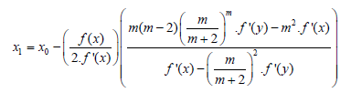

Li et al (2009) method:
Dong’s method:

Slide 7
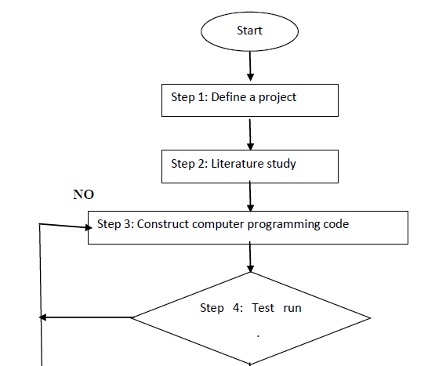
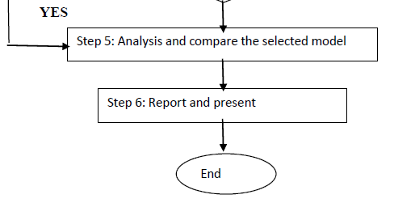
METHODOLOGY

Slide 8
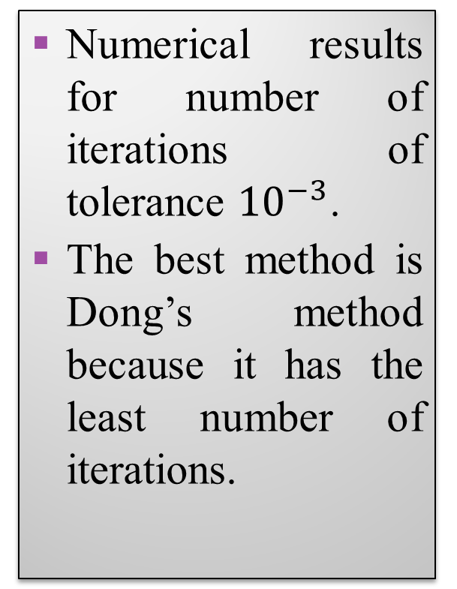
RESULTS AND DISCUSSION
Functions |  | Schroder method | Halley method | Li et al. (2009) method | Dong method
 | -2.7 | 12 | 108 | 164 | 118
 | -1.2 | 30 | 100 | 207 | 46
 | -0.1 | 117 | 27 | 471 | 5
F1 | 0.3 | 6 | 10 | 25 | 3
 | 1.2 | 3 | 8 | 19 | 2
 | 2.1 | 4 | 11 | 30 | 3
 | -2.7 | 6 | 14 | 36 | 3
 | -1.2 | 3 | 10 | 25 | 2
 | -0.1 | 4 | 13 | 39 | 3
F2 | 0.3 | 4 | 14 | 42 | 3
 | 1.2 | 5 | 16 | 47 | 3
 | 2.1 | 5 | 17 | 51 | 4
 | -2.7 | 4 | 21 | 59 | 3
 | -1.2 | 4 | 22 | 61 | 3
 | -0.1 | 5 | 71 | 63 | 9
F3 | 0.3 | 5 | 47 | 281 | 3
 | 1.2 | 18 | 58 | 240 | 9
 | 2.1 | 12 | 44 | 425 | 7
 | -2.7 | 6 | 19 | 44 | 10
 | -1.2 | 8 | 7 | 26 | 22
 | -0.1 | 6 | 8 | 22 | 11
F4 | 0.3 | 5 | 8 | 46 | 4
 | 1.2 | 2 | 4 | 6 | 2
 | 2.1 | 6 | 12 | 37 | 4
 | -2.7 | 125 | 22 | 30 | 42
 | -1.2 | 8 | 12 | 35 | 33
 | -0.1 | 4 | 10 | 27 | 3
F5 | 0.3 | 4 | 9 | 24 | 3
 | 1.2 | 3 | 9 | 26 | 3
 | 2.1 | 4 | 11 | 32 | 3
 | -2.7 | 10 | 29 | 54 | 6
 | -1.2 | 249 | 14 | 33 | 4
 | -0.1 | 3 | 10 | 22 | 3
F6 | 0.3 | 4 | 13 | 36 | 3
 | 1.2 | 4 | 18 | 52 | 4
 | 2.1 | 9 | 20 | 25 | 3
Numerical results for number of iterations of tolerance ${10}^{−3}$.
The best method is Dong’s method because it has the least number of iterations.

Slide 9
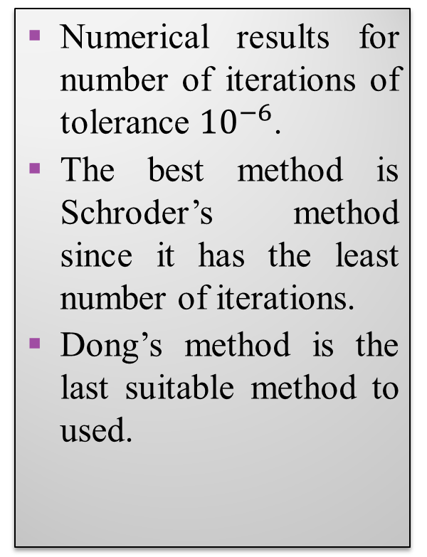
Functions |  | Schroder method | Halley method | Li et al. (2009) method | Dong method
 | -2.7 | 13 | 118 | 202 | 119
 | -1.2 | 31 | 110 | 245 | 47
 | -0.1 | 118 | 36 | 509 | 5
F1 | 0.3 | 7 | 20 | 63 | 4
 | 1.2 | 4 | 18 | 57 | 4
 | 2.1 | 5 | 20 | 68 | 4
 | -2.7 | 7 | 28 | 87 | 4
 | -1.2 | 4 | 24 | 77 | 3
 | -0.1 | 5 | 27 | 90 | 3
F2 | 0.3 | 29 | 28 | 94 | 4
 | 1.2 | 5 | 29 | 99 | 4
 | 2.1 | 6 | 30 | 103 | 4
 | -2.7 | 5 | 49 | 165 | 4
 | -1.2 | 5 | 49 | 169 | 4
 | -0.1 | 6 | 98 | 164 | 10
F3 | 0.3 | 6 | 74 | 389 | 3
 | 1.2 | 19 | 86 | 347 | 9
 | 2.1 | 13 | 173 | 532 | 7
 | -2.7 | 7 | 29 | 81 | 11
 | -1.2 | 10 | 17 | 64 | 22
 | -0.1 | 7 | 18 | 60 | 11
F4 | 0.3 | 6 | 18 | 60 | 5
 | 1.2 | 3 | 14 | 44 | 3
 | 2.1 | 7 | 22 | 75 | 4
 | -2.7 | 125 | 32 | 67 | 6335
 | -1.2 | 9 | 22 | 72 | 34
 | -0.1 | 5 | 20 | 65 | 4
F5 | 0.3 | 4 | 19 | 62 | 3
 | 1.2 | 4 | 19 | 64 | 3
 | 2.1 | 5 | 21 | 70 | 4
 | -2.7 | 11 | 46 | 120 | 6
 | -1.2 | 249 | 32 | 99 | 6
 | -0.1 | 4 | 27 | 88 | 3
F6 | 0.3 | 5 | 31 | 102 | 4
 | 1.2 | 5 | 35 | 118 | 5
 | 2.1 | 10 | 37 | 90 | 7008
Numerical results for number of iterations of tolerance ${10}^{−6}$.
The best method is Schroder’s method since it has the least number of iterations.
Dong’s method is the last suitable method to used.

Slide 10
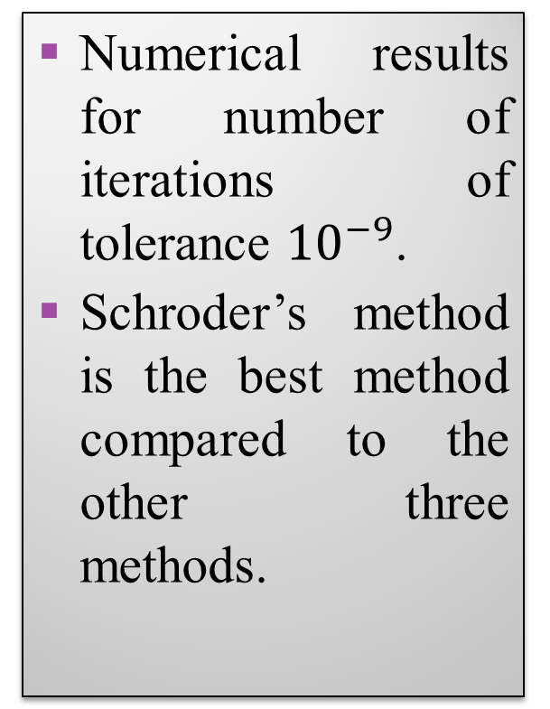
Functions |  | Schroder method | Halley method | Li et al. (2009) method | Dong method
 | -2.7 | 14 | 128 | 237 | 119
 | -1.2 | 31 | 119 | 280 | 47
 | -0.1 | 118 | 46 | 544 | 7
F1 | 0.3 | 7 | 30 | 98 | 4
 | 1.2 | 5 | 27 | 92 | 4
 | 2.1 | 6 | 30 | 103 | 4
 | -2.7 | 8 | 41 | 136 | 4
 | -1.2 | 4 | 36 | 125 | 3
 | -0.1 | 5 | 40 | 142 | 5
F2 | 0.3 | 29 | 41 | 145 | 5
 | 1.2 | 6 | 43 | 150 | 6
 | 2.1 | 6 | 44 | 154 | 4
 | -2.7 | 5 | 75 | 266 | 6
 | -1.2 | 5 | 76 | 269 | 5
 | -0.1 | 6 | 124 | 264 | 15
F3 | 0.3 | 7 | 101 | 489 | 6639
 | 1.2 | 20 | 112 | 447 | 3057
 | 2.1 | 14 | 199 | 633 | 10
 | -2.7 | 8 | 38 | 117 | 14
 | -1.2 | 10 | 26 | 99 | 23
 | -0.1 | 7 | 28 | 95 | 13
F4 | 0.3 | 7 | 28 | 95 | 7
 | 1.2 | 4 | 24 | 79 | 3
 | 2.1 | 8 | 32 | 110 | 6
 | -2.7 | 126 | 42 | 105 | fail
 | -1.2 | 9 | 32 | 110 | 34
 | -0.1 | 6 | 30 | 102 | 4
F5 | 0.3 | 5 | 29 | 100 | 4
 | 1.2 | 4 | 29 | 101 | 4
 | 2.1 | 5 | 31 | 108 | 4
 | -2.7 | 11 | 63 | 185 | 7
 | -1.2 | fail | 49 | 164 | 6117
 | -0.1 | 5 | 44 | 153 | 4
F6 | 0.3 | 5 | 48 | 168 | 4
 | 1.2 | 6 | 52 | 183 | 5
 | 2.1 | 10 | 54 | 156 | fail
Numerical results for number of iterations of tolerance ${10}^{−9}$.
Schroder’s method is the best method compared to the other three methods.

Slide 11
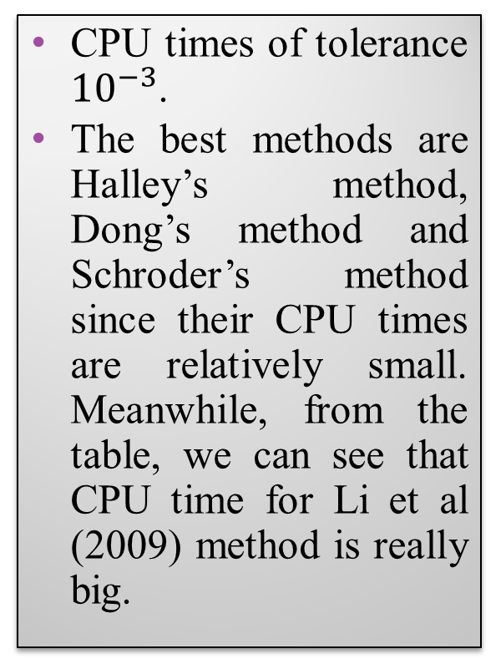
Functions |  | Schroder method | Halley method | Li et al. (2009) method | Dong method
 | -2.7 | 1.421875 | 1.46875 | 1.84375 | 2.046875
 | -1.2 | 1.1875 | 2.890625 | 1.5 | 1.140625
 | -0.1 | 1.671875 | 2.265625 | 1.671875 | 1.171875
F1 | 0.3 | 5.84375 | 1.765625 | 2.03125 | 3.84375
 | 1.2 | 1.171875 | 1.71875 | 2.171875 | 1.265625
 | 2.1 | 1.3125 | 1.09375 | 6.046875 | 1.265625
 | -2.7 | 1.265625 | 2.03125 | 2.71875 | 2.359375
 | -1.2 | 1.0625 | 1.703125 | 1.703125 | 1.1875
 | -0.1 | 1.109375 | 1.703125 | 1.4375 | 1.484375
F2 | 0.3 | 3.0625 | 4.375 | 4.75 | 1.6875
 | 1.2 | 1.421875 | 1.625 | 1.421875 | 1.09375
 | 2.1 | 2.1875 | 1.84375 | 1.875 | 1.578125
 | -2.7 | 1.078125 | 1.046875 | 24.015625 | 1.84375
 | -1.2 | 1.171875 | 1.109375 | 29.625 | 1.40625
 | -0.1 | 1.125 | 1.234375 | 27.71875 | 1.890625
F3 | 0.3 | 1.140625 | 2.484375 | 19.53125 | 1.609375
 | 1.2 | 2.28125 | 2.078125 | 24.015625 | 1.34375
 | 2.1 | 1.328125 | 2.03125 | 21.828125 | 1.96875
 | -2.7 | 1.0625 | 1.078125 | 11.125 | 1.796875
 | -1.2 | 1.09375 | 1.0625 | 16.359375 | 1.71875
 | -0.1 | 1.03125 | 1.0625 | 13.859375 | 1.4375
F4 | 0.3 | 1.171875 | 1.515625 | 3.78125 | 1.71875
 | 1.2 | 1.609375 | 1.109375 | 8.515625 | 1.4375
 | 2.1 | 1.40625 | 1.21875 | 5.84375 | 1.203125
 | -2.7 | 1.53125 | 1.09375 | 37.109375 | 1.375
 | -1.2 | 1.109375 | 1.03125 | 40.5 | 1.046875
 | -0.1 | 1.890625 | 1.109375 | 38.75 | 1.375
F5 | 0.3 | 2.671875 | 1.109375 | 3.28125 | 1.421875
 | 1.2 | 1.15625 | 1.078125 | 35.4375 | 1.421875
 | 2.1 | 1.1875 | 1.078125 | 33.734375 | 1.796875
 | -2.7 | 1.09375 | 1.1875 | 49.625 | 1.078125
 | -1.2 | 3.625 | 1.109375 | 53.28125 | 0.984375
 | -0.1 | 1.03125 | 1.125 | 51.40625 | 0.984375
F6 | 0.3 | 1.28125 | 1.375 | 44.296875 | 1.28125
 | 1.2 | 1.40625 | 1.3125 | 47.796875 | 3.5
 | 2.1 | 1.671875 | 1.4375 | 45.984375 | 1.25
CPU times of tolerance ${10}^{−3}$.
The best methods are Halley’s method, Dong’s method and Schroder’s method since their CPU times are relatively small. Meanwhile, from the table, we can see that CPU time for Li et al (2009) method is really big.

Slide 12
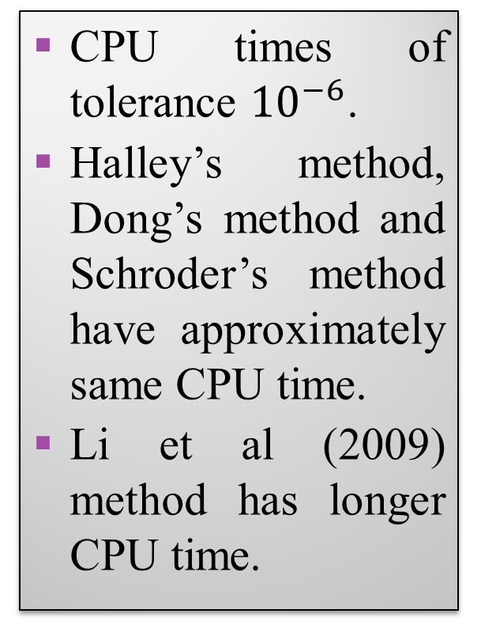
Functions |  | Schroder method | Halley method | Li et al. (2009) method | Dong method
 | -2.7 | 1.09375 | 1.21875 | 1.359375 | 2.5
 | -1.2 | 1.078125 | 1.59375 | 2.6875 | 1.15625
 | -0.1 | 1.140625 | 1.96875 | 1.625 | 1.109375
F1 | 0.3 | 3.078125 | 1.109375 | 1.6875 | 1.609375
 | 1.2 | 1.5625 | 1.140625 | 2.71875 | 1.515625
 | 2.1 | 1.234375 | 1.1875 | 2.484375 | 1.53125
 | -2.7 | 1.078125 | 2.3125 | 1.453125 | 1.09375
 | -1.2 | 1.171875 | 1.59375 | 1.390625 | 1.125
 | -0.1 | 0.984375 | 1.34375 | 1.640625 | 1.171875
F2 | 0.3 | 1.09375 | 2.84375 | 1.65625 | 1.03125
 | 1.2 | 1.078125 | 2.203125 | 1.421875 | 1.078125
 | 2.1 | 2.25 | 1.265625 | 1.90625 | 1.171875
 | -2.7 | 1.03125 | 1.171875 | 26.359375 | 1.375
 | -1.2 | 1.140625 | 1.15625 | 30.140625 | 1.25
 | -0.1 | 1.09375 | 1.140625 | 28.1875 | 1.6875
F3 | 0.3 | 1.15625 | 1.59375 | 20.015625 | 2.390625
 | 1.2 | 1.109375 | 1.03125 | 24.484375 | 1.609375
 | 2.1 | 1.234375 | 1.859375 | 22.328125 | 1.484375
 | -2.7 | 1.0625 | 1.109375 | 12.125 | 1.328125
 | -1.2 | 1.0625 | 1.171875 | 17.3125 | 1.6875
 | -0.1 | 1.125 | 1.1875 | 14.671875 | 1.359375
F4 | 0.3 | 1.0625 | 1.171875 | 3.75 | 1.609375
 | 1.2 | 1.046875 | 1.015625 | 9.40625 | 1.28125
 | 2.1 | 1.671875 | 1.28125 | 6.640625 | 1.796875
 | -2.7 | 1.25 | 1.046875 | 37.5625 | 7.203125
 | -1.2 | 1.21875 | 1.078125 | 40.8125 | 1.125
 | -0.1 | 1.15625 | 1.015625 | 39.125 | 1.1875
F5 | 0.3 | 1.1875 | 1.140625 | 32.015625 | 1.53125
 | 1.2 | 1.171875 | 1.03125 | 35.765625 | 1.125
 | 2.1 | 1.15625 | 1.078125 | 34.140625 | 1.5
 | -2.7 | 1.046875 | 1.046875 | 50.015625 | 1.171875
 | -1.2 | 1.46875 | 1.046875 | 53.65625 | 1.453125
 | -0.1 | 1.640625 | 1.09375 | 51.84375 | 1.03125
F6 | 0.3 | 2.203125 | 3.6875 | 44.671875 | 1.703125
 | 1.2 | 1.15625 | 1.25 | 48.21875 | 1.6875
 | 2.1 | 1.3125 | 1.578125 | 46.375 | 1.703125
CPU times of tolerance ${10}^{−6}$.
Halley’s method, Dong’s method and Schroder’s method have approximately same CPU time.
Li et al (2009) method has longer CPU time.

Slide 13
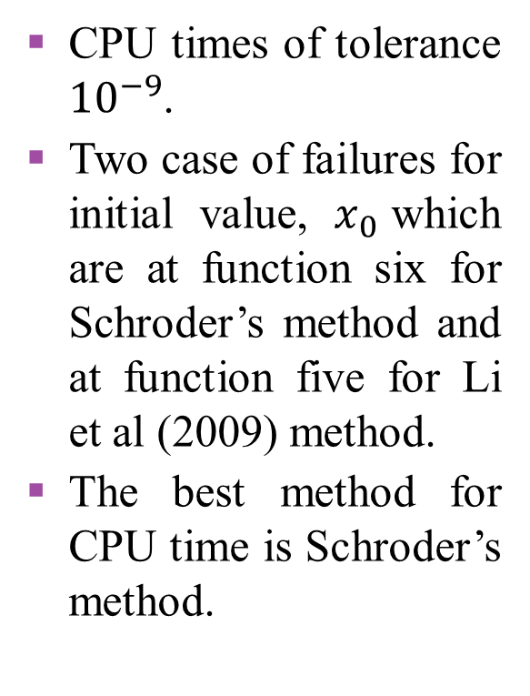
Functions |  | Schroder method | Halley method | Li et al. (2009) method | Dong method
 | -2.7 | 1.359375 | 2.84375 | 1.59375 | 1.703125
 | -1.2 | 1.015625 | 1.71875 | 1.578125 | 1.046875
 | -0.1 | 1.15625 | 1.640625 | 1.578125 | 1.09375
F1 | 0.3 | 2.3125 | 1.28125 | 1.1875 | 2.78125
 | 1.2 | 1.609375 | 1.203125 | 1.390625 | 1.484375
 | 2.1 | 1.03125 | 1.109375 | 2.671875 | 1.765625
 | -2.7 | 1.453125 | 1.859375 | 1.359375 | 1.6875
 | -1.2 | 1.03125 | 1.546875 | 1.65625 | 1.15625
 | -0.1 | 1.15625 | 1.921875 | 1.5 | 1.3125
F2 | 0.3 | 1.015625 | 1.15625 | 2.421875 | 1.140625
 | 1.2 | 1.09375 | 1.96875 | 1.53125 | 1.171875
 | 2.1 | 1.953125 | 1.625 | 1.453125 | 1.65625
 | -2.7 | 1.15625 | 1.109375 | 26.84375 | 4.375
 | -1.2 | 1.09375 | 1.15625 | 30.65625 | 1.375
 | -0.1 | 1.046875 | 1.265625 | 28.6875 | 1.234375
F3 | 0.3 | 1.03125 | 5.171875 | 20.484375 | 8.359375
 | 1.2 | 1.1875 | 1.125 | 24.953125 | 4.375
 | 2.1 | 1.203125 | 2.0625 | 22.84375 | 8.359375
 | -2.7 | 0.984375 | 1.046875 | 13.03125 | 1.1875
 | -1.2 | 1.640625 | 1.015625 | 18.21875 | 1.28125
 | -0.1 | 1.015625 | 1.0625 | 15.484375 | 1.140625
F4 | 0.3 | 0.953125 | 1.0625 | 5.140625 | 1.375
 | 1.2 | 1.046875 | 1.046875 | 10.296875 | 1.328125
 | 2.1 | 1.625 | 1.171875 | 7.71875 | 1.359375
 | -2.7 | 1.34375 | 1.140625 | 37.890625 | fail
 | -1.2 | 1.15625 | 1.1875 | 41.21875 | 1.15625
 | -0.1 | 1.25 | 1.046875 | 39.453125 | 1.234375
F5 | 0.3 | 1.171875 | 1.359375 | 32.4375 | 1.15625
 | 1.2 | 1.140625 | 1.671875 | 36.171875 | 1.203125
 | 2.1 | 1.0625 | 1.046875 | 34.53125 | 1.671875
 | -2.7 | 1.09375 | 1.25 | 50.484375 | 1.15625
 | -1.2 | fail | 1.0625 | 54.125 | 7.03125
 | -0.1 | 1.09375 | 1.0625 | 52.3125 | 1.046875
F6 | 0.3 | 2.109375 | 2.8125 | 41.21875 | 1.15625
 | 1.2 | 1.125 | 1.203125 | 48.671875 | 1.515625
 | 2.1 | 1.15625 | 1.25 | 46.859375 | 3.515625
CPU times of tolerance ${10}^{−9}$.
Two case of failures for initial value, $x_{0}$which are at function six for Schroder’s method and at function five for Li et al (2009) method.
The best method for CPU time is Schroder’s method.

Slide 14
CONCLUSION AND RECOMMENDATION
Halley’s method is the best approach when resolving these functions.
In terms of CPU time, the result show that even though Schroder’s method.
Test function has been applied with larger intervals.
Try on more different functions try on more different functions.

Slide 15
THANK YOU

