Slide 1
Migraine Diagnosis using Fuzzy Expert System
Supervisor’s Name : Prof Madya Wan Dorishah Bt Wan Abdul Manan
Name : Nor Syafiqah Binti Omar
Matrix Number : 2018424894

Slide 2
Problem Statement
Unrelated symptoms that might be minor on their own could be warning signs of a more serious medical disease or condition (Chunha et al., 2019).
There is no particular test that can determine migraine. Hence, physical symptoms are being used in order to diagnose whether a person suffers migraine or not (Chandra 2014).
In order to help people identify the level of migraine that they are suffering based on the symptoms occur, a fuzzy expert system is developed to do the diagnosis for migraine.

Slide 3
Objectives
To identify how expert diagnoses migraine.
To develop a fuzzy expert system to diagnose migraine.
To evaluate the functionality of the system in diagnosing the disease.

Slide 4
Scope
ITEM | DESCRIPTION
User | People who want to identify the cause of the symptoms whether it is indeed migraine or not.
Data Used | Extracted by doing interview with an expert in Klinik Nuraeen.
Method | Fuzzy Expert System.
Evaluation | Test the functionality of the system.

Slide 5
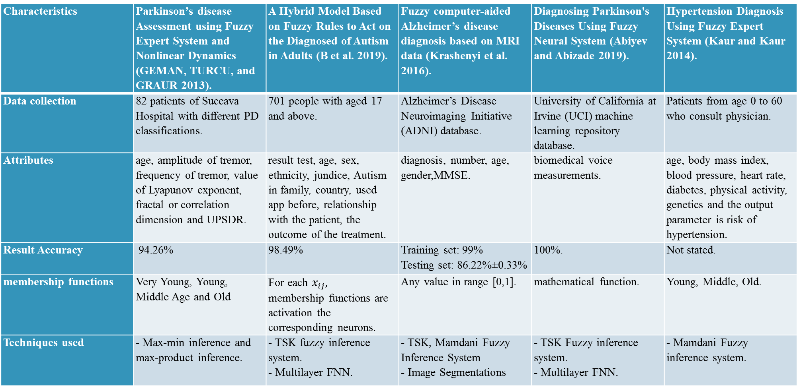
Application using Fuzzy System

Slide 6
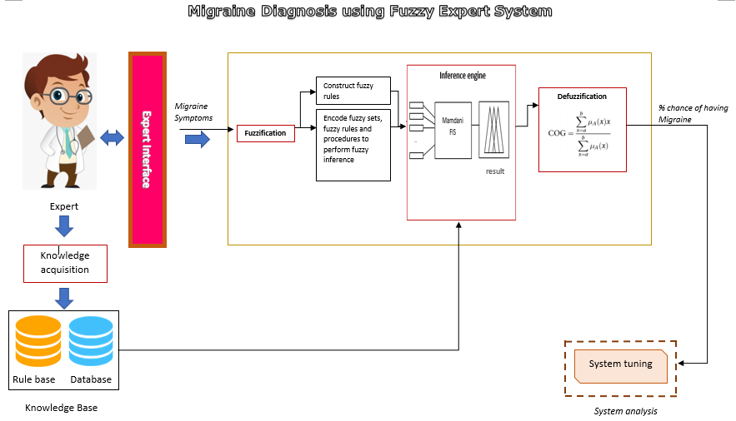
Migraine Diagnosis using Fuzzy Expert System Conceptual Framework

Slide 7
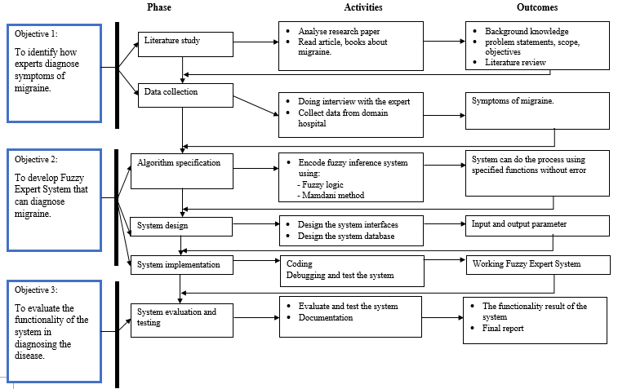
Migraine Diagnosis using Fuzzy Expert System Methodology Framework

Slide 8
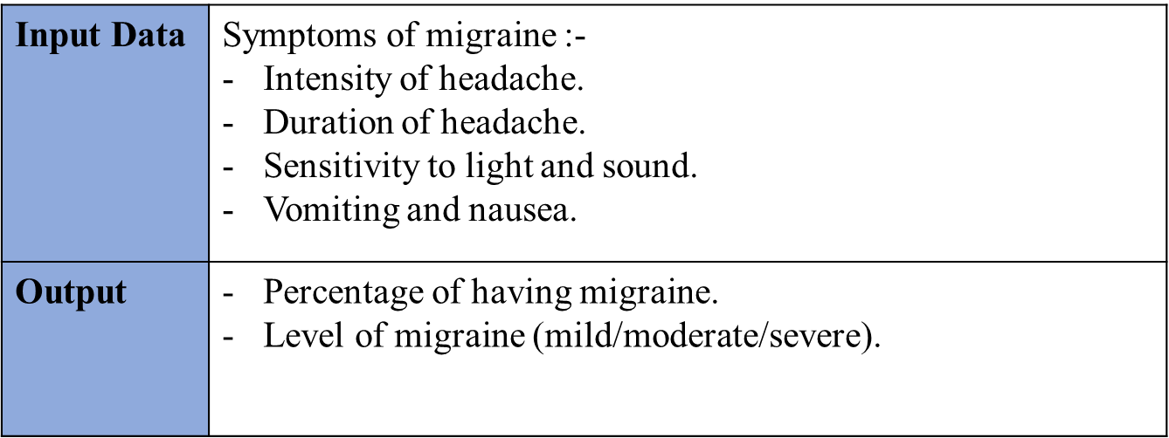
Analysis Phase: Data Collection

Slide 9
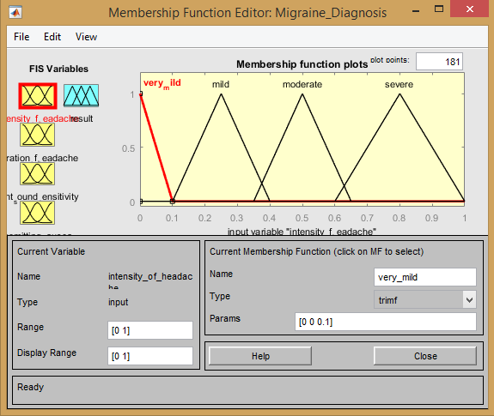
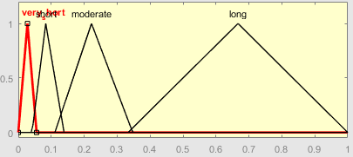
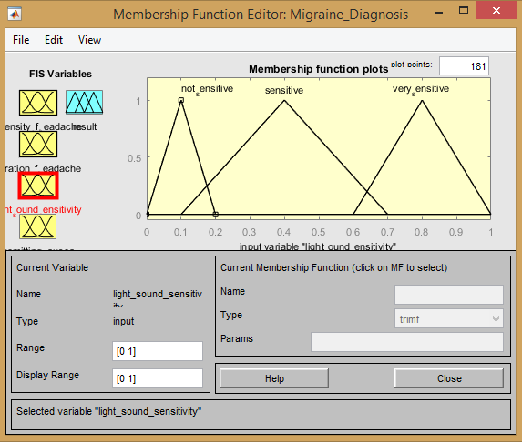
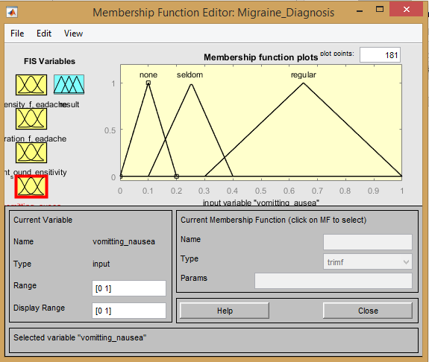
Analysis Phase: Data Preparation (Raw Data)
Linguistic variables (input) | Linguistic values | Range
Intensity of headache | Very Mild | [0 – 0.1]
 | Mild | [0.1 – 0.4]
 | Moderate | [0.35 – 0.65]
 | Severe | [0.6 – 1]
Duration of headache | Very Short | [0 – 0.056]
 | Short | [0.042 – 0.139]
 | Moderate | [0.111 – 0.347]
 | Long | [0.333 – 1]
Sensitivity to light and sound | Not Sensitive | [0 – 0.2]
 | Sensitive | [0.1 - 0.7]
 | Very sensitive | [0.6 – 1.0]
Vomiting and nausea | None | [0 – 0.2]
 | Seldom | [0.1 – 0.4]
 | Regular | [0.3 – 1.0]

Slide 10
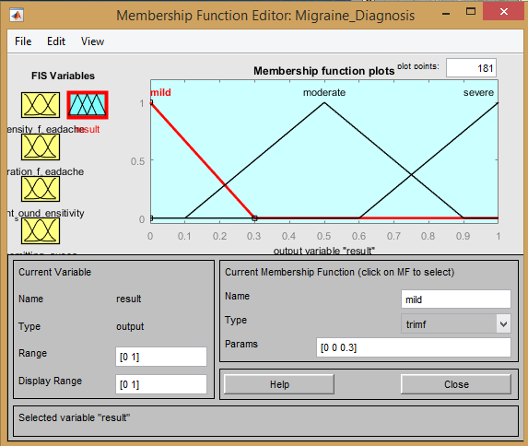
Analysis Phase: Data Preparation (Raw Data)
Linguistic variable (output) | Linguistic values | Range
Level of migraine | Very Mild | [0]
 | Mild | [0.05 – 0.3]
 | Moderate | [0.1 – 0.9]
 | Severe | [0.6 – 1]

Slide 11
Analysis Phase: Data Preparation (Clean Data)
1. If (intensity_of_headache is very_mild) and (duration_of_headache is very_short) and (light_sound_sensitivity is not_sensitive) and (vomitting_nausea is none) then (result is mild) (1) 2. If (intensity_of_headache is very_mild) and (duration_of_headache is very_short) and (light_sound_sensitivity is not_sensitive) and (vomitting_nausea is seldom) then (result is mild) (1) 3. If (intensity_of_headache is very_mild) and (duration_of_headache is very_short) and (light_sound_sensitivity is not_sensitive) and (vomitting_nausea is regular) then (result is moderate) (1) 4. If (intensity_of_headache is very_mild) and (duration_of_headache is very_short) and (light_sound_sensitivity is sensitive) and (vomitting_nausea is none) then (result is mild) (1) 5. If (intensity_of_headache is very_mild) and (duration_of_headache is very_short) and (light_sound_sensitivity is sensitive) and (vomitting_nausea is seldom) then (result is mild) (1) 6. If (intensity_of_headache is very_mild) and (duration_of_headache is very_short) and (light_sound_sensitivity is sensitive) and (vomitting_nausea is regular) then (result is moderate) (1) . . 140. If (intensity_of_headache is severe) and (duration_of_headache is long) and (light_sound_sensitivity is very_sensitive) and (vomitting_nausea is none) then (result is moderate) (1) 141. If (intensity_of_headache is severe) and (duration_of_headache is long) and (light_sound_sensitivity is very_sensitive) and (vomitting_nausea is seldom) then (result is severe) (1) 142. If (intensity_of_headache is severe) and (duration_of_headache is long) and (light_sound_sensitivity is very_sensitive) and (vomitting_nausea is regular) then (result is severe) (1)

Slide 12
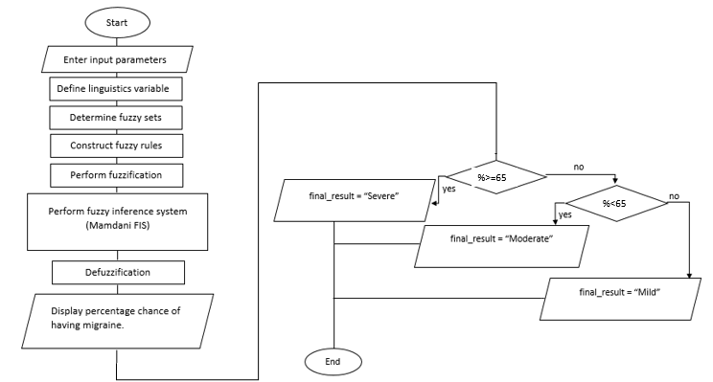
Migraine Diagnosis using Fuzzy Expert System Process Flow

Slide 13
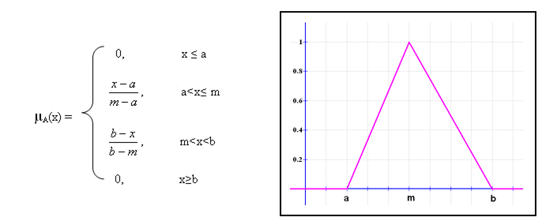
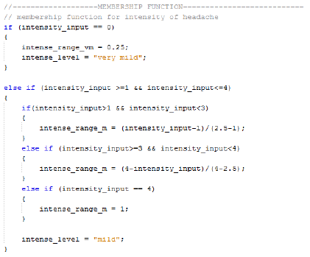
Technique Method
Calculate membership function of each input.
Triangular function
Formula | Sample implementation

Slide 14
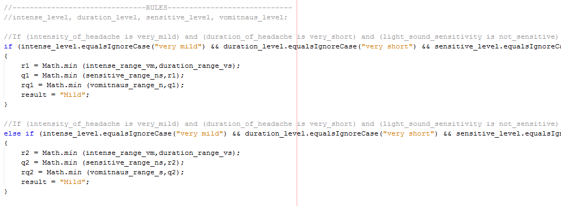
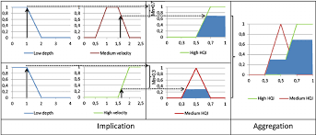

2. Rule evaluation.
3. Result aggregation (fuzzy sets that represent the outputs of each rule are combined into a single fuzzy set)

Slide 15
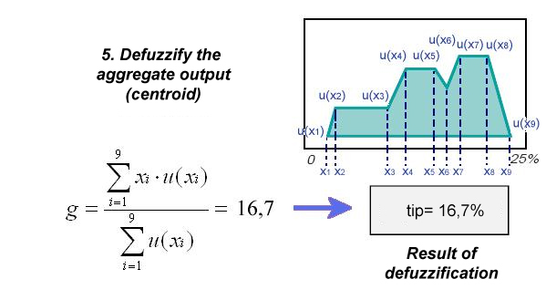
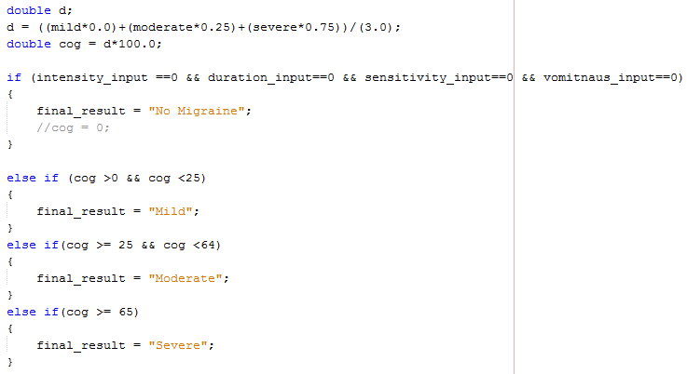
4. Defuzzification.
Centre of Gravity (COG)
Formula | Sample implementation

Slide 16
Result Analysis
No | Input field |  |  |  | Level of migraine
 | Intensity of headache | Duration of headache | Sensitivity to light and sound | Vomiting and nausea | System result | Actual result
1 | severe | moderate | very sensitive | none | moderate (54.58%) | moderate
2 | severe | long | very sensitive | regular | severe (66.67%) | severe
3 | mild | moderate | not sensitive | none | moderate (50.83%) | moderate
4 | severe | short | very sensitive | seldom | mild (19.17%) | severe
5 | mild | long | sensitive | none | severe (66.67%) | moderate
6 | mild | long | very sensitive | regular | moderate (17.38%) | severe
7 | mild | long | very sensitive | regular | severe (66.67%) | severe
8 | mild | moderate | not sensitive | none | moderate (50.56%) | moderate
9 | severe | short | not sensitive | regular | moderate (29.17%) | severe
10 | very mild | very short | very sensitive | regular | severe (66.67%) | moderate

Slide 17
Project Testing/ Evaluation
ASPECT | RANGE
 | Very dissatisfied | Dissatisfied | Natural | Satisfied
System effectiveness. |  |  |  | √
System can accept data without error. |  |  |  | √
System helpfulness in diagnosing migraine. |  |  | √
System interactive buttons work successfully. |  |  |  | √
Time efficiency. |  |  | √
User interface. |  |  | √
Ease of use. |  |  |  | √
Data can be stored into database. |  |  |  | √

Slide 18
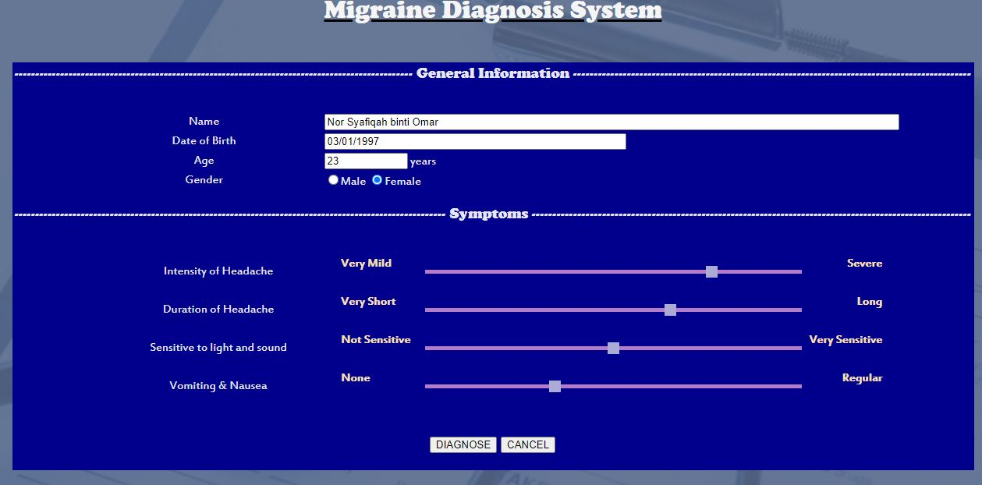
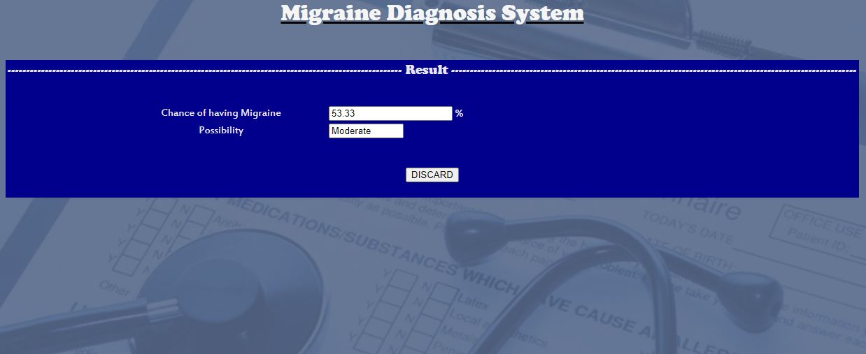

Slide 19
Screen Demo Video

Slide 20
Conclusion
As a conclusion, all phases in the system development is being done based on the above brief conceptual framework in order to build a well functional system that can diagnose migraine. There are two analysis that are being done which are result analysis and system functionality analysis. The results of all steps are shown in the chapter and is being combined with the expert rules outcome in doing result analysis. This research can be improvise for future work or research by using a suitable and latest method.

Slide 21
References
Abiyev, Rahib H. and Sanan Abizade. 2019. “Diagnosing Parkinson’s Diseases Using Fuzzy Neural System.” 1–18.
Adams, Henry E. 1987. “Everything You Want to Know About Depression.” Contemporary Psychology: A Journal of Reviews 32(9):802–3.
Adeli, Ali and Mehdi Neshat. 2010. “A Fuzzy Expert System for Heart Disease Diagnosis.” in Proceedings of the International MultiConference of Engineers and Computer Scientists 2010, IMECS 2010.
Al-shawwa, Mohammed and Samy S. Abu-naser. 2019. “Knowledge Based System for Apple Problems Using CLIPS.” (April).
Al-shayea, Qeethara Kadhim, Itedal S. H. Bahia, and Juan Manuel. 2010. “Urinary System Diseases Diagnosis Using Artificial Neural Networks.” 10(7):118–22.
Amiri, Fatemeh Mohammadi and Ameneh Khadivar. 2017. “Fuzzy Expert System for Diagnosis and Treatment of Musculoskeletal Disorders in Wrist.” Tehnicki Vjesnik 24:147–55.
Aoe, Jo, Ryohei Fukuma, Takufumi Yanagisawa, Tatsuya Harada, Masataka Tanaka, Maki Kobayashi, You Inoue, Shota Yamamoto, Yuichiro Ohnishi, and Haruhiko Kishima. 2019. “Automatic Diagnosis of Neurological Diseases Using MEG Signals with a Deep Neural Network.” Scientific Reports 9(1):1–9.
B, Giorgio Morales, Itamar Salazar-reque, Joel Telles, and D. Daniel. 2019. Artificial Intelligence Applications and Innovations - Bramer Max.Pdf. Springer International Publishing.
Balogh, Erin P., Bryan T. Miller, and John R. Ball. 2016. Improving Diagnosis in Health Care.
Bartleson, Jd and Fred Michael Cutrer. 2015. “Migraine Update. Diagnosis and Treatment.” (May 2010).
Carey, John, Johns Hopkins Otolaryngology-head, Neck Surgery, Michael Teixido, and John Carey. 1998. “Migraine. More than a Headache.” Harvard Health Letter / from Harvard Medical School 23(3):4–5.
Cavallaro, Fausto. 2015. “A Takagi-Sugeno Fuzzy Inference System for Developing a Sustainability Index of Biomass.” Sustainability (Switzerland) 7(9):12359–71.

Slide 22
References
Chandra, Vishal. 2014. “Fuzzy Expert System for Migraine Analysis and Diagnosis.” International Journal of Science and Research (IJSR) 3(6):956–59.
Chowdhury, Tanjia. 2018. “Fuzzy Logic Based Expert System for Detecting Colorectal Cancer.” 389–93.
Eckardt, M., U. Ruch, and M. Schnabel. 1988. “Knowledge Based System for Diagnosing Anemia.” (April):562–562.
Faculty, Gaza, Computer Engineering Ecom, Artificial Intelligence Eng, and Ibraheem Lubbad. n.d. “Fuzzy Expert Systems.” (x).
GEMAN, O., C. O. TURCU, and A. GRAUR. 2013. “Parkinson’s Disease Assessment Using Fuzzy Expert System and Nonlinear Dynamics.” Advances in Electrical and Computer Engineering 13(1):41–46.
Geman, Oana, Corneliu-octavian Turcu, and Adrian Graur. 2014. “Parkinson’s Disease Assessment Using Fuzzy Expert System and Nonlinear Dynamics.” (February 2013).
Hassan, Norlida, Nureize Arbaiy, Noor Aziyan Ahmad Shah, and Zehan Afizah. 2017. “Fuzzy Expert System for Heart Attack Diagnosis.” IOP Conference Series: Materials Science and Engineering 226(1).
Hassanzad, Maryam, Azam Orooji, Ali Valinejadi, and Aliakbar Velayati. 2019. “A Fuzzy Rule-Based Expert System for Diagnosing Cystic Fibrosis.” 9(12):5974–84.
J, Ayangbekun Oluwafemi and Jimoh Ibrahim A. 2015. “Expert System for Diagnosis Neurodegenerative Diseases.” 04(04):694–98.
Joram, Mutai K., Bii K. Harrison, and Kiplang’at N. Joseph. 2017. “A Knowledge-Based System for Life Insurance Underwriting.” International Journal of Information Technology and Computer Science 9(3):40–49.
Kaur, Rupinder and Amrit Kaur. 2014. “Hypertension Diagnosis Using Fuzzy Expert System.” International Journal of Engineering Research and Applications (IJERA) 14(March):2248–9622.
Krashenyi, Igor, Javier Ramírez, Anton Popov, and Juan Manuel Górriz. 2016. “Fuzzy Computer-Aided Alzheimer’s Disease Diagnosis Based on MRI Data.” Current Alzheimer Research 13(5):545–56.

