Slide 1
COUNTER SERVICE SATISFACTION RECOGNITION USING CONVOLUTIONAL NEURAL NETWORK
NAME: RAHIL AMIERA BT MUSTAFA BAKRIM
SUPERVISOR: DR. HAMIDAH BT JANTAN

Slide 2
Problem statement
Nowadays, customer’s feedback is quite hard to get because people do not have much time to fill in the feedback form .
However, the satisfaction toward the service is shown through customers facial expression.
Classification of facial expression is using CNN algorithm because of its high accuracy.

Slide 3
objectives
1) To identify the requirement of Convolutional Neural Network(CNN) for classify the facial expression.
2) To develop a facial expression recognition system for basic emotion in counter service.
3) To evaluate the whole functionalities and accuracy of the system.

Slide 4
scope
DATA | USER | METHOD | PROCESS
Facial expression dataset(300 dataset) | Staff at any counter service section | Convolutional Neural Network | This system can classify human expression into seven basic expression only. Neutral, angry, and happy.

Slide 5
Related works
Characteristic | Facial Expression Recognition as an Implicit Customers’ Feedback | Facial Expression Recognition Using Attentional Convolutional Network | Emotion recognition from facial expression using deep convolutional neural network | Facial Expression Recognition using Neural Network | Human Emotion Recognition using Machine Learning
Algorithm | Artificial Neural Network | Attentional Neural Network | Convolutional Neural Network | Principle Component Analysis | Recurrent Neural Network
Accuracy | - | 92.0% | 92.81% | 88.1% | -
Description | To track the face in the video sequences | Focus on feature-rich parts of the face | Focus on recognizing eight different classes of emotion through facial expression | Recognize the different human gesture in colour image. | Classifying human emotions from facial expressions

Slide 6
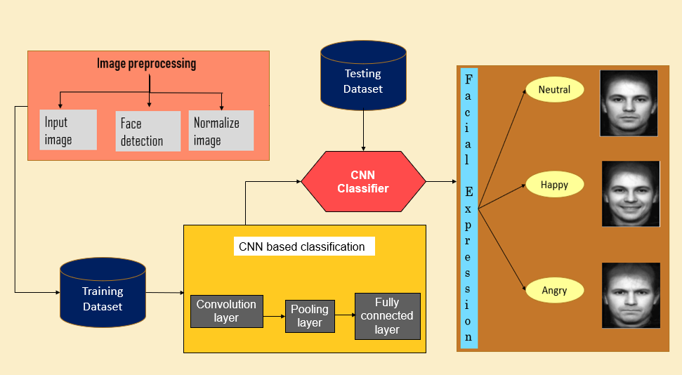
COUNTER SERVICE SATISFACTION RECOGNITION CONCEPTUAL FRAMEWORK

Slide 7
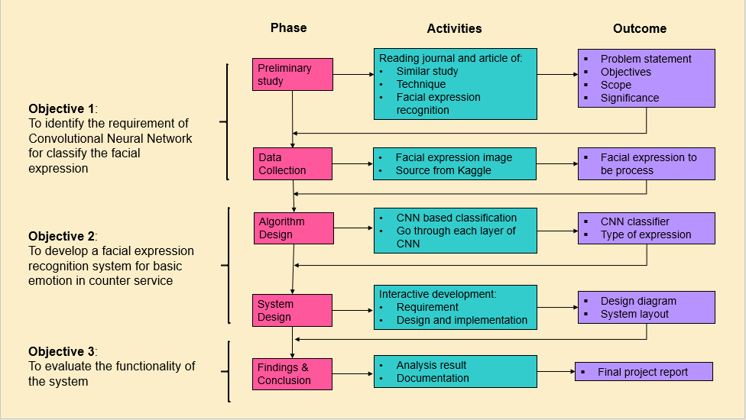
COUNTER SERVICE SATISFACTION RECOGNITION METHODOLOGY FRAMEWORK

Slide 8
Analysis: data collection
Characteristic | Description
Data Type | Secondary data: Facial expression image
Data Size | 256*256 pixels
Number of Dataset | 300 3 categories ( neutral, happy, angry)
Source | Kaggle(https://www.kaggle.com/ahmedmoorsy/facial-expression)

Slide 9
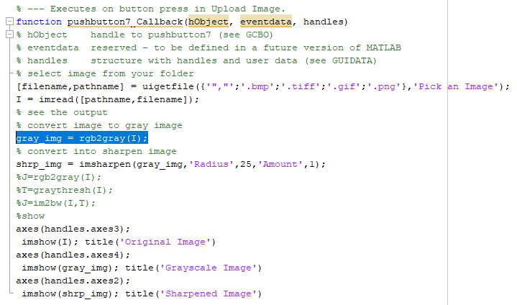
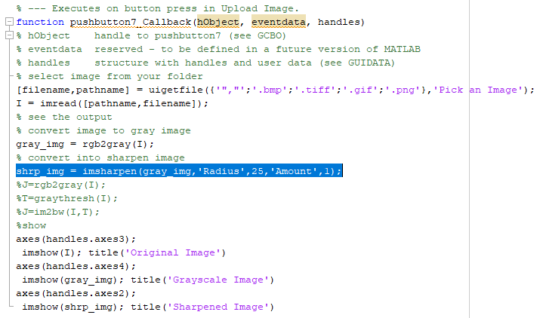
Analysis: data preparation
Pre-processing Image:-
Step 1: Convert to grayscale image
Step 2: Convert to sharpened image

Slide 10

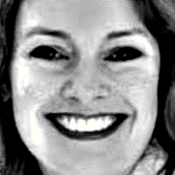


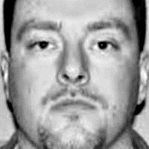
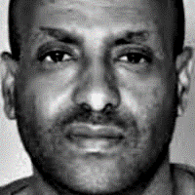
Sample of raw
data
Sample of clean data
Pre-process
Convert to grayscale
Sharpened the image

Slide 11
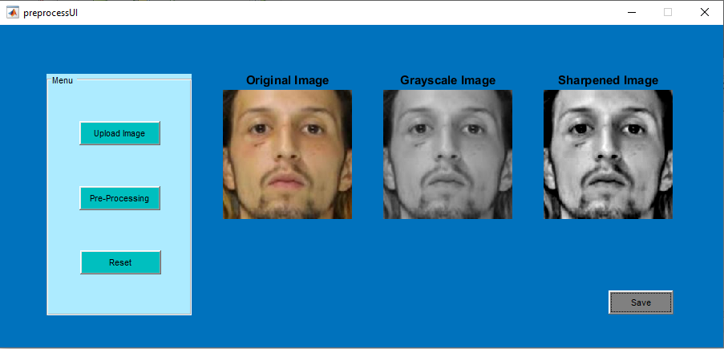

Slide 12
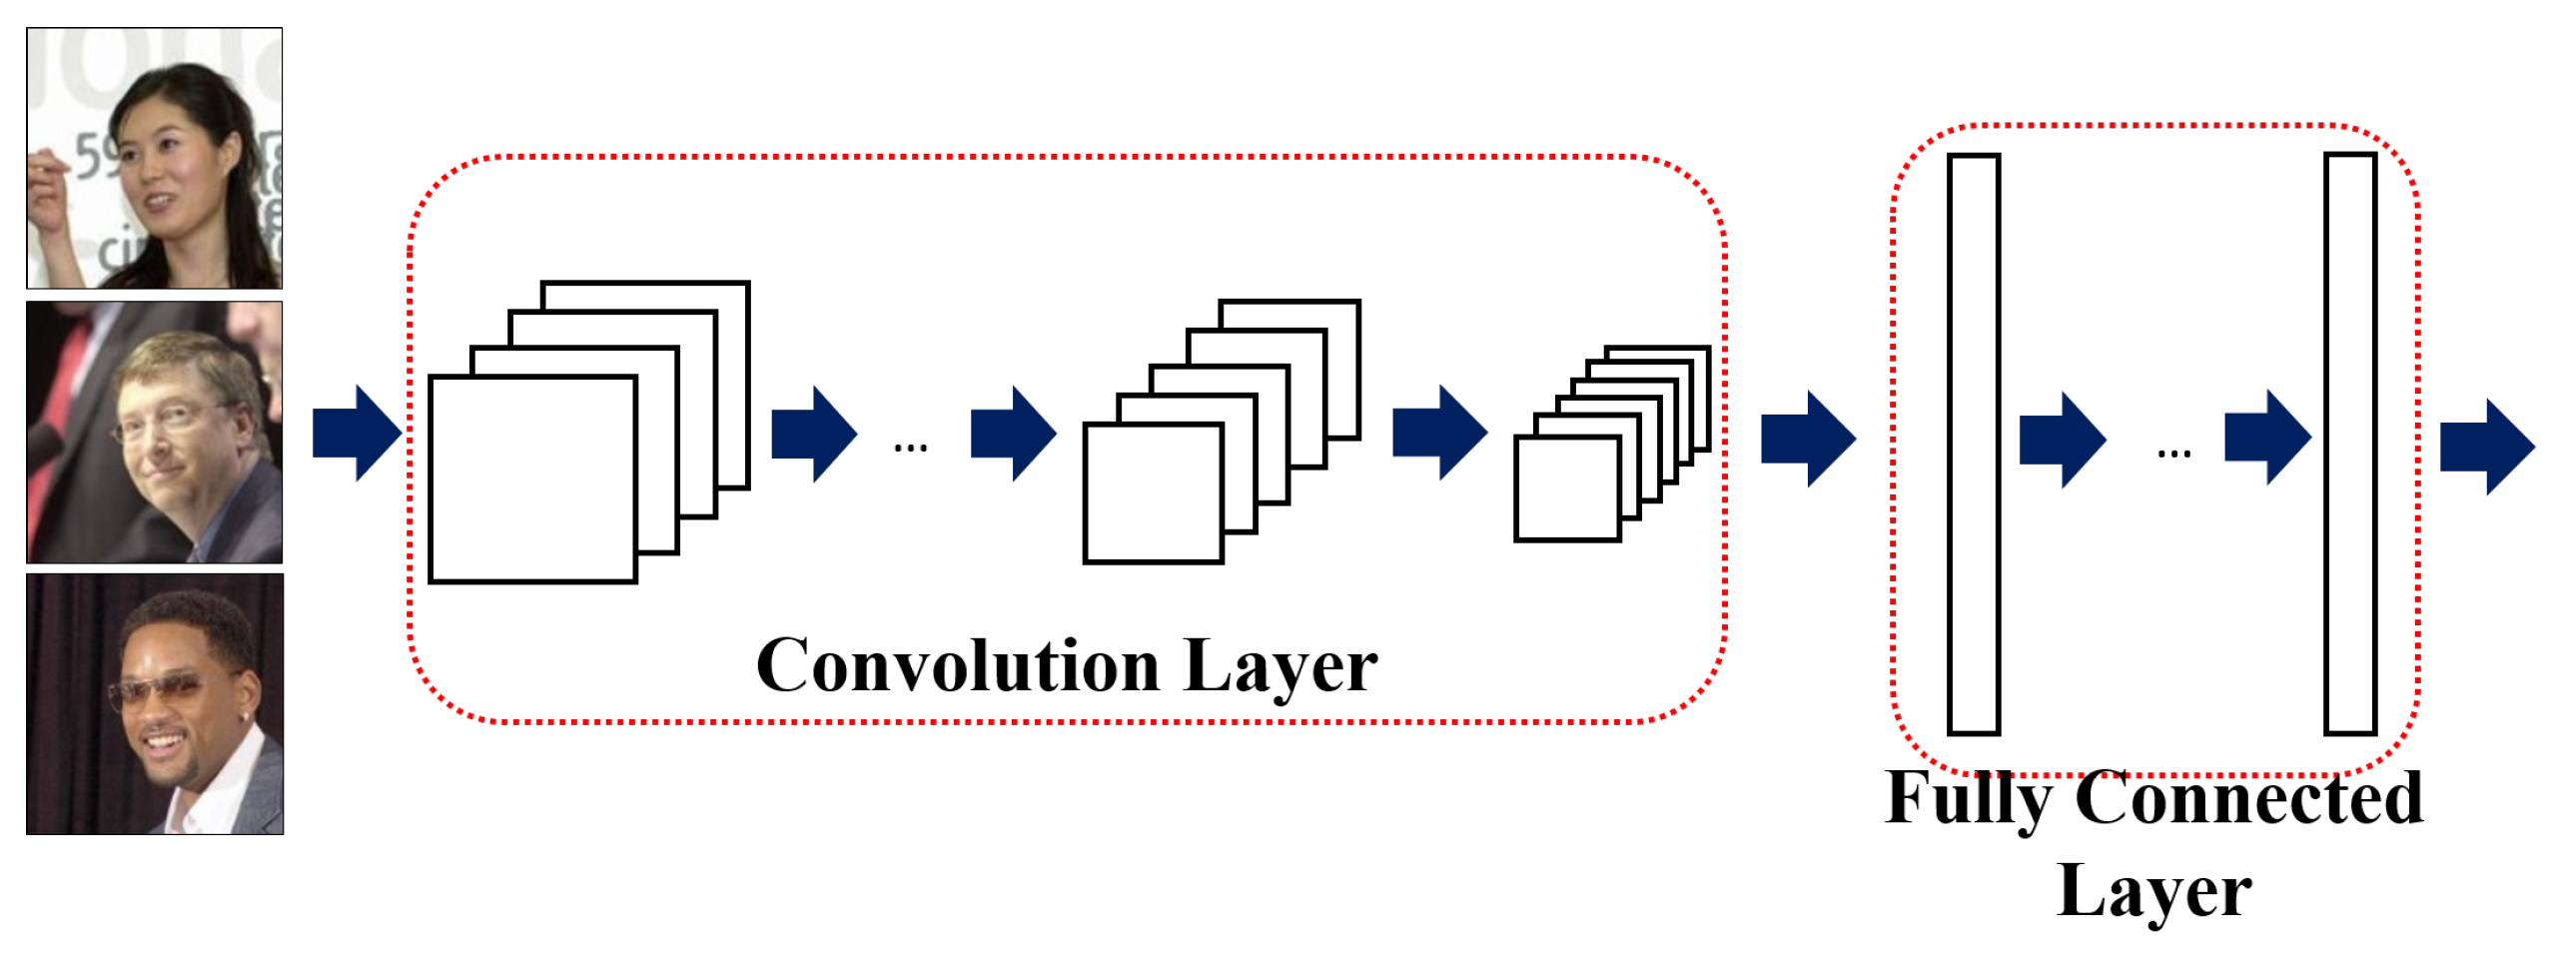
implementation
Happy
Input layer
Neutral
Angry

Slide 13
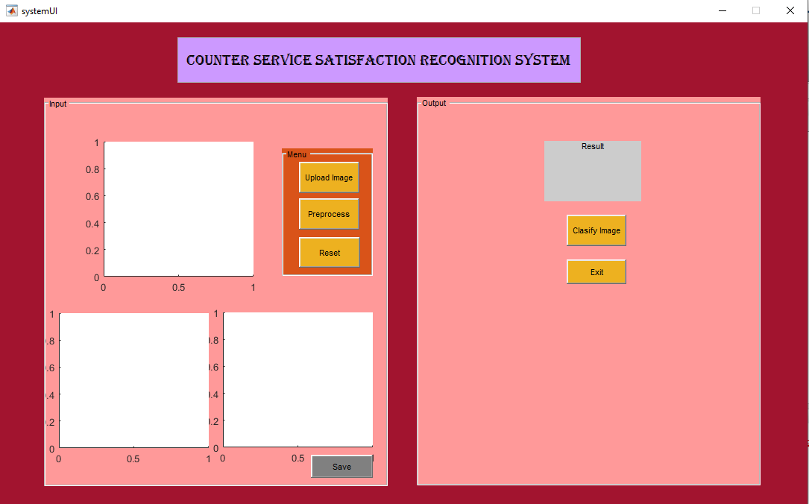
SYSTEM LAYOUT

Slide 14
Experiment setup
Properties | Values
Number of Dataset | 150
Number of Experiment | 54
Size Image | 28*28 pixels
Epoch | 5,10
Learning Rate | 0.001, 0.0001, 0.00001
Train and Test Split | 90:10, 80:20, 70:30
Batch Size | 64,50,40

Slide 15
Result analysis
The experiment result for 90:10 spilt
Split | MaxEpochs | MiniBatchSize | Learning_rate | Accuracy Result
90:10 | 10 | 64 | 0.001 | 0.3333
 |  |  | 0.0001 | 0.7778
 |  |  | 0.00001 | 0.5556
 |  | 50 | 0.001 | 0.4442
 |  |  | 0.0001 | 0.6667
 |  |  | 0.00001 | 0.6666
 |  | 40 | 0.001 | 0.4444
 |  |  | 0.0001 | 0.5556
 |  |  | 0.00001 | 0.6667
 | 5 | 64 | 0.001 | 0.2222
 |  |  | 0.0001 | 0.3333
 |  |  | 0.00001 | 0.6667
 |  | 50 | 0.001 | 0.2222
 |  |  | 0.0001 | 0.6667
 |  |  | 0.00001 | 0.5556
 |  | 40 | 0.001 | 0.4444
 |  |  | 0.0001 | 0.7778
 |  |  | 0.00001 | 0.7778

Slide 16
RESULT ANALYSIS (CONT.)
The experiment result for 80:20 spilt
Split | MaxEpochs | MiniBatchSize | Learning_rate | Accuracy Result
80:20 | 10 | 64 | 0.001 | 0.2223
 |  |  | 0.0001 | 0.7778
 |  |  | 0.00001 | 0.6667
 |  | 50 | 0.001 | 0.5000
 |  |  | 0.0001 | 0.7222
 |  |  | 0.00001 | 0.7222
 |  | 40 | 0.001 | 0.2778
 |  |  | 0.0001 | 0.7222
 |  |  | 0.00001 | 0.7222
 | 5 | 64 | 0.001 | 0.2222
 |  |  | 0.0001 | 0.5556
 |  |  | 0.00001 | 0.6111
 |  | 50 | 0.001 | 0.2778
 |  |  | 0.0001 | 0.5556
 |  |  | 0.00001 | 0.5556
 |  | 40 | 0.001 | 0.2222
 |  |  | 0.0001 | 0.4443
 |  |  | 0.00001 | 0.5000

Slide 17
RESULT ANALYSIS (CONT.)
The experiment result for 70:30 spilt
Split | MaxEpochs | MiniBatchSize | Learning_rate | Accuracy Result
70:30 | 10 | 64 | 0.001 | 0.5000
 |  |  | 0.0001 | 0.5769
 |  |  | 0.00001 | 0.7692
 |  | 50 | 0.001 | 0.3076
 |  |  | 0.0001 | 0.6154
 |  |  | 0.00001 | 0.5769
 |  | 40 | 0.001 | 0.5000
 |  |  | 0.0001 | 0.6923
 |  |  | 0.00001 | 0.5769
 | 5 | 64 | 0.001 | 0.3077
 |  |  | 0.0001 | 0.5385
 |  |  | 0.00001 | 0.6538
 |  | 50 | 0.001 | 0.1923
 |  |  | 0.0001 | 0.5769
 |  |  | 0.00001 | 0.5385
 |  | 40 | 0.001 | 0.3076
 |  |  | 0.0001 | 0.3462
 |  |  | 0.00001 | 0.5767

Slide 18
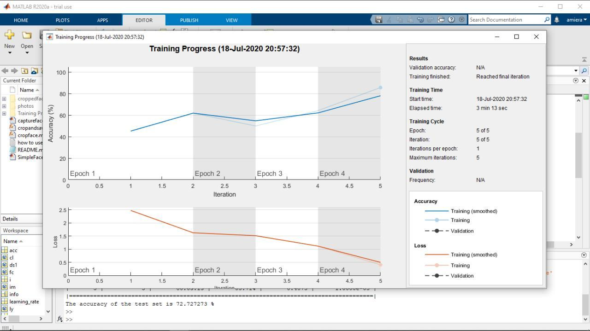
Project testing and evaluation
Training data | 150
Data spilt | 80:20
Number of layers | 3
Max epoch | 10
Mini batch size | 64
Learning rate | 0.0001
Accuracy rate | 0.7778
54 experiments has been done in obtaining the best model.
The best spilt to get the best accuracy is 80:20.
It shows that the CNN algorithm is suitable for training image as it produced high accuracy.

Slide 19
Project testing and evaluation
(Functionality test)
Functionality Test | 1 Very bad | 2 Bad | 3 Neutral | 4 Good | 5 Very good
Upload image button |  |  |  |  | /
Display input image |  |  |  |  | /
Pre-process button |  |  |  |  | /
Display pre-process image |  |  |  | /
Reset button |  |  |  |  | /
Classify image button |  |  |  |  | /
Display classification result |  |  |  |  | /
Exit button |  |  |  |  | /

Slide 20
System demonstration

Slide 21
conclusion
This chapter completes the project as it discussed on the overall conclusion, limitations, and recommendations for future works of the project. The objectives discussed has been achieved in guiding on the development of this project. On the other hands, the limitations have been detected together with its recommendation for the future improvement of the upcoming system.

Slide 22
references
[1] Abdulrahman, M., & Eleyan, A. (2015). Facial expression recognition using Support Vector Machines. 2015 23rd Signal Processing and Communications Applications Conference, SIU 2015 - Proceedings, 276–279. https://doi.org/10.1109/SIU.2015.7129813
[2] Adesuyi, F. A. (2013). Secure Authentication for Mobile Banking Using Facial Recognition. IOSR Journal of Computer Engineering, 10(3), 51–59. https://doi.org/10.9790/0661-01035159
[3] Barreto, A. M. (2017). Application of facial expression studies on the of marketing. Emotional Expression: The Brain and the Face, (June), 163–189.
[4] Battini Sönmez, E. (2017). A study on facial expression recognition. Gazi University Journal of Science, 30(3), 19–27.
[5] Bendjillali, R. I., Beladgham, M., & Merit, K. (2019). Improved Facial Expression Recognition Based on DWT Feature for Deep CNN. https://doi.org/10.3390/electronics8030324
[6] Bhandare, A., Bhide, M., Gokhale, P., & Chandavarkar, R. (2016). Applications of Convolutional Neural Networks. 7(5), 2206–2215.

Slide 23
References (cont.)
[7] Bhattacharya, P., & Engineering, S. (2007). Classification of Facial Expressions Using K-Nearest. 555–556.
[8] Chirikjian, J. G., & Fabian, S. (1997). Biotechnology for community college faculty. FASEB Journal, 11(9).
[9] Gu, J., Wang, Z., Kuen, J., Ma, L., Shahroudy, A., Shuai, B., & Liu, T. (2017). Recent Advances in Convolutional Neural Networks. (December 2015). https://doi.org/10.1016/j.patcog.2017.10.013
[10]Gupta, P., Saxena, N., Sharma, M., & Tripathi, J. (2018). Deep Neural Network for Human Face Recognition. International Journal of Engineering and Manufacturing, 8(1), 63–71. https://doi.org/10.5815/ijem.2018.01.06
[11]Jeong, M., & Ko, B. C. (2018). Driver’s facial expression recognition in real-time for safe driving. Sensors (Switzerland), 18(12). https://doi.org/10.3390/s18124270
[12]Kharat, G. U. (2008). Human Emotion Recognition System Using Optimally Designed SVM With Different Facial Feature Extraction Techniques. 7(6), 650–659.

Slide 24
THANK YOU…

