Slide 1
STRESS LEVEL DETECTION USING FUZZY LOGIC
SUPERVISOR’S NAME: TS. DR RAJESWARI RAJU
NAME: NOR HUSNA NABILA BT KHUZAINI
MATRIC’S NUM: 2017412146

Slide 2
PROBLEM STATEMENT
Uncontrolled stress can lead to exhaustion, depression and several other sicknesses. Due to stress there are may be other health issues like obesity, heart attack, diabetes, asthma (Ahuja et al.,2019)
Stress level at high phase occurred suicide. Every hour, a student commits suicide in the different part of country (Banga et al.,2019)
Stress can effect the performance of the person’s work. These problems decrease the production and increase the work-related costs (Ekiz et al.,2019)
SOLUTION
To prevent stress from becoming chronic and provoking irreversible damages, it is necessary to detect it in its early stages (Alberdi et al, 2016)
Fuzzy logic has been proven to be one of the effective methods to bring clarity in the world of medicine (Fatai et al., 2014)
Consist of linguistic assessments of the patients’ symptoms provided by the doctors/medical experts with their corresponding confidence levels (West, 2013)

Slide 3
SCOPE
The user of this system is a doctor, counsellor and therapist to detect a patient’s stress level.
This system will diagnoses the symptoms of stress and the provide the data to the level that has been classify.
The data were classify using Fuzzy Logic
OBJECTIVE
To Identify how the expert detect the stress level.
To construct the Stress Level Detection System using Fuzzy Logic.
To evaluate the effectiveness of constructed Stress Level Detection System using Fuzzy Logic.

Slide 4
APPLICATION THAT USED FUZZY IN HEALTH CARE
Characteristic | Stress | Depression | Dementia
Country | Spain | Switzerland | Ukraine
Data Set | 80 female, age around 19 to 32 years old | 41 patient of older adults | 818 patients
Model analysis | Fuzzy Logic | Fuzzy set for prediction and regression | Fuzzy Inferences system–clustering algorithm
Result | Accuracy greater than 90%. | Easier to manage and less intrusive | 88% sensitivity, 91% specificity, 88% accurately, 88% positive predictive value

Slide 5

STRESS LEVEL DETECTION USING FUZZY LOGIC CONCEPTUAL FRAMEWORK
PROCESS
INPUT
Input Data(crisp)
FUZZIFICATION
Set of input Variable
Information data patient
User
Patient share problem
RULE
INFERENCES
Fuzzy Inference engine
KNOWLEDGE BASED
DEFUZZIFICATION
Data from expert
Output Fuzzy Set
Acute
OUTPUT
Episodic
type of stress level
CHRONIC

Slide 6
STRESS LEVEL PREDICTION METHODOLOGY FRAMEWORK
Phase
Activities
Outcome
Reading Journal and article of :
Type of stress
Symptoms of stress
Technique for classification
Similar study
Problem statement
Objective
Scope
Significant
Objective 1:
Initial Study
To identify how the expert detect the stress level.
Data Collection
From research paper
Require data to detect the stress level
Algorithm Design
Fuzzy logic for classify
Stress level detection using fuzzy logic algorithm
Objective 2:
To construct Stress Level Detection system using Fuzzy Logic
System Design Development
Interactive development :
Require
Analysis
Design and implementation
Design the system layout
The symptom of stress
Objective 3:
To evaluate the effectiveness of constructed Stress Level Detection System using Fuzzy Logic.
Findings and conclusion
Analysis result
Documentation
System for Stress level detection
Final Project Report

Slide 7
PROJECT METHODOLOGY FRAMEWORK
PHASE | TASK | ACTIVITIES | EXPECTED DELIVERABLES/ OUTCOME
GATHERING INFORMATION | Literature review | Reading journal Thesis project Article | Literature review
DATA COLLECTION | Primary data acquisition | Collect data from web about stress Collect data from expert | Symptom of stress Level of stress
SYSTEM DESIGN | Classify the rules | Finding symptoms of stress Fuzzy logic to classify | Classification of stress level
IMPLEMENTATION | Coding Debugging and System testing | Writing program for implementation using JAVA | Working optimization engine
RESULT ANALYSIS | Functional test | Potential performance evaluation method | 3 type of stress level: - Acute stress - Episodic stress - Chronic stress

Slide 8
DATA COLLECTION
Characteristic | Description
Input | Symptoms of stress Days of headache Digestive issue (gas constipation, diarrhae) Struggle to sleep Feel anxiety, worry and phobia Eyebrow wrinkle Mouth Reaction
Output | Level of stress Acute stress Episodic stress Chronic stress

Slide 9
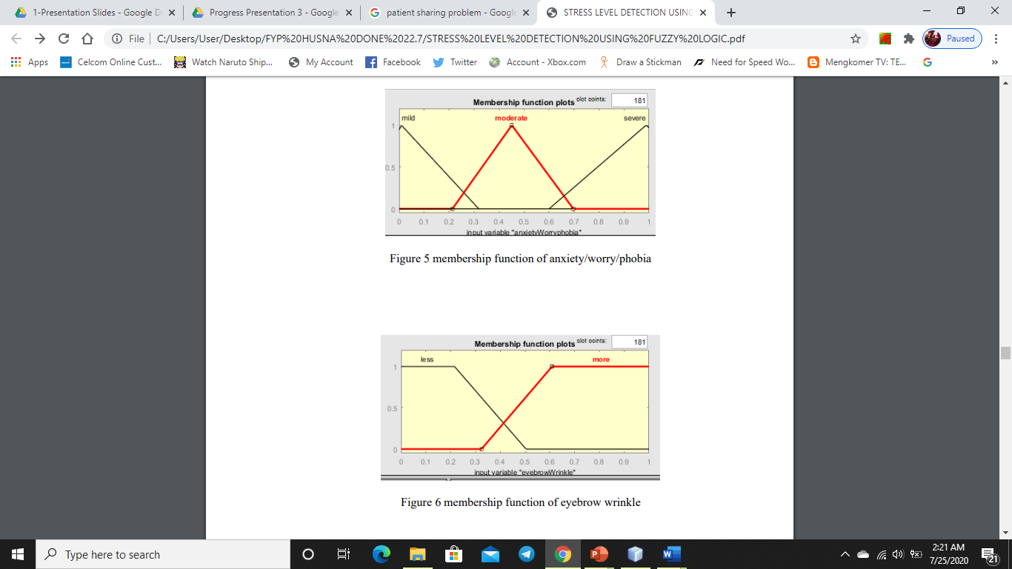
RAW DATA
Input Learning Features | Linguistic Values
Day of headaches | Less 5 day More 5 day
Digestive issues | Mild Moderate Severe
Sleep struggle | None Seldom Regular
Anxiety/worry/phobia | Mild Moderate Severe
Wrinkle eyebrow | Less More
Mouth reaction | Sad Anger

Slide 10
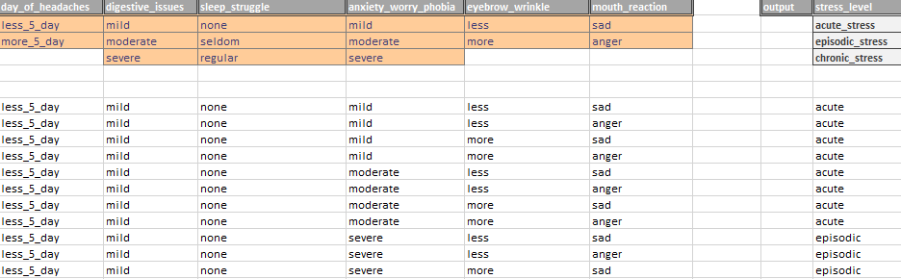
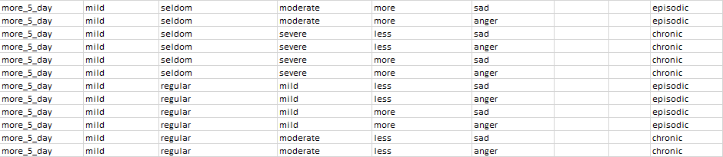
Data Pre-processing

Slide 11
CLEAN DATA
If (day_of_headaches is less_5_day) and (digestive_issues is mild) and (sleep_struggle is none) and (anxiety_worry_phobia is mild) and (eyebrow_wrinkle is less) and (mouth_react is sad), then (stress_level is acute stress).
If (day_of_headaches is less_5_day) and (digestive_issues is mild) and (sleep_struggle is none) and (anxiety_worry_phobia is mild) and (eyebrow_wrinkle is less) and (mouth_react is anger), then (stress_level is acute stress).
If (day_of_headaches is less_5_day) and (digestive_issues is mild) and (sleep_struggle is none) and (anxiety_worry_phobia is mild) and (eyebrow_wrinkle is more) and (mouth_react is sad), then (stress_level is acute stress).
If (day_of_headaches is less_5_day) and (digestive_issues is mild) and (sleep_struggle is regular) and (anxiety_worry_phobia is mild) and (eyebrow_wrinkle is more) and (mouth_react is sad), then (stress_level is episodic stress).
If (day_of_headaches is less_5_day) and (digestive_issues is mild) and (sleep_struggle is regular) and (anxiety_worry_phobia is mild) and (eyebrow_wrinkle is more) and (mouth_react is anger), then (stress_level is episodic stress).
If (day_of_headaches is more_5_day) and (digestive_issues is severe) and (sleep_struggle is regular) and (anxiety_worry_phobia is severe) and (eyebrow_wrinkle is more) and (mouth_react is anger), then (stress_level is chronic stress).

Slide 12
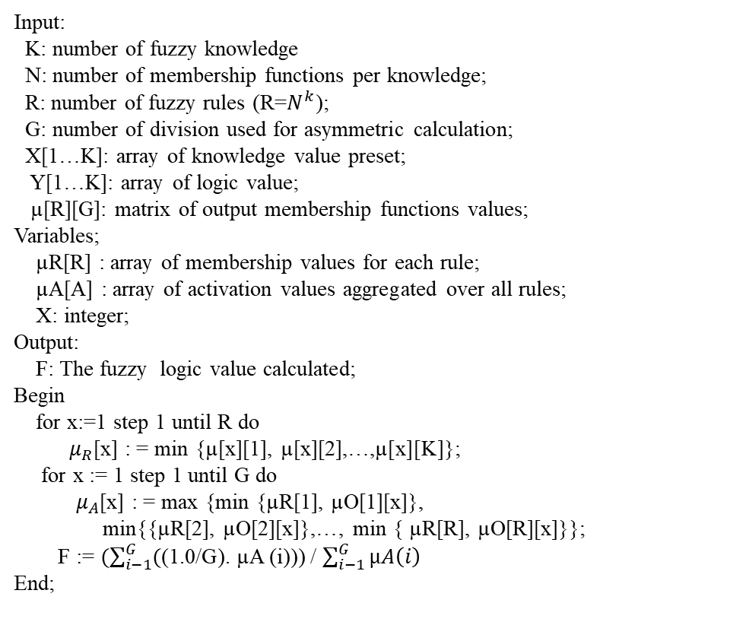
Stress Level Detection using Fuzzy Logic logical design
Start
Symptoms of stress
Input:
K: number of fuzzy knowledge
N: number of membership functions per knowledge;
R: number of fuzzy rules (R=$N^{k}$);
G: number of division used for asymmetric calculation;
X[1…K]: array of knowledge value preset;
Y[1…K]: array of logic value;
µ[R][G]: matrix of output membership functions values;
Variables;
µR[R] : array of membership values for each rule;
µA[A] : array of activation values aggregated over all rules;
X: integer;
Output:
F: The fuzzy logic value calculated;
Begin
for x:=1 step 1 until R do
$μ_{R}$[x] : = min {µ[x][1], µ[x][2],…,µ[x][K]};
for x := 1 step 1 until G do
${ μ}_{A}$[x] : = max {min {µR[1], µO[1][x]},
min{{µR[2], µO[2][x]},…, min { µR[R], µO[R][x]}};
F := $(\sum_{i−1}^{G}{(\text{(1.0/}\text{G}\text{).}}$µA (i))) / $\sum_{i−1}^{G}{µA\left(i\right)}$
End;
Input data
Identify linguistic variables
Fuzzy set and membership function
Fuzzy rule
Fuzzification
Inference rules
Acute
Episodic
Defuzzification
Chronic
End

Slide 13
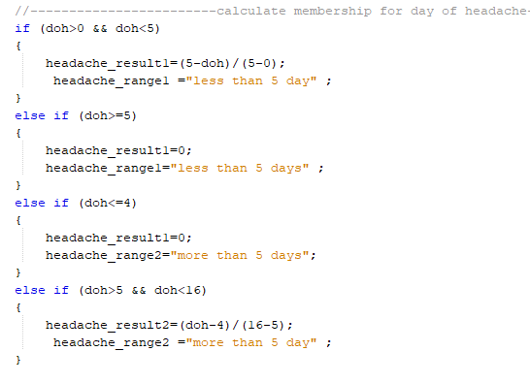
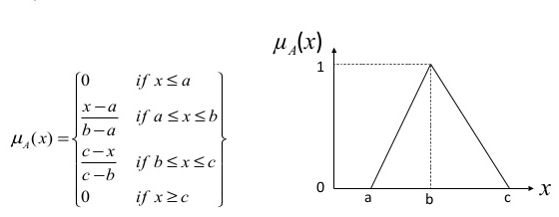
TECHNIQUE METHOD
1) Membership function

Slide 14
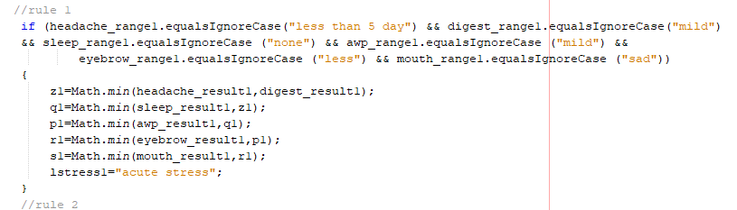
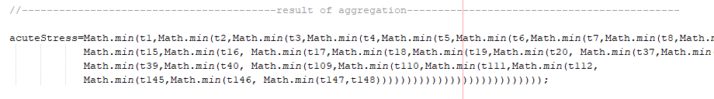
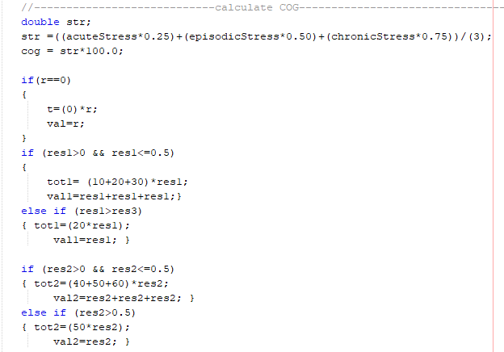
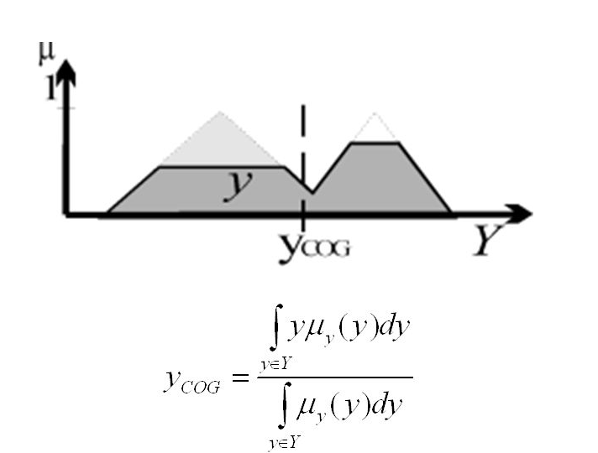
2) Evaluation for each rule
3) Difuzzification using COG

Slide 15
RESULT ANALYSIS
Symptoms | Case 1 | Case 2 | Case 3
Day_of_headaches | <5days | >5 days | <5days
Digestive_issues | mild | Moderate | Severe
Sleep_struggle | none | seldom | Regular
Anxiety_worry_phobia | mild | mild | Severe
Eyebrow_wrinkle | Less | more | more
Mouth_react | sad | anger | Sad
Result_system Rule_result | Acute Acute | Acute Acute | Chronic Acute
Range | Result
Stress_range <35% | Acute stress
35%>= Stress_range <=80% | Episodic stress
Stress_range > 80% | Chronic stress

Slide 16
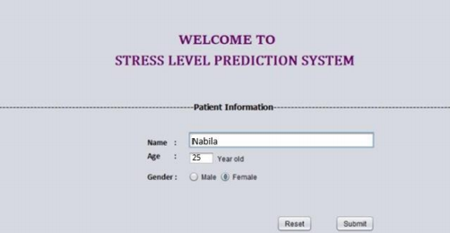
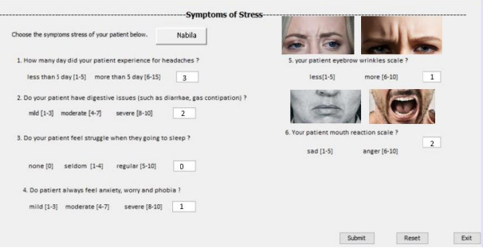
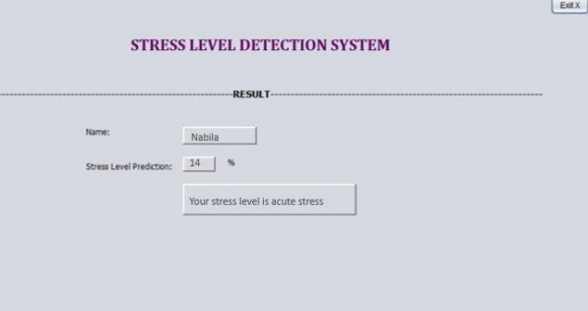
PROJECT TESTING

Slide 17
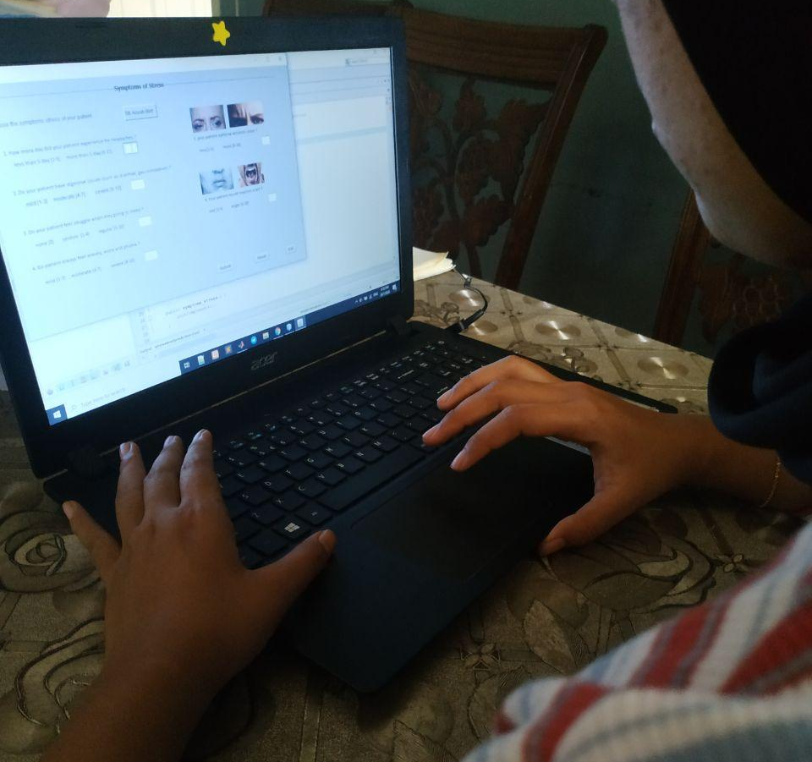
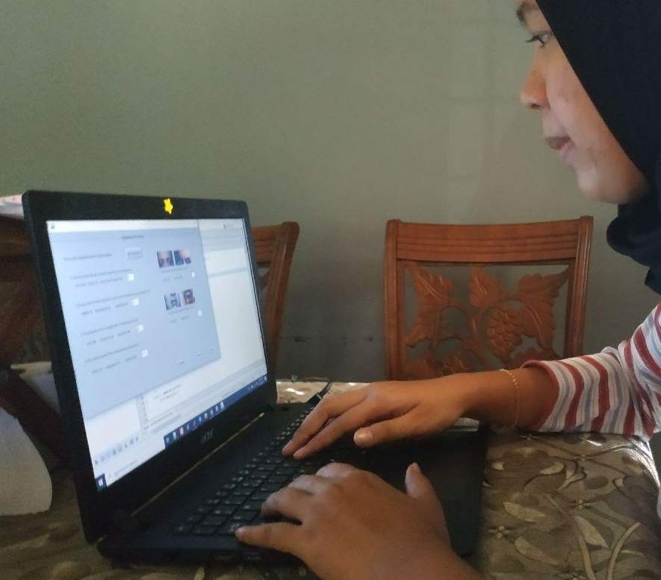
User testing from medical staff
-Simple and easy to use
-The user give a feedback about the stress level detection system need to add HR and BP to improve the system.

Slide 18
Evaluation survey
Aspect | Very Dissatisfied | Dissatisfied | Natural | Satisfied
Interface system
Easy to use
User understand the result
Inconsistency in this system
Time efficiency

Slide 19
SYSTEM DEMO

Slide 20
CONCLUSION
In conclusion, this research done achieved the objective which is;
-To Identify how the expert detect the stress level.
-To construct the Stress Level Detection System using Fuzzy Logic.
-To evaluate the effectiveness of constructed Stress Level Detection System using Fuzzy Logic.
The result give positive feedback that fuzzy logic also can use to detect the stress level.

Slide 21
REFERENCES
Abid, R., Saleem, N., Khalid, H. A., Ahmad, F., Rizwan, M., Manzoor, J., & Junaid, K. (2019). Stress detection of the employees working in software houses using fuzzy inference. International Journal of Advanced Computer Science and Applications, 10(1), 217–224. https://doi.org/10.14569/IJACSA.2019.0100129
Ahuja, R., & Banga, A. (2019). Mental stress detection in university students using machine learning algorithms. Procedia Computer Science, 152, 349–353. https://doi.org/10.1016/j.procs.2019.05.007
Bergmeir, C., & Ben, M. (2015). frbs : Fuzzy Rule-Based Systems for Classification. Journal of Statistical Software, 65(6), 1–30. Retrieved from https://www.google.com/url?sa=t&rct=j&q=&esrc=s&source=web&cd=3&cad=rja&uact=8&ved=0CC4QFjACahUKEwj6w6CX3YjJAhUKo5QKHV5ZA7o&url=http://www.jstatsoft.org/article/view/v065i06/v65i06.pdf&usg=AFQjCNFS2WBfftNazZX 1oNYydV5jsJVTPg
Can, Y. S., Chalabianloo, N., Ekiz, D., & Ersoy, C. (2019). Continuous stress detection using wearable sensors in real life: Algorithmic programming contest case study. Sensors (Switzerland), 19(8). https://doi.org/10.3390/s19081849
Cantara, A. D., & Ceniza, A. M. (2016). Stress Sensor Prototype : Determining the Stress Level in using a Computer through Validated Self-Made Heart Rate ( HR ) and Galvanic Skin Response ( GSR ) Sensors and Fuzzy Logic Algorithm. Internationl Journal ERTV, 5(03), 28–38.
De Oliveira, F., Lanzillotti, R., da Costa, R., Gonçalves, R., Ventura, P., & de Carvalho, L. (2014). A virtual reality exposure therapy for PTSD patients controlled by a fuzzy logic system. Journal of Accessibility and Design for All:JACCES, 4(2), 117–129. https://doi.org/10.17411/jacces.v4i2.41
De Santos Sierra, A., Sánchez Ávila, C., Guerra Casanova, J., & Bailador Del Pozo, G. (2011). A stress-detection system based on physiological signals and fuzzy logic. IEEE Transactions on Industrial Electronics, 58(10), 4857–4865. https://doi.org/10.1109/TIE.2010.2103538

Slide 22
Dobbins, C., & Fairclough, S. (2019). Detecting and Visualizing Context and Stress via a Fuzzy Rule-Based System during Commuter Driving. In 2019 IEEE International Conference on Pervasive Computing and Communications Workshops, PerCom Workshops 2019 (pp. 499–504). Institute of Electrical and Electronics Engineers Inc. https://doi.org/10.1109/PERCOMW.2019.8730600
Ekong, V., Uyinomen, O., Enobakhare, E., & Emmanuel, A. (2013). A fuzzy inference system for predicting depression risk levels. African Journal of Mathematics and Computer Science Research, 6(10), 197–204. https://doi.org/10.5897/AJMCSR2013.0511
Giannakakis, G., Pediaditis, M., Manousos, D., Kazantzaki, E., Chiarugi, F., Simos, P. G.,Tsiknakis, M. (2017). Stress and anxiety detection using facial cues from videos. Biomedical Signal Processing and Control, 31, 89–101. https://doi.org/10.1016/j.bspc.2016.06.020 Html, F. (2019). Journal of Healthcare Engineering Indexed in Science Citation Index Expanded, (c), 1–6.
Kaur, S., & Kaur, P. (2017). A Review on Fuzzy Rule-Base Expert System Diagnostic the Psychological Disorder. International Journal of Computer Science and Mobile Computing, 6(12), 1–6.
Kamavisdar, P., Saluja, S., & Agrawal, S. (2013). A Survey on Image Classification Approaches and Techniques. International Journal of Advanced Research in Computer and Communication Engineering, 2(1). Retrieved from www.ijarcce.com
Memmedova, K. (2017). Fuzzy logic modelling of the impact of using technology on anxiety and aggression levels of students. In Procedia Computer Science (Vol. 120, pp. 495–501). Elsevier B.V.https://doi.org/10.1016/j.procs.2017.11.270
Moukayed, F., Yun, H., Bisson, T., & Fortenbacher, A. (2018). Detecting academic emotions from learners’ skin conductance and heart rate: A Data-driven Approach using Fuzzy Logic. In CEUR Workshop Proceedings (Vol. 2250).CEUR-WS

Slide 23
Padmaja, B., Rama Prasad, V. V., & Sunitha, K. V. N. (2018). Machine learning approach for stress detection using wireless physical activity tracker. International Journal of Machine Learning and Computing, 8(1), 33–38. https://doi.org/10.18178/ijmlc.2018.8.1.659
Raichur, N., Lonakadi, N., & Mural, P. (2017). Detection of Stress Using Image Processing and Machine Learning Techniques. International Journal of Engineering and Technology, 9(3S), 1–8. https://doi.org/10.21817/ijet/2017/v9i3/170903s001
Rosiek, A., Rosiek-Kryszewska, A., Leksowski, Ł., & Leksowski, K. (2016). Chronic stress and suicidal thinking among medical students. International Journal of Environmental Research and Public Health, 13(2). https://doi.org/10.3390/ijerph13020212
Ranganathan G., Rangarajan R., Bindhu V., Evaluation of ECG Signal for Mental Stress Assessment Using Fuzzy Technique. International Journal of Soft Computing and Engineering (IJSCE). http://www.ijsce.org/attachments/File/Vol-1_Issue4/D0121081411.pdf
Subhani, A. R., Mumtaz, W., Saad, M. N. B. M., Kamel, N., & Malik, A. S. (2017). Machine learning framework for the detection of mental stress at multiple levels. IEEE Access, 5, 13545–13556. https://doi.org/10.1109/ACCESS.2017.2723622
Venkataraman, D. (2018). Extraction of Facial Features for Depression Detection among Students. International Journal of Pure and Applied Mathematics, 118. Vyas, R., & Garg, G. (2012). Face Recognition Using Feature Extraction and NeuroFuzzy Techniques. International Journal of Electronics and Computer Science Engineering, 1(4), 2048–2056.
Zhai, J., & Barreto, A. (2006). Stress detection in computer users based on digital signal processing of noninvasive physiological variables. In Annual International Conference of the IEEE Engineering in Medicine and Biology - Proceedings (pp. 1355–1358). https://doi.org/10.1109/IEMBS.2006.259421

