Slide 1
Skin cancer classification using artificial neural network
NORHAMIRA BINTI MOHAMAD
(2017412226)
SUPERVISOR NAME : Ts. DR RAJESWARI RAJU

Slide 2
PROBLEM STATEMENT
PROBLEM STATEMENT | SOLUTION
The World Health Organisation (WHO) has reported that the incidence of both keratinocyte carcinoma and melanoma skin cancer has been increasing over the past decades. Peoples just ignore this even they notice there is something unusual with their skin. They also does not know the type of skin cancer they face even they notice it. | That’s why this system is proposed to classify the type of skin cancer whether melanoma or carcinoma.
Doctor’s diagnosis is reliable but the procedure maybe take time and efforts. | From the research, the proposed system is proved to be much convenient than the conventional Biopsy method. Since this method is Computer Based Diagnosis, there is no need for any skin removal for diagnosis. It requires only the dermoscopic image.

Slide 3
OBJECTIVE SCOPE
To identify the type of skin cancer.
To develop the skin cancer classification system using artificial neural network algorithm.
To evaluate the functionality of proposed classification system.
The target user of this proposed system is the doctor especially for dermatologist that do the diagnosis for skin cancer .
The dermatologist will use it to classify the type of skin cancer faster and more accurate.
The classification will using the skin image.

Slide 4
RELATED WORK (SIMILAR APPLICATION)
Method/Technique | Sub-Area/Sub-Field | Aim
Artificial Neural Network | Medical | The system aims to detect and classify melanoma skin cancer by using dermoscopy images for computer aided diagnostic (Jain & Pise, 2015).
Artificial Neural Network | Fault detection | Neural networks are trained to perform fault detection, and the effects of two hyperparameters (number of hidden layers and number of neurons in the last hidden layer) and data augmentation on the performance of neural networks are examined.
Artificial Neural Network | Text Classification | The classification stage, receives the radical frequency vectors, submit them to the ART-2A neural network that classifies them and stores the patterns in clusters, based on their similarity level.
Feed Forward Neural Network | Psoriasis Detection | This system is developed to skin texture recognition algorithm to differentiate know whether patients have healthy or unhealthy skins (Al Abbadi et al., 2010).

Slide 5
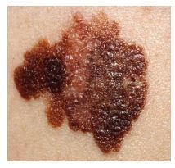
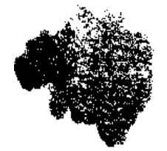
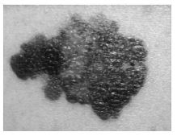
SKIN CANCER CLASSIFICATION CONCEPTUAL FRAMEWORK
Image pre-processing
Image Enhancement
  Input image Filtered image
Texture analysis using gray level co-occurance matrix(GLCM)
Feature Extraction
Grayscale image
Input layer
Training data
dataset
Hidden layer
Testing data
Melanoma
Output layer
Artificial neural network model
Result
Carcinoma
neural network algorithm

Slide 6
Activities
Outcome
Objective 1:
To identify the type of skin cancer
using Artificial Neural Network.
Objective 2:
To develop the skin cancer
classification system.
Objective 3:
To evaluate the functionality and
usability of proposed
classification system.
Phase
S
K
I
N
C
AN
C
E
R
C
L
A
S
S
I
F
I
C
A
T
I
ON
M
E
T
H
O
D
O
L
O
G
Y
F
R
A
M
E
W
O
R
K
Preliminary study
Reading journals and articles of:
Data visualization
Technique
Similar study
Problem statement
Objectives
Scope
Significance of project
Data Collection
Secondary data acquisition
Skin image to be process
Artificial Neural Network algorithm
Artificial Neural Network act as classifier. Ann has three layers which is input, hidden and output layer.
Classify skin image into two types of skin cancer
Algorithm Design
Interactive Development:
Requirement
Analysis
Design and Implementation
System Design and Development
Design diagram and prototype
Findings and conclusion
Analysis Result
Documentation
Report the finding of the result implementation and evaluation result

Slide 7
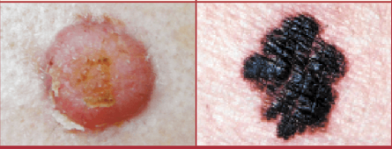
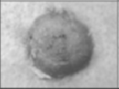
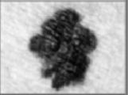
ANALYSIS PHASE
Characteristics | Description
Data Type | Skin image
Source | https://www.kaggle.com/kmader/skin-cancer-mnist-ham10000
Num of data | 100 data (80 for training and 20 for testing)
Sample of raw data:
Sample of clean data:
Carcinoma
Melanoma
Carcinoma
Melanoma

Slide 8
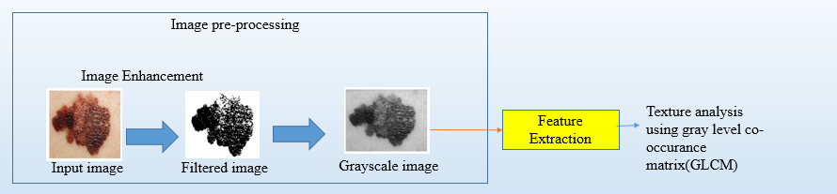
DATA PREPARATION METHOD AND PROCESS

Slide 9
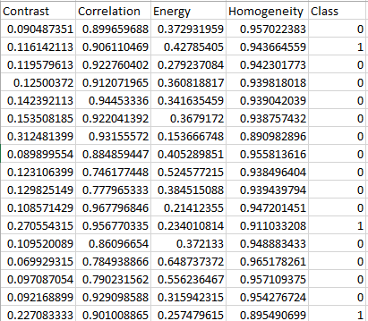
VALUE OF FEATURE EXTRACTION BY USING GLCM

Slide 10
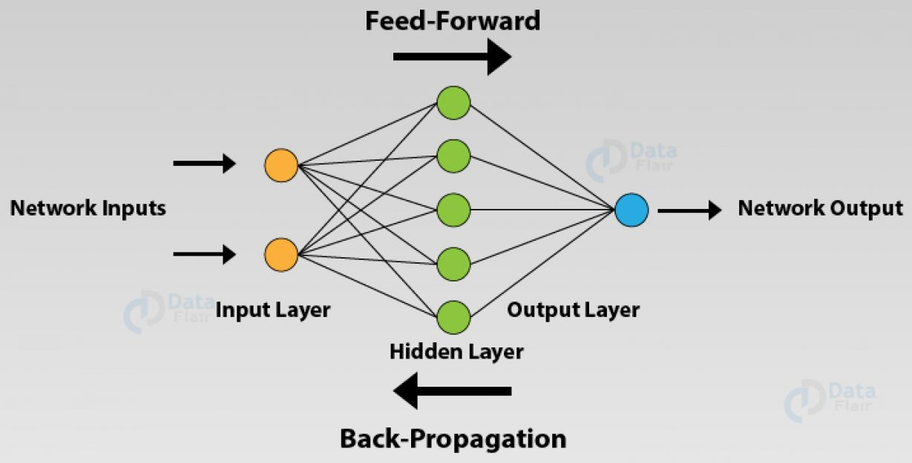
SYSTEM ARCHITECTURE
The input layer is the first layer of an ANN that receives the input information in the form of various texts, numbers, audio files, image pixels.
Hidden layers. These hidden layers perform various types of mathematical computation on the input data and recognize the patterns that are part of.
In the output layer, we obtain the result that we obtain through rigorous computations performed by the middle layer.
In the feedforward ANNs, the flow of information takes place only in one direction. That is, the flow of information is from the input layer to the hidden layer and finally to the output.
Each node in the network has some weights assigned to it. A transfer function is used for calculating the weighted sum of the inputs and the bias.
The neural network predicts the output and we evaluate how correct the output is using the various error functions. Finally, based on the result, the model adjusts the weights of the neural networks to optimize the network.

Slide 11
EXPERIMENT SETUP
Fine Tuning - process to take network model that has been trained for given task, and make it perform for second or next similar task.
MODEL | EPOCH | LEARNING RATE | ACCURACY |  | MSE
 |  |  | Training(%) | Testing(%)
1 | 1000 | 0.5 | 72 | 70 | 0.192
2 | 100 | 0.5 | 65 | 55 | 0.23
3 | 1000 | 0.1 | 70 | 70 | 0.2

Slide 12
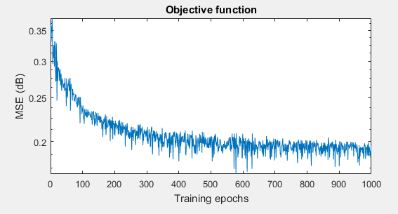
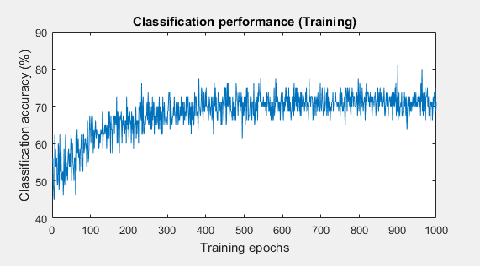
RESULT ANALYSIS
Training accuracy –72%
Testing Accuracy –70%
Mean square error – 0.192

Slide 13
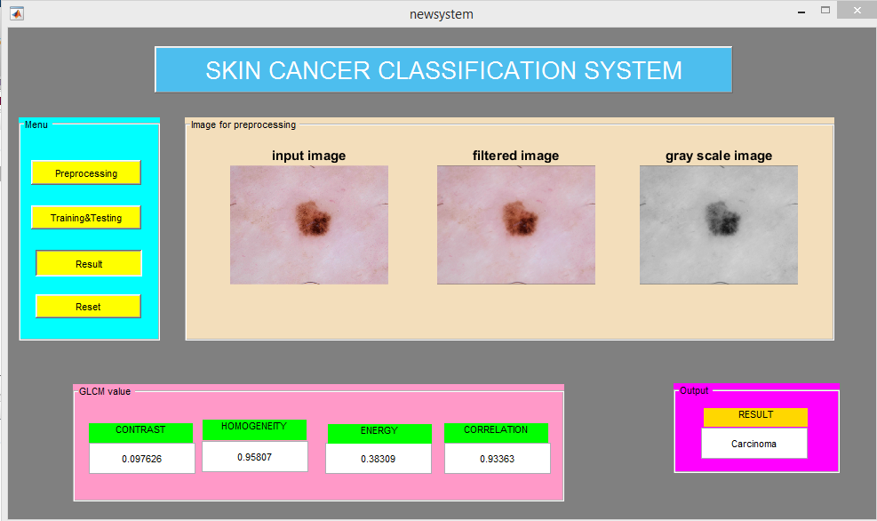
PROTOTYPE RESULT

Slide 14
PROJECT TESTING & EVALUATION
Functionality test
All button is successfully function.
The system can classify the type of skin cancer.
The image can be upload.
Easy to use.

Slide 15
CONCLUSION
The objective of the system has been achieved which is the symptom of skin cancer has been identified.
Next, the skin cancer classification system using Artificial Neural Network has been develop successfully.
The functionality of classification system also has been evaluated, but still, it still has to do an enhancement and improvement of this system for future work.

Slide 16
REFERENCES
Al Abbadi, N. K., Dahir, N. S., AL-Dhalimi, M. A., & Restom, H. (2010). Psoriasis detection using skin color and texture features. Journal of Computer Science, 6(6), 648–652. https://doi.org/10.3844/jcssp.2010.648.652
Alom, Z., Yakopcic, C., Taha, T. M., & Asari, V. K. (n.d.). Breast Cancer Classification from Histopathological Images with Inception Recurrent Residual Convolutional Neural Network.
Antony, A., Ramesh, A., Sojan, A., Mathews, B., & Varghese, T. A. (2016). Skin Cancer Detection Using Artificial Neural Networking. 4(4), 305–308. https://doi.org/10.17148/IJIREEICE.2016.4476
Azura, A. (n.d.). Is skin cancer common in Malr. Retrieved from https://www.thestar.com.my/lifestyle/health/2015/02/08/is-skin-cancer-common-in-malaysia/
Cell, S., Cancer, S., Cell, S., & Cancers, S. (n.d.). Basal and Squamous Cell Skin Cancer Early Detection , Diagnosis , and Staging Can Basal and Squamous Cell Skin Cancers Be Found Early ? 1–14.
Clinical, N., Guidelines, P., & Guidelines, N. (2013). Squamous cell skin cancer. NCCN Guidelines. Retrieved from https://www.nlm.nih.gov/medlineplus/ency/article/000829.htm
Devi, M. S., Sruthi, A. N., & Balamurugan, P. (2018). Artificial neural network classification-based skin cancer detection. 7, 591–593.
Gustafson, E., Pacheco, J., Wehbe, F., Silverberg, J., & Thompson, W. (2017). A Machine Learning Algorithm for Identifying Atopic Dermatitis in Adults from Electronic Health Records. Proceedings - 2017 IEEE International Conference on Healthcare Informatics, ICHI 2017, 83–90. https://doi.org/10.1109/ICHI.2017.31
Ishwarya, M., Sudha, J., & Ph, D. (2019).   Prediction of Skin Cancer Using Morphological Neural Network Analysis. 842–854. https://doi.org/10.15680/IJIRSET.2019.0802032

Slide 17
Jain, S., & Pise, N. (2015). Computer aided Melanoma skin cancer detection using Image Processing. Procedia - Procedia Computer Science, 48(Iccc), 735–740. https://doi.org/10.1016/j.procs.2015.04.209
Masood, A., & Al-jumaily, A. A. (2013). Computer Aided Diagnostic Support System for Skin Cancer : A Review of Techniques and Algorithms. 2013.
Meenakshi, M. M., & Natarajan, S. (2019). Melanoma Skin Cancer Detection using Image Processing and Machine Learning. 7(10), 1–5.
Mehdy, M. M., Ng, P. Y., Shair, E. F., Saleh, N. I., & Gomes, C. (2017). Artificial Neural Networks in Image Processing for Early Detection of Breast Cancer. 2017.
Olatunji, S. O., & Arif, H. (2013). IDENTIFICATION OF ERYTHEMATO-SQUAMOUS SKIN DISEASES USING EXTREME LEARNING MACHINE AND ARTIFICIAL NEURAL NETWORK. 6956(October). https://doi.org/10.21917/ijsc.2013.0090
Paliwal, N. (2016). Skin Cancer Segmentation , Detection And Classification Using Hybrid Image Processing Technique. (4), 71–73.
Tests, D., & Diabetes, F. O. R. (2015). 2 . Classification and Diagnosis of Diabetes. 38(January), 8–16. https://doi.org/10.2337/dc15-S005
Übeylı, E. D., & Güler, İ. (2005). Automatic detection of erythemato-squamous diseases using adaptive neuro-fuzzy inference systems. Computers in Biology and Medicine, 35(5), 421–433. https://doi.org/10.1016/J.COMPBIOMED.2004.03.003
Yogesh, B. (2017). EARLY DIAGNOSIS OF SKIN CANCER USING ARTIFICIAL NEURAL. 5, 1–7.
Zakareya, M., & Alam, M. B. (2018). Classification of Cancerous Skin using Artificial Neural Network Classifier. 181(22), 21–25.

