Slide 1
LEARNING STYLE PREDICTION
FOR PROGRAMMING
COURSES USING FUZZY LOGIC
WAN NUR FARISYA BT WAN AZAHAR
2017412292
SUPERVISOR’S NAME :
MADAM SHARIFAH NURULHIKMAH SYED YASIN

Slide 2
PROBLEM STATEMENT
There are many student fail for programming paper in university (Rahim, Zaman, Ahmad, & Ali, 2018).
Students do not aware the suitable learning style (Al-Zayed, 2017).

Slide 3
OBJECTIVE
1) To identify the requirement of a learning style for a programming subject
2) To design and develop a learning style prediction system using Fuzzy Logic.
3) To evaluate the functionality of the proposed system.

Slide 4
SCOPE
System can be used by the students who take programming courses and want to know their learning style. Anyone who wants to know their learning style needs to fulfil all the criteria questions.
The system will predict the student learning style according to their level of criteria using fuzzy Logic.
The fuzzy Logic algorithm will calculate the membership function for each criteria and construct the fuzzy rule for all criteria then do the defuzzification using centre of gravity (cog).
It will show the best suitable learning style to the user which is a visual, auditory, kinestatic or read/ write

Slide 5
RELATED WORK
Characteristic | Fuzzy Approach to Detect Learning Style Using Mccarthy Model as a Tool for E-learning System(Goyal et al., 2015) | Fuzzy-logic based learning style prediction in e-learning using web interface information (DEBORAH et al., 2015) | PREDICTING LEARNERS STYLES BASED ON FUZZY MODEL (Alian & Shaout, 2017) | Online Learning Styles Identification Model, Based on the Analysis of User Interactions Within an E-Learning Platforms, Using Neural Networks and Fuzzy Logic (Alfaro et al., 2018)
Area of study | India | India | India | Brazil
Learning style model | Kolb's model of | Felder-Silverman Learning Style Felder-Silverman Learning Style Model (FSLSM) Model | VARK Model | Kolb’s Learning Style
Model Analysis | Fuzzy Approach -Fuzzy Logic -Fuzzy Set | Fuzzy Logic | Fuzzy Logic | Backpropagation Neural Network and Fuzzy Logic concepts

Slide 6
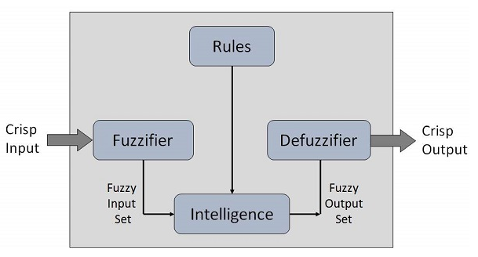
LEARNING STYLE PREDICTION
FOR PROGRAMMING COURSES USING FUZZY LOGIC
CONCEPTUAL FRAMEWORK
input
output
Inference engine
Visual
Information
user
User
Result of learning style
Auditory
Question
Kinestatic
Read

Slide 7
LEARNING STYLE PREDICTION FOR PROGRAMMING COURSES USING FUZZY LOGIC
METHODOLOGY FRAMEWORK
Objective
Phases
Methods
Outputs
To identify the requirement of prediction of learning style for programming subject.
To design and develop learning style prediction system for the student by using Fuzzy Logic.
To evaluate the function of the proposed system.
Reading Journal and article of:
Programming Student Education
Fuzzy Logic
Model of learning style
Problem Statement
Objectives
Scope
Significance of the project
Preliminary Study
Data collection
From research paper
Required data to predict the student learning style
Algorithm Design
Formula for Fuzzy Logic
VARK MODEL Learning style
Algorithm of predict the learning style student
Interactive development
Requirement
Design and Implementation
System Design &Implementation
Design Diagram
Report the finding of the result implementation and evaluation result
Findings & Evaluation
Analysis Result
Documentation

Slide 8
ANALYSIS PHASES: DATA COLLECTION
Input data | Criteria of the learning style By Nature Read Likeness Thinking time Speaking Rate Activity Level Visual Distraction Worse Auditory Distraction Using Instructions
Output data | Learning style of the student -visual -auditory -Kinestatics -Read and Write

Slide 9
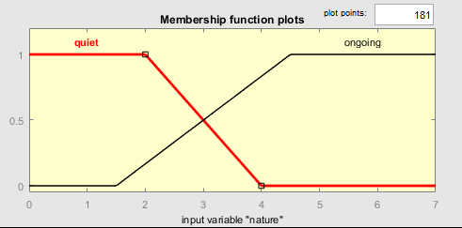
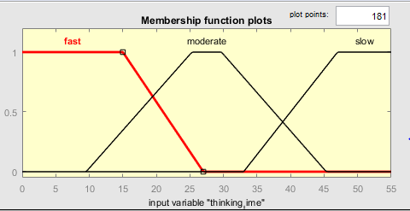
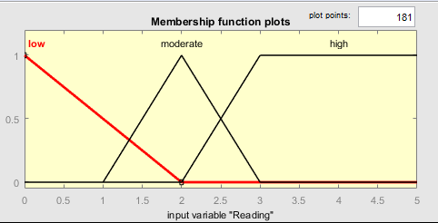
DATA PREPARATION : RAW DATA
Input Learning Features | Linguistic Terms | Fuzzy Number
By Nature | Outgoing Quiet | (3,4,7) (0,2,3)
Read Likeness | Low Moderate High | (0,2) (1,2,3) (2,3,5)
Thinking time | Fast Moderate Slow | (0,15,27) (10,27, 33,45) (34,45,55)
Speaking Rate | Slow Medium Fast | (1,50,100) (101,125,150) (151,175,250)
Activity Level | Mild Moderate Strenuous | (0,2,4) (5,6,7) (8,10,13)
Activity Enjoyment | Worse No difference Better | (0,1,2) (3,4) (5,7,9)
Visual Distraction Worse | Low Moderate High | (0,5,8) (9.11,14) (15,18,20)
Auditory Distraction | Low Moderate High | (0,5,10) (11,13,15) (16,17,20)
Using Instructions | No Instructions Verbal Instructions | (0,3.5) (0,3.5)

Slide 10
CLEAN DATA
If (nature is quiet) and (Reading is low) and (thinking_time is fast) and (speaking_rate is slow) and (activity_level is mild) and (activity_enjoyment is worse) and (visual_distraction is low) and (auditory_distraction is low) and (using_instructions is noInstruction) then (learning_style is visual) (1)
If (nature is quiet) and (Reading is low) and (thinking_time is fast) and (speaking_rate is slow) and (activity_level is mild) and (activity_enjoyment is worse) and (visual_distraction is low) and (auditory_distraction is low) and (using_instructions is VerbalInstruction) then (learning_style is visual) (1)
If (nature is quiet) and (Reading is low) and (thinking_time is fast) and (speaking_rate is slow) and (activity_level is mild) and (activity_enjoyment is worse) and (visual_distraction is low) and (auditory_distraction is moderate) and (using_instructions is noInstruction) then (learning_style is visual) (1)
If (nature is quiet) and (Reading is low) and (thinking_time is fast) and (speaking_rate is slow) and (activity_level is mild) and (activity_enjoyment is worse) and (visual_distraction is low) and (auditory_distraction is high) and (using_instructions is noInstruction) then (learning_style is visual) (1)
If (nature is quiet) and (Reading is low) and (thinking_time is fast) and (speaking_rate is slow) and (activity_level is mild) and (activity_enjoyment is worse) and (visual_distraction is low) and (auditory_distraction is high) and (using_instructions is VerbalInstruction) then (learning_style is visual) (1)

Slide 11
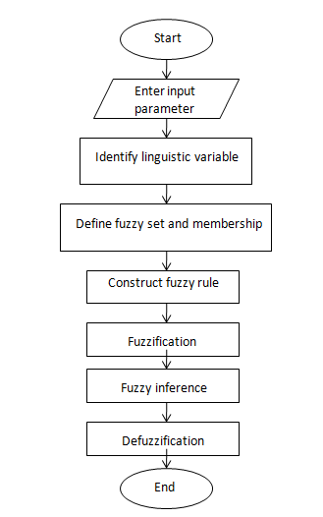
LEARNING STYLE PREDICTION PROCESS FLOW

Slide 12
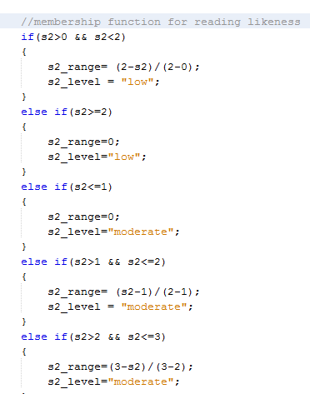
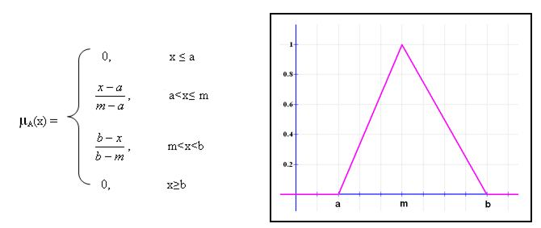
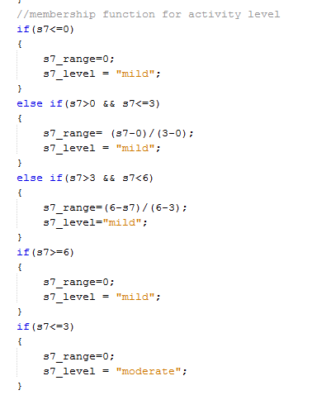
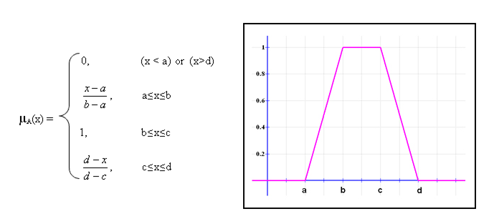
TECHNIQUE METHOD
membership function
Triangular function
Trapezoidal function

Slide 13
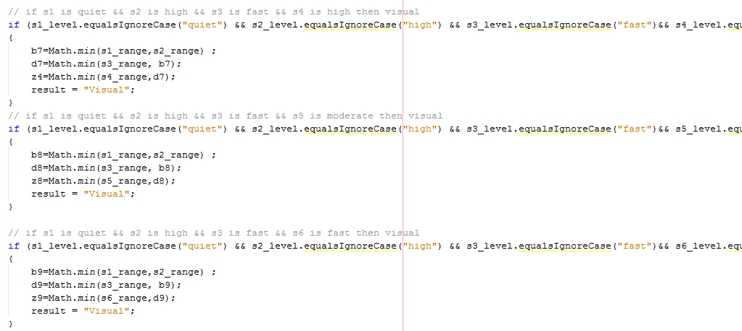
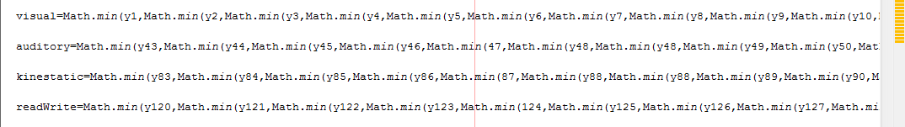
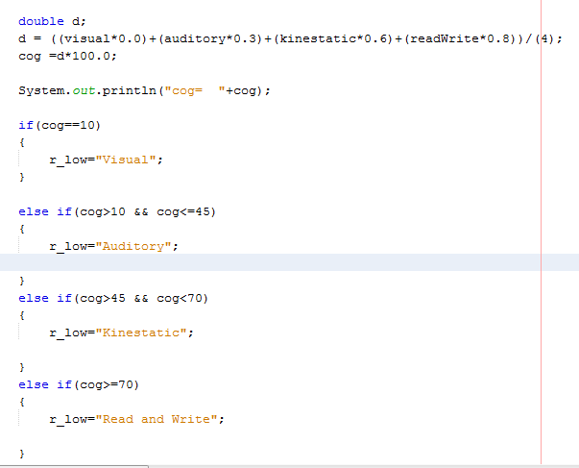
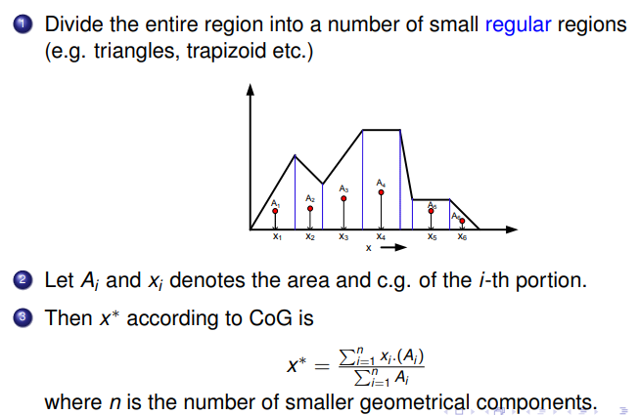
2. Rule evaluation for each rule
3. Difuzzification using centroid method Centre of Gravity (CoG)

Slide 14
RESULT ANALYSIS
No. Input criteria |  | 1 | 2 | 3
By Nature |  | outgoing | outgoing | quiet
Read Likeness |  | low | low | high
Thinking time |  | slow | moderate | moderate
Visual distraction |  | moderate | moderate | moderate
Auditory distraction |  | high | moderate | high
Speaking rate |  | medium | medium | medium
Activity level |  | moderate | moderate | moderate
Using instruction |  | frequent | rarely | Sometime
Activity enjoyment |  | better | better | better
Output | System result | Kinestatic | kinestatic | kinestatic
 | Rule result | Kinestatic | kinestatic | auditory

Slide 15
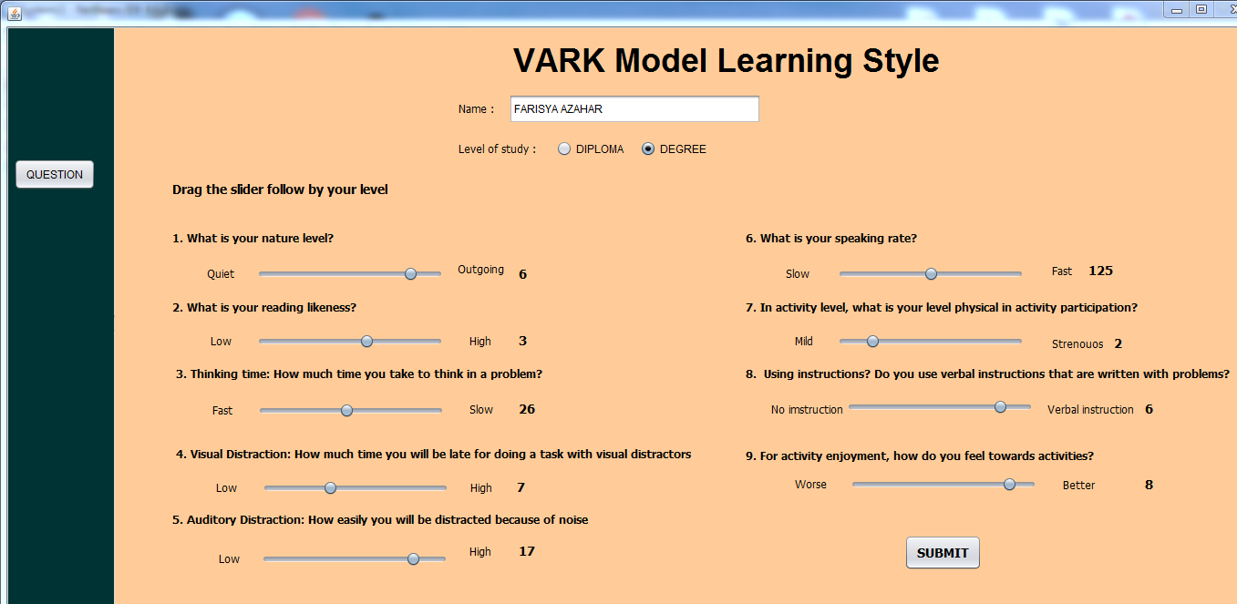
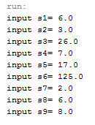
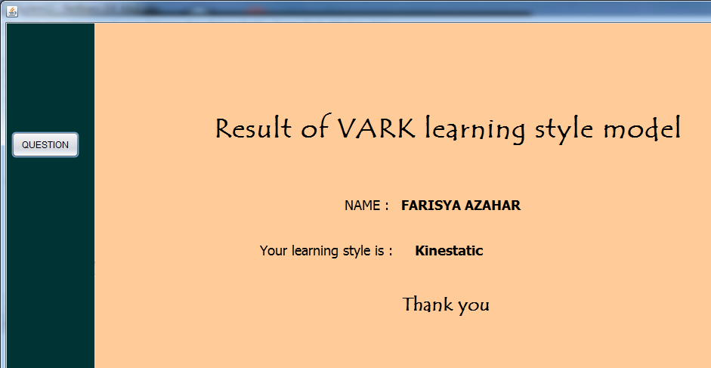
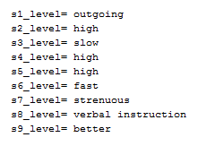
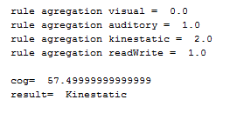
PROJECT TESTING/EVALUATION
SYSTEM TESTING
1. User select the level of the criteria
3. Result
2. Calculate the result using Mamdani
Fuzzy Inference System
Calculate membership function based
on input
Perform rule evaluation
Perform result aggregation
Perform defuzzification

Slide 16
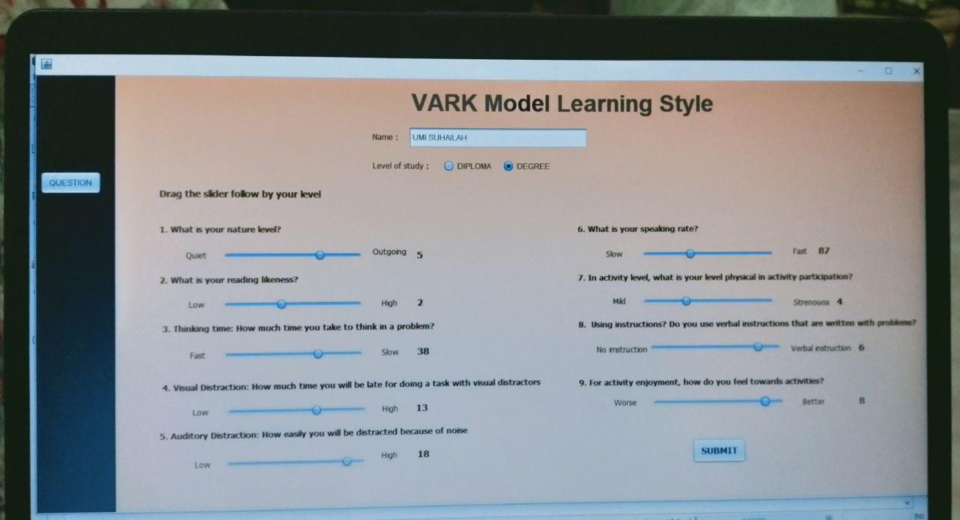
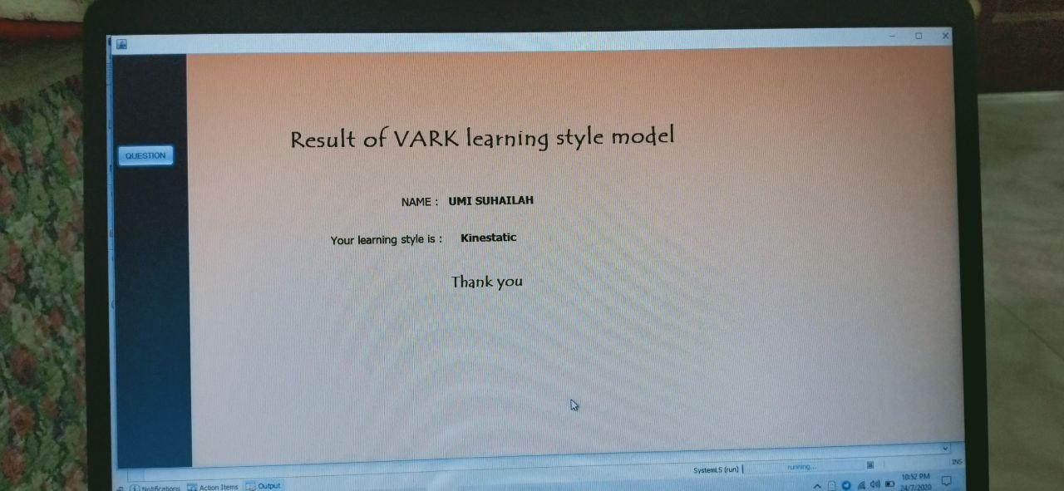
Photo from computer science student from UiTM
Got a few feedback form the user about the system, take the comment to improve the system better.

Slide 17
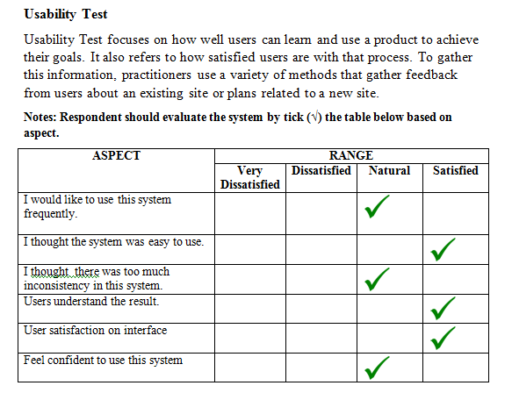
Usability test

Slide 18
SCREEN DEMO VIDEO

Slide 19
CONCLUSION
As the conclusion, the objective of the project are achieved, where the system can predict the student learning style by using fuzzy logic. The system come out with the functionality of the system work as expected and it can be improvise for future work or research by using a suitable and latest method.

Slide 20
REFERENCE
Abdullah, M., Alqahtani, A., Aljabri, J., Altowirgi, R., & Fallatah, R. (2015). Learning Style Classification Based on Student’s Behavior in Moodle Learning Management System. Transactions on Machine Learning and Artificial Intelligence, 3(1), 30. https://doi.org/10.14738/tmlai.31.868
Al-Zayed, N. N. Y. (2017). An Investigation of Learning Style Preferences on the Students’ Academic Achievements of English. International Journal of English Linguistics, 7(5), 176. https://doi.org/10.5539/ijel.v7n5p176
Alfaro, L., Rivera, C., Luna-Urquizo, J., Castañeda, E., & Fialho, F. (2018). Online Learning Styles Identification Model, Based on the Analysis of User Interactions Within an E-Learning Platforms, Using Neural Networks and Fuzzy Logic. International Journal of Engineering & Technology, 7(3.13), 76. https://doi.org/10.14419/ijet.v7i3.13.16328
Alian, M., & Shaout, A. (2017). Predicting learners styles based on fuzzy model. Education and Information Technologies, 22(5), 2217–2234. https://doi.org/10.1007/s10639-016-9543-4
Ansari, A. Q., & Islamia, J. M. (2015). The Basics of Fuzzy Logic : A Tutorial Review The Basics of Fuzzy Logic : A Tutorial Review A . Q . Ansari. Computereducation 88, (June), 5–9.
Bernard, J., Chang, T. W., Popescu, E., & Graf, S. (2017). Learning style Identifier: Improving the precision of learning style identification through computational intelligence algorithms. Expert Systems with Applications, 75, 94–108. https://doi.org/10.1016/j.eswa.2017.01.021

Slide 21
Bhagavathi, S. L., & Thomas Niba, S. (2016). An automatic system for detecting and counting rbc and wbc using fuzzy logic. ARPN Journal of Engineering and Applied Sciences, 11(11), 6891–6894.
Dahdouh, K., & Dakkak, A. (2019). Building an e-learning recommender system using Association Rules techniques and R environment (Vol. 3). https://doi.org/10.1007/978-3-030-11928-7
DEBORAH, L. J. E. G. A. T. H. A., SATHIYASEELAN, R., AUDITHAN, S., & VIJAYAKUMAR, P. (2015). Fuzzy-logic based learning style prediction in e-learning using web interface information. Sadhana - Academy Proceedings in Engineering Sciences, 40(2), 379–394. https://doi.org/10.1007/s12046-015-0334-1
Dote, Y. (1995). Introduction to fuzzy logic. IECON Proceedings (Industrial Electronics Conference), 1(January 2013), 50–56. https://doi.org/10.4018/978-1-59140-324-1.ch001
Goyal, M., Yadav, D., & Tripathi, A. (2015). Fuzzy approach to detect learning style using McCarthy model as a tool for e-learning system. 2015 4th International Symposium on Emerging Trends and Technologies in Libraries and Information Services, ETTLIS 2015 - Proceedings, (October), 295–300. https://doi.org/10.1109/ETTLIS.2015.7048215
Info, R. (2019). Learning Styles All Students Are Created Equally ( and. 1–6.
Khudhair, R., & Ahmed, A. (2017). Artificial Neural Networks in E-Learning Personalization : A Review Artificial Neural Networks in E-Learning Personalization : A Review. (December 2016). https://doi.org/10.11648/j.ijiis.20160506.14
Kids, T. T., & Styles, L. (2019). Learning Styles Teaching To Kids ’ Learning Styles Different Learning Styles – Different Ways to Learn. 1–5.
Kolekar, S. V., Pai, R. M., & Manohara Pai, M. M. (2017). Prediction of Learner’s Profile Based on Learning Styles in Adaptive E-learning System. International Journal of Emerging Technologies in Learning, 12(6), 31–51. https://doi.org/10.3991/ijet.v12i06.6579

Slide 22
Moström, J. E., & Moström, J. E. (2011). A Study of Student Problems in Learning to Program.
Muslihudin, M., Susanti, T. S., & Maseleno, A. (2018). The priority of rural road development using fuzzy logic based simple additive weighting. International Journal of Pure and Applied Mathematics, 118(Special Issue 8), 9–16.
Paper, C. (2016). Adaptivity based on Felder-Silverman Learning Styles Model in E-Learning Systems. (November).
Pasina, I., Bayram, G., Labib, W., Abdelhadi, A., & Nurunnabi, M. (2019). MethodsX Clustering students into groups according to their learning style. MethodsX, 6(September), 2189–2197. https://doi.org/10.1016/j.mex.2019.09.026
Rahim, H., Zaman, H. B., Ahmad, A., Ali, N. M., Teknologi, J., Tuanku, P., & Sirajuddin, S. (2018). Student ’ s Difficulties in Learning Programming. 2(3), 40–43. https://doi.org/10.26666/rmp.ajtve.2018.3.7
S Askari, S. M., & Anwar Hussain, M. (2020). E-Transactional Fraud Detection Using Fuzzy Association Rule Mining. SSRN Electronic Journal. https://doi.org/10.2139/ssrn.3512408
Sheriff, N. M. (2017). Research Universities in Malaysia: What Beholds? Asian Journal of University Education, 13(2), 35–50.
Styles, L. (2006). VARK Learning Styles: Visual, Auditory, Read/Write, Kinesthetic Visual Learning Style. VARK Learning Styles. Retrieved from http://gardner-webb.edu/Assets/gardnerwebb/academics/advising/files/vark-learning-styles.pdf
Sweta, S., & Lal, K. (2016). Learner Model for Automatic Detection of Learning Style Using FCM in Adaptive E-Learning System. IOSR Journal of Computer Engineering, 18(2), 18–24. https://doi.org/10.9790/0661-1802041824

Slide 23
Thank You

