Slide 1
POSTAL ADDRESS HANDWRITTEN RECOGNITION USING
CONVOLUTIONAL NEURAL NETWORK
PREPARED BY:
NUR HASYIMAH BT ABD AZIZ
(2017412128)
SUPERVISOR’S NAME:
PROF MADYA TS. DR. HAMIDAH BT JANTAN

Slide 2
PROBLEM STATEMENT
Required more time and often affected by errors (Uhliarik, 2013).
Other algorithm can not recognize the text when the image contain noise(Revathi et al., 2015).
The task of converting handwritten text into digital format is laborious and one of the most challenging tasks in pattern recognition
# By using the Convolutional Neural Network algorithm,
it will help to overcome all of the problem

Slide 3
OBJECTIVE
To identify the requirement of Convolutional Neural Network method for handwritten recognition.
To develop document handwritten recognition system using Convolutional Neural Network.
To evaluate the accuracy of Convolutional Neural Network model for classify the handwritten text.

Slide 4
SCOPE
ASPECT | DESCRIPTION
User | The user must just need basic knowledge on how to use the system since it is the user-friendly system. The system does not need an expert to use the system.
Data | The system can recognize only English handwritten character and digit.
Method | The system will use Convolutional Neural Network algorithm to recognize the handwritten text.
Process | The system can recognize the handwritten text from an image and convert into digital format such as .txt as an output.

Slide 5
SIMILAR APPLICATION
CHARACTERISTIC AND DATASET | ALGORITHM/ TECHNIQUE | DESCRIPTION | ACCURACY RATE
Handwritten for Bank Cheques Recognition ( EMNIST) | 2D Convolution Neural Network | Automatic cheque processing (Srivastava et al., 2019) | Digit: 98% Letter: 97%
Handwriting recognition on form document using convolutional neural network and support vector machines ( NIST SD 19 2nd edition) | Convolutional Neural Network and Support Vector Machines | The learning model is based on CNN as a powerful feature extraction and SVM as a high-end classifier (Darmatasia & Fanany, 2017). | 83.37%
Offline Handwritten Mathematical Symbol Recognition Utilizing Deep Learning ( MNIST) | Convolutional Neural Network | The process of symbol recognition includes symbol segmentation and accurate classification for over 300 classes (Nazemi, Tavakolian, Fitzpatrick, Fernando, & Suen, 2019). | 90%
Handwritten Character Recognition Using Feed-Forward Neural Network Models | Feed-Forward Neural Network | In this paper we consider the two approaches of feature extraction from the images of handwritten capital and small letters of English alphabets (Karade et al., 2015). | 85%
Devanagari Handwritten Numeral Recognition Using Probabilistic Neural Network (UCI) | Probabilistic Neural Network | Probabilistic Neural Network (PNN) Classifier is used to classify the Devanagari numerals separately (Abhay S. Lengare, 2014). | 98.47%

Slide 6
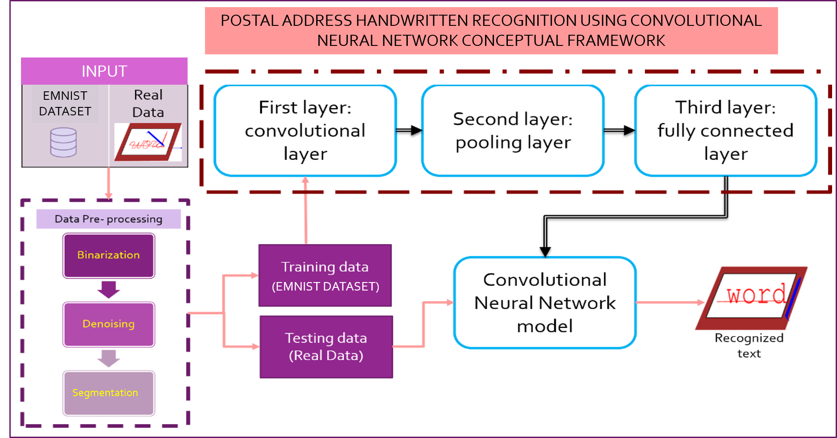

Slide 7
POSTAL ADDRESS HANDWRITTEN RECOGNITION USING CONVOLUTIONAL NEURAL NETWORK METHODOLOGY FRAMEWORK
Objective
Phases
Methods
Outputs
To identify the requirement of Convolutional Neural Network process
To develop hand-written character recognition system in Phyton.
To evaluate the accuracy of Convolutional Neural Network model for classify the handwritten document.
Thesis Project
Article
Journal
e-book
Chapter 1 :Introduction
Chapter 2:Literature review
Research background
Preliminary Study
Data collection
Acquire the dataset from MNIST database
Image data ready to be pre-process
Convolutional Neural Network Algorithm for recognition of handwritten image
Algorithm Design
CNN classifier are built
Interactive development
Requirement
Design and Implementation
System Design & Development
Design Diagram
Findings & Conclusions
Report the finding of the result implementation and evaluation result
Analysis Result
Documentation

Slide 8












Analysis Phase : Data Collection
Characteristic | Training and Testing Data | Validation data
Data Type | Handwritten Image
Image Size | 32 * 32 pixels | Various size
Source | (EMNIST) https://www.kaggle.com/vaibhao/handwritten-characters | https://www.kaggle.com/nabeel965/handwritten-words-dataset
Folder and Number of Dataset | Total image : 1750 Total folder :35 10 class (0-9) 25 class (combination of small and capital letter) *Each class contain 50 images | 10 images
Sample data

Slide 9
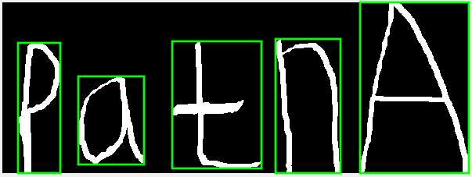
Analysis Phase: Data preparation
TRAINING AND TESTING DATA
DATA SELECTION – reduce number of image Original dataset contain more than 10 000 images for each folder but in this project, 50 images is selected for each folder.
EVALUATION DATA
PREPROCESS
Convert to grayscale
Convert to binary image
Remove noise fewer than 30 pixels
RAW DATA
SEGMENTATION
SEPARATE TEXT INTO EACH WORD

Slide 10
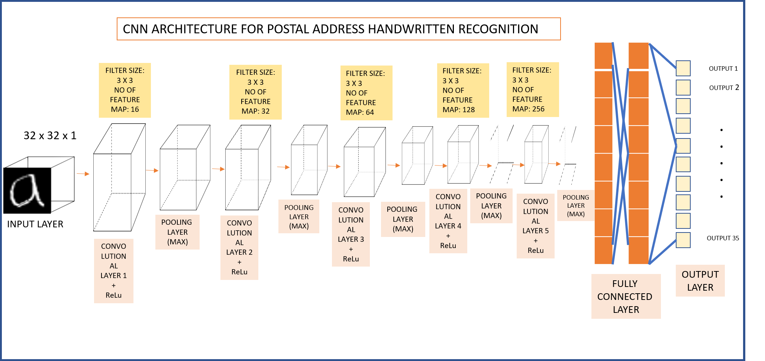

Slide 11
EXPERIMENT SETUP
Properties | Values
Numbers of Dataset | 1750
Number of Experiments | 48
Epoch | 10,20,50,100
Parameter | Experiment Range
Train and Test Split | 90:10, 80 :20, 70:30
Input size | 32 * 32
Number of Feature Map | 16,32,64,128,256
Filter Size | 3 * 3
Initial Learning Rate | 0.001, 0.0001
Batch Size | 10,20

Slide 12
RESULT ANALYSIS
(COMPUTATIONAL ANALYSIS)
The result for experiment for 0.7: 0.3 data split
Max Epochs | Mini Batch Size | Initial Learning Rate | Accuracy rate
10 | 10 | 0.001 | 0.0771
 |  | 0.0001 | 0.0410
 | 20 | 0.001 | 0.0286
 |  | 0.0001 | 0.0390
20 | 10 | 0.001 | 0.9295
 |  | 0.0001 | 0.0714
 | 20 | 0.001 | 0.0390
 |  | 0.0001 | 0.0295
50 | 10 | 0.001 | 0.9314
 |  | 0.0001 | 0.0600
 | 20 | 0.001 | 0.9257
 |  | 0.0001 | 0.0286
100 | 10 | 0.001 | 0.9171
 |  | 0.0001 | 0.0364
 | 20 | 0.001 | 0.9076
 |  | 0.0001 | 0.0528

Slide 13
RESULT ANALYSIS
(COMPUTATIONAL ANALYSIS)
The result for experiment for 0.8: 0.2 data split
Max Epochs | Mini Batch Size | Initial Learning Rate | Accuracy rate
10 | 10 | 0.001 | 0.4943
 |  | 0.0001 | 0.0343
 | 20 | 0.001 | 0.0742
 |  | 0.0001 | 0.0286
20 | 10 | 0.001 | 0.9400
 |  | 0.0001 | 0.0500
 | 20 | 0.001 | 0.4014
 |  | 0.0001 | 0.0371
50 | 10 | 0.001 | 0.8322
 |  | 0.0001 | 0.0615
 | 20 | 0.001 | 0.8956
 |  | 0.0001 | 0.0411
100 | 10 | 0.001 | 0.9357
 |  | 0.0001 | 0.0855
 | 20 | 0.001 | 0.9143
 |  | 0.0001 | 0.1189

Slide 14
RESULT ANALYSIS
(COMPUTATIONAL ANALYSIS)
The result for experiment for 0.9: 0.1 data split
Max Epochs | Mini Batch Size | Initial Learning Rate | Accuracy rate
10 | 10 | 0.001 | 0.7914
 |  | 0.0001 | 0.0429
 | 20 | 0.001 | 0.1143
 |  | 0.0001 | 0.0343
20 | 10 | 0.001 | 0.9486
 |  | 0.0001 | 0.0343
 | 20 | 0.001 | 0.8800
 |  | 0.0001 | 0.0486
50 | 10 | 0.001 | 0.9136
 |  | 0.0001 | 0.0589
 | 20 | 0.001 | 0.7568
 |  | 0.0001 | 0.0547
100 | 10 | 0.001 | 0.9956
 |  | 0.0001 | 0.0985
 | 20 | 0.001 | 0.9387
 |  | 0.0001 | 0.0547

Slide 15
PROJECT TESTING AND EVALUATION
(FUNCTIONALITY TEST)
To complete the evaluation task, I ask 3 person which is my classmate who using MATLAB application in their project. Table below show the rate that given by them.
Functionality Aspect | 1 Very Bad | 2 Bad | 3 Neutral | 4 Good | 5 Very Good
“Select Image” button work properly |  |  |  |  | 3/3
Successfully input image into the system |  |  |  |  | 3/3
Preprocess button work properly |  |  |  | 2/3 | 1/3
The system successfully display the clean image. |  |  |  | 2/3 | 1/3
“Recognize Text” button work properly |  |  |  | 3/3
The system successfully produces an output |  |  |  | 3/3
“Clear Image” button work properly to delete the image from the system. |  |  |  | 3/3
Exit button work correctly. |  |  |  |  | 3/3

Slide 16
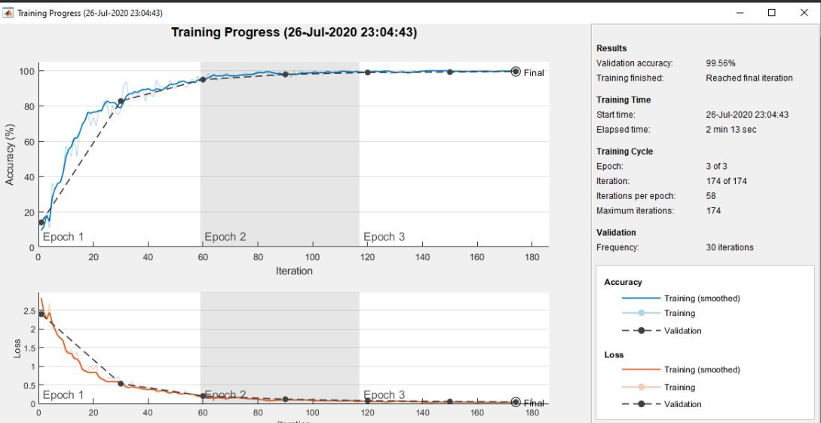
PROJECT TESTING AND EVALUATION

Slide 17
PROJECT TESTING AND EVALUATION
(Computational Analysis)
Accuracy = number of sample recognized correctly / Total number of samples
Best CNN model description
Training data | 1750
Data split | 90:10
Number of convolutional layers | 5
Max Epoch | 100
Mini batch size | 10
Initial learning rate | 0.001
Accuracy rate | 0.9956
Misclassification Rate | 0.0044

Slide 18
CONCLUSION
The CNN requirement gathered in objective one, the system built in objective two, and evaluation on the CNN model in objective three is having a significant influence on the overview in this project describing the results of each achieved goal. At the other hand, from this creation of the project, many lessons are learnt.

Slide 19
POSTAL ADDRESS HANDWRITTEN RECOGNITION USING CONVOLUTIONAL NEURAL NETWORK SYSTEM DEMO

Slide 20
REFERENCES
Abhay S. Lengare, D. S. S. P. (2014). INTERNATIONAL JOURNAL OF ENGINEERING SCIENCES & RESEARCH TECHNOLOGY Devanagari Handwritten Numeral Recognition Using Probabilistic Neural Network *1,2. 3(5), 3–6.
Adi, C. (2019). Hand Written Character Recognition Using Neural Networks. 1–12.
Al-wzwazy, H. (2016). Convolutional Neural Networks. (May). https://doi.org/10.15680/IJIRCCE.2016.
Chanda, P. B. (2019). Analysis on Efficient Handwritten Document Recognition Technique Using Feature Extraction and Back Propagation Neural Network Approaches. 1–8.
Chatterjee, C. C. (2019). Basics of the Classic CNN. 1–9. Retrieved from https://towardsdatascience.com/basics-of-the-classic-cnn-a3dce1225add
Gunawan, T. S., Noor, A. F. R. M., & Kartiwi, M. (2018). Development of english handwritten recognition using deep neural network. Indonesian Journal of Electrical Engineering and Computer Science, 10(2), 562–568. https://doi.org/10.11591/ijeecs.v10.i2.pp562-568

Slide 21
REFERENCES
Hijazi, B. S., Kumar, R., Rowen, C., & Group, I. P. (1999). What is a CNO? Nursing Times, 95(27), 15. https://doi.org/10.1142/9789812798589_0002
Karade, N., Pratap Singh, M., & Butey, P. K. (2015). Handwritten Character Recognition Using Feed-Forward Neural Network Models. International Journal of Computer Engineering and Technology, 6(2), 976–6367.
Maheshwari, M., Namdev, D., & Maheshwari, S. (2018). A Systematic Review of Automation in Handwritten Character Recognition. 13(10), 8090–8099.
Medhi, D., & Ramasamy, K. (2019). View all Topics Networking and Network Routing : An Introduction Subnetting , CIDR , and Variable Length Subnet Masking. 1–12.
Mustafaoglu, A. (2016). School of Computer Science Final Year Project Report Offline Handwriting Recognition using Neural Networks. (April).
Nada, R. (2018). SIGNATURE RECOGNITION USING. (October).
Nazemi, A., Tavakolian, N., Fitzpatrick, D., Fernando, C. a, & Suen, C. Y. (2019). Offline handwritten mathematical symbol recognition utilising deep learning.

Slide 22
REFERENCES
1–8. Retrieved from http://arxiv.org/abs/1910.07395
Pant, A. K., Panday, S. P., & Joshi, S. R. (n.d.). Off-line Nepali Handwritten Character Recognition Using Multilayer Perceptron and Radial Basis Function Neural Networks.
Rodman, H. (1980). Are Conceptual Frameworks Necessary for Theory Building? The Case of Family Sociology. Sociological Quarterly, 21(3), 429–441. https://doi.org/10.1111/j.1533-8525.1980.tb00623.x
S, S. N. R., & Afseena, S. (2015). Handwritten Character Recognition – A Review. 5(3), 1–6.
Srivastava, S., Priyadarshini, J., Gopal, S., Gupta, S., & Dayal, H. S. (2019). Optical character recognition on bank cheques using 2D convolution neural network. Advances in Intelligent Systems and Computing, 697, 589–596. https://doi.org/10.1007/978-981-13-1822-1_55

Slide 23
REFERENCES
Subhashini, P. P. S., & Prasad, V. V. K. D. V. (2013). Recognition of Handwritten Digits Using Rbf Neural Network. International Journal of Research in Engineering and Technology, 02(03), 393–397. https://doi.org/10.15623/ijret.2013.0203028
Sudheer Kumar, E., & Shoba Bindu, C. (2019). Medical Image Analysis Using Deep Learning: A Systematic Literature Review. Communications in Computer and Information Science, 985, 81–97. https://doi.org/10.1007/978-981-13-8300-7_8
Uhliarik, I. (2013). COMENIUS UNIVERSITY IN BRATISLAVA FACULTY OF MATHEMATICS , PHYSICS AND INFORMATICS HANDWRITTEN CHARACTER RECOGNITION USING.
Wehle, H. (2017). ML – AI- COGNITIVE. (August).
Wiles, R. (2019). Have we solved the problem of handwriting recognition ? 1–8.
Williams, T., Software, H., & External, L. R. (2019). Handwriting recognition. 1–6.

