Slide 1
EMBEDDED NUMERICAL METHOD FOR EARLY STEPS OF SOLVING FIRST ORDER ORDINARY
ADAMS-MOULTAN METHOD
IN DIFFERENTIAL EQUATION
Name:
Nur Alifah Ilyana Binti Rasidi
Student ID:
2017669338
Supervisor:
Dr. Mohd Rivaie Bin Mohd Ali

Slide 2
INTRODUCTION
Numerical analysis is the area of mathematics and computer science that creates, analyzes, and implements algorithms for solving numerically the problems of continuous mathematics. (Atkinson, 1989)
Single-step method is said to be a one-step method if the method only uses information from the previous single point to meet and run the formula with constant step size measurement.
Example : Euler method, Heun method, Taylor Series method, and Runge-Kutta methods
The multiple step method is a method that uses information from more than one of the previous points to start and run the formula.
Example : Adams-Bashford method, the Adams-Moulton method and Milne method

Slide 3
OBJECTIVE
To solve the first order ODE theoretically using theoretical methods.
To solve first order ODE numerically using Adams-Moulton methods.
To analyze the efficiency of Adams-Moulton method for solving first order ODE.
To determine the best Adams-Moulton multistep method for solving ODE.

Slide 4
PROBLEM STATEMENT
A theoretical method is complicated and has a longer calculation compared to the numerical method.
To find the correct formula to be used and blend together.
This research will find out the efficiency of different methods :
  Single-step methods (Runge-Kutta Forth Oder method)
  Multiple step methods (Adams-Moulton Two-step method, Adams-Moulton Three-step method and Adams-Moulton Four-step method)
The multiple step methods is used at the final step and it is found that there is slightly difference at the result when the single step methods is used to get initial value.
This study is expected to find out the best Adams-Moulton multiple step using various single-step method

Slide 5
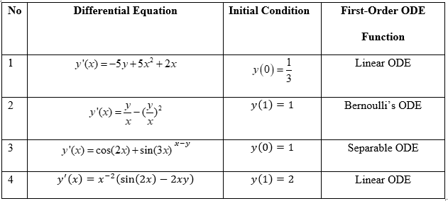
METHODOLOGY
Step 1: Generate ODE problem
Step 2: Study of theoretical and numerical method

Slide 6
Step 3: Construct Programming Code
  The software used in this study is Maple 16 due to its simple programming code compared to other mathematical software such as MATLAB.
  It is known to give higher efficiency result
Step 4: Test run programming code
Step 5: Result analysis of methods
  All the results are analyses based on the percentage of relative error for each version of the Adams-Moulton Method
Step 6: Conclusion
  Made based on errors and CPU time analysis for each Adams-Moulton method.

Slide 7
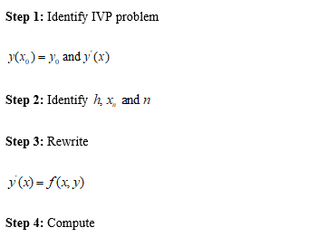
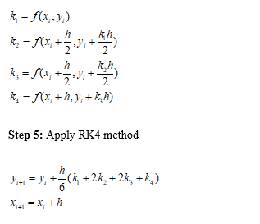
METHODS
RK4 Method
Each RK4 methods derived from an appropriate Taylor method
The method several function evaluations performed at each step and eliminate the necessity to compute the higher derivatives

Slide 8
Adams Moulton Method
Multistep method is divided in two types, that is explicit and implicit type
The explicit type is called Adams Bashforth methods and the implicit type is called Adams Moulton methods
Both methods are simply the forward and backward Euler method respectively.
The Adams Moulton method cannot used directly from the first initial point.
This method needs a pre-requisite point

Slide 9
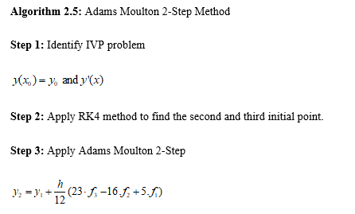
Adams Moulton 2-Step Method
Adams Moulton 2-Step method is a continuity of the RK4 method
This method needs three initial points in order to be working. However
The IVP only provided the first initial point
The second and third initial point is obtain using RK4
For the fourth and the successive point, the points are obtained using the Adams Moulton 2-Step method.

Slide 10
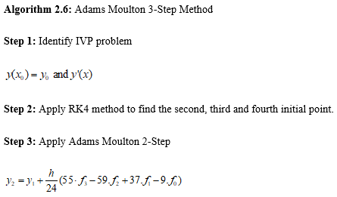
Adams Moulton 3-Step Method
Adams Moulton 3-Step method required four initial points including the first initial point that is given as IVP.
The second, third and fourth initial point is obtain using RK4.
For the fifth and the successive point, the points are obtained using Adams Moulton 3-Step method.

Slide 11
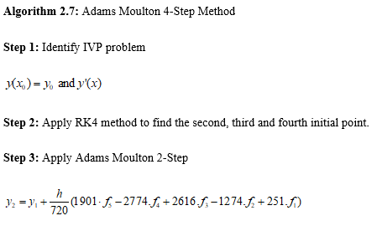
Adams Moulton 4-Step Method
Like previous, Adams Moulton 4-Step method required five initial points including the first initial point that is given as IVP.
The second, third, fourth and fifth initial point is obtain using RK4.
For the sixth and the successive point, the points are obtained using Adams Moulton 4-Step method.

Slide 12
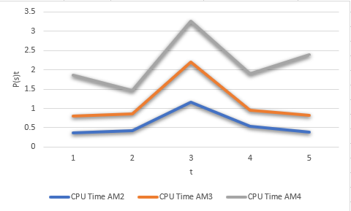
RESULTS AND DISCUSSION
The results in Figure 4.1 shows a line at the bottom which is Adams Moulton 2-Step method. The result concluded that Adams Moulton 2-Step method is the best solver based on CPU time analysis.

Slide 13

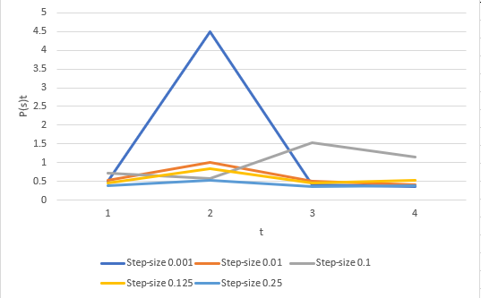

Slide 14
By referring to the result, it shows that the step-size of 0.25 is the best solver because it is the lower line.
Based on figure above, it is concluded that the best method is Adams Moulton 2-Step with the step size of 0.25.

Slide 15
CONCLUSION
Different type of ODE problem such as linear, separable and Bernoulli’s have been solved using theoretical method
All these ODE problems had been solved successfully
Maple16 software has been used to created programming code of Adams Moulton method to find the solution for all the ODE problem numerically and it has been run successfully
The recorded CPU time is analyzed to determine the fastest method to obtain the approximate solution.
Performance profile based on CPU time analysis has been successfully plotted
Based on performance profile, it showed that the best method in terms of accuracy is Adams Moulton 2-Step method with a step size of 0.25

Slide 16
RECOMMENDATION
Researchers might consider another version of Adams Moulton or Adams Bashforth method to solve the same or different problem of ODE
This study could also be extended to solve second order ODE problem using the same methods or employing another version of Adams Moulton method
The coded program using Maple16 could also be coded in MATLAB or Mathematica to see the behavior of CPU time

Slide 17
THANK YOU

