Slide 1
Bangsal Chetak Order Processing System (BCOPS)
By:
Faznur Farhanah bt Zainol Nahar
2017669198

Slide 2
Background of Study
Case Study: Bangsal Chetak Company
AOI: Sales Order System
Domain: Business
Theory: Human Computer Interaction
Current Purchasing Process
Proposed Solution
Start
Problem | Proposed Solution
1. No website to properly display their products | Order processing system
2. Losing tract of orders | The orders will be organized in computerized system
3. The staff unable to know the number of products available | Storing data in a database to allow easy retrieval, management and report generation
Customer go to the store to buy products
Customer choose the desired products
Problem Statement
1. The company do not have their own website
2. Losing tract of order, still using paper-based management system
3. The staff unable to know the number of products available
Product Obtained
Payment
Objectives
To identify the current business process and the problem arises from the process
To design and develop an order processing system for Bangsal Chetak company
To evaluate the functionality and usability of the proposed system
End

Slide 3
HCI & order processing system
HCI encompasses extensive areas and designing effective user interface (UI) is one of the areas that has always been emphasized, as effective interfaces provide potential to improve overall system performance
Usability is a core terminology in HCI. It has been defined as “the extent to which a product can be used by specified users to achieve specified goals with effectiveness, efficiency, and satisfaction in a specified context of use

Slide 4
HCI principles implemented: -
Strive for consistency
Offer informative feedback
Enable frequent users to use shortcuts

Slide 5
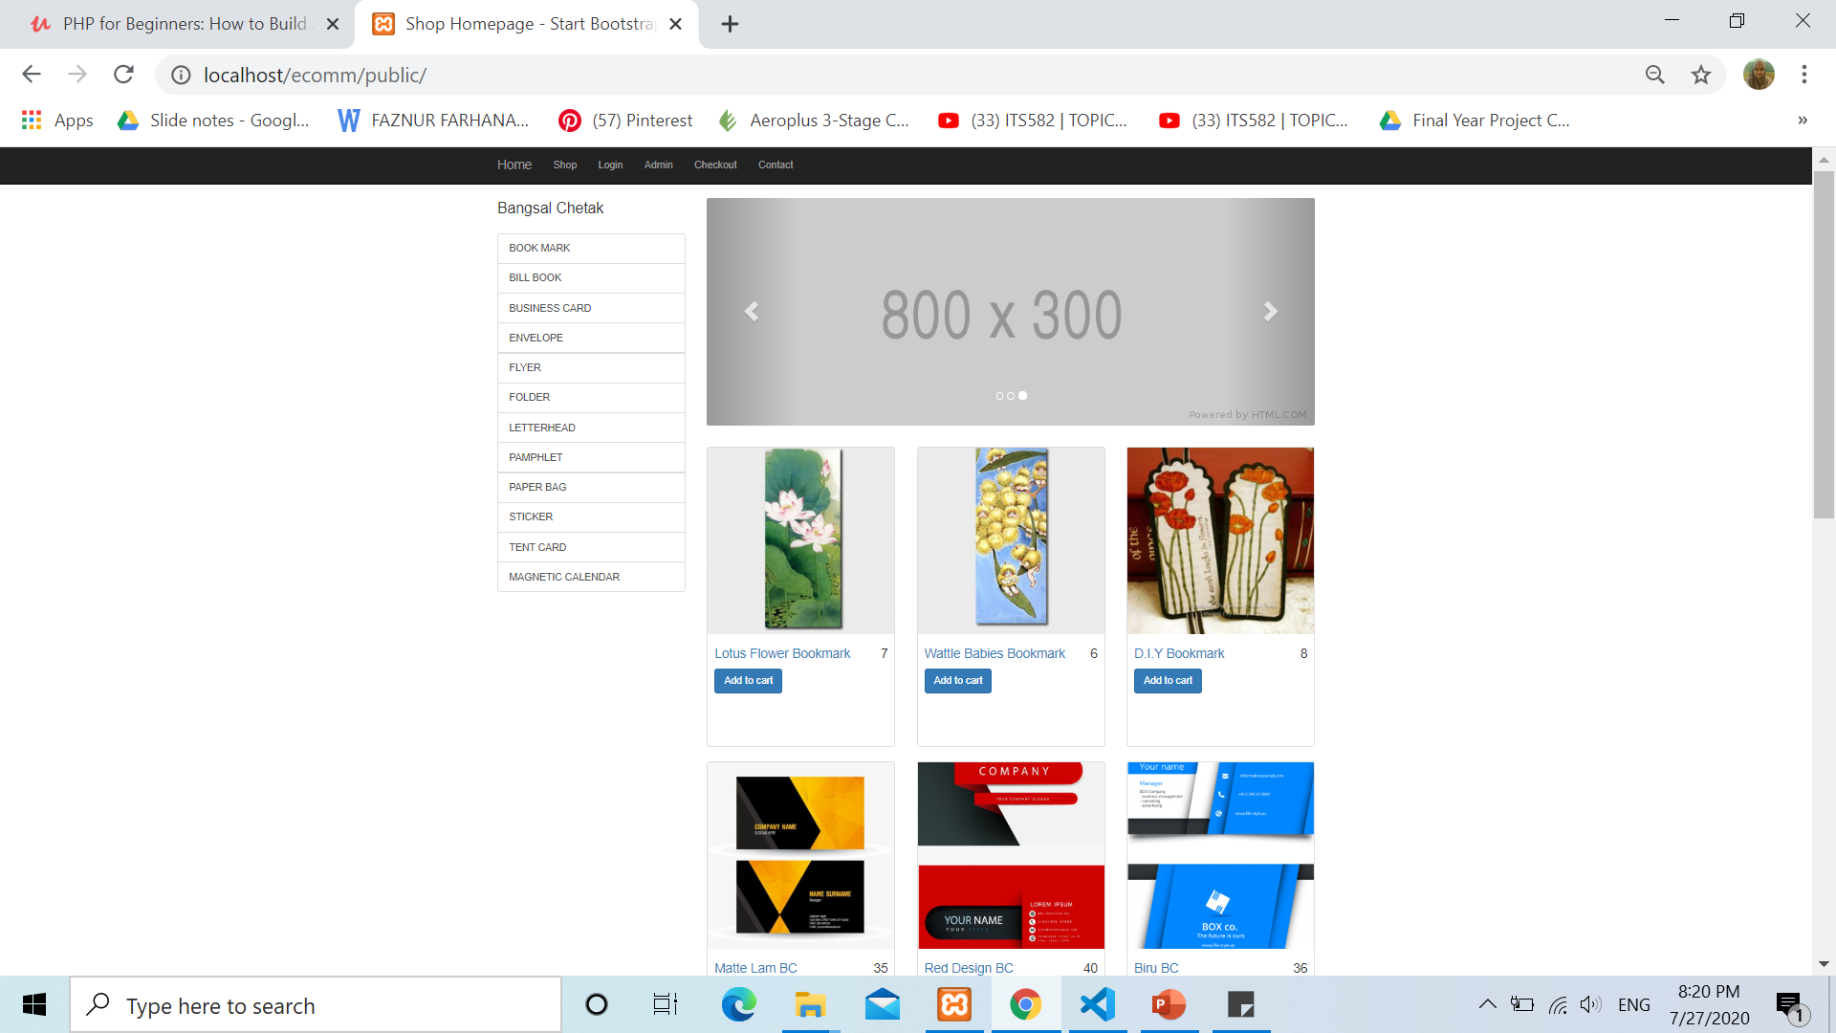
Home page for Bangsal Chetak Website

Slide 6

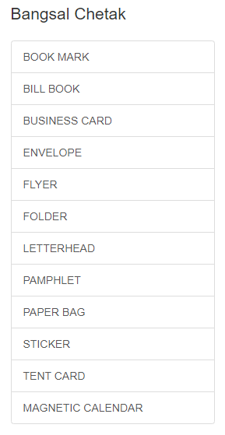
Merging Human Computer Interaction (UI) concept with EC system
Human Computer Interaction | How it is implemented
Design patterns | Implementation in the system
1. Navigation
2. Display of Information (List, classify, order)

Slide 7
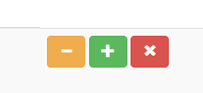
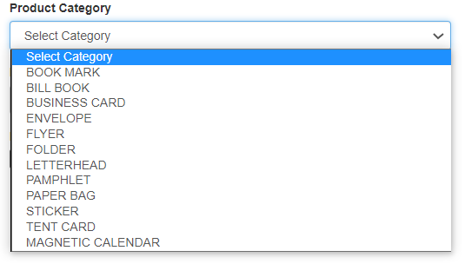
Human Computer Interaction | How it is implemented
Design patterns | Implementation in the system
3. Button
2. Input mode and selection (input area & form)

