Slide 1
Mustaffa Paint Store
Inventory System (MPSIS)
Prepared by: Muhammad Zamir Bin Roslan
Supervisor: Madam Normalina Binti Ibrahim
Examiner: Miss Nor Hasnul Azirah Binti Abdul Hamid
Lecturer: Miss Nik Marsyahariani Binti Nik Daud

Slide 2
Background of Study
Case Study: Mustaffa Paint Store
AOI: Inventory Management System
Domain: Retail Business
Theory: Point of Sale System
Current Business Process
Start
Customer come to the retail
Proposed Solution
Customer ask for the product
Problem Statement
1. Manual inventory checking process
2. Out of stock due to unchecking stock
2. Losing customer data and no record of sales
Problem | Proposed Solution
1. Manual inventory checking process | Product list display the product’s details and quantity
2. Out of stock due to unrecord stock | Record of stock in products in inventory
3. Losing customer data and no record of sales | Storing data in a database and generate an automated invoice of customer’s product purchase
1
Staff check the availability of products in the store
2
Available
No
Objectives
To identify the current process and requirement for inventory management activities.
To design and develop an inventory management system
To evaluate the functionality and usability of the proposed system.
Yes
Customer provides personal detail and products information
3
Staff record customer information in a book
End

Slide 3
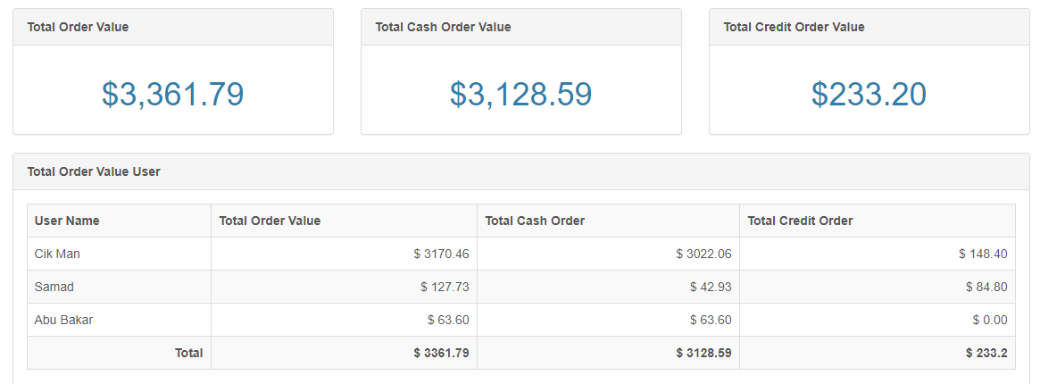
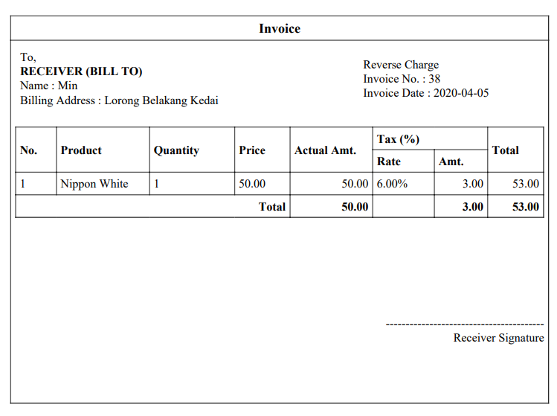
Theory
Theory – Point of Sale | How it is implemented
Characteristics | Implementation in the system
1. Sales Performance
2. Invoice

Slide 4
THANK YOU ☺

