Slide 1
SOCIAL ANXIETY DISORDER DIAGNOSTIC USING K-NEAREST NEIGHBOR
NAME: MUHAMMAD FAIZ BIN ABD HALIM
SUPERVISOR: MDM NORLINA BINTI MOHD SABRI

Slide 2
Problem Statement
People with social anxiety disorder avoid treatment because of fear, shame or stigma
The lack of familiarity of the social anxiety disorder among health care providers to diagnose social anxiety disorder

Slide 3
Objectives
To investigate and propose K-Nearest Neighbor algorithm technique for solving problem in social anxiety diagnosis.
To develop a prototype for social anxiety disorder diagnostic based on K-Nearest Neighbor algorithm.
To test the accuracy of the K-Nearest Neighbor algorithm in the social anxiety diagnosis.

Slide 4
Scope
Prototype that can detect level of social anxiety disorder (Mild, Moderate, Severe)
Interface for the user to answer the questionnaire
Questionnaire is refer from Social Interaction Anxiety Scale (SIAS)
Contain 20 question

Slide 5
Similar Application
APPLICATION | ALGORITHM | OBJECTIVE | RESULT
EEG complexity as a biomarker for autism spectrum disorder (ASD) risk | KNN | Applied machine learning methods to classify infants into higher risk group at ASD or control. | KNN provided 0.77 ac-curacy at age 9 months infants, and the result was statistically Significant (Bosl, Tierney, Tager-Flusberg, & Nelson, 2011).
Applying k-Nearest Neighbor in Diagnosing Heart Disease Patients | KNN | Applying KNN to help healthcare professionals in the diagnosis of heart disease. | The accuracy achieved without voting KNN ranged between 94% and 97.4 % with different values of K (Shouman, Turner, & Stocker, 2012).
Mental stress level measurement using HRV analysis and KNN classifier with efficient voting scheme. | KNN | Heart Rate Variability (HRV) used to detect the stress level and given as input to the KNN classifier | The efficiency of KNN classifier is improved by using the combination scheme, the stress classification accuracy is 95% (L. Vanitha, Dr. G.R. Suresh, Dr. M. Chandrasekar, 2016).
Classification of schizophrenia and bipolar disorder by using machine learning algorithms | KNN | Schizophrenia, bipolar disorders patients were analyzed by using classification algorithms KNN. | Prediction accuracy was found on testing data as 86% (Saylan & Yilancioglu, 2016).

Slide 6
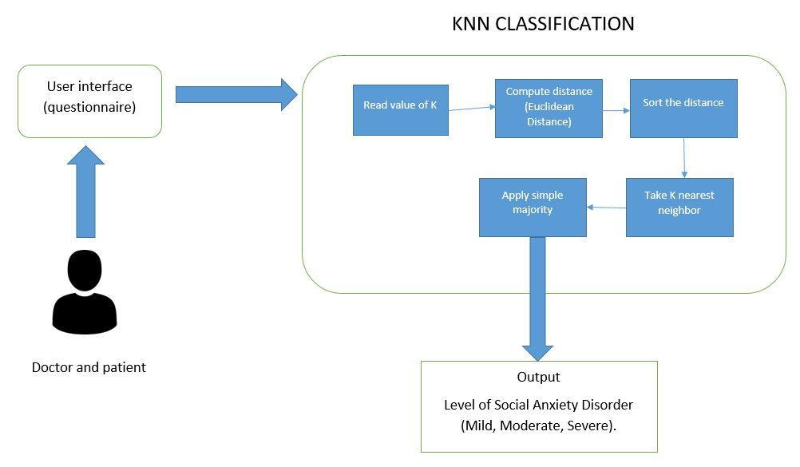
Social Anxiety Disorder Diagnostic Conceptual Framework

Slide 7
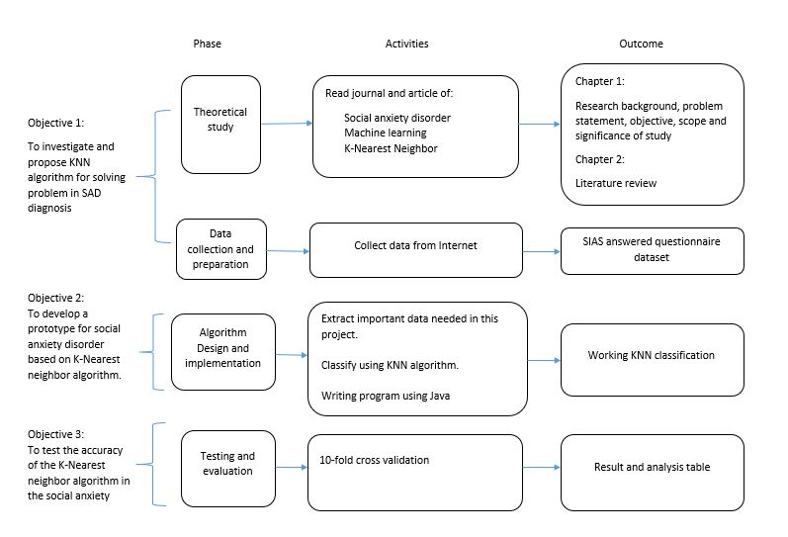
Social Anxiety Disorder Diagnostic Methodology Framework

Slide 8
Data collection
Dataset | Description
Source | https://data.mendeley.com/datasets/kd7tky2jps/1#file-6ce993ba-1674-4a25-9c66-e64b80eac9b6
Number of data | 281
About data | Social Interaction Anxiety Scale Contain 20 question Each question rated on 5-point scale from 0 to 4

Slide 9
Data preparation
unwanted data is removed.
Class for each data is determine.
Add all scale and get the score.
Class | Score
Mild | Score from 20 to 35
Moderate | Score from 36 to 50
Severe | Score from 51 to 80

Slide 10
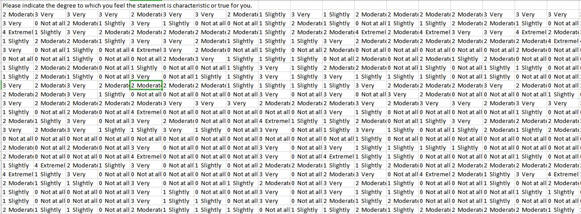
Raw data

Slide 11
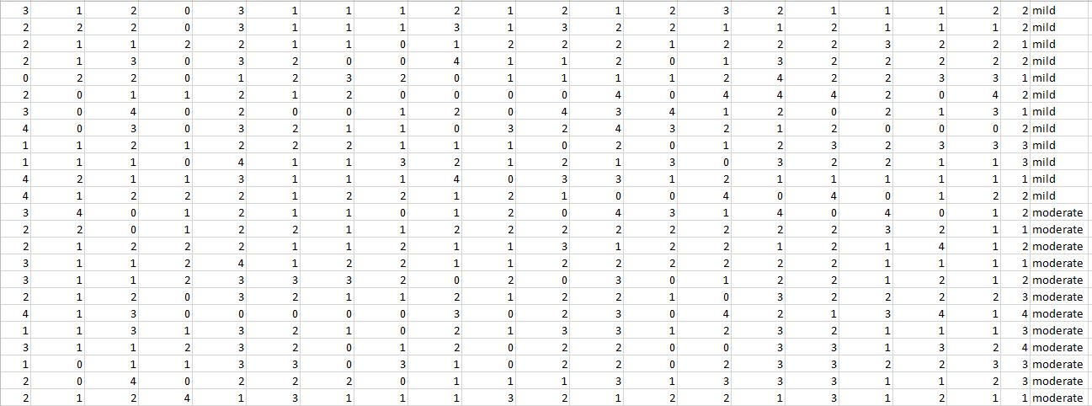
Clean data

Slide 12
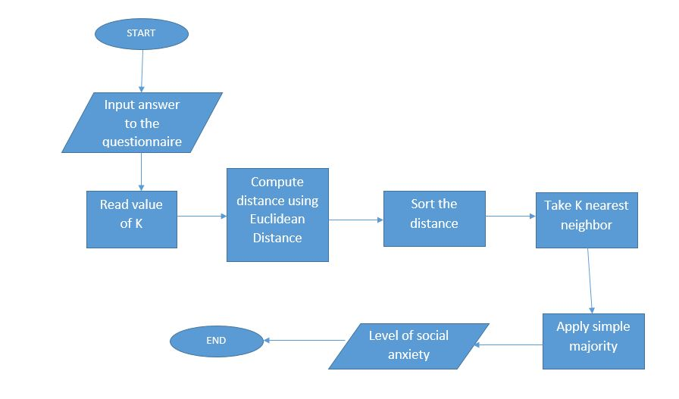
Social Anxiety Disorder Diagnostic Process Flow Chart

Slide 13

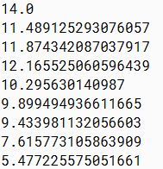
K-Nearest Neighbor Algorithm Steps
Read value of K
  K=7
Compute distance
  Euclidean Distance

Slide 14
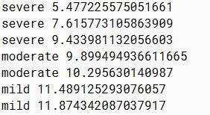
Sort the distance
Take K-Nearest Neighbor

Slide 15
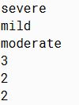

Apply simple majority

Slide 16
Project evaluation
10-fold cross validation
The dataset is split into 10 groups and the classifier is trained and tested 10 separate times until each group is used as test set.
Find the accuracy of the model based on the best K.

Slide 17
K/ Groups | 1 | 3 | 5 | 7 | 9 | 11 | 13
1 | 0.72413793 | 0.75862069 | 0.72413793 | 0.62068966 | 0.65517241 | 0.68965517 | 0.68965517
2 | 0.78571429 | 0.85714286 | 0.78571429 | 0.82142857 | 0.78571429 | 0.78571429 | 0.78571429
3 | 0.82142857 | 0.85714286 | 0.96428571 | 0.96428571 | 0.89285714 | 0.85714286 | 0.89285714
4 | 0.92857143 | 0.89285714 | 0.92857143 | 0.92857143 | 0.89285714 | 0.89285714 | 0.89285714
5 | 0.89285714 | 0.85714286 | 0.85714286 | 0.89285714 | 0.85714286 | 0.89285714 | 0.89285714
6 | 0.82142857 | 0.82142857 | 0.85714286 | 0.89285714 | 0.89285714 | 0.92857143 | 0.92857143
7 | 0.82142857 | 0.96428571 | 0.96428571 | 0.96428571 | 0.96428571 | 1.0 | 0.92857143
8 | 0.75 | 0.78571429 | 0.85714286 | 0.92857143 | 0.85714286 | 0.89285714 | 0.89285714
9 | 0.67857143 | 0.75 | 0.78571429 | 0.75 | 0.75 | 0.75 | 0.75
10 | 0.53571429 | 0.60714286 | 0.53571429 | 0.64285714 | 0.64285714 | 0.64285714 | 0.60714286
Average | 0.7760 | 0.8150 | 0.8260 | 0.8406 | 0.8190 | 0.8333 | 0.8261

Slide 18
System demonstration

Slide 19
Conclusion
As conclusion, all of the three objectives social anxiety disorder diagnostic prototype is achieved. The prototype can be used to detect the level of social anxiety disorder of a patient.

Slide 20
Reference
Hegde, J., & Rokseth, B. (2020). Applications of machine learning methods for engineering risk assessment – A review. Safety Science, 122(September 2019), 104492. https://doi.org/10.1016/j.ssci.2019.09.015
Srivastava, S., Pant, M., & Agarwal, N. (2016). A Review on Role of Fuzzy Logic in Psychology. https://doi.org/10.1007/978-981-10-0451-3_70
Yuan, J. N. Z., Ping, W. W., Wen, Y. H., & Husain, W. (2013). Healthcare applications on mobile cloud computing. 3rd International Conference on Digital Information Processing and Communications, ICDIPC 2013, 514–522.
Ascent of machine learning in medicine. (2019). Nature Materials, 18(5), 407. https://doi.org/10.1038/s41563-019-0360-1
Altuntas, S., Özsoy, E. B., Mor, Ş., Altuntas, S., Özsoy, E. B., & Mor, Ş. (2019). ScienceDirect ScienceDirect Innovative new product development : a case study * Innovative new product development : a case study *. Procedia Computer Science, 158, 214–221. https://doi.org/10.1016/j.procs.2019.09.044
Garcia-Lopez, L., & Moore, H. T. A. (2015). Validation and diagnostic efficiency of the mini-SPIN in Spanish-speaking adolescents. PLoS ONE, 10(8), 1–11. https://doi.org/10.1371/journal.pone.0135862
Chegini, M., Bernard, J., Berger, P., Sourin, A., Andrews, K., & Schreck, T. (2019). Interactive labelling of a multivariate dataset for supervised machine learning using linked visualisations, clustering, and active learning. Visual Informatics, 3(1), 9–17. https://doi.org/10.1016/j.visinf.2019.03.002
Burt, A., & Volchenboum, S. (2018). How Health Care Changes When Algorithms Start Making Diagnoses. 4–8.
Benabdellah, A. C., Benghabrit, A., & Bouhaddou, I. (2019). A survey of clustering algorithms for an industrial context. Procedia Computer Science, 148, 291–302. https://doi.org/10.1016/j.procs.2019.01.022
Miao, K. H., & Miao, J. H. (2018). Coronary heart disease diagnosis using deep neural networks. International Journal of Advanced Computer Science and Applications, 9(10), 1–8. https://doi.org/10.14569/IJACSA.2018.091001

